Slide 1
r Forecast “Data Challenge” Maps for PICO
Minneapolis Workshop
May 2 2018
Clem Pryke

Slide 2
PICO Sims for r forecast
Leveraging existing generator code etc. from CMB-S4
“Data Challenge” approach – sets of shared simulated data maps available on NERSC
Include LCDM, foreground, noise and tensors
Idea is to have multiple groups and individuals run re-analysis on these with using multiple techniques
Try to separate out tensor signal
Investigate σ(r) and bias on r across a range of foreground models

Slide 3
PySM Foreground Model Package
PySM = “Python Sky Model” – relatively simple python code for generating realizations of the sky at given set of frequencies – see arXiv:1608.02841 and http://github.com/bthorne93/PySM_public
Contains several models for each of AME (a), dust (d), free-free (f), and synchrotron (s)
Designated as a1d1f1s1, a2d4f1s3, a2d7f1s3 etc
The above are the three we have used for CMB-S4 so far and this choice has been inherited for PICO
Uses templates from Haslam, WMAP, Planck and various analyses thereof (inc. Commander)
Spatial/spectral variation (decorrelation) included

Slide 4
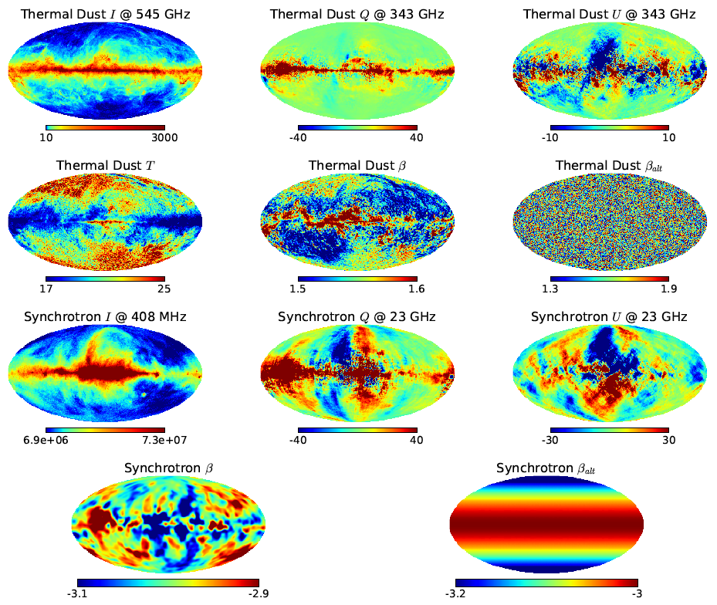
PySM Uses Commander Templates

Slide 5
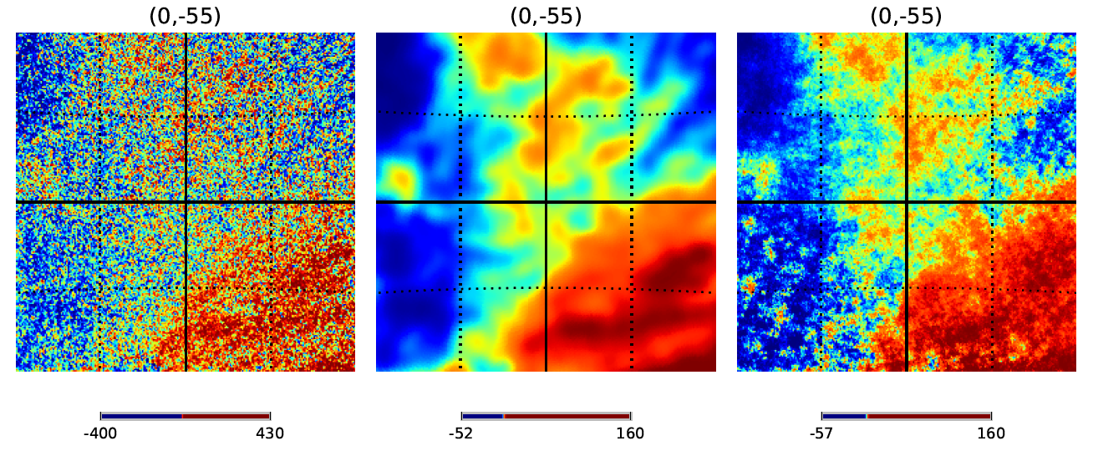
PySM small scale power fill in
Small angular scales are noise dominated – filters them out and fills back in (Gaussian) small scale structure to produce continuous power-law foreground spectra
Modulates small scale amplitude across sky to keep match
Left: noisy template, middle: smoothed template, right: plus Gaussian small scale power

Slide 6
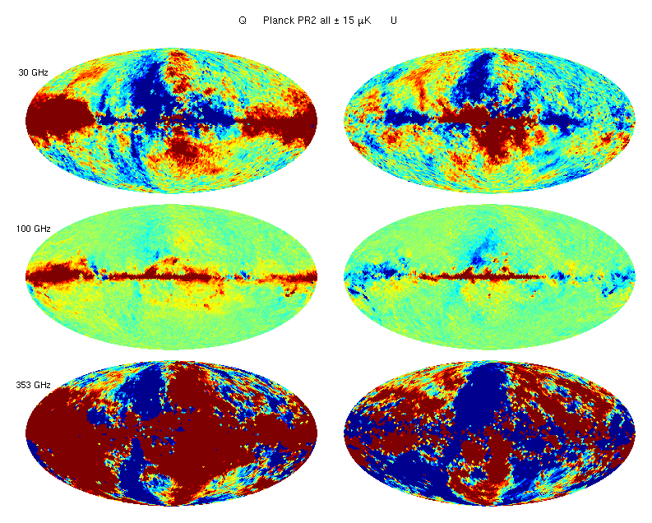
Planck Reality

Slide 7
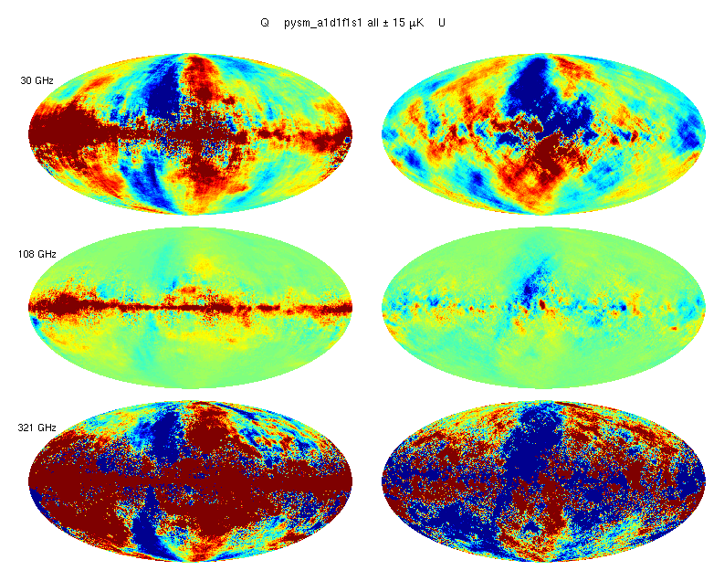
Model 1 (PySM)

Slide 8
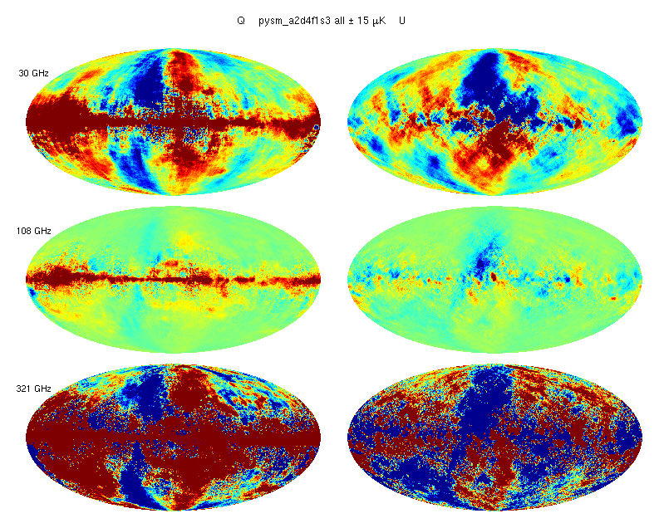
Model 2 (PySM)

Slide 9
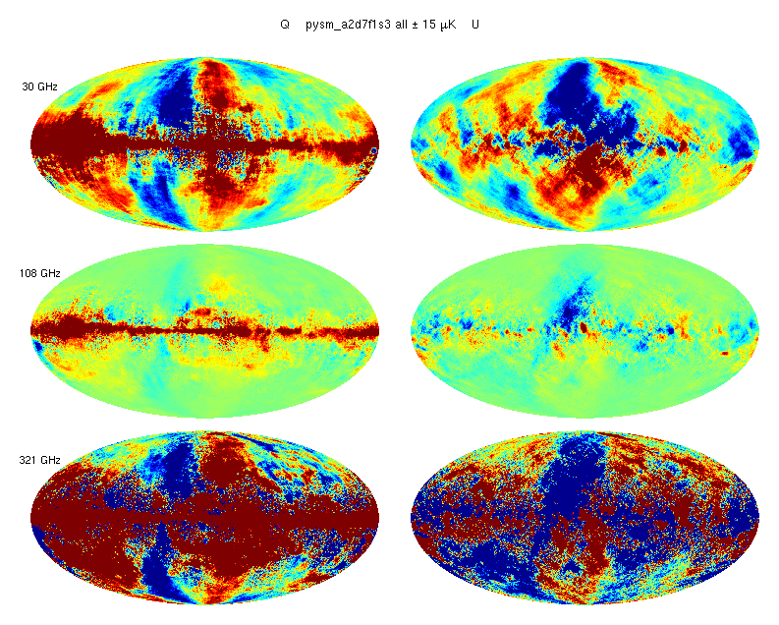
Model 3 (PySM)

Slide 10
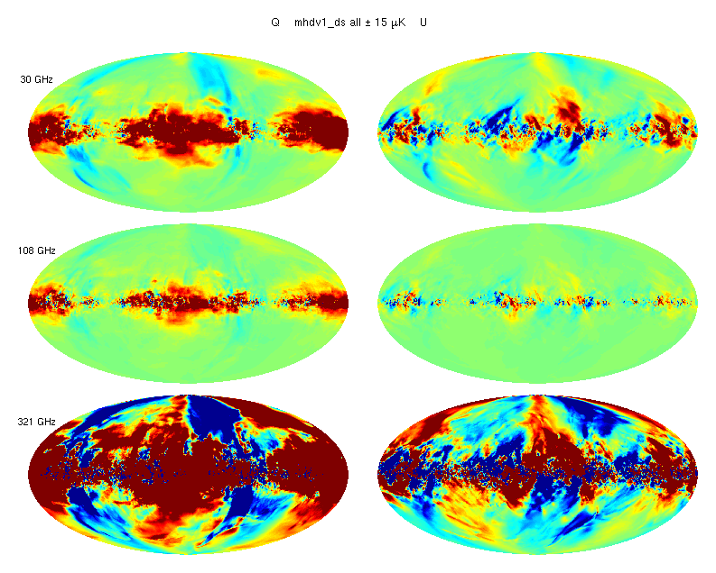
Model 6 (MHDv1)
(Hensley/Flauger)

Slide 11
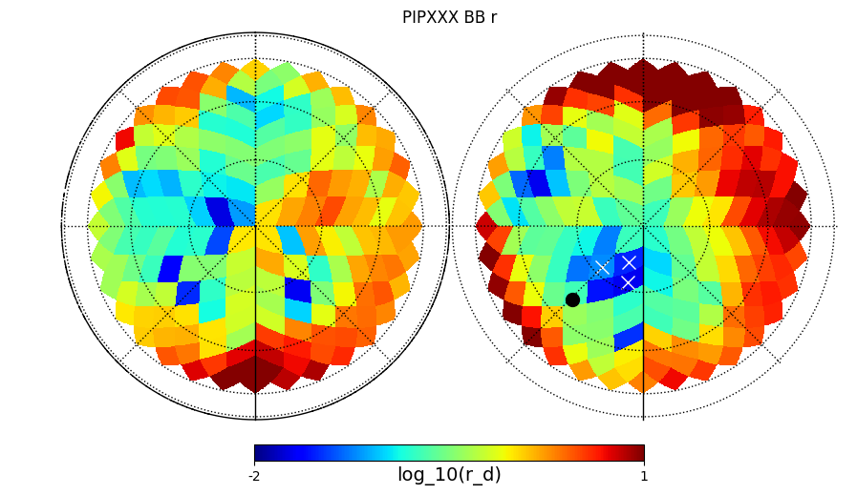
BB Dust Power Variation Across the Sky
Original plot from PIPXXX paper –
log(abs(r equiv. dust at 150GHz)) for overlapping 400 deg² patches

Slide 12
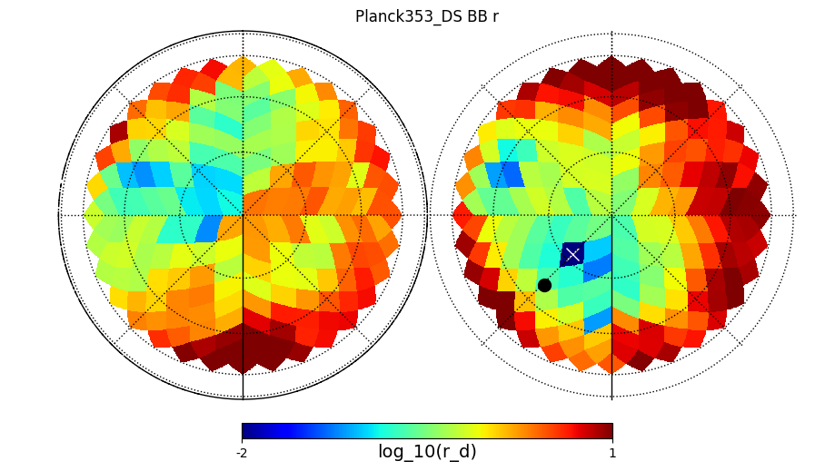
BB Dust Power Variation Across the Sky
Our (BK group) attempt to reproduce –
similar, but smoother looking variation (not sure why)

Slide 13
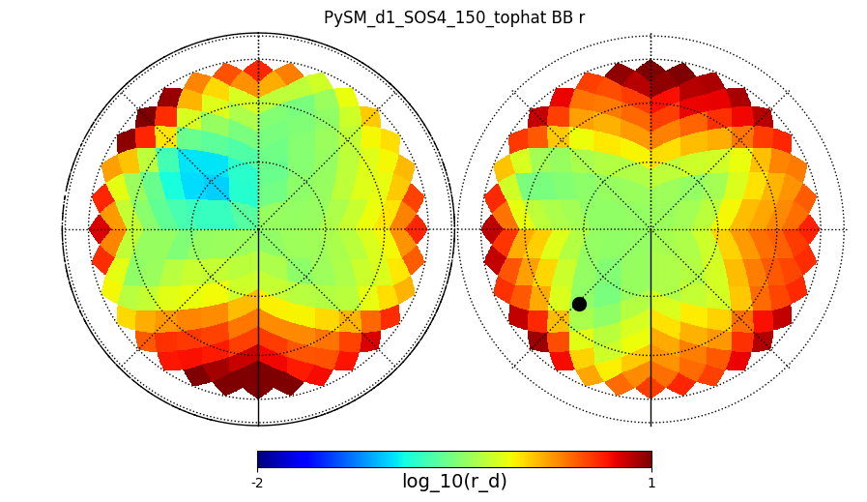
BB Dust Power Variation Across the Sky
Plot by
Kenny Lau
Same thing for PySM d1 model –
not fully “realistic” but maybe “representational”

Slide 14
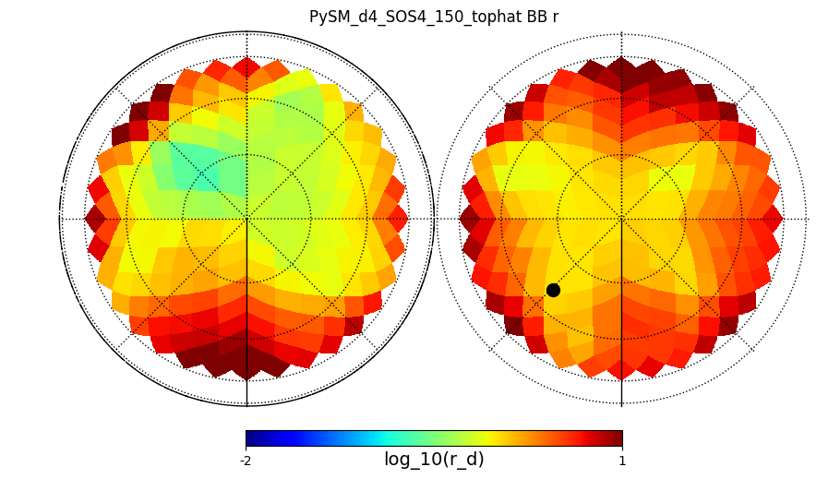
BB Dust Power Variation Across the Sky
Plot by
Kenny Lau
Same thing for PySM d4 model –
way more BB power – not representational

Slide 15
Make PICO Sims
LCDM realizations inherited from Planck – available as both unlensed and lensed a_{lm}’s
For the moment “fake” delensing by combining unlensed and lensed maps to obtain effective A_{L}=0.15
Beam smoothing applied to LCDM and foreground as per PICO v3.2 specs.
Noise taken as white with level as per PICO v3.2 specs.
A little bit of tensors injected into every even numbered realization (at the moment r=0.003)
(Only one “realization” for PySM model – so add it on top of varying LCDM/noise realizations.)
(Also have toy “model 0” uniform Guassian with uniform spectral index.)

Slide 16
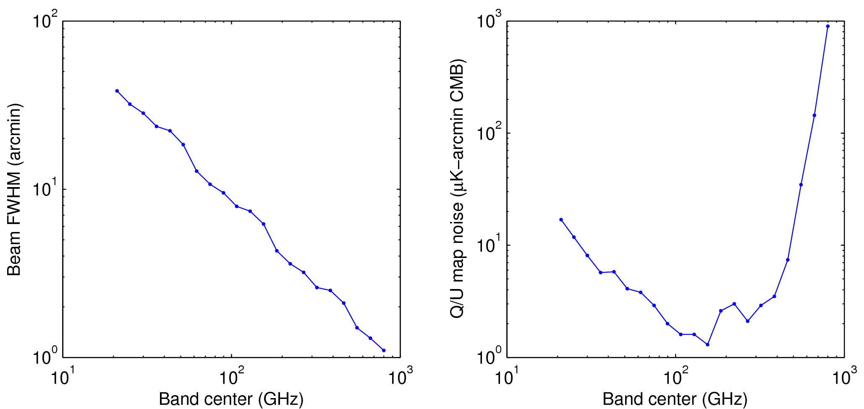
v3.2 Beam widths and Noise levels

Slide 17
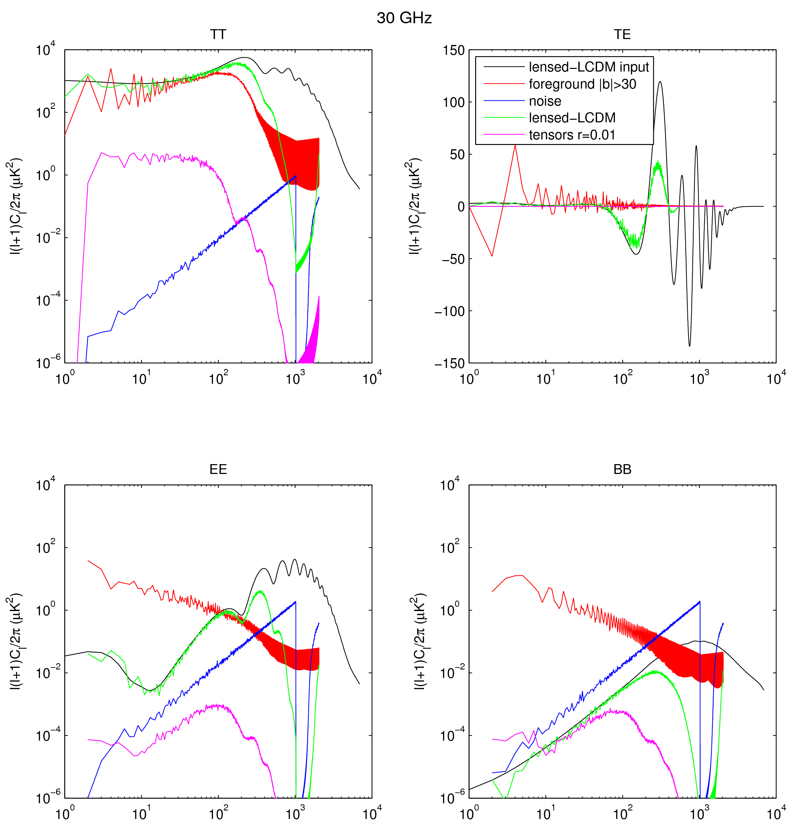
30 GHz

Slide 18
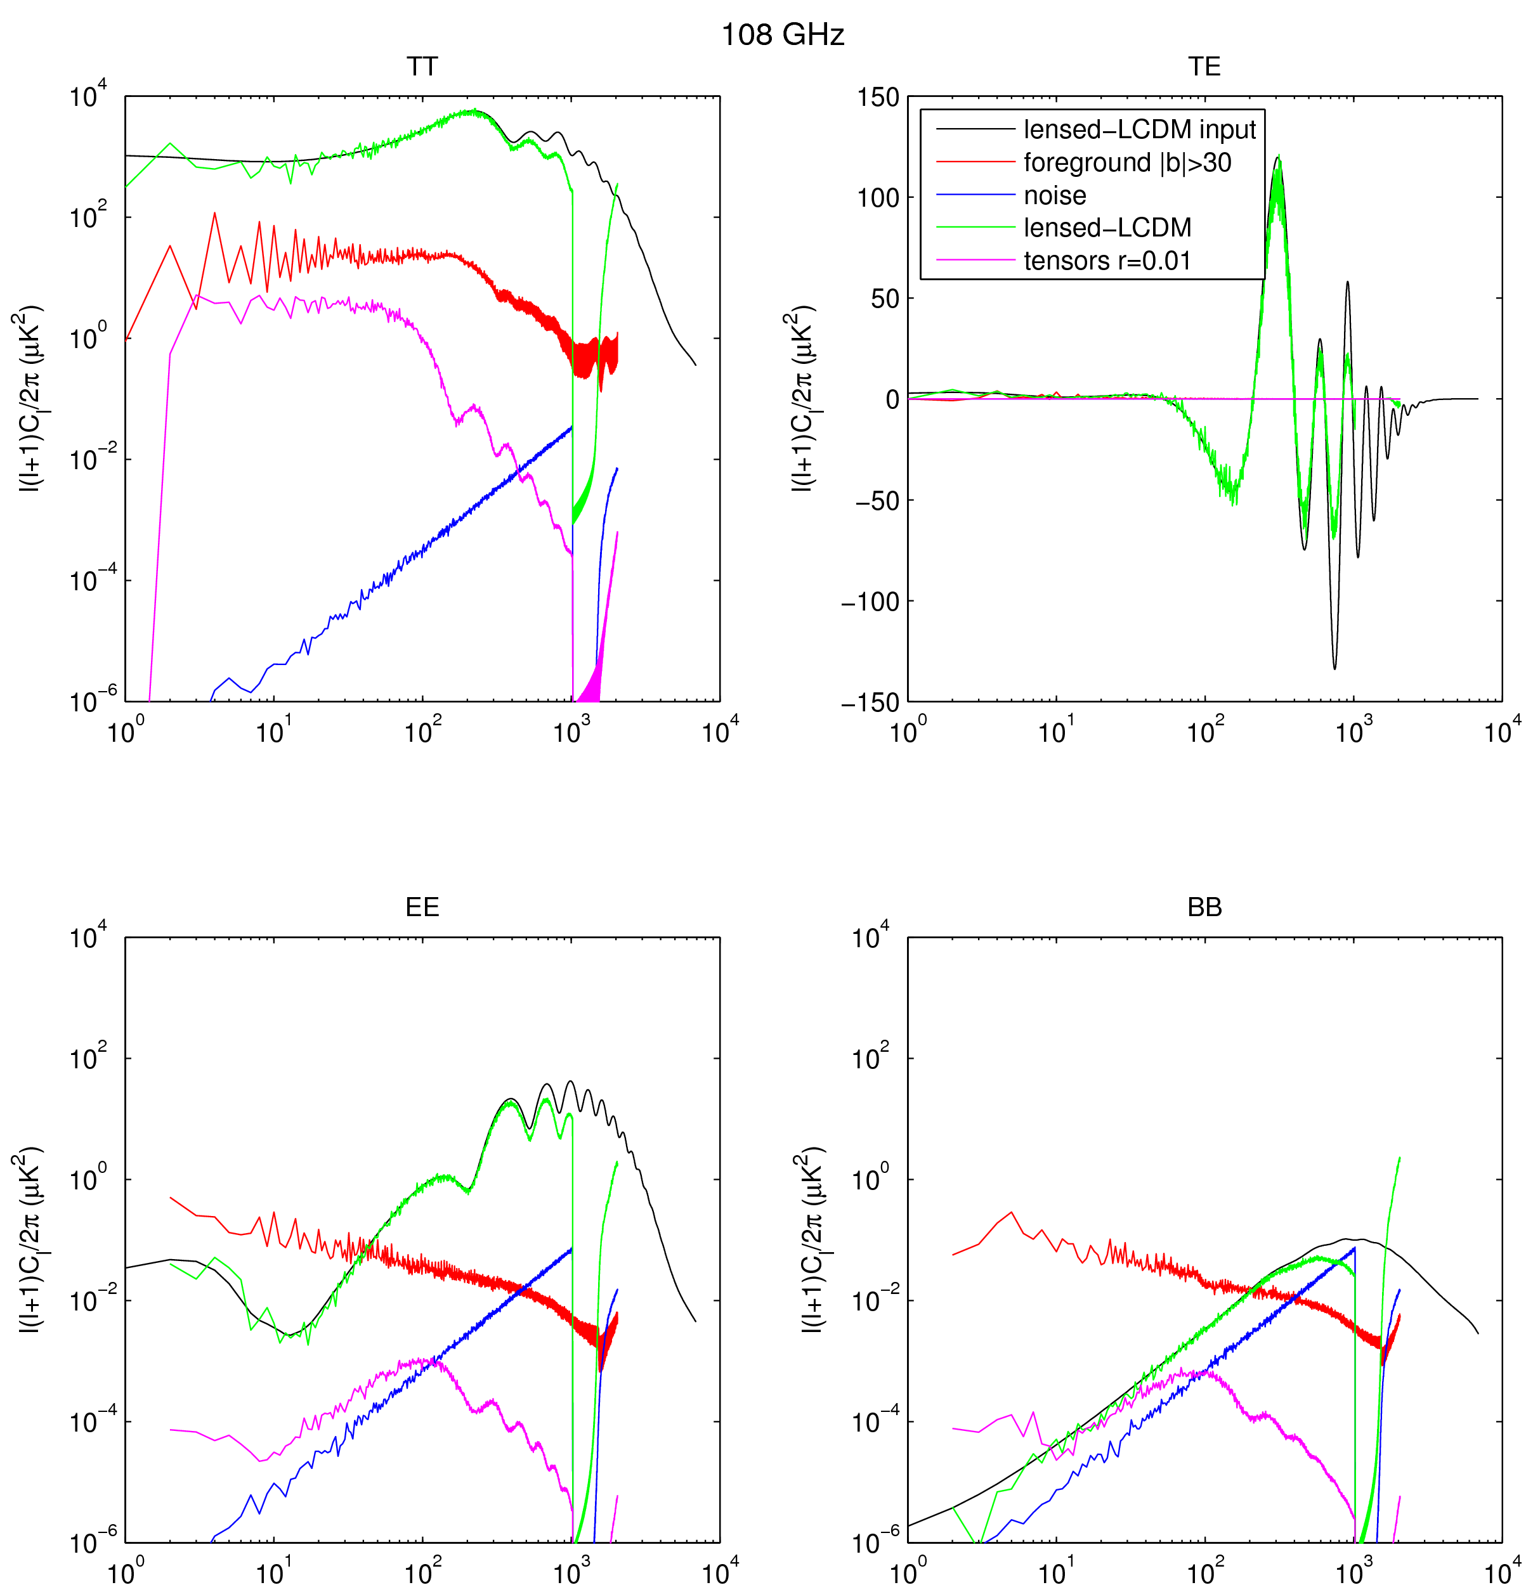
108 GHz
For this model need to clean by 1-2 orders of mag at fg min.

Slide 19
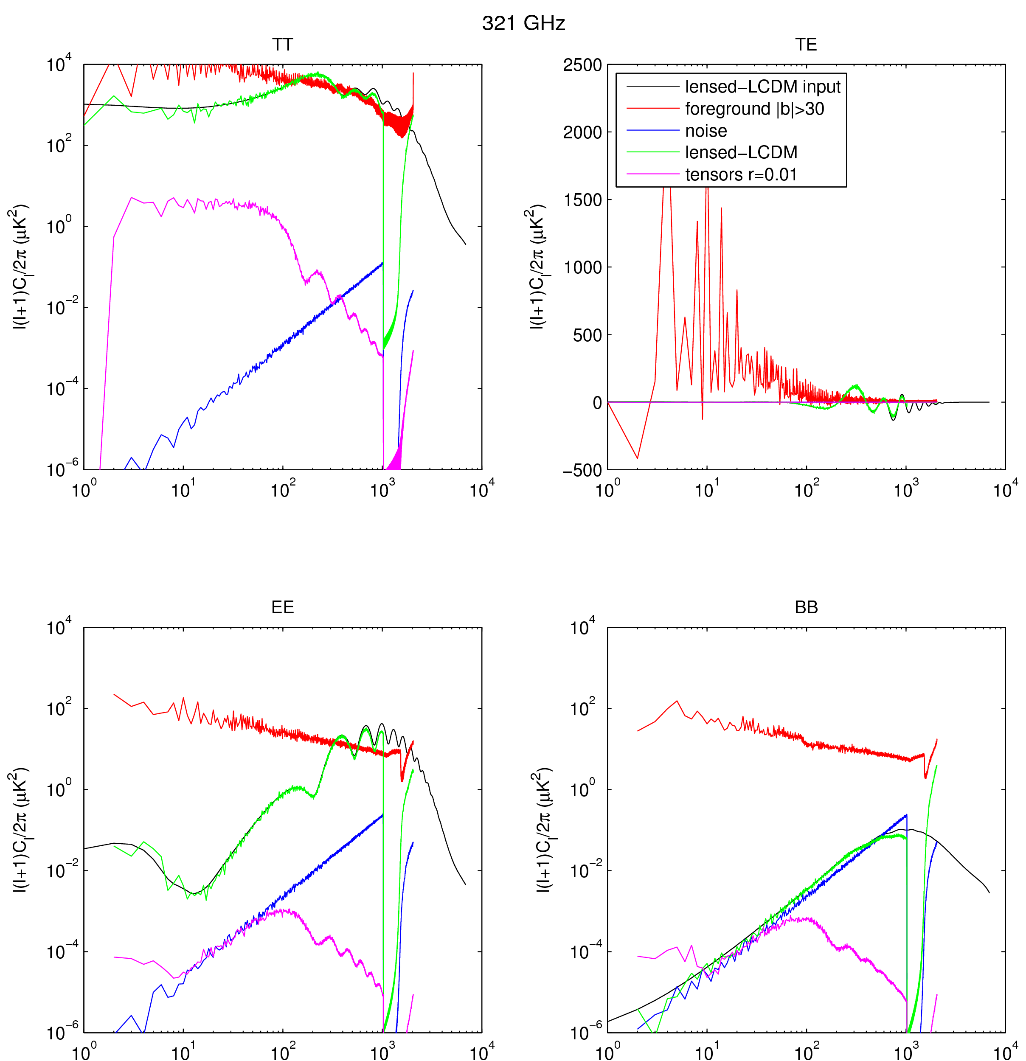
321 GHz

Slide 20
The Task
Take the stacks of multi-frequency maps and run component separation.
Mask out the unrecoverable galactic plane region.
Take the power spectra of the resulting map using a method with sufficiently low E to B mixing for the given mask.
Derive the maximum likelihood value of r
Or any equivalent series of operations…
Repeat for many realizations and look at histogram of values
Look at mean (bias), sigma (uncertainty), etc.

Slide 21
Results
Errr…
Unfortunately we got a late start and don’t have much more from this effort yet
Mathieu has some results from PSM based sims...

Slide 22
So instead a worked example:
Did a very similar study for CMB-S4 Concept Definition Task Force (CDT) study, and reported in appendix A of Final Report https://www.nsf.gov/mps/ast/aaac/cmbs4cdt.jsp
3% patch of clean high latitude sky
Two independent re-analyses
(a) ILC based (Raphael Flauger)
(b) parametric multi-component fit (BK group, Victor Buza)

Slide 23
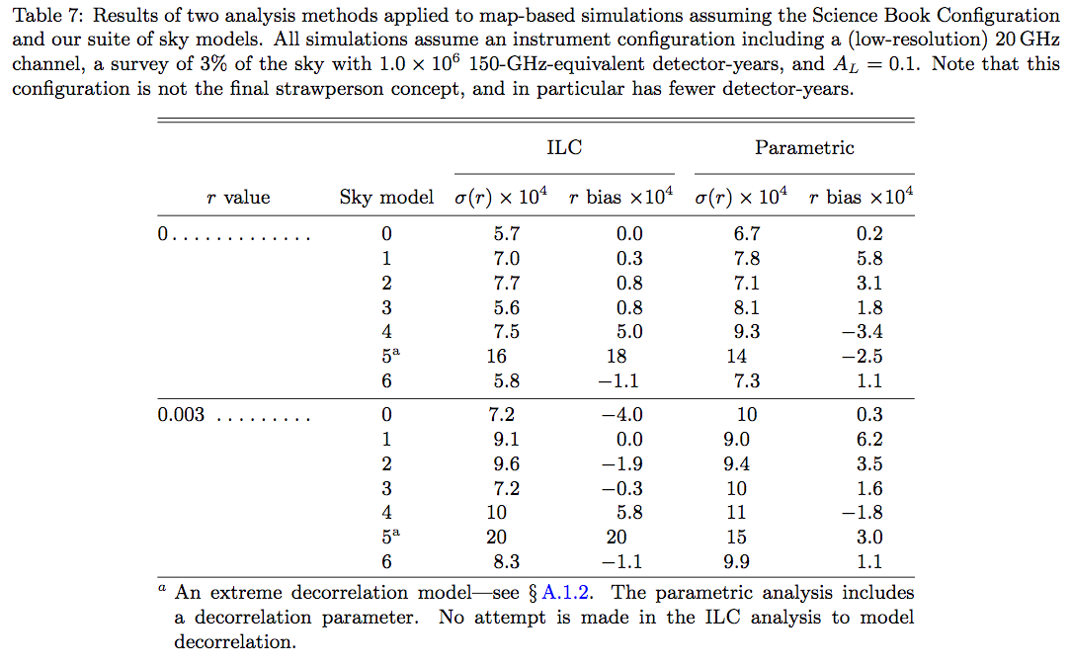
CDT Report Results

Slide 24
Thoughts/Conclusions
The point of such a study is not that any one of the considered foreground models can be known to be “correct”
The idea is that taken together they represent some kind of “spanning set” of the range of possible real foreground behavior
If the re-analysis can be shown to be robust under all “reasonable” considered models then maybe OK to proceed
That may sound kind of weak but I personally don’t think it is possible to offer any greater guarantee of success.
All potential component separators and re-analyzers invited! The maps are available on NERSC.
It would be great if we could do “real delensing” – I think there are people in the room right now who know how…

