Slide 1
CMB Probe Optics Design
July 13, 2017
Scan strategy and fitting the 1.4 m EPIC Crossed-Dragone within sun shields

Slide 2
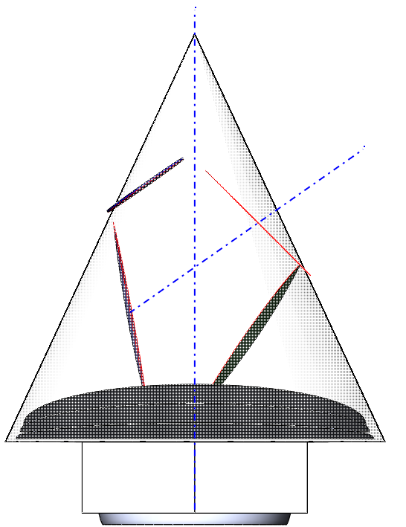
EPIC Cross-Dragone 1.4 m
A = 25 °
B = 55 °
A = 25°
Focal plane (dark blue)
B = 55°
Secondary (green)
Primary (light blue)
4.6 m

Slide 3
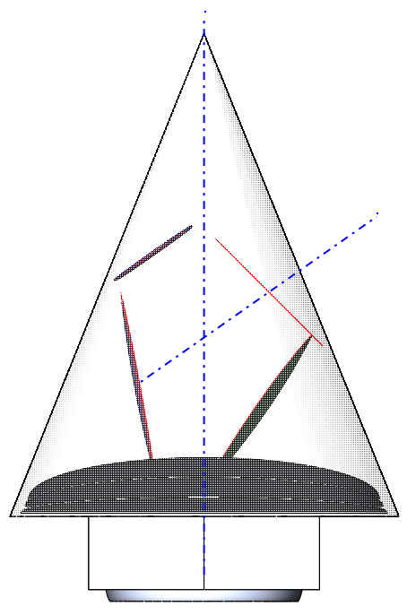
EPIC Cross-Dragone 1.4 m
A = 22 °
B = 55 °
22°
55°
4.6 m

Slide 4
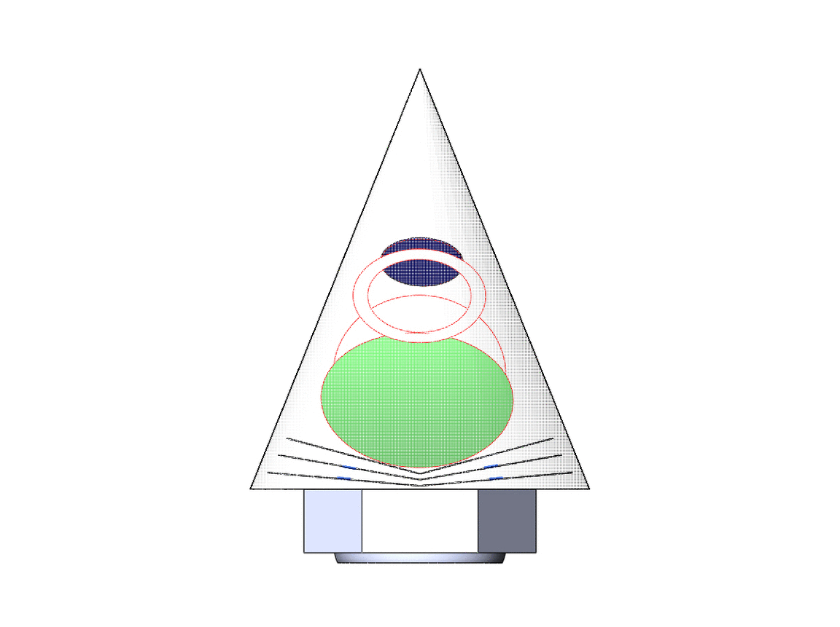
EPIC Cross-Dragone 1.4 m
A = 22 °
B = 55 °
180 ° rotation in 15 ° steps
If GIF doesn’t load see pages 9-15
4.6 m

Slide 5
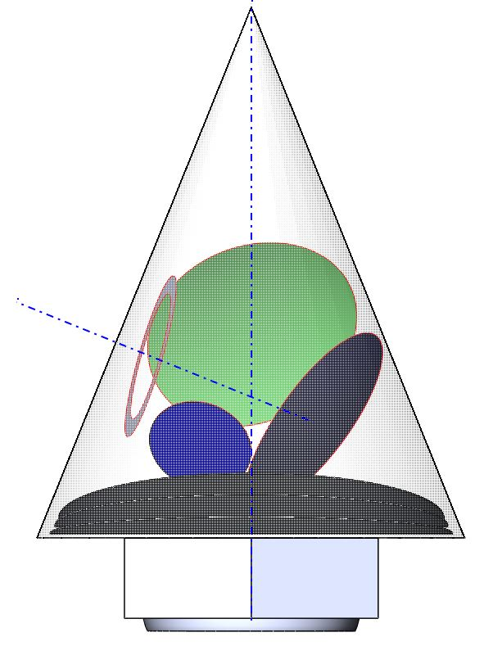
EPIC Cross-Dragone 1.4 m
A = 22 °
B = 55 °
Rotated to lower focal plane
Still fits within sun shield
22°
55°
4.6 m

Slide 6
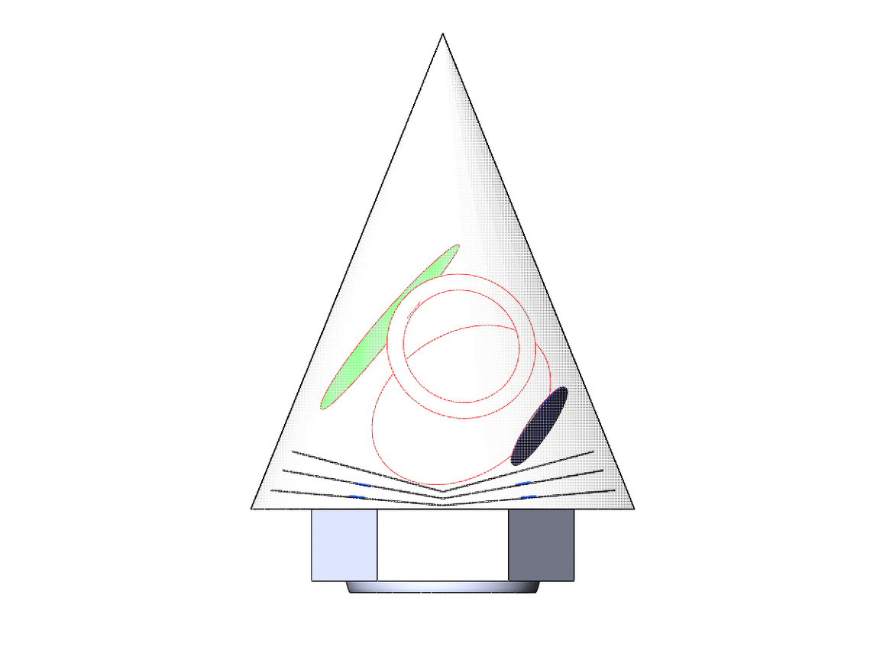
EPIC Cross-Dragone 1.4 m
A = 22 °
B = 68 °
A + B = 90 °
180 ° rotation in 15 ° deg steps
If GIF doesn’t load see pages 17-23
4.6 m

Slide 7
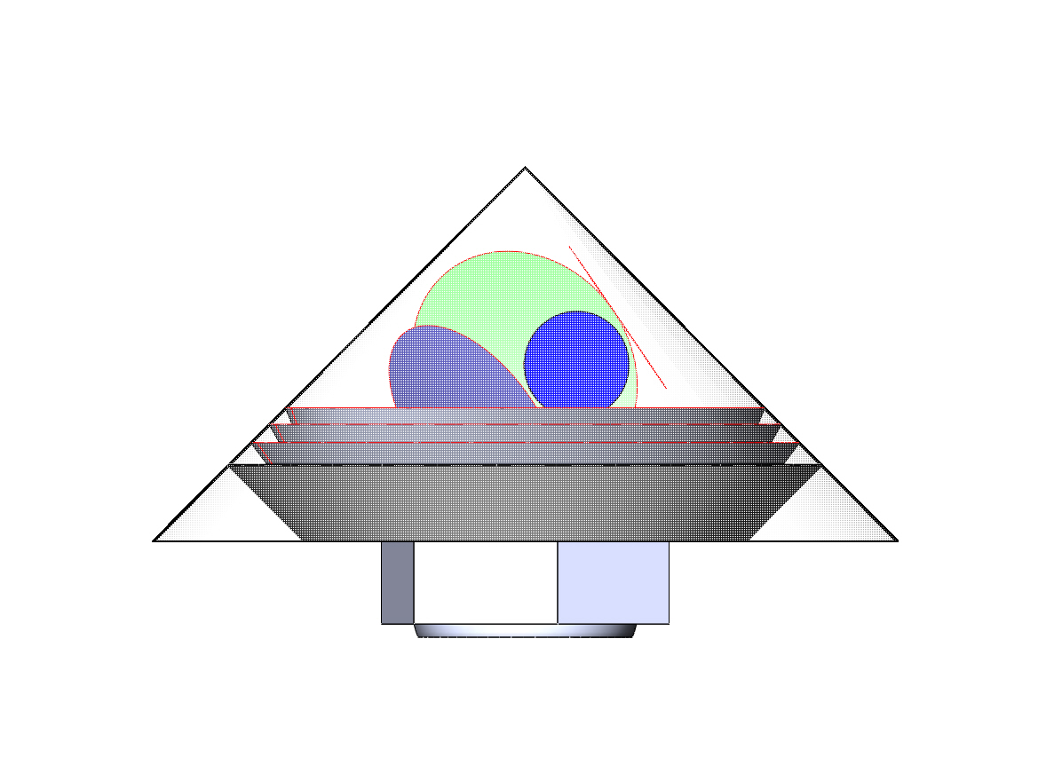
EPIC Cross-Dragone 1.4 m
A = 45 °
B = 55 °
1.1m extendable shields allow A = 45 °
45°
B = 55°
1.1 m
4.6 m

Slide 9
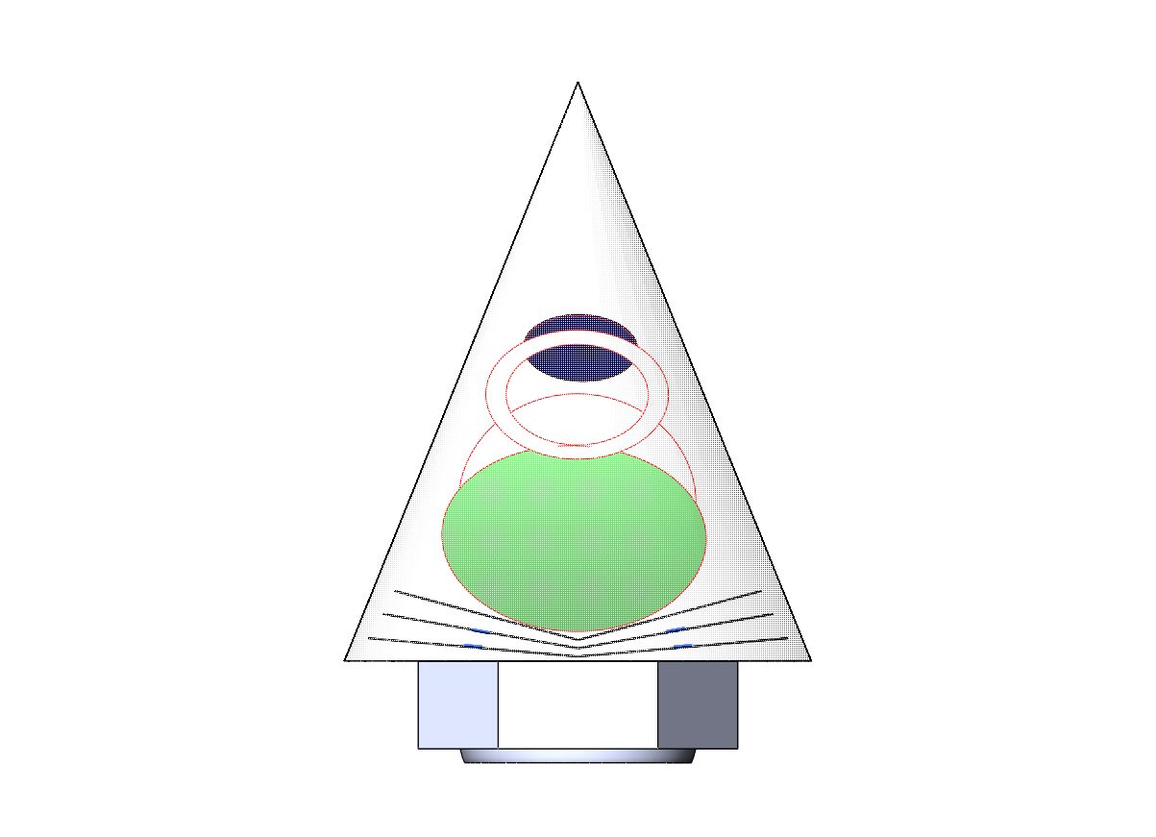
EPIC Cross-Dragone 1.4 m
A = 22 °
B = 55 °
0 ° view

Slide 10
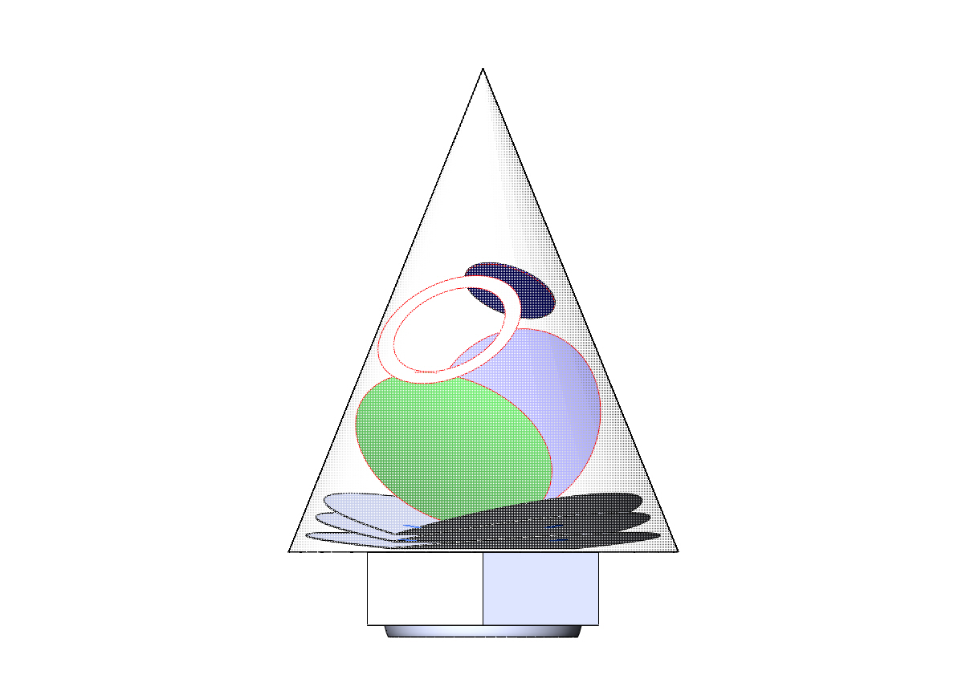
EPIC Cross-Dragone 1.4 m
A = 22 °
B = 55 °
30 ° view

Slide 11
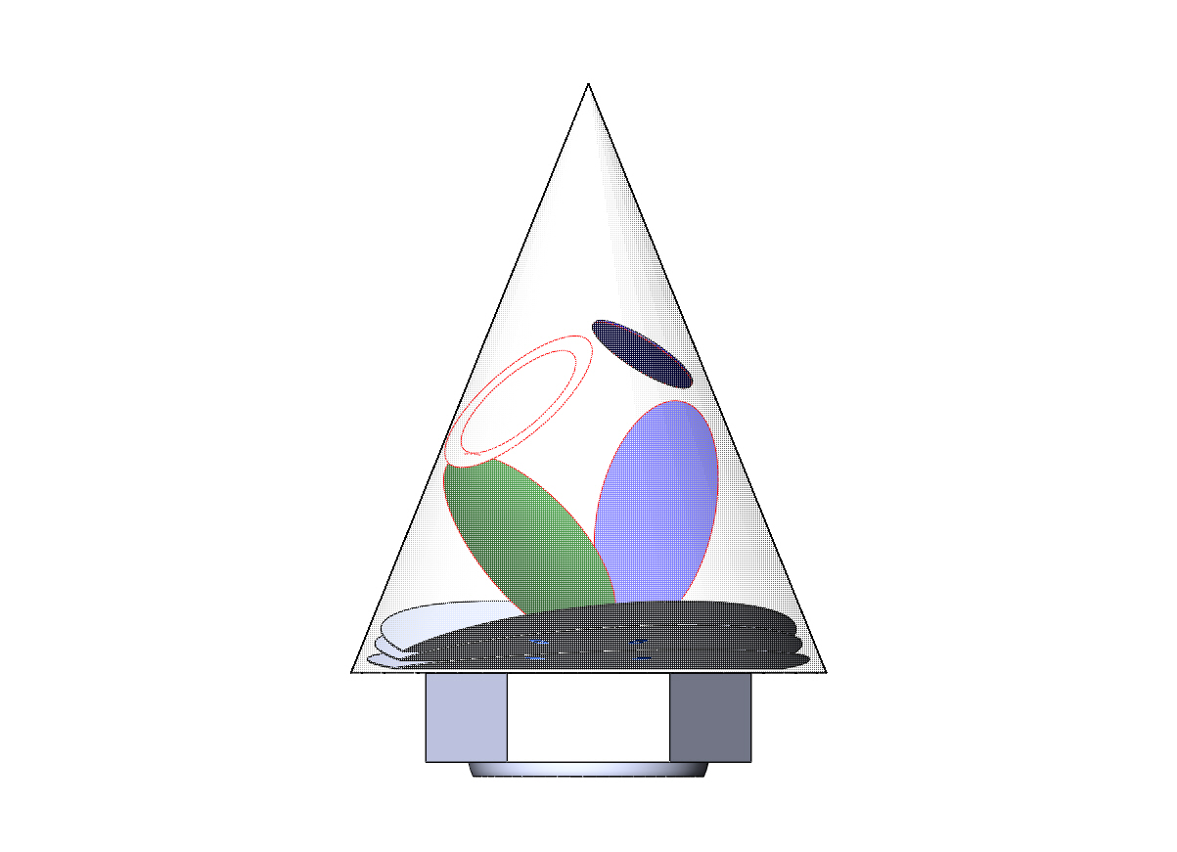
EPIC Cross-Dragone 1.4 m
A = 22 °
B = 55 °
60 ° view

Slide 12
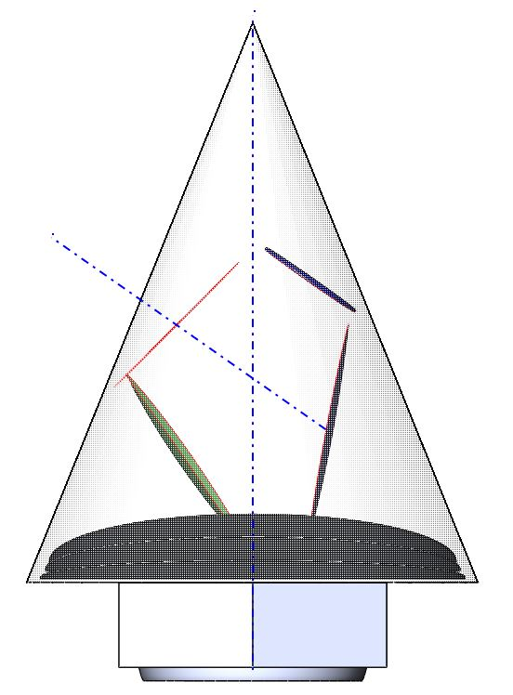
EPIC Cross-Dragone 1.4 m
A = 22 °
B = 55 °
90 ° view

Slide 13
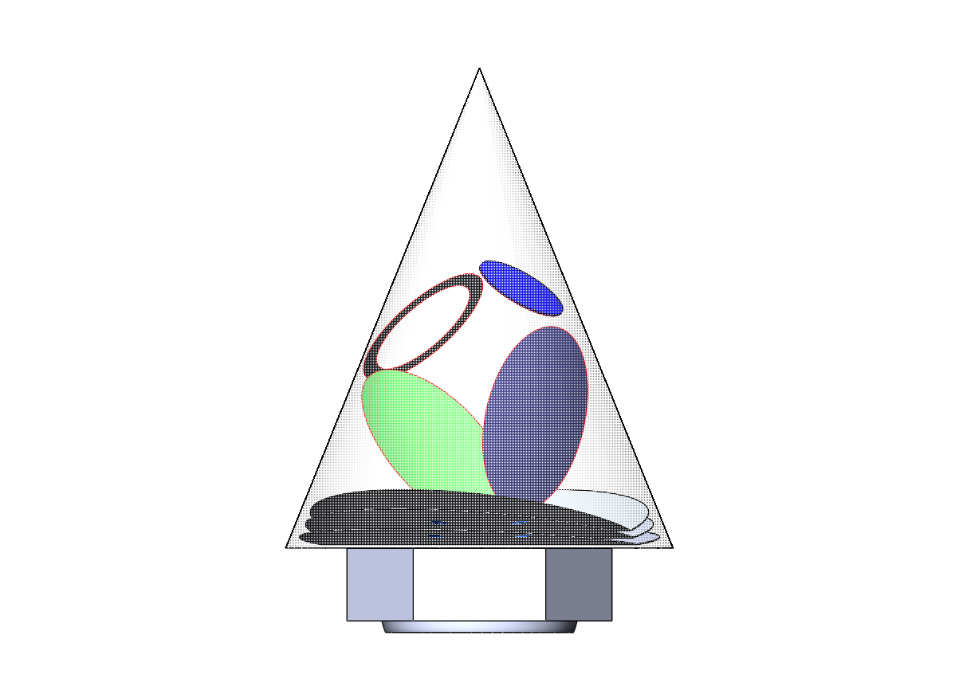
EPIC Cross-Dragone 1.4 m
A = 22 °
B = 55 °
120 ° view

Slide 14
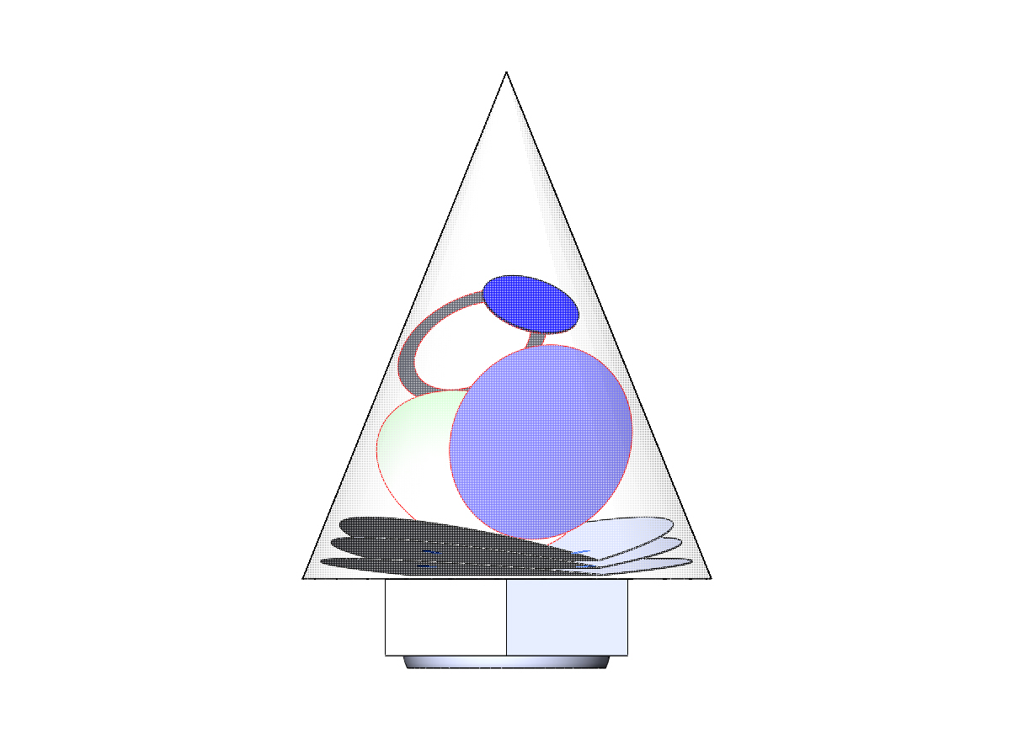
EPIC Cross-Dragone 1.4 m
A = 22 °
B = 55 °
150 ° view

Slide 15
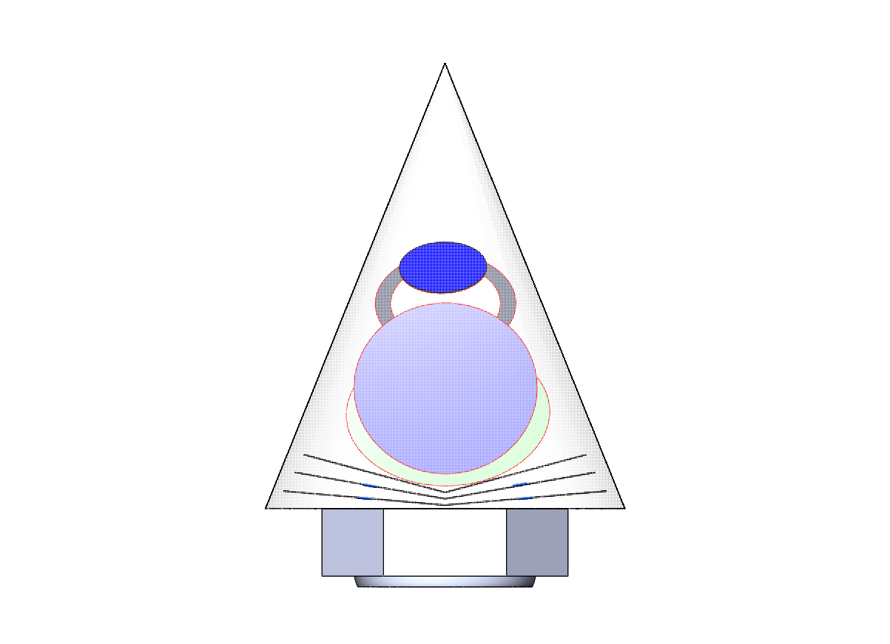
EPIC Cross-Dragone 1.4 m
A = 22 °
B = 55 °
180 ° view

Slide 17
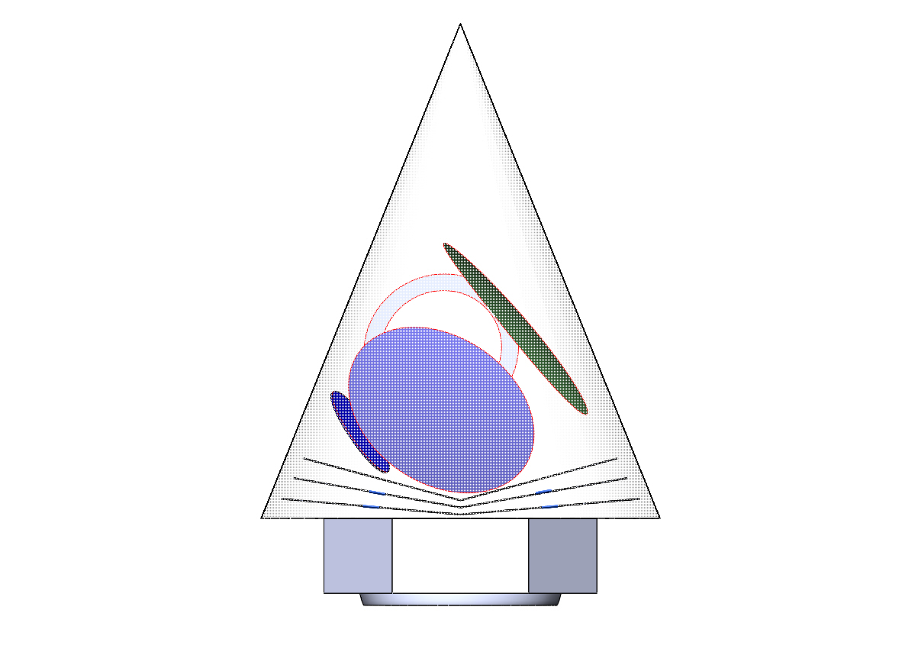
EPIC Cross-Dragone 1.4 m
A = 22 °
B = 68 °
A + B = 90 °
0 ° view

Slide 18
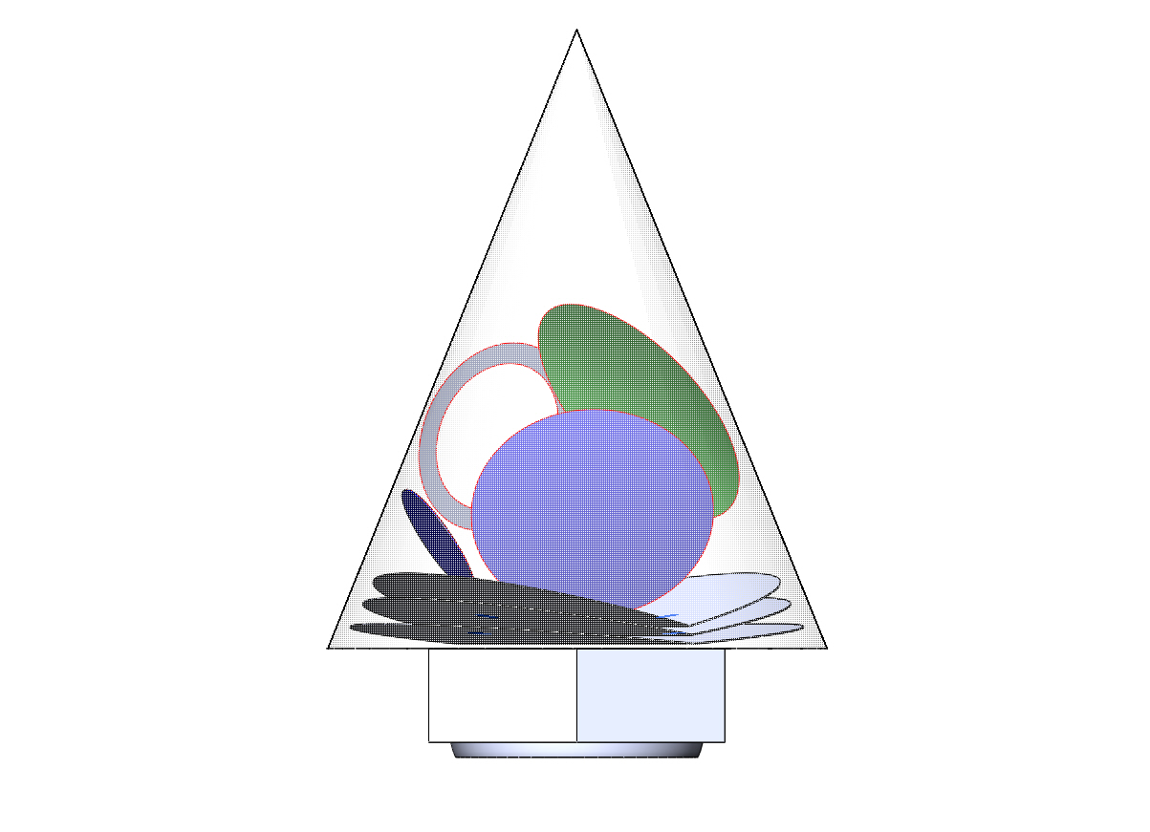
EPIC Cross-Dragone 1.4 m
A = 22 °
B = 68 °
A + B = 90 °
30 ° view

Slide 19
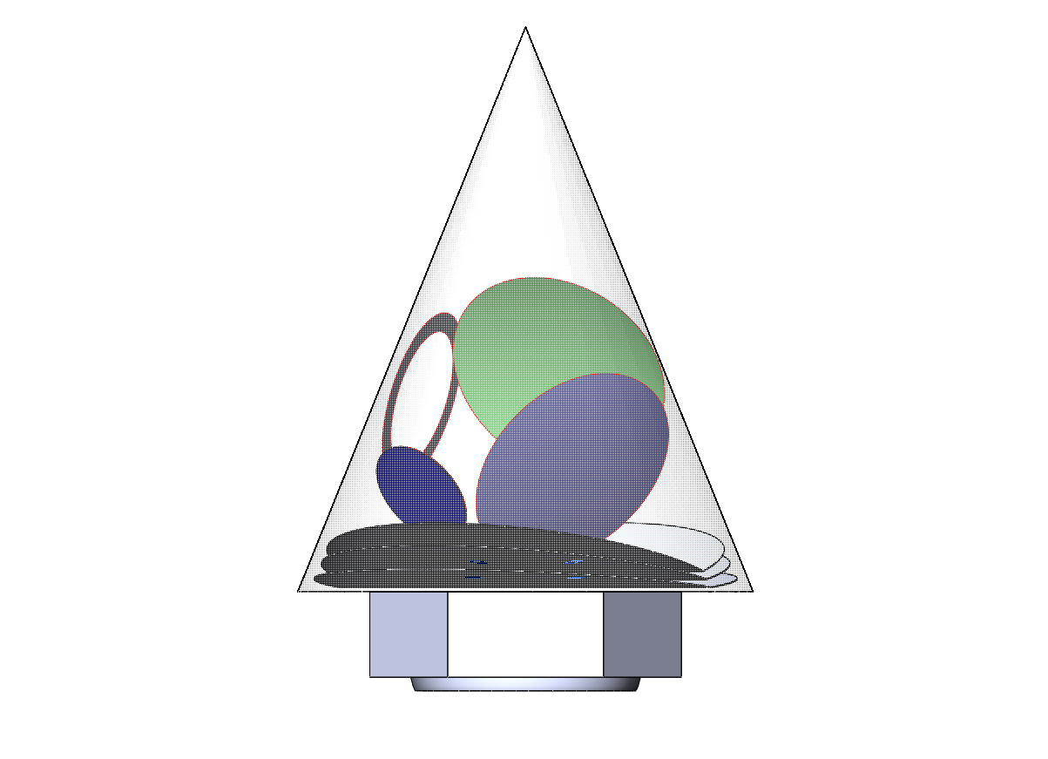
EPIC Cross-Dragone 1.4 m
A = 22 °
B = 68 °
A + B = 90 °
60 ° view

Slide 20
EPIC Cross-Dragone 1.4 m
A = 22 °
B = 68 °
A + B = 90 °
90 ° view

Slide 21
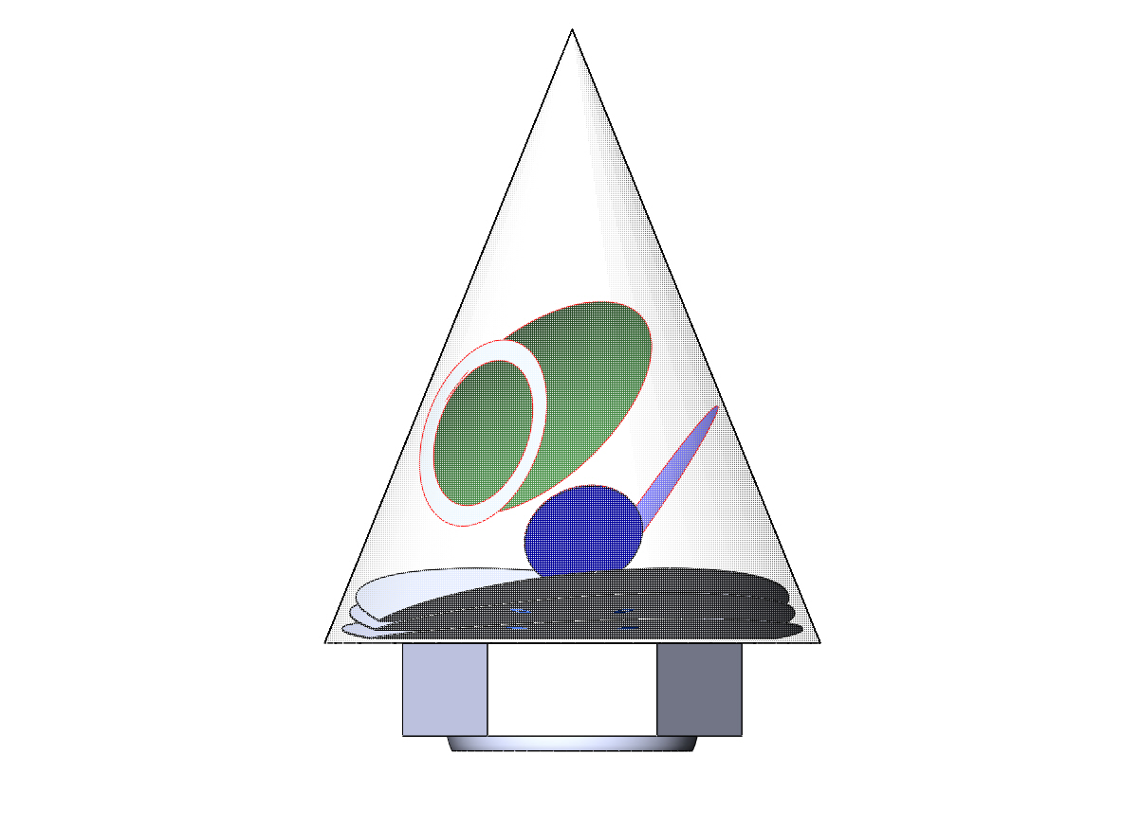
EPIC Cross-Dragone 1.4 m
A = 22 °
B = 68 °
A + B = 90 °
120 ° view

Slide 22
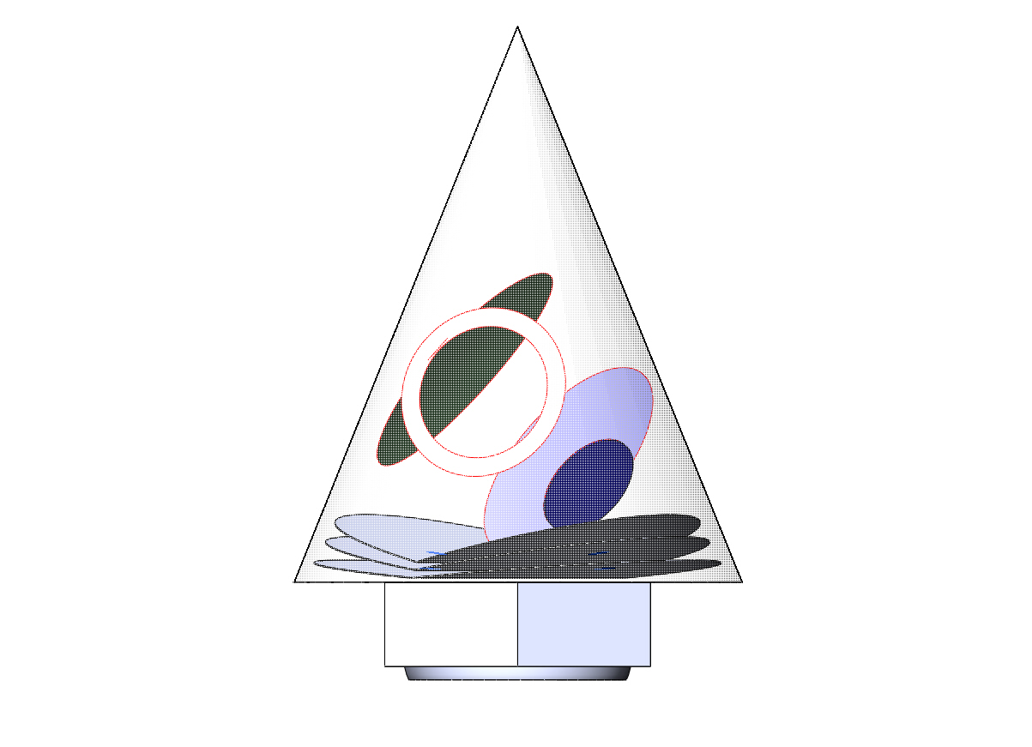
EPIC Cross-Dragone 1.4 m
A = 22 °
B = 68 °
A + B = 90 °
150 ° view

Slide 23
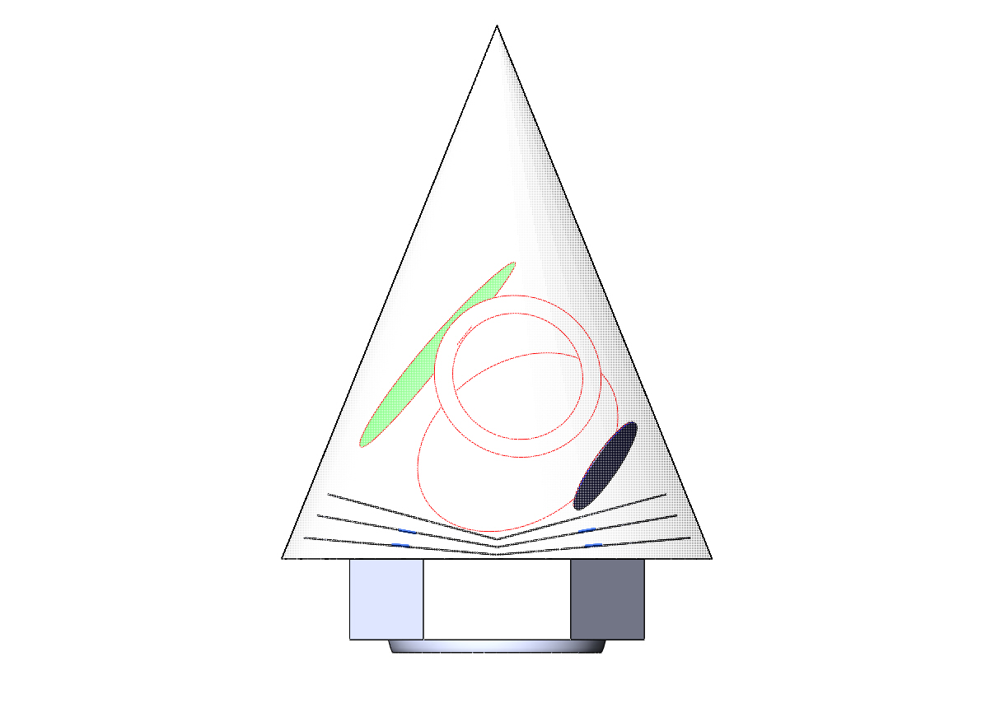
EPIC Cross-Dragone 1.4 m
A = 22 °
B = 68 °
A + B = 90 °
180 ° view

