Slide 1
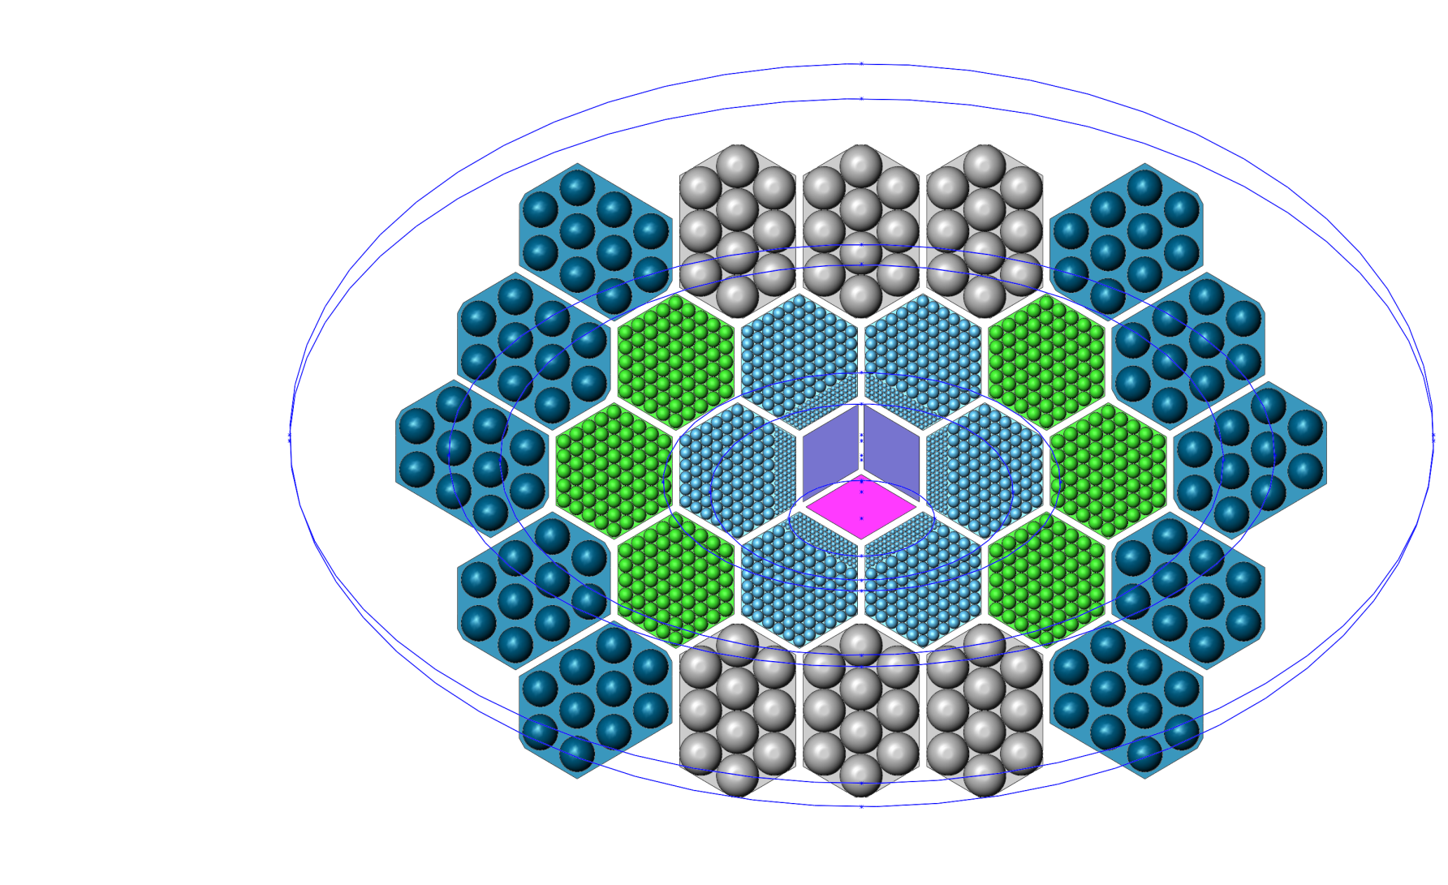
Focal Plane1, irregular hexagons
approximately 19 x 12 deg, 65 x 45 cm.
Red stars mark locations used to set mirror apertures in CodeV.
Top of Focal Plane
C, 145 GHz
D, 174GHz
Scan direction
B, 58.3 GHz
A, 48.6 GHz
Bottom of Focal Plane

Slide 2
Focal Plane, irregular hexagons
Wire bonding or bump bonding chips on focal plane?
Wire bonds have heritage and allow more flexibility.
Limited to 1400 detectors per wafer 1700 detectors per hex wafer (bond pitch = 80 um)
Bump bonds allow more density of connections per chip.
If KIDs (or similar) are dominate tech in 5 years this point is moot.
Volume needed for 100 mK readout components? 4K readout components?
100 mK TDM requires 4 mm^2 per channel (Hannes)
100 mK FDM requires LCs, about 50-80 mm^2 channel (from EBEX-IDS, LCs on silicon wafer)
4K, both need SQUIDs
Pixel | Bands (GHz) | Upper edge of upper band (GHz) | Irregular hex Number | Bolometers per wafer | Area behind 1 wafer (mm^2) | Area needed for TDM chips (mm^2)
A | 21, 30, 43 | 48.6 | 60 | 60 | 8100 | 240
B | 25, 36, 52 | 58.3 | 100 | 60 | 8100 | 240
C | 62, 90, 129 | 145 | 366 | 366 | 5700 | 1500
D | 75, 108, 155 | 174 | 510 | 990 | 5700 | 3960
E | 186, 268, 385 | 433 | 480
F | 223, 321, 462 | 520 | 450 | 1350 | 1730 | 5400
G | 555 | 624 | 220 | 1000 | 1730 | 4000
H | 666 | 749 | 200
I | 799 | 899 | 180

Slide 3
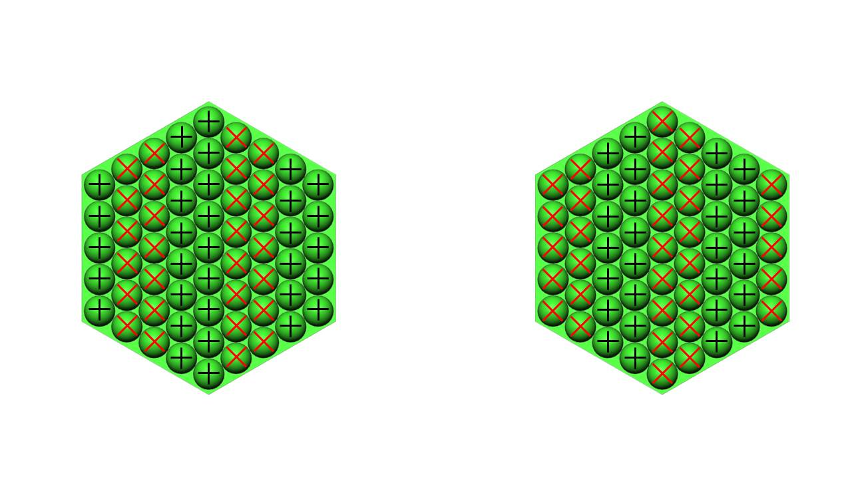
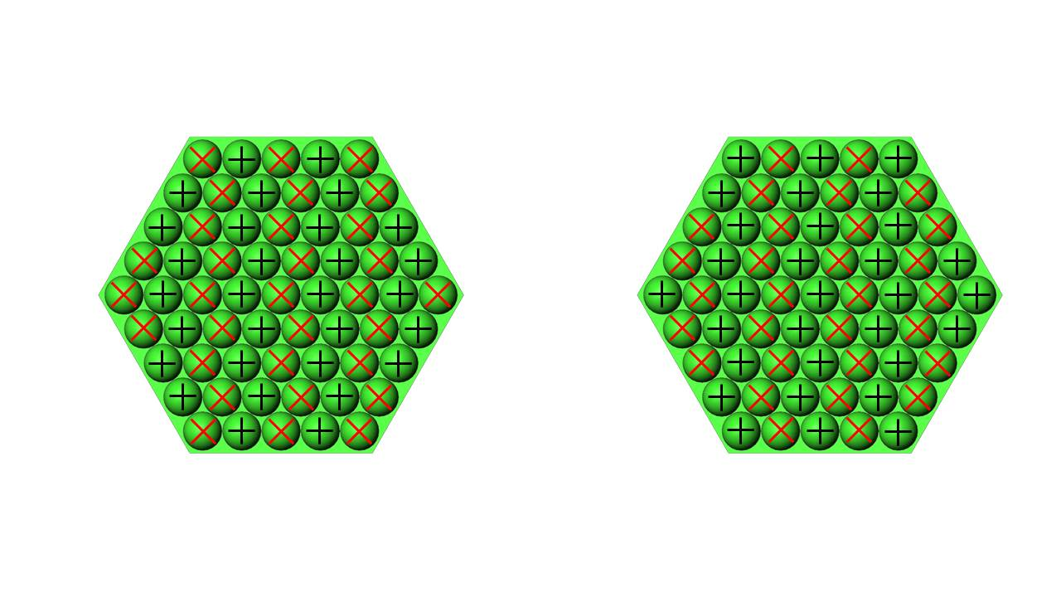
Orienting Q/U pixels
Q/U pixel pairs should follow each along scan path.
This is 0th order. Not account for distortion by the optics.
Showing only a single wafer pair, but all pairs would be similar.
Case 1 is original layout
Case 2 is rotated by 30 deg.
Far Q/U pair
Close Q/U pair
Case 1
Left side of focal plane
Right side of focal plane
Scan direction
Close Q/U pair
Far Q/U pair
Case 2

Slide 4
Readout for central wafers
More TDM chips at 100 mK are needed than fit in the area behind 1 detector wafer
We need bump bonds on the back of a wafer to connect the number of bolos to readout
sky
Coupling optics, probably feedhorns
Bump bonds to circuit board
Total thickness of few cm
TDM chips
Printed circuit boards
Flex cable

