Slide 1
To Do
Slide 3: check WMAP results for the EE
Slide 3: fix \ell annotations
Slide 3: what were the other Einstein Probes?
Add finkbeiner model reference
Fix slide with delensing
check with larry what is \tau_cluster
Say ‘why a space mission for each science goal’ and ‘why this space mission’ for each science goal
status of ground-based neutrino measurements from s4 book, and Abazajian’s 2014

Slide 2
Update on CMB Mission Concepts
APS 2018 April Meeting, IPSIG Mini-Symposium
Shaul Hanany
University of Minnesota
(PIXIE Contributions by Kogut, LiteBIRD from Hazumi talk,
CORE from available documents)

Slide 3
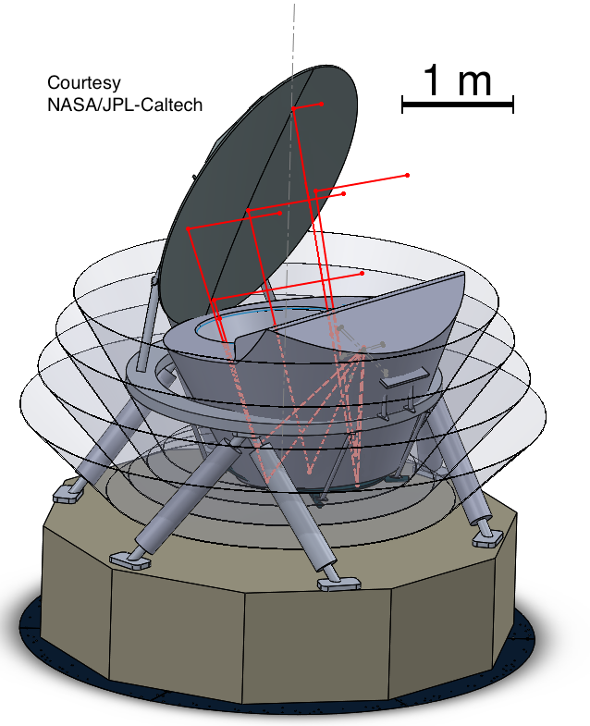
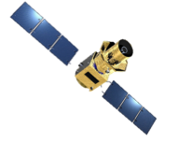
CMB Mission Concepts
Active
On Hold
PICO
LiteBIRD
CORE (ESA)
PIXIE (NASA)
NASA Study
JAXA Phase A
Proposed
CMB-Bharat
(India)
Notes:
Here is a current tally of CMB mission concepts. There are two active concepts, LiteBIRD, a Japanese led mission that is currently funded in Japan to conduct a PhaseA study, and PICO, which we are currently studying here in the US.
There are two missions on hold. They are on-hold in the sense that they have been recently proposed, and declined and will likely be proposed again. These are CORE submitted to ESA and by ESA and PIXIE submitted to NASA.
Before I give more details on these missions, let me take a historical perspective, which may be useful for the discussion later.

Slide 4
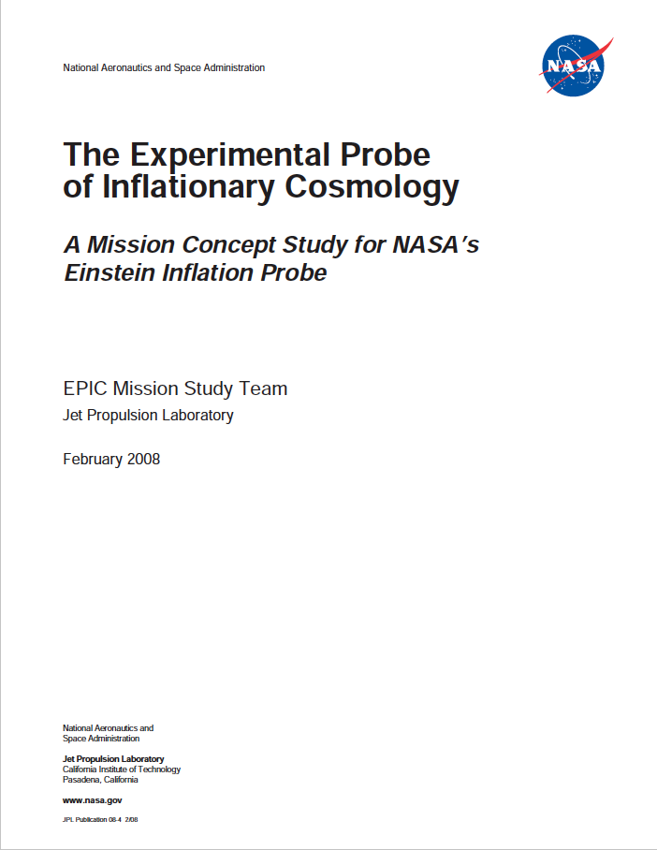
Back 10 years
WMAP was entering its year 8
Planck a year from launch
Few results on EE
Pre-Planck
Bock et al. May 2008
Pryke et al. 2008
Planck 2015
Notes:
Ten years ago, plus about few weeks, we posted this report on astro-ph. We were engaged in an activity similar to one we are doing now, studying a future CMB space mission.
Our mission was called EPIC (Experimental Probe of Inflationary Cosmology), and it was one of three candidate ‘Probes’, they were called ‘Einstein Probes’, that NASA was considering for launch sometime in the future. The cost cap for the Probes was $1B, and so we were studying what mission design, and what science can fit within that cost.
WMAP was entering its 8th year of operation; Planck was still a year from launch, and by that time we had several detections of TE and EE (showing QUAD).

Slide 5
Back 10 years
WMAP observations just ended
Planck a year from launch
Few results on EE
Pre-Planck
EPIC - IM / June 2009
Pryke et al. 2008
Notes:
Ten years ago, plus about few weeks, we posted this report on astro-ph. We were engaged in an activity similar to one we are doing now, studying a future CMB space mission.
Our mission was called EPIC (Experimental Probe of Inflationary Cosmology), and it was one of three candidate ‘Probes’, they were called ‘Einstein Probes’, that NASA was considering for launch sometime in the future. The cost cap for the Probes was $1B, and so we were studying what mission design, and what science can fit within that cost.
WMAP was entering its 8th year of operation; Planck was still a year from launch, and by that time we had several detections of TE and EE (showing QUAD).

Slide 6
EPIC-LC
$660M
6 x 30 cm apertures refracting telescopes
8 m
Bock et al. 2008; arXiv:0805.4207
EPIC-CS
(not costed, >$1B)
3 meter reflecting telescope
Notes:
In that study we explored

Slide 7
EPIC-LC
$660M
Bock et al. 2008; arXiv:0805.4207
EPIC-CS
(not costed, >$1B)
Bock et al. 2008; arXiv:0805.4207
Notes:
In that study we explored

Slide 8
About 9 years ago
Experimental Probe of Inflationary Cosmology
EPIC - IM
Bock et al. 6/2009
Notes:
About 9 years ago we posted this report on astro-ph.
We were engaged in an activity similar to one we are doing now with PICO, studying a future CMB space mission.
Our mission was called EPIC (Experimental Probe of Inflationary Cosmology), and it was one of three candidate ‘Einstein Probes’, that NASA was considering for launch sometime in the future. The cost cap for the Probes was $1B.

Slide 9
EPIC-IM
1.4 m, 2 mirror, Cross-Dragone Telescope,
~$900M
EPIC - IM
Bock et al. 6/2009
EPIC - IM
Notes:
This is EPIC.
It was

Slide 10
EPIC-IM
EPIC - IM
Bock et al. 6/2009
Notes:
Talk about E, B polarization spectra
Talk about 5 uK*arcmin, and

Slide 11
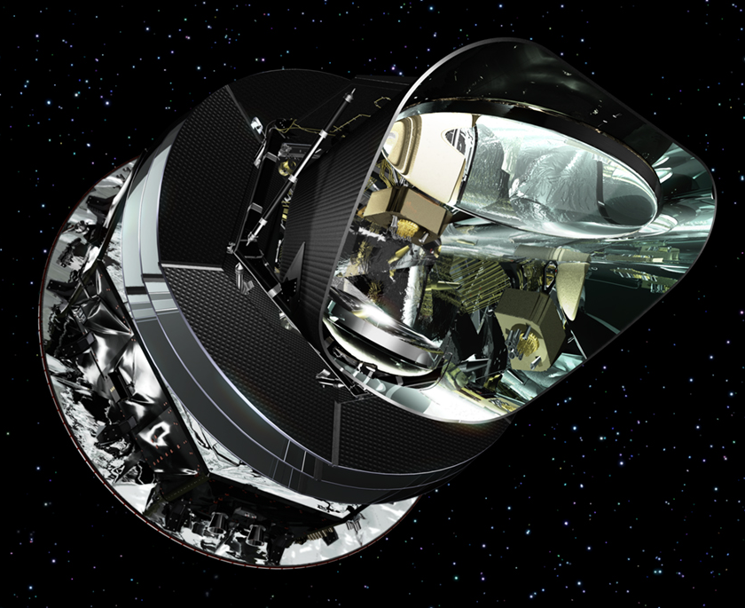
Planck Launches in 5/2005
EPIC - IM
Bock et al. 6/2009
Planck Launches in May 2009
Notes:
Ten years ago, plus about few weeks, we posted this report on astro-ph. We were engaged in an activity similar to one we are doing now, studying a future CMB space mission.
Our mission was called EPIC (Experimental Probe of Inflationary Cosmology), and it was one of three candidate ‘Probes’, they were called ‘Einstein Probes’, that NASA was considering for launch sometime in the future. The cost cap for the Probes was $1B, and so we were studying what mission design, and what science can fit within that cost.
WMAP was entering its 8th year of operation; Planck was still a year from launch, and by that time we had several detections of TE and EE (showing QUAD).

Slide 12
Decadal Panel 2010:
New space Activities - Medium Projects
CMB listed as a strategic program (priority 2, after exoplanet searches)
Sub-orbital program to continue search for the B-mode signal
Continued investment in technology development
“A successful detection of B-modes from inflation could trigger a mid-decade shift in focus toward preparing to map them over the entire sky.”
“Wait and see what we learn from Planck”
EPIC - IM

Slide 13
Decadal Panel 2010
WFIRST (>$1B)
Explorer Program
Missions of Opportunity $65M
Small Explorer ~$150M
Explorer $250M
EPIC - IM

Slide 14
CMB Mission Concepts
Active
On Hold
PICO
LiteBIRD
CORE (ESA)
PIXIE (NASA)
NASA Study
JAXA Phase A
Proposed
CMB-Bharat
(India)
Notes:
Here is a current tally of CMB mission concepts. There are two active concepts, LiteBIRD, a Japanese led mission that is currently funded in Japan to conduct a PhaseA study, and PICO, which we are currently studying here in the US.
There are two missions on hold. They are on-hold in the sense that they have been recently proposed, and declined and will likely be proposed again. These are CORE submitted to ESA and by ESA and PIXIE submitted to NASA.
Before I give more details on these missions, let me take a historical perspective, which may be useful for the discussion later.

Slide 15
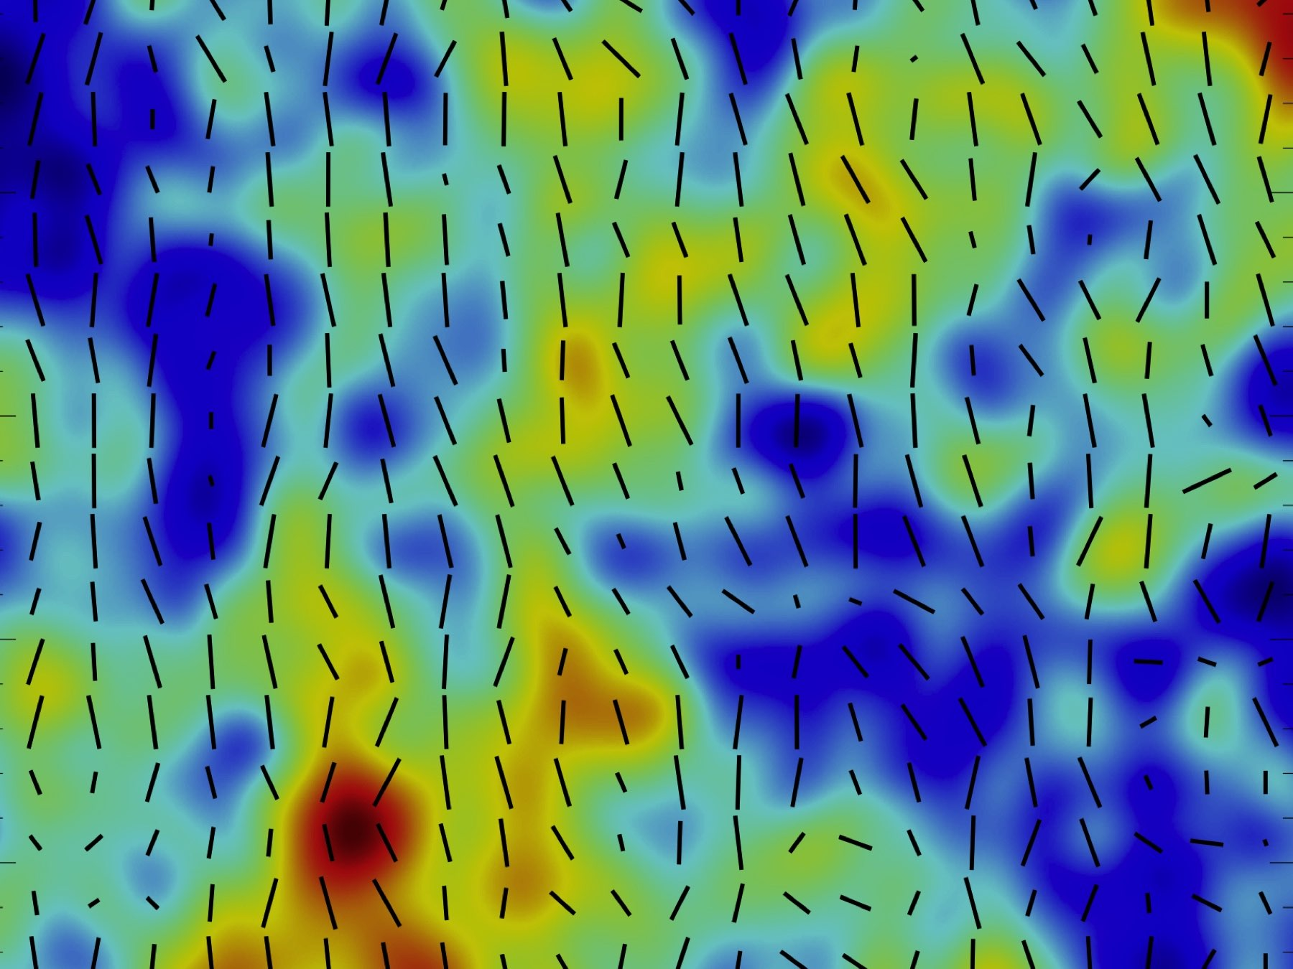
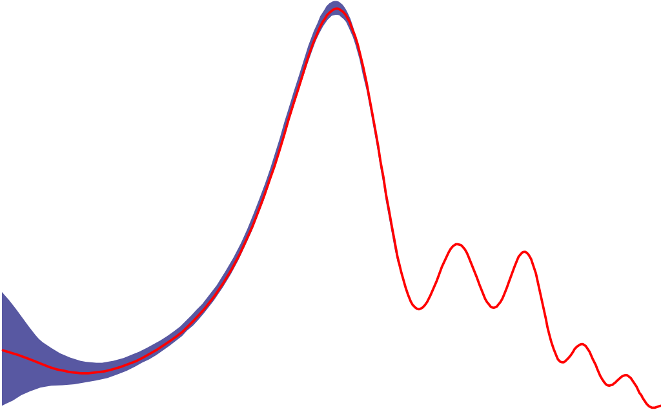
PIXIE:
The Primordial Inflation Explorer
PI: Al Kogut

Slide 16
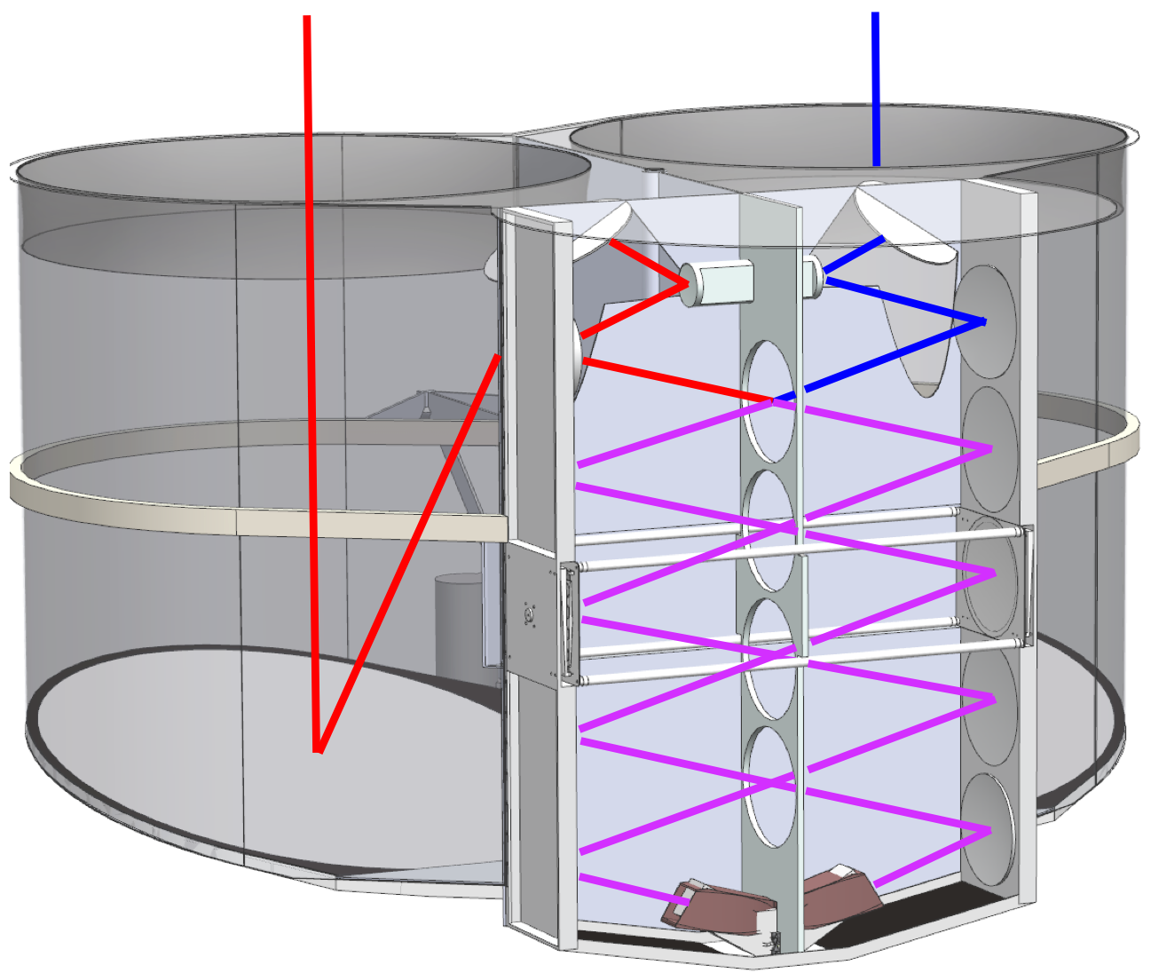
PIXIE Nulling Polarimeter
Instrument
Isothermal
With CMB
Interfere
Two Beams From Sky
Science Goal | PIXIE Measurement
Inflation | Polarization B-modes
Neutrino Mass | Polarization E-modes
Reionization | Polarization E-modes
Dark Matter | Spectral Distortion (𝜇)
Large-Scale Structure | Spectral Distortion (y)
Start Formation History | Far-IR Intensity Mapping
Radio Background | Synchrotron intensity+ polarization
Beam-Forming
Optics
Polarizing Fourier Transform Spectrometer for Broad Frequency Coverage
Multi-Moded Detectors
for Photon-Limited Sensitivity

Slide 17
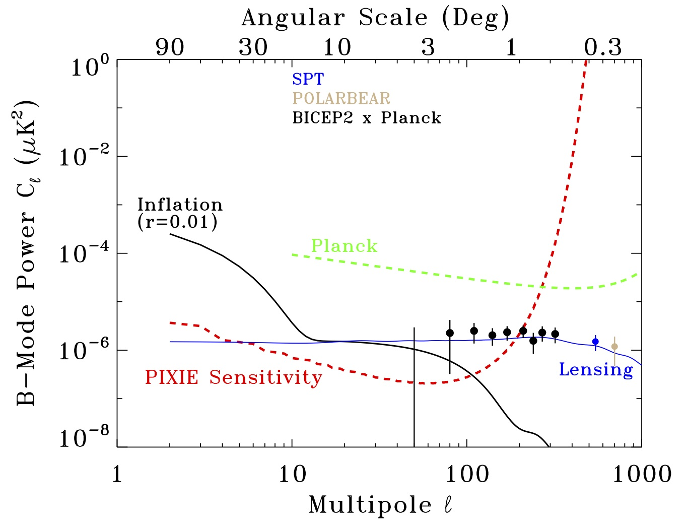
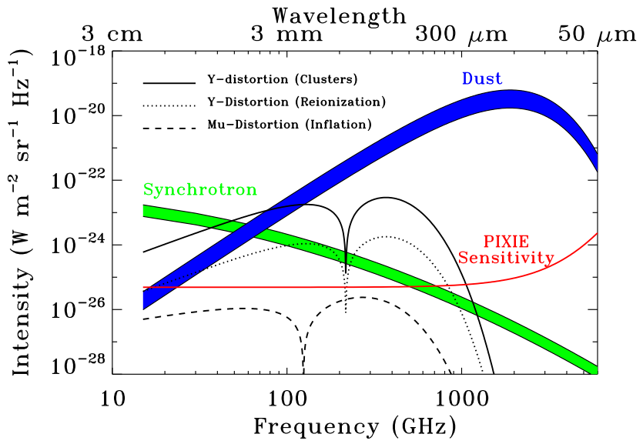
Unique Science Capability
Full-Sky Spectro-Polarimetric Survey
400 frequency channels, 30 GHz to 6 THz
Resolution: 0.9°
CMB sensitivity 70 nk RMS per pixel
4.8 uK*arcmin
Legacy Archive for far-IR Astrophysics
Multiple Science Goals
Polarization: r < 10⁻³ at 5 sigma
Cosmic-variance limit EE (reionization)
Neutrino mass at 5 sigma
Spectral distortions: |y| < 5 x 10⁻⁸, |μ| < 10⁻⁷
Improve FIRAS constraints by factor 1000
Total thermal energy in electrons
Dark matter decay/annihilation
Intensity mapping of C+, CO lines
Star formation history / turn-off
Notes:
Note \ell range: coarse resolution

Slide 18
Status of PIXIE
Explorer Program
11 missions proposed Dec 2016
PIXIE declined
Future plans
Next MIDEX opportunity 2020/2021
Also proposing Balloon-borne version for dust science (Flight 2021?)

Slide 20
CORE
Submitted to ESA Medium class
Cost <= E750M, including member countries
Most recent submission: M5, 10/2016

Slide 21
CORE
Imager, 60 - 600 GHz
19 bands
1.2 m aperture; 3 mirror, Cross-Dragone
7.7’ resolution at 145 GHz
in polarization
r=0.001

Slide 22
CORE Status
Did not advance to PhaseA study (cost risk)
Next ESA cycle - not clear
Yesterday:
submission of CMB-Bharat CORE-like - mission to Indian Space Research Organization

Slide 23
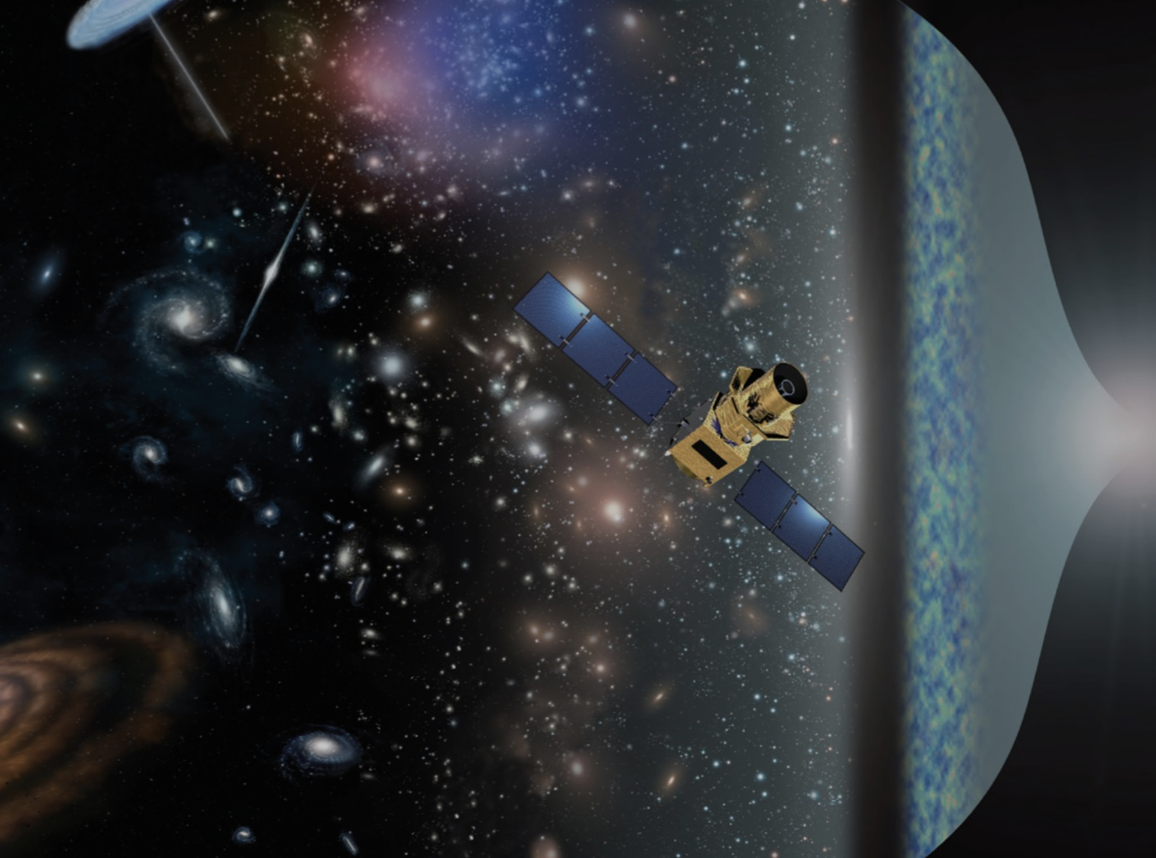
LiteBIRD
Masashi Hazumi
1) Institute of Particle and Nuclear Studies (IPNS), High Energy Accelerator Research Organization (KEK)
2) Kavli Institute for Mathematics and Physics of the Universe (Kavli IPMU), The University of Tokyo
3) Graduate School for Advanced Studies (SOKENDAI)
4) Institute of Space and Astronautical Science (ISAS), Japan Aerospace Exploration Agency (JAXA)
Notes:
Thank you. I am honored to be here to say a few words on LiteBIRD,
which is a satellite candidate of Institute of Space and Astronautical Science ,
Japan Aerospace Exploration Agency (JAXA)
aiming a launch in mid. 2020s.

Slide 24
“Current Status of LiteBIRD in JAXA” by Toru Yamada (Former ISAS Director of International Strategy and Coordination)

Slide 25
Full success of LiteBIRD
s(r) < 1 × 10⁻³ (for r=0)
All sky survey (for 2 ≤ ≤ 200)*
Remarks
s(r) is the total uncertainty on the r measurement that includes the following uncertainties**
statistical uncertainties
instrumental systematic uncertainties
uncertainties due to residual foregrounds and bias
uncertainties due to lensing B-mode
cosmic variance (for r > 0)
observer bias
The above should be achieved without delensing.
* More precise (i.e. long) definition ensures >5sigma r detection from each bump for r > 0.01.
** We also use an expression δr = σ(r=0), which has no cosmic variance.

Slide 26
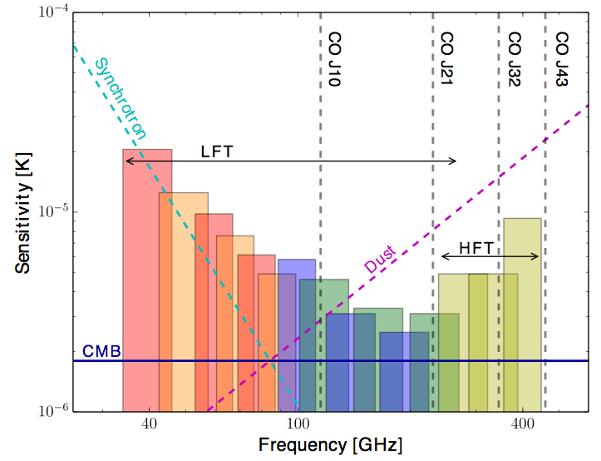
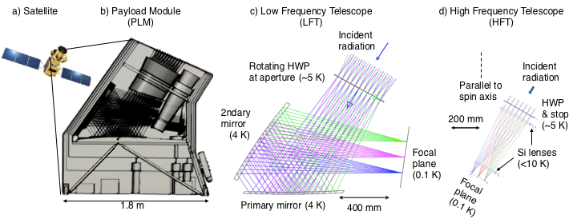
Imager, 35 - 450 GHz
15 frequency bands (some overlap)
Two telescopes; 0.5 deg resolution at 100 GHz
in polarization

Slide 27
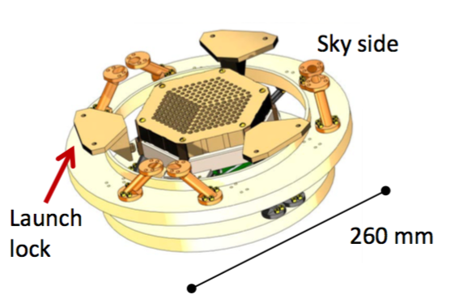
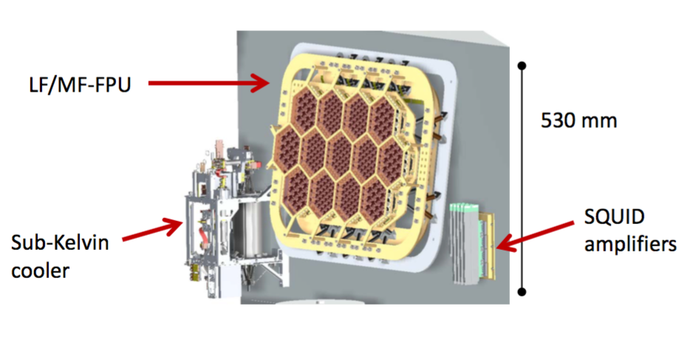
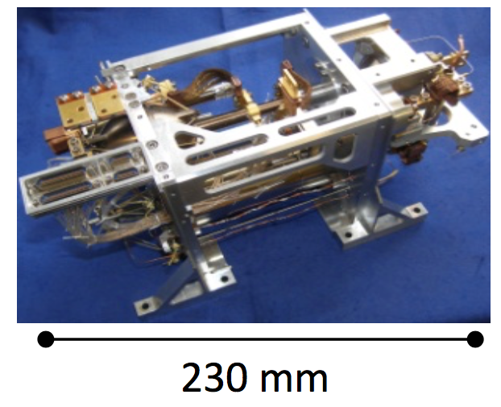
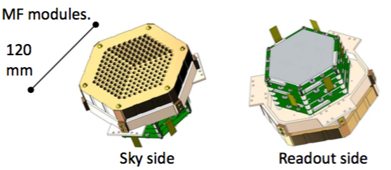
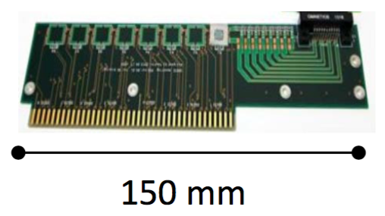
LiteBIRD U.S. Deliverables (A. LEE, US PI)
HF = High Frequency, MF = Mid Frequency, LF = Low Frequency
to Europe
Sub-Kelvin Cooler
HF-FPU
SQUID Amplifiers
HF Module
LF Module
MF Module

Slide 28
LiteBIRD Status
Japan:
Phase A1 will conclude in 8/2018
Then downselect
US:
2016 Mission of Opportunity ($65M) proceeded to PhaseA; PhaseB declined
Technology development continues
Will submit at next MO (2019?)
Notes:
Thank you. I am honored to be here to say a few words on LiteBIRD,
which is a satellite candidate of Institute of Space and Astronautical Science ,
Japan Aerospace Exploration Agency (JAXA)
aiming a launch in mid. 2020s.

Slide 29
Probe of Inflation and
Cosmic Origins
(PICO)

Slide 30
NASA Prep for 2020
Recall
Decadal 2010 did not recommend space missions between $250M - $1000M

Slide 31
NASA Prep for 2020
Set up 8 Probe Mission Studies; Probe= $400M-$1000M
Transient Astrophysics Probe (Camp, GSFC)
Cosmic Dawn Intensity Mapper (Cooray, UC Irvine)
Cosmic Evolution through UV Spectroscopy (Danchi, GSFC)
Galaxy Evolution Probe (Glenn, UColorado)
Inflation Probe (Hanany, University of Minnesota)
High Spatial Resolution X-Ray Probe (Mushotzky, UMaryland)
Multi-Messenger Astrophysics (Olinto, UChicago)
Precise Radial Velocity Observatory (Plavchan, Missouri State)

Slide 32
NASA Prep for 2020
Inflation Probe = Probe of Inflation and Cosmic Origin (PICO)
Studies will produce 50 pg. reports + cost estimates that will be submitted to NASA and to the Decadal Panel (12/2018)
Possible outcomes:
Panel recommends a funding wedge. Probes are competed later.
Panel recommends specific missions
Any combination of the above
Our desired outcome: panel recognizes the promise of a future space mission and gives high ranking (maintain ‘strategic’ status)

Slide 33
The PICO Collaboration
Open to all - subscribe, contribute
Steering Committee: Bennett, Dodelson, Page
Executive Committee: Borrill, Bock, Crill, Devlin, Flauger, Jones, Hanany, Knox, Kogut, Lawrence, McMahon, Pryke, Trangsrud
7 working groups:
Fundamental physics (Flauger)
Extragalactic science (Battaglia)
Galactic science (Chuss+Fissel)
Foregrounds + Data challenge (Hanany, Borrill)
Imager (Hanany)
Spectrometer (Kogut)
Systematics (Crill)
Wiki: https://z.umn.edu/cmbprobe; Mailing list: cmbprobe@lists.physics.umn.edu

Slide 34
Spectrometer, Imager, or both?
We began by considering which instrument(s) to implement
The EC concluded that there is strong case for two Probe scale missions, one devoted to spectroscopy and another to imaging
The EC considered the case for a combined mission and concluded that it will weaken both instruments
PICO will be given detailed costing as an imaging mission.

Slide 35
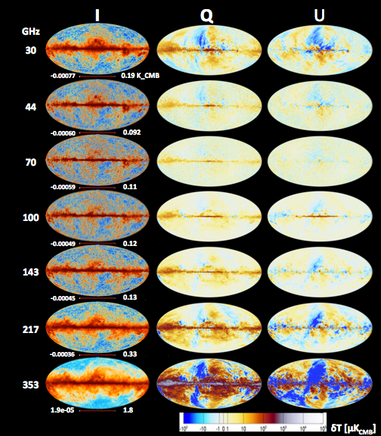
PICO in Brief
Millimeter/submillimeter-wave, polarimetric survey of the entire sky
21 bands between 20 GHz and 800 GHz
1.4 m aperture telescope
Diffraction limited resolution: 38’ to 1’
13,000 transition edge sensor bolometers + multiplexed readouts
4 year survey from L2 (1 year margin)
0.6 uK*arcmin, 80 times the sensitivity of Planck
Planck 2015
Notes:
PICO is a millimeter/sub-millimeter polarimetric survey of the entire sky. It will produce maps of Stokes I,Q, and U in 21 frequency bands between 20 and 800 GHz, a frequency range that includes emissions from a broad range of galactic, extragalactic, and cosmological sources, including the cosmic microwave background.
It will have a 1.4 meter, two-reflector telescope giving diffraction limited resolution as low as 1’. It will use 12,400 transition edge sensor bolometers and multiplexed readouts, and it will survey the sky for 4 years from L2. The best point of comparison to PICO is the Planck mission, which operated over a similar frequency range. Planck produced polarization maps in only 7 frequency bands, and with 70 times higher polarization noise level. Thus PICO is equivalent to almost 5000 Planck’s.
PICO’s science goals address nearly all goals stated by NASA’s Science strategic plan.

Slide 36
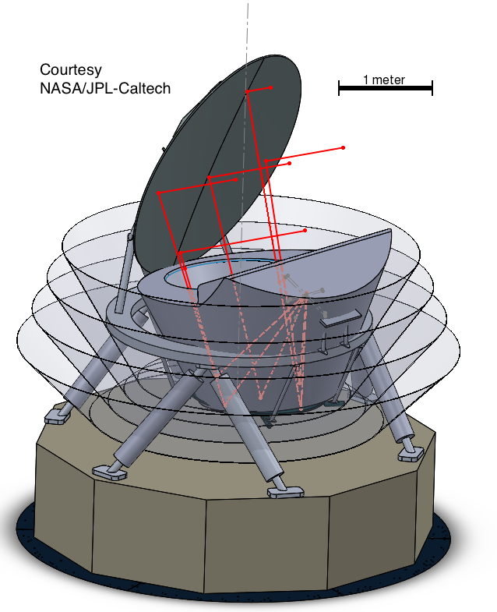
NASA Science Strategic Goals
Explore how the Universe began
Discover how the Universe works
Explore how the Universe evolved
Notes:
To summarize:
PICOs science goals of inflation, quantum gravity, particle physics, extragalactic and galactic structure and evolution are all unique and can only be probed with the measurements proposed.
PICO is the only instrument with the combination of sky coverage, resolution, frequency bands, and sensitivity, to achieve this science with one platform.
We had our initial engineering and costing study completed; no significant issues in engineering nor in cost were identified. The technology implementation is a simple extension of today’s technologies. And the mission is a good fit to the cost window.

Slide 37
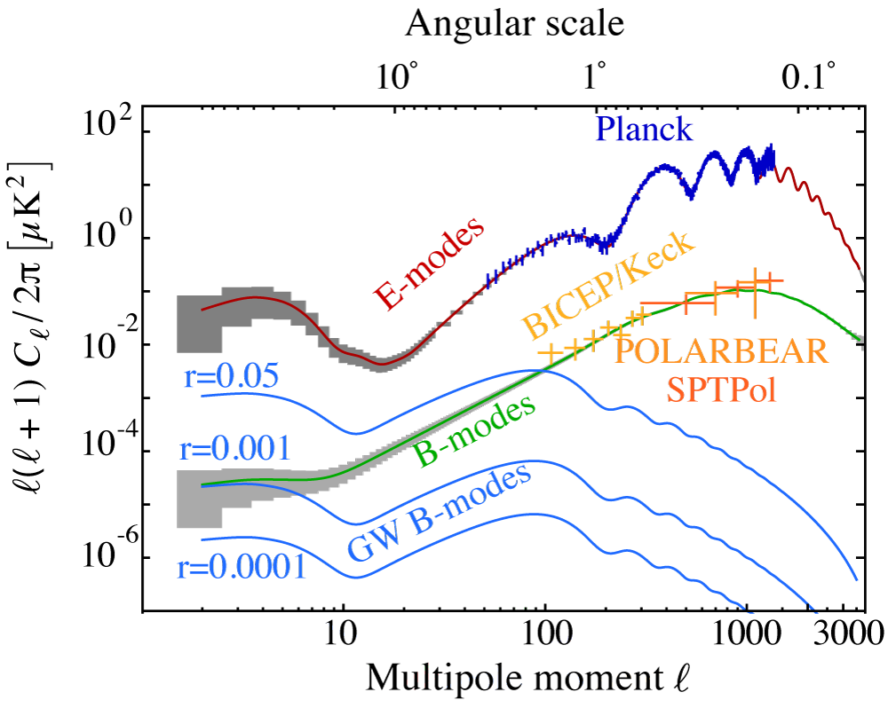
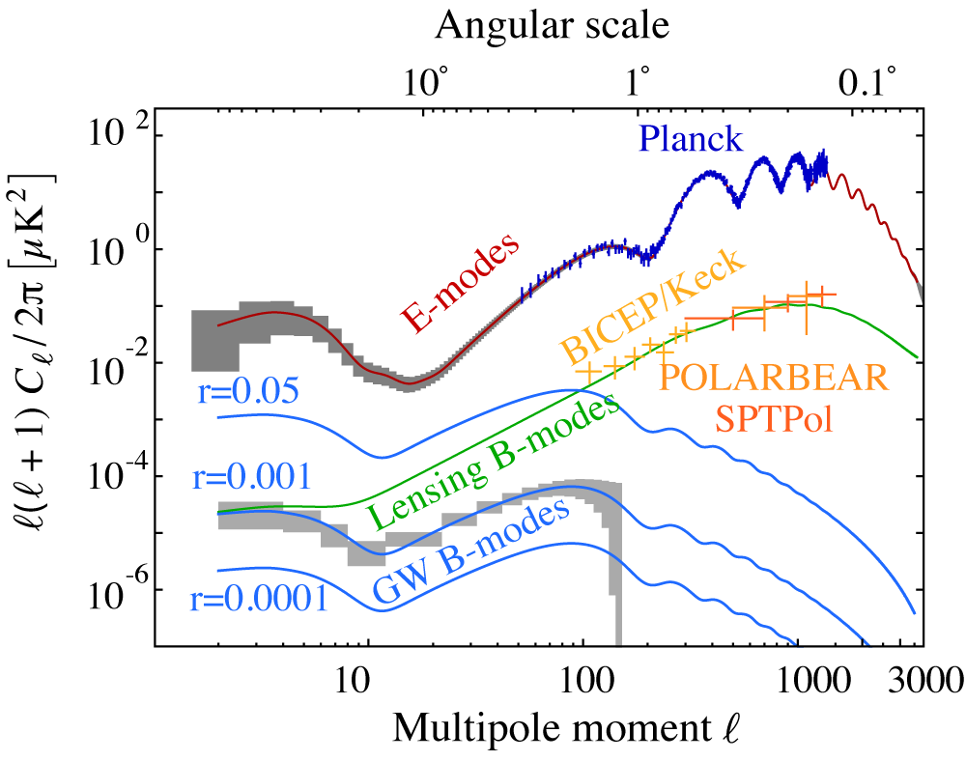
Explore How the Universe Began
Detect or set upper bound on the energy scale of inflation
Currently
PICO:
700 times lower than current constraint
quoted constraints include x2.5 margin
Includes internal delensing, removal of a simple foregrounds model; excludes systematic uncertainties; 40% of sky
Figure: R. Flauger
Figure: R. Flauger
Notes:
It will explore how the Universe began by detecting or setting an upper bound on the energy scale at which inflation occurred. This energy scale is quantified by means of the tensor to scalar ratio r, which sets the level of the B mode power spectrum at low \ell. B80 is the level of B at \ell=80. The current 95% confidence limit on r is 0.07. PICO will set a 95% confidence limit that is 700 times more stringent.
The PICO determination of the CMB polarization E and B angular power spectra are shown in grey boxes in these panels. The constraints on the inflation signal come from a measurement of the B-mode spectrum, which has contributions from inflation, shown in blue for different values of r, and from lensing shown in green. Our projections, shown on the lower panel for the case that r=0.001, include using PICO’s high resolution data to remove the lensing foreground, and they include removal of a simple foregrounds model.
(The limits we quote on the value of r and sigma(r) include a factor of 2.5 margin. )

Slide 38
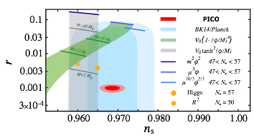
Explore How The Universe Began
Detection would point to specific large field inflation models as the drivers for inflation, and would motivate their connection to string theory
An upper limit will exclude classes of inflation potentials
Figure: R. Flauger
Notes:
A detection of inflation would point to specific large field inflation models as the drivers for inflation, and it would motivate connecting them to string theory. A detection would be the first observation of quantum gravity.
The panel below shows r as a function of n, the power law index of the scalar fluctuations power spectrum. In blue are current constraints from Planck and the bicep/keck experiments, and in red are the PICO constraints if r=0.001. An upper limit at a level of 1e-4 would exclude several favored classes of potentials as the driving force of inflation.
Only CMB measurements can probe this key information about inflation, and PICO is the most sensitive such probe planned for the foreseeable future.

Slide 39
Explore how the Universe Evolved
Determine the reionization history of the Universe
Measurement of the EE power spectrum on the largest angular scales gives a measurement of
Planck:
PICO: cosmic variance limited
Notes:
PICO will explore how the Universe evolved by determining the reionization history of the Universe. The E-mode power spectrum over the largest angular scales is sensitive to the optical depth to reionization.
Here we show forecasts in a plane of the redshift to reionization and the duration of reionization. We show current constraints by Planck in yellow and exclusion regions by other experiments.
PICO, shown in blue, will measure the optical depth to cosmic variance limits. This measurement is uniquely suited for a space based mission that has an unimpeded view of the entire sky.

Slide 40
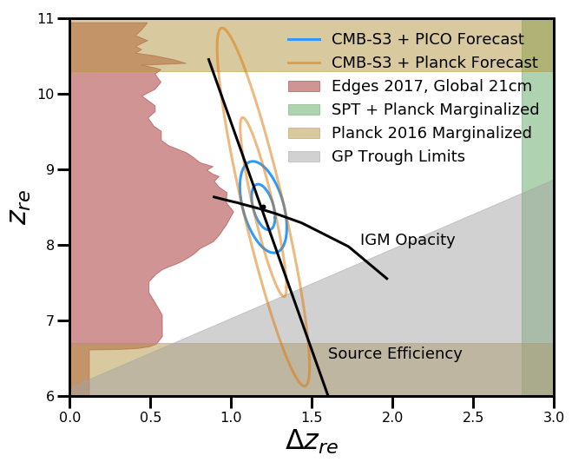
Constraining Models of Reionization
(Planck, PICO)
(S3, SPT)
Transition from neutral to ionized Universe controlled by ‘IGM Opacity’ and ‘Source Efficiency’ parameters
Figure: N. Battaglia, M. Alvarez
Notes:
PICO will explore how the Universe evolved by determining the reionization history of the Universe. The E-mode power spectrum over the largest angular scales is sensitive to the optical depth to reionization.
Here we show forecasts in a plane of the redshift to reionization and the duration of reionization. We show current constraints by Planck in yellow and exclusion regions by other experiments.
PICO, shown in blue, will measure the optical depth to cosmic variance limits. This measurement is uniquely suited for a space based mission that has an unimpeded view of the entire sky.

Slide 41
Discover How The Universe Works
Determine the sum of neutrino masses
Measurements of the matter power spectrum, primarily through the lensing potential power spectrum
But degeneracy with and
Currently
or depending on mass hierarchy
Abazajian et al 2016
Lensing Potential
Couchot et al 1703.10829
Noise / mode
Figure: A. Van Engelen
Notes:
we should be able to show the same lensing potential for different values of tau and sum nu

Slide 42
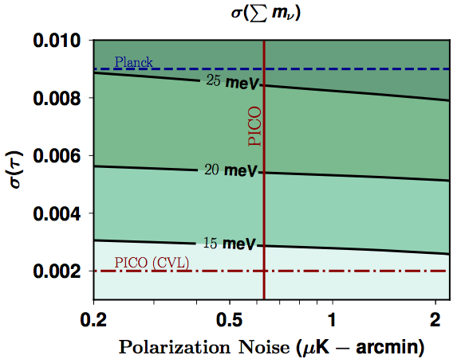
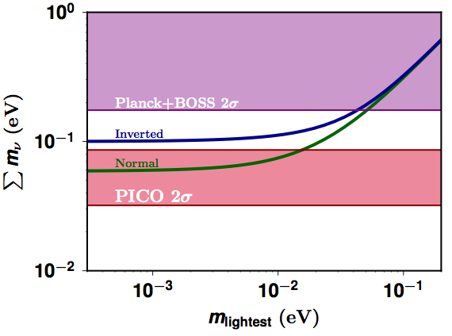
Neutrino Mass Constraint
PICO: using DESI BAO to break degeneracy
or detection
Determine mass hierarchy, or mass of the lightest neutrino (if mass hierarchy known)
Measurement is unique to space
Figure: D. Green
Figure: D. Green
Notes:
The PICO tau converts the measurement from a 2 sigma to a 4 sigma measurement.

Slide 43
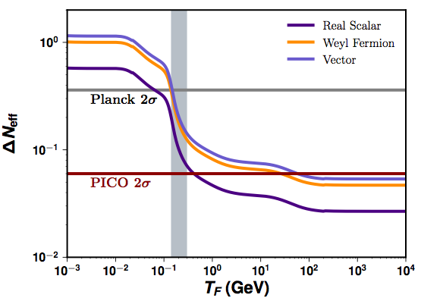
Discover How The Universe Works
Determine the number of relativistic species of particles in the early Universe
Standard model:
Planck:
There could be other species
The change in depends on the type of particle and its mass
QCD
Figure: D. Green
(= 0.027 for single, light scalar)
Notes:
PICO will also determine the number of relativistic species of particles, Neff, also less accurately known as the ‘number of neutrino families’. The canonical Standard Model is 3.046 for a minimum of three known neutrino families. But there may be other particles, for example a light sterile neutrino or dark photons.
With large sky coverage, shown on the vertical axis, and its high sensitivity on the horizontal PICO will reach 6 times the accuracy of Planck.
The PICO constraint pushes our ability to probe the existence of new particles to epochs in the evolution of the universe that are earlier than the QCD phase transition. For example, we would reach an energy threshold that is 300 times higher than the current Planck constraints, for the case of new vector type particles.
The CMB gives the strongest constraints on Neff compared to any other available probe.

Slide 44
Discover How The Universe Works
Number of relativistic species affects the damping tail + shifts the peaks in
Constraint strength is proportional to number of modes available
PICO’s constraint comes mostly from the EE power spectrum
damping
Amplitude
Phase
Phase
Figure: Green
Figure: J. Meyers
Figure: D. Green
Baumann et al. 2017
lensed
un lensed
N1
N2
Figure: J. Meyers
Notes:
PICO will also determine the number of relativistic species of particles, Neff, also less accurately known as the ‘number of neutrino families’. The canonical Standard Model is 3.046 for a minimum of three known neutrino families. But there may be other particles, for example a light sterile neutrino or dark photons.
With large sky coverage, shown on the vertical axis, and its high sensitivity on the horizontal PICO will reach 6 times the accuracy of Planck.
The PICO constraint pushes our ability to probe the existence of new particles to epochs in the evolution of the universe that are earlier than the QCD phase transition. For example, we would reach an energy threshold that is 300 times higher than the current Planck constraints, for the case of new vector type particles.
The CMB gives the strongest constraints on Neff compared to any other available probe.

Slide 45
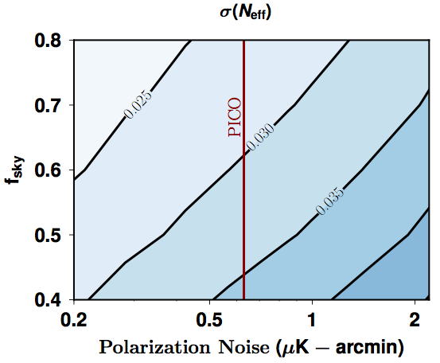
Constraints on Number of Light Relics
PICO’s constraint comes mostly from the EE power spectrum
PICO:
Extend range of energy to exclude new species by
x300 for vector particle
x2.5 for scalar particle
Cross the QCD phase transition
QCD
now
with PICO
x300
Figure: D. Green
Figure: D. Green
Notes:
PICO will also determine the number of relativistic species of particles, Neff, also less accurately known as the ‘number of neutrino families’. The canonical Standard Model is 3.046 for a minimum of three known neutrino families. But there may be other particles, for example a light sterile neutrino or dark photons.
With large sky coverage, shown on the vertical axis, and its high sensitivity on the horizontal PICO will reach 6 times the accuracy of Planck.
The PICO constraint pushes our ability to probe the existence of new particles to epochs in the evolution of the universe that are earlier than the QCD phase transition. For example, we would reach an energy threshold that is 300 times higher than the current Planck constraints, for the case of new vector type particles.
The CMB gives the strongest constraints on Neff compared to any other available probe.

Slide 46
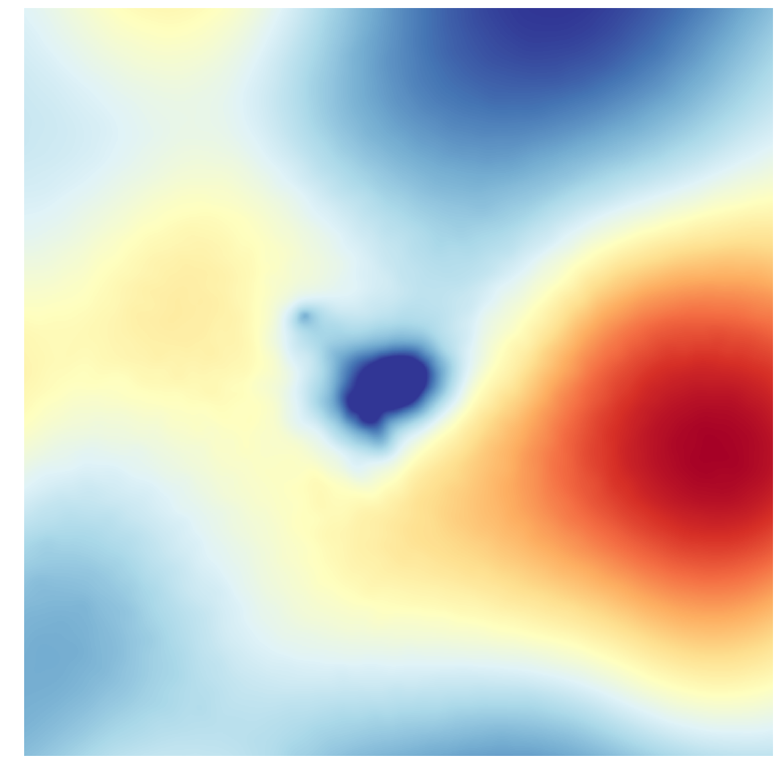
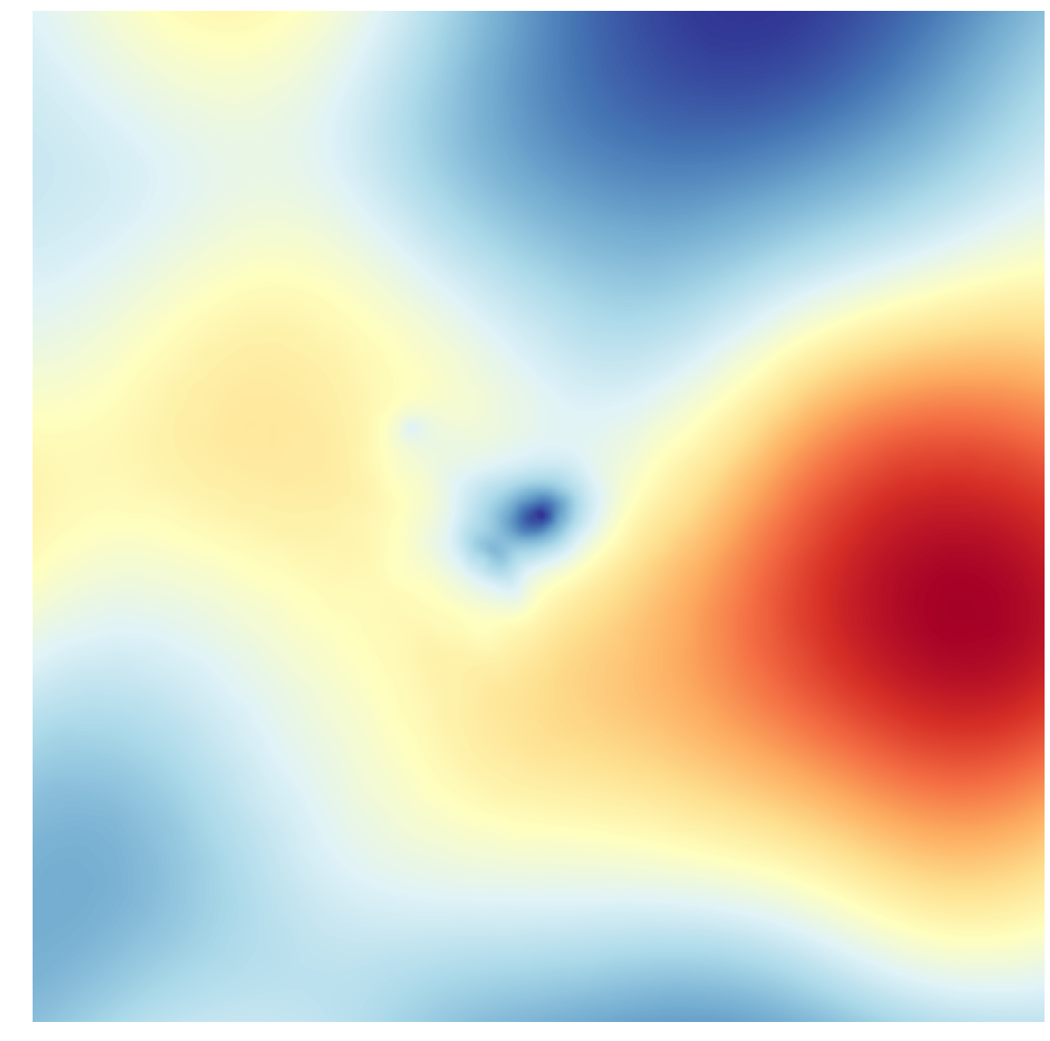
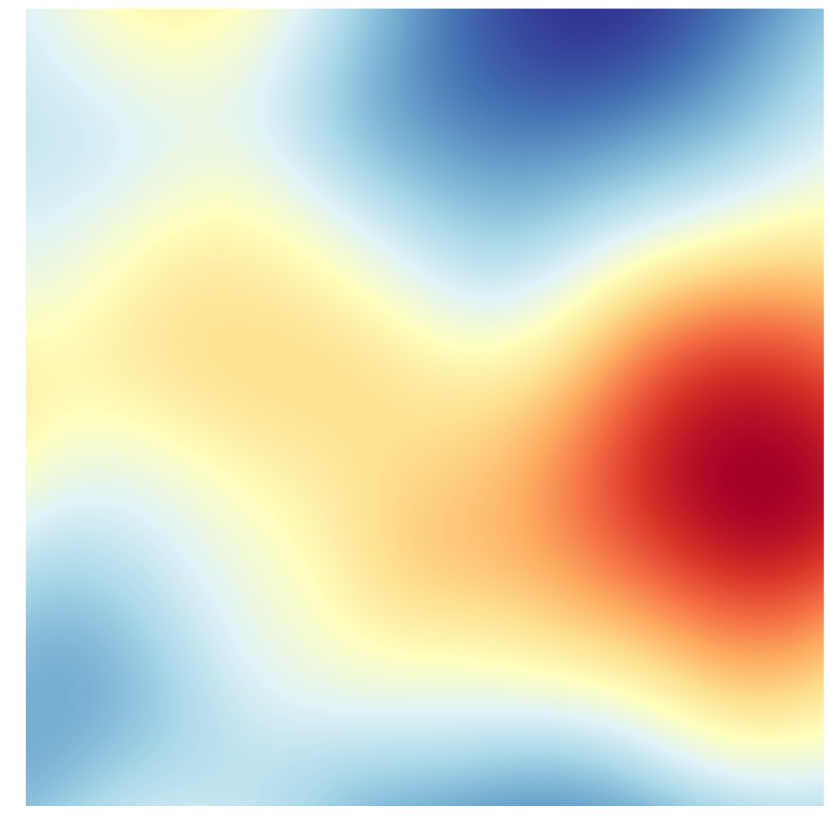
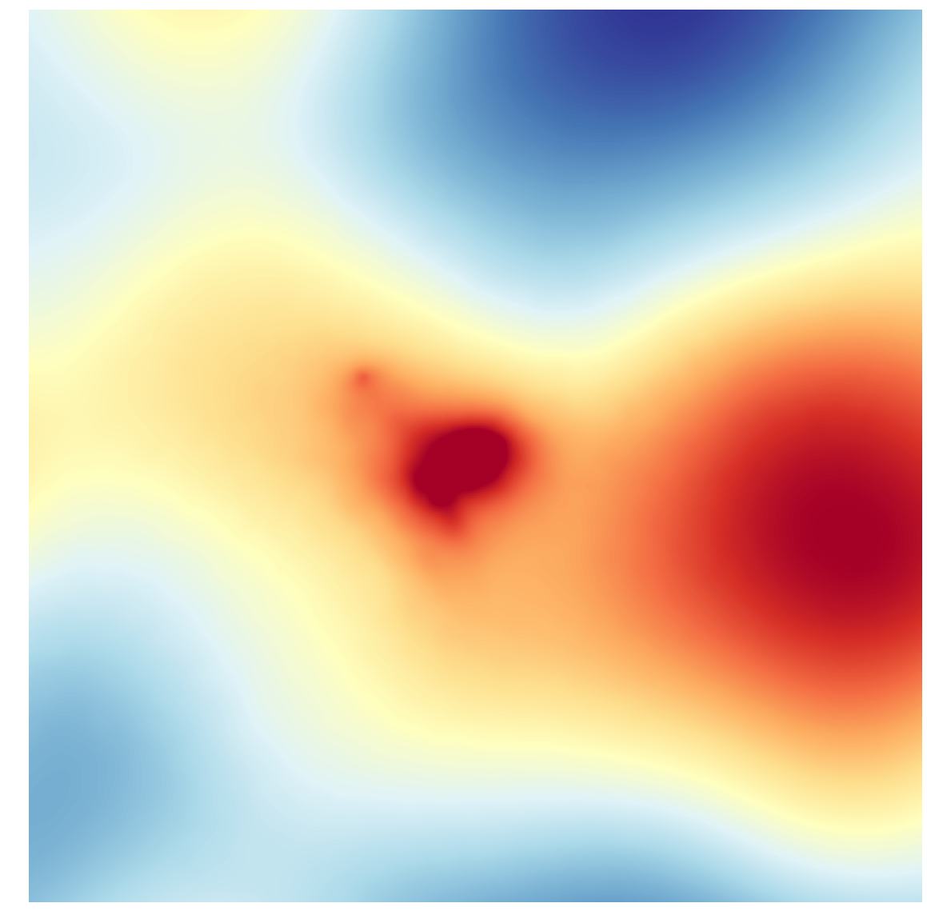
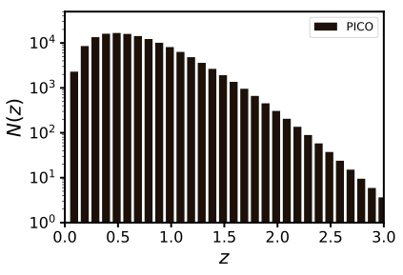
Explore how the Universe Works
Extract cosmological parameters with 140,000 clusters, 1000 with z>2
using thermal SZ, full sky
Planck: ~2000
S3: 20,000
Correlate lensing map with other mass tracer surveys
30 GHz
150 GHz
217 GHz
300 GHz
Simulated Temperature signature of SZ cluster. Figure: N. Battaglia
Figure: N. Battaglia
Lensing Potential
Noise / Mode
Figure: A. Van Engelen

Slide 47
Explore how the Universe Evolved
Map magnetic field for our Entire Galaxy
Planck, 5’
PICO, smoothed to 5’
PICO, 1’
Figure: Fissel, Chuss
Notes:
PICO will explore how the universe evolved by determining the relative roles of turbulence and the magnetic field in Milky Way dynamics and star formation efficiency; the information comes from a measurement of the galactic magnetic field.
The map shows the region on the sky in which current Planck data gives polarization uncertainty of less than 0.3%, with its 5’ beams. It is the small fraction of sky shown in yellow. PICO’s data will extend the information over the entire sky at the same resolution; And it will give the same polarization uncertainty at 5 times higher resolution over most of the sky, shown in green.
PICO will map sub-mm emission from the interstellar medium in nearly 100 nearby galaxies to determine how typical the Milky Way is; only a handful have been mapped in the sub-mm to date.
And it will constrain the shape and composition of interstellar dust grains.

Slide 48
Turbulence and Magnetic Field
Nearby Molecular Clouds at < 1 pc resolution
Determine the relative roles of turbulence and magnetic field in Milky Way dynamics and star formation efficiency
Resolve Bfield structure in 8 nearby clouds at core scale (0.1pc), 10 at filament scale (0.5pc).
Currently: none.
Resolve Bfield structure in >2000 galactic clouds with 1pc resolution to compare large scale turbulence and magnetic field.
Currently: 14 (Planck)
1 pc
0.5 pc
# of local clouds for which reach a specific FWHM resolution
0.1 pc
0.2 pc
0.05 pc
Figure: Fissel, Chuss
Beam FWHM [arcmin]
Far Molecular Clouds at 1 pc resolution
from Bolocam Survey (0.3 of galactic plane)
total = 700
1 pc res at this distance
Figure: Fissel, Chuss
Notes:
PICO will explore how the universe evolved by determining the relative roles of turbulence and the magnetic field in Milky Way dynamics and star formation efficiency; the information comes from a measurement of the galactic magnetic field.
The map shows the region on the sky in which current Planck data gives polarization uncertainty of less than 0.3%, with its 5’ beams. It is the small fraction of sky shown in yellow. PICO’s data will extend the information over the entire sky at the same resolution; And it will give the same polarization uncertainty at 5 times higher resolution over most of the sky, shown in green.
PICO will map sub-mm emission from the interstellar medium in nearly 100 nearby galaxies to determine how typical the Milky Way is; only a handful have been mapped in the sub-mm to date.
And it will constrain the shape and composition of interstellar dust grains.

Slide 49
Is the Milky Way Typical? Dust in Milky Way
Map sub-mm emission from the ISM in 70 nearby galaxies
Only handful mapped to date.
Constrain the shape and composition of interstellar dust grains
Figure: Fissel, Chuss
21 PICO Bands
Planck
BlastPol
Guillet et al. 2018
Notes:
PICO will explore how the universe evolved by determining the relative roles of turbulence and the magnetic field in Milky Way dynamics and star formation efficiency; the information comes from a measurement of the galactic magnetic field.
The map shows the region on the sky in which current Planck data gives polarization uncertainty of less than 0.3%, with its 5’ beams. It is the small fraction of sky shown in yellow. PICO’s data will extend the information over the entire sky at the same resolution; And it will give the same polarization uncertainty at 5 times higher resolution over most of the sky, shown in green.
PICO will map sub-mm emission from the interstellar medium in nearly 100 nearby galaxies to determine how typical the Milky Way is; only a handful have been mapped in the sub-mm to date.
And it will constrain the shape and composition of interstellar dust grains.

Slide 50
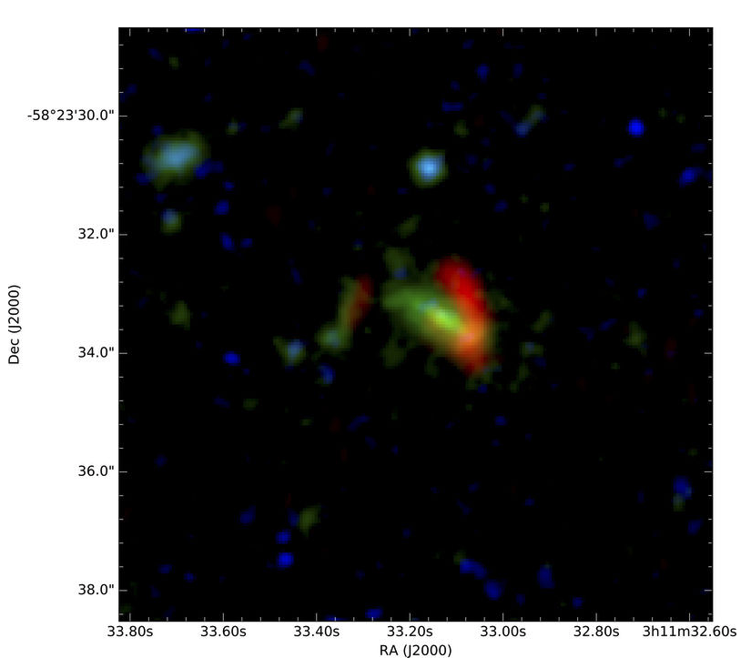
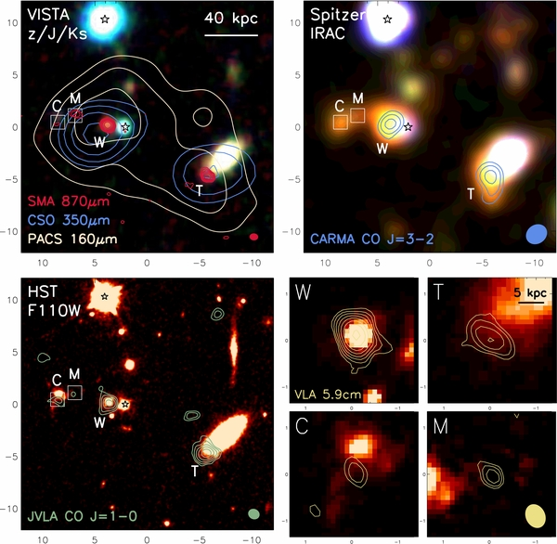
Legacy Science
Discover 3000 highly magnified dusty galaxies at z up to ~4.5;
Discover 3000 proto-clusters over the sky and extending to high redshift;
Detect polarization of 4000 radio and FIR-emitting galaxies;
x10-100 more than known today
Probe star formation history; determine galaxy and cluster formation and evolution; learn about dark matter substructure; and measure properties of jets in radio-loud sources.
NSF News Release Dec. 6, 2017
Marrone et al. 2017; two strongly lensed massive galaxies, z=6.9
(SPT initial detection)
Ivison et al. 2013; proto-cluster core, z=2.4
(Herschel initial detection)
Notes:
PICO will produce a rich legacy data set that will be mined for years. In addition to 21 sky maps of Stokes I, Q, U it is expected to discover 3000 highly magnified dusty galaxies, similar to the one recently discovered in the SPT field, and garnered an NSF press release. It will discover 3000 porto-clusters, 4000 radio and Far IR emitting galaxies and tens of thousands of new clusters. All of these give factors of 10 to 100 improvement over what is known today.
These sources will be used to probe star formation history, determine galaxy and cluster formation and evolution, learn about dark matter substructure, measure the properties of jets in radio-loud sources.

Slide 51
PICO Summary
Inflation, quantum gravity, particle physics, extragalactic and galactic structure and evolution:
All unique goals for the PICO measurements
PICO is the only instrument with the combination of sky coverage, resolution, frequency bands, and sensitivity to achieve all of this science with one platform.
Initial engineering + costing study complete:
Technology implementation is a simple extension of today’s technologies; no technological breakthroughs required
Mission is a good fit to the cost window
Notes:
To summarize:
PICOs science goals of inflation, quantum gravity, particle physics, extragalactic and galactic structure and evolution are all unique and can only be probed with the measurements proposed.
PICO is the only instrument with the combination of sky coverage, resolution, frequency bands, and sensitivity, to achieve this science with one platform.
We had our initial engineering and costing study completed; no significant issues in engineering nor in cost were identified. The technology implementation is a simple extension of today’s technologies. And the mission is a good fit to the cost window.

Slide 52
CMB Mission Concepts
Active
On Hold
PICO
LiteBIRD
CORE (ESA)
PIXIE (NASA)
NASA Study
JAXA Phase A
Proposed
CMB-Bharat
(India)
Notes:
Here is a current tally of CMB mission concepts. There are two active concepts, LiteBIRD, a Japanese led mission that is currently funded in Japan to conduct a PhaseA study, and PICO, which we are currently studying here in the US.
There are two missions on hold. They are on-hold in the sense that they have been recently proposed, and declined and will likely be proposed again. These are CORE submitted to ESA and by ESA and PIXIE submitted to NASA.
Before I give more details on these missions, let me take a historical perspective, which may be useful for the discussion later.

Slide 53
Last Slide
The CMB has more science to give
The decadal panel will soon decide our program for the next decade
There is intense activity in both orbital and sub-orbital (ground, balloons) activities
Attend PICO workshop: May 1,2,3, Minneapolis to discuss preparations for the decadal panel
http://pico.umn.edu
wiki: https://z.umn.edu/cmbprobe
Notes:
To summarize:
PICOs science goals of inflation, quantum gravity, particle physics, extragalactic and galactic structure and evolution are all unique and can only be probed with the measurements proposed.
PICO is the only instrument with the combination of sky coverage, resolution, frequency bands, and sensitivity, to achieve this science with one platform.
We had our initial engineering and costing study completed; no significant issues in engineering nor in cost were identified. The technology implementation is a simple extension of today’s technologies. And the mission is a good fit to the cost window.

Slide 54
Additional Slides

Slide 55
Simple Foreground Model
Figure: R. Flauger
2 component dust model (a-la Finkbeiner et al)
Synchrotron with power law frequency dependence
dependence consistent with Planck and WMAP
Includes correlation between dust and synchrotron, consistent with current data
Model does not include:
spatial variation of the spectral index
spatial variation of dust temperature
Foreground separation based on ILC
40% of sky (70% of sky reduces )
Figure: R. Flauger
Notes:
It will explore how the Universe began by detecting or setting an upper bound on the energy scale at which inflation occurred. This energy scale is quantified by means of a parameter r. The current 95% confidence limit on r is 0.07. PICO will set a 95% confidence limit that is 700 times more stringent.
The PICO determination of the CMB polarization E and B angular power spectra are shown in grey boxes in these panels. The constraints on the inflation signal come from a measurement of the B-mode spectrum, which has contributions from inflation, shown in blue for different values of r, and from lensing shown in green. Our projections, shown on the lower panel for the case that r=0.001, include using PICO’s high resolution data to remove the lensing foreground, and they include removal of a simple foregrounds model.
(The limits we quote on the value of r and sigma(r) include a factor of 2.5 margin. )

Slide 56
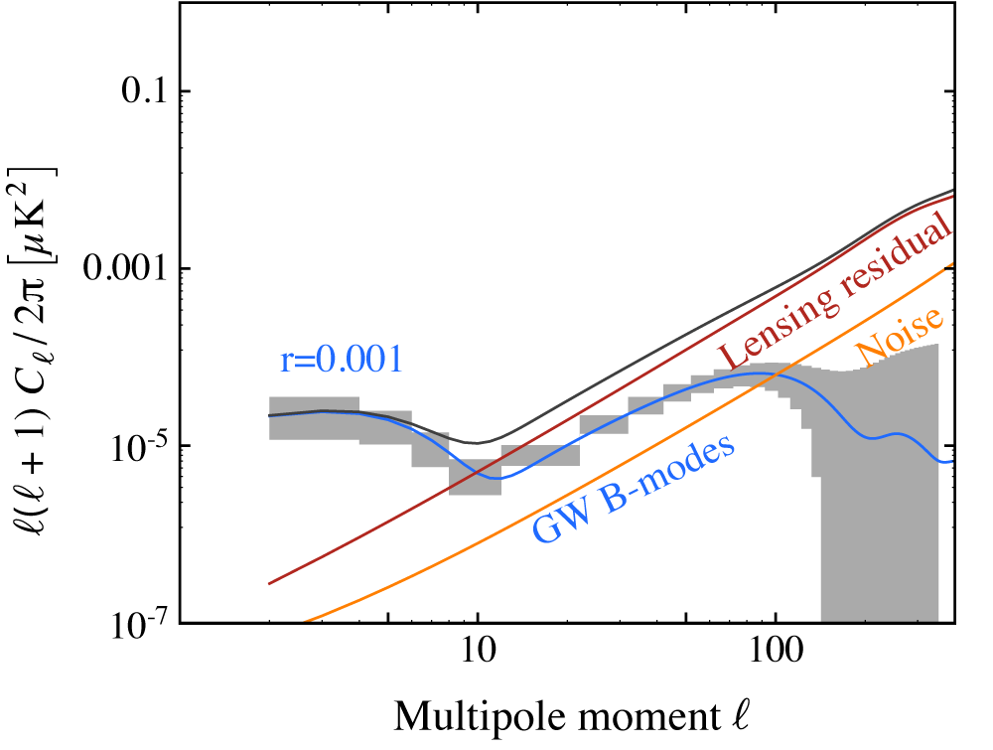
Delensing
Figure: R. Flauger
Iterative delensing post-ILC foreground separation
Lensing reduction by a factor of ~7:
S/N > 10 on lensing potential power spectrum across broad range of
Figure: R. Flauger
Figure: R. Flauger
Figure: R. Flauger
Lensing Potential Power Spectrum
PICO Noise Level
Notes:
It will explore how the Universe began by detecting or setting an upper bound on the energy scale at which inflation occurred. This energy scale is quantified by means of a parameter r. The current 95% confidence limit on r is 0.07. PICO will set a 95% confidence limit that is 700 times more stringent.
The PICO determination of the CMB polarization E and B angular power spectra are shown in grey boxes in these panels. The constraints on the inflation signal come from a measurement of the B-mode spectrum, which has contributions from inflation, shown in blue for different values of r, and from lensing shown in green. Our projections, shown on the lower panel for the case that r=0.001, include using PICO’s high resolution data to remove the lensing foreground, and they include removal of a simple foregrounds model.
(The limits we quote on the value of r and sigma(r) include a factor of 2.5 margin. )

Slide 57
Balloons
Currently funded: PIPER, SPIDER (2nd flight)
Proposed: IDS, BFORE, Dust Buster
IDS:
20,000 detectors,
7 bands, 150 - 360 GHz
Combined observations with BICEP/Keck (10 bands total)
Notes:
To summarize:
PICOs science goals of inflation, quantum gravity, particle physics, extragalactic and galactic structure and evolution are all unique and can only be probed with the measurements proposed.
PICO is the only instrument with the combination of sky coverage, resolution, frequency bands, and sensitivity, to achieve this science with one platform.
We had our initial engineering and costing study completed; no significant issues in engineering nor in cost were identified. The technology implementation is a simple extension of today’s technologies. And the mission is a good fit to the cost window.

Slide 58
What’s at Stake
NASA only invests in technology development or balloon payloads that lead to a future space mission.
Over the years NASA has spent significant resources in CMB activities (space, balloons, tech development) because there was a mission in the future.
NASA invests only in what the decadal panel recommends
Many of us (most? all?) recognize the strengths of a future CMB space mission, the complementarity with sub-orbital, and the value of keeping NASA engaged with CMB

Slide 59
S4 Neutrino Mass Constraints
Figure: D. Green
Figure: D. Green
Notes:
remove the words ‘planck’ say ‘with current sigma

Slide 60
S4 Inflation Constraints
Figure: R. Flauger
Designed to provide detection of r>0.003
3-8% of sky
r >= 0.004 (5 sigma) in 4 years
r >= 0.003 (5 sigma) in 8 years
Notes:
It will explore how the Universe began by detecting or setting an upper bound on the energy scale at which inflation occurred. This energy scale is quantified by means of the tensor to scalar ratio r, which sets the level of the B mode power spectrum at low \ell. B80 is the level of B at \ell=80. The current 95% confidence limit on r is 0.07. PICO will set a 95% confidence limit that is 700 times more stringent.
The PICO determination of the CMB polarization E and B angular power spectra are shown in grey boxes in these panels. The constraints on the inflation signal come from a measurement of the B-mode spectrum, which has contributions from inflation, shown in blue for different values of r, and from lensing shown in green. Our projections, shown on the lower panel for the case that r=0.001, include using PICO’s high resolution data to remove the lensing foreground, and they include removal of a simple foregrounds model.
(The limits we quote on the value of r and sigma(r) include a factor of 2.5 margin. )

Slide 61
“When we began our study we sought to answer five fundamental implementation questions:
1) can foregrounds be measured and subtracted to a sufficiently low level?;
2) can systematic errors be controlled?;
3) can we develop optics with sufficiently large throughput, low polarization, and frequency coverage from 30 to 300 GHz?;
4) is there a technical path to realizing the sensitivity and systematic error requirements?; and
5) what are the specific mission architecture parameters, including cost?
Detailed answers to these questions are contained in this report. Currently in Phase 2, we are exploring a mission concept targeting a ~2m aperture, in between the two options described in the current report with a small (~30 cm) and large (~4m) missions.”
Bock et al. 2009
arXiv:0906.1188
Notes:
A year later

Slide 62
Optics + Cooling
Open Dragone Telescope
No direct view to sky
No three-reflection sidelobe
Cold stop (without cooling primary mirror)
Design includes enhancement to DLFOV through coma correction
Primary mirror at ~40 K;
Stop + secondary actively cooled to ~6 K;
Focal plane @ 0.1 K with cADR
Cold Stop is
1.1 m diameter
Focal Plane

Slide 63
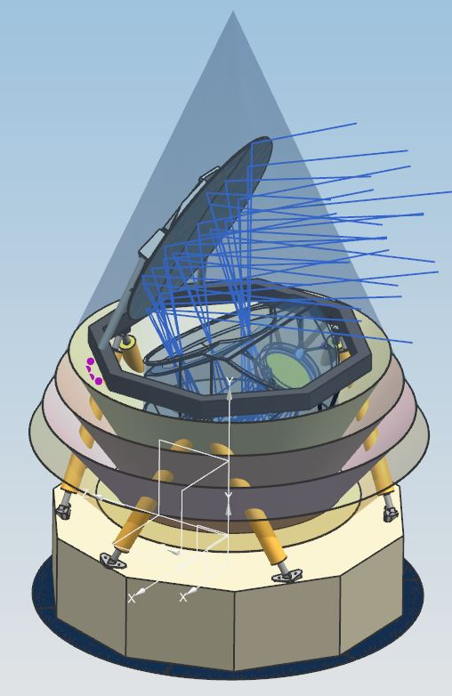
Mission
L2
4 years
Mass, Power - TBD
alpha/beta: 30, 60
spin: 1 RPM
Data: 3.2 TBits/day
polarization noise = 0.7 uK*arcmin

Slide 64
Additional Slides

Slide 65
News from CORE
The non-selection of CORE for the ESA M5 call was due to the lack of a major partner for what was perceived as an ambitious mission with a cost that could exceed the cost cap available for M5.
The CORE consortium has been encouraged to look for a major international partner to propose/implement such a mission.
Discussions of CORE proposal leaders with colleagues in India, initiated in the summer of 2017, identified a convergence of scientific interests.
A proposal for an Indian CMB mission, to be implemented in collaboration with international partners and launched in ~2029, was proposed to ISRO on Apr. 16, 2018 by a consortium of ~90 scientists, in answer to an AO from ISRO issued Feb. 3, 2018.
In Europe, participation to such a mission could be envisaged either through ESA (e.g. through a MO, or through a proposal in answer to the next M-class call, expected ~2019), or through contribution involving national agencies (e.g. CNES, ASI, …).

Slide 66
CMB-Bharat
The mission proposed to ISRO, CMB-Bharat, is conceptually close to CORE or PICO in terms of performance and implementation
1.2-1.5m telescope passively cooled to 40-100 K
a focal plane array of a few thousands of detectors distributed among about ~20 frequency bands in the 30-900 GHz range
Final CMB sensitivity after component separation of ~1-2 uK.arcmin and few arcminute angular resolution.
Two interesting options, to be further assessed in a study phase, are proposed
A second instrument, a small FTS similar to a reduced version of PIXIE, for absolute calibration, zero-level of intensity maps, and observing large-scale polarization in many frequency bands. With sensitivity >100 times better than COBE/FIRAS, this instrument can also do CMB spectral distortion science, and is a pathfinder for a future very ambitious CMB spectral distortions space mission.
After 4 years of nominal full-sky observations in survey mode, a mission extension of ~2 years could be dedicated to pointed observations of small regions of sky for deep surveys. In observatory mode, targets could be selected through calls open to the wider scientific community.

Slide 67
PICO and Sub-Orbital CMB Efforts
PICO’s capabilities are not matched by any other foreseeable experiment
Full sky coverage with ~4’ resolution (and the same depth S4 has on 5% of the sky)
Access to the entire range of angular scales of the B-mode signal, including the largest, while maintaining the capability to delens
Notes:
Need to work on this slide
Show the BB signal show the two peaks; show the delensing. Al Kogut’s points.

Slide 68
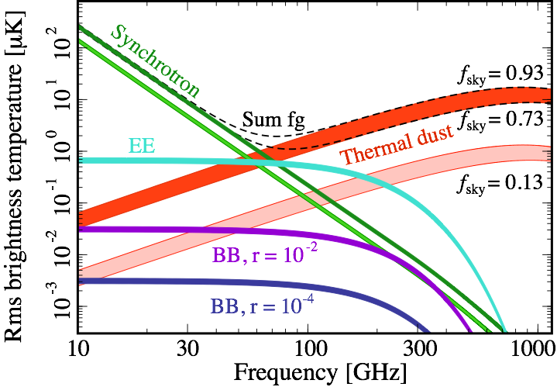
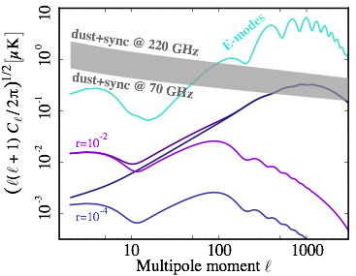
PICO and Sub-Orbital CMB Efforts
Unmatched/unmatcheable frequency coverage
Galactic foregrounds are known to overwhelm the cosmological B-mode signal
Signals are at the nano-K level: even low level of residual foregrounds can bias the measurement
Space gives the most systematic-error-robust platform
Signals are at the nano-K level
75% sky
Notes:
PICO’s capabilities can not be matched by any foreseeable ground-based effort

