Slide 1
Cooling Architecture (Based on information exchange with C. Paine, JPL; here using publicly available information)

Slide 2
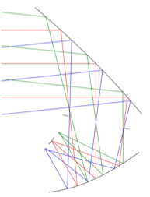
baseline architecture
Primary mirror is passively cooled to 30 - 40 K
Current calculations assume 30 K; may need to be tweaked.
4 K stage implementation is similar to EPIC-IM (CORE)
MIRI-type 3-stage PT as precooler for ⁴He 4.5 K JT (and 1.7 K J-T)
Note: MIRI cooler spec-ed for 6.5 K. Will recalculate optical loads for 6.5 K
CORE: Similar PT precooler and ⁴He JT system
100 mK stage
why 100 mK? Lower noise; easier to implement Low G bolometers
Options: Continuous ADR (Goddard); Single shot ADR (Duband); Closed cycled dilution refrigerator (France)
30 K
1 m
0.1 K
6.5 K

Slide 3
Open Issues
Need to calculate
Thermal loads from support structures
Thermal loads from wiring
Thermal loads from optical loads (need to place IR filters)
Need to argue about fabrication of IR filters (or tiling and loss of throughput)
30 K
1 m
0.1 K
6.5 K

