Slide 1
PICO and C-BASS
Low frequency foreground measurements form the ground
PICO Collaboration Science Meeting
University of Minnesota
1st May – 3rd May
Jaz R. Hill-Valler
Mike Jones, Angela Taylor, Luke Jew, Jamie Leech, Richard Grumitt
Plus C-BASS collaborators at Manchester, CalTech, UKZN and SARAO

Slide 2
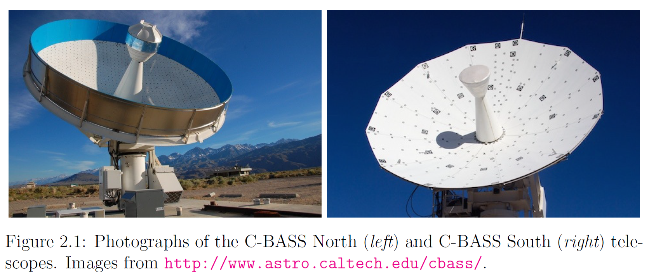
100 μK deg (6000 μK arcmin!)… but when corrected for synchrotron spectral index
= 0.75 μK arcmin @ 100 GHz!

Slide 3
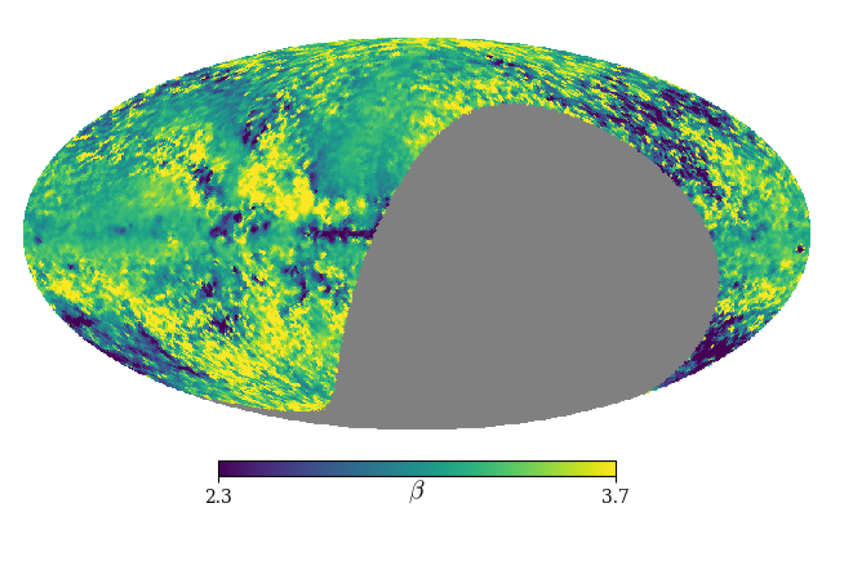
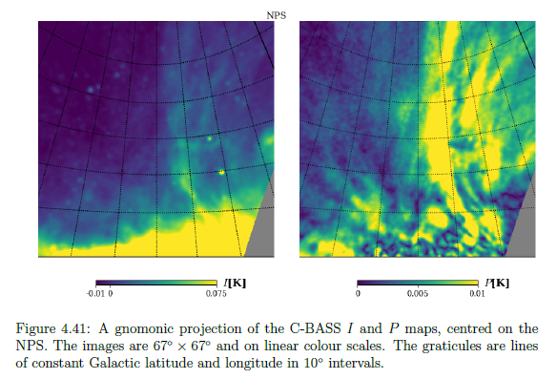
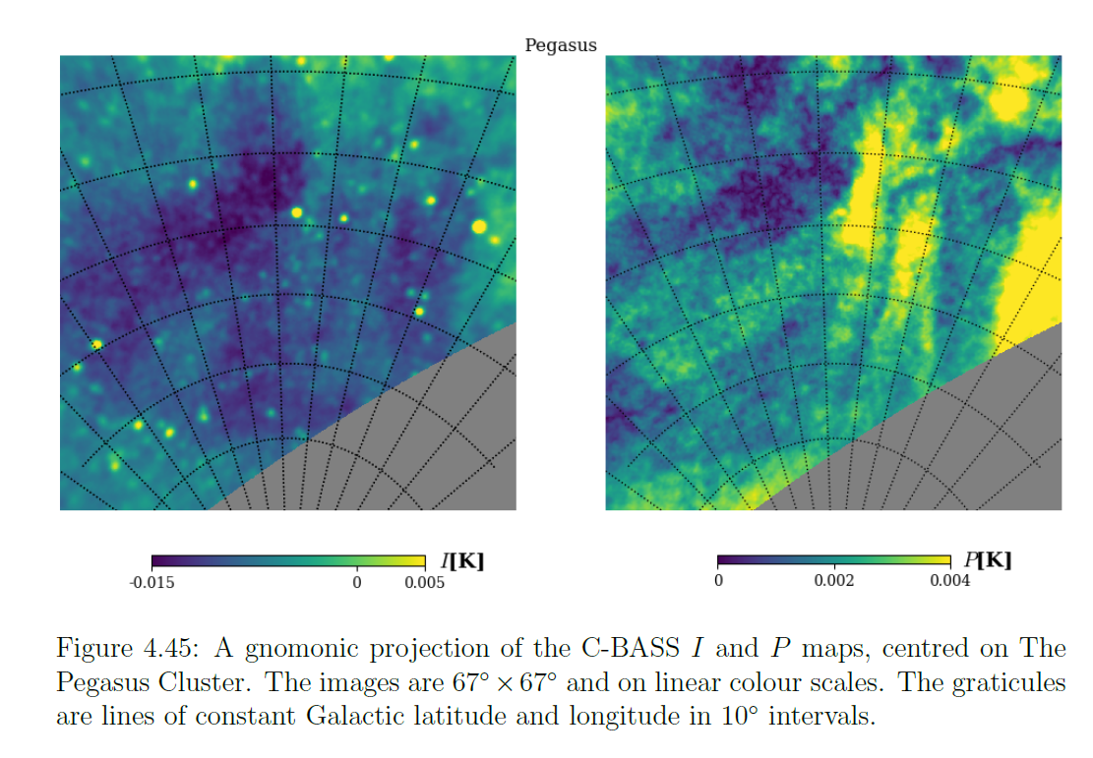
C-BASS and Planck 30 GHz P maps downgraded to N_{side} = 64
Preliminary C-BASS/Planck 30 GHz spectral index map

Slide 4
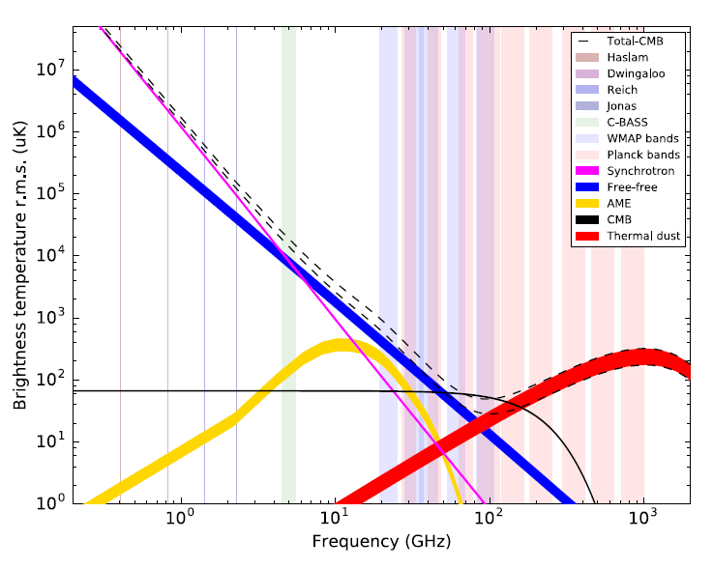
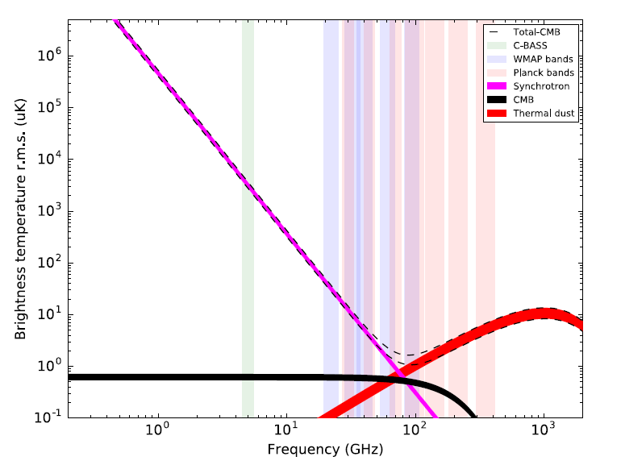
Filling in the gaps…
There are more parameters to juggle than there are frequency data!

Slide 5
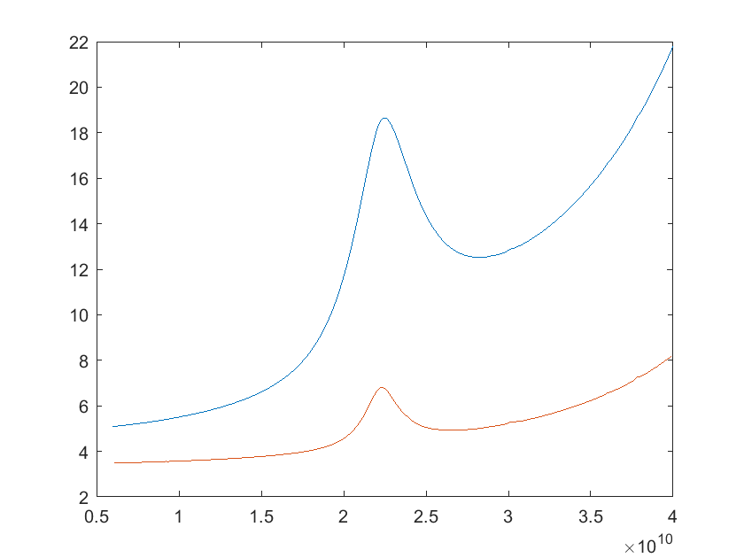
NextBASS Specifications
7 – 30 GHz : 6m telescope
Sample peak of AME
2 bands, 2:1 with 20% bw for each channel
Match 1μKarcmin at 100 GHz
Sky Temperature [K]
Frequency [GHz]

Slide 6
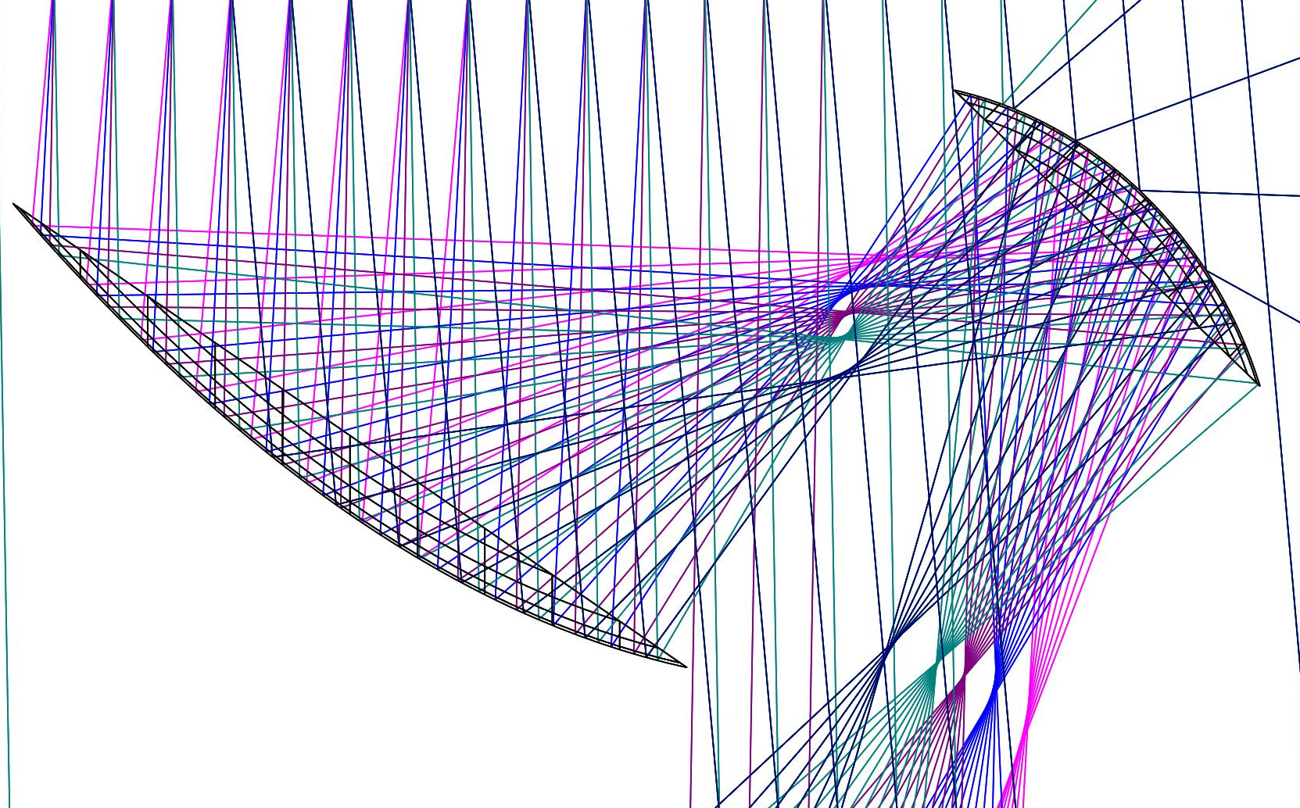
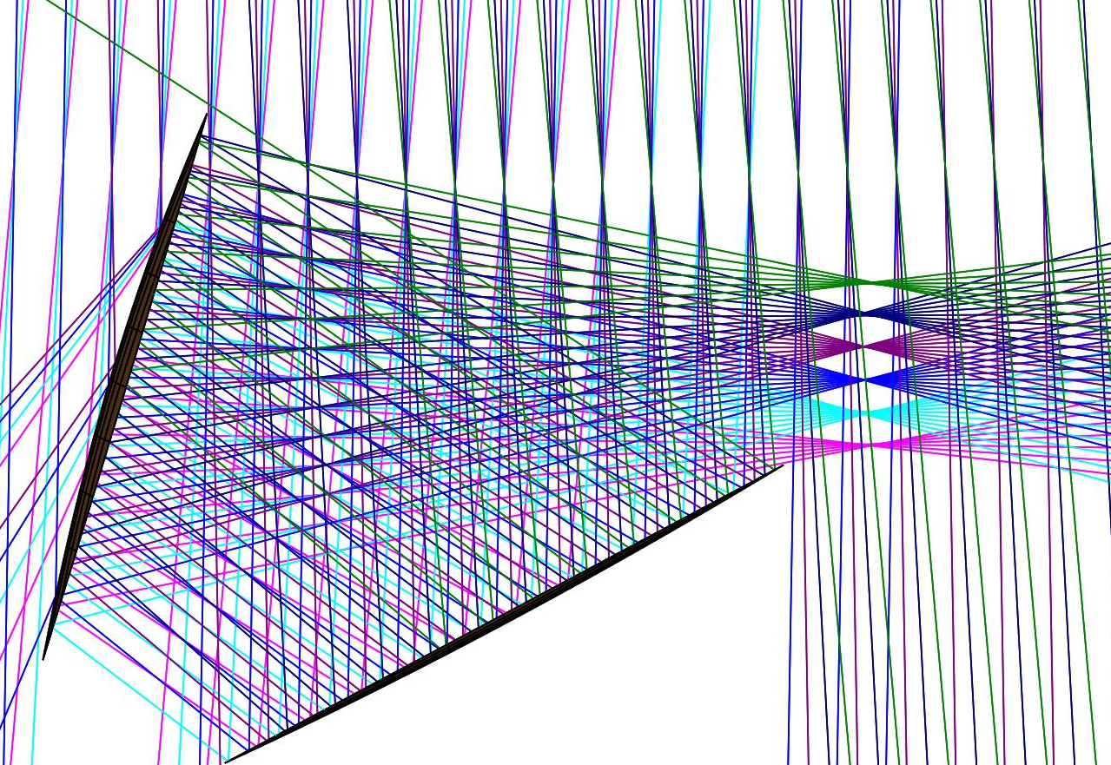
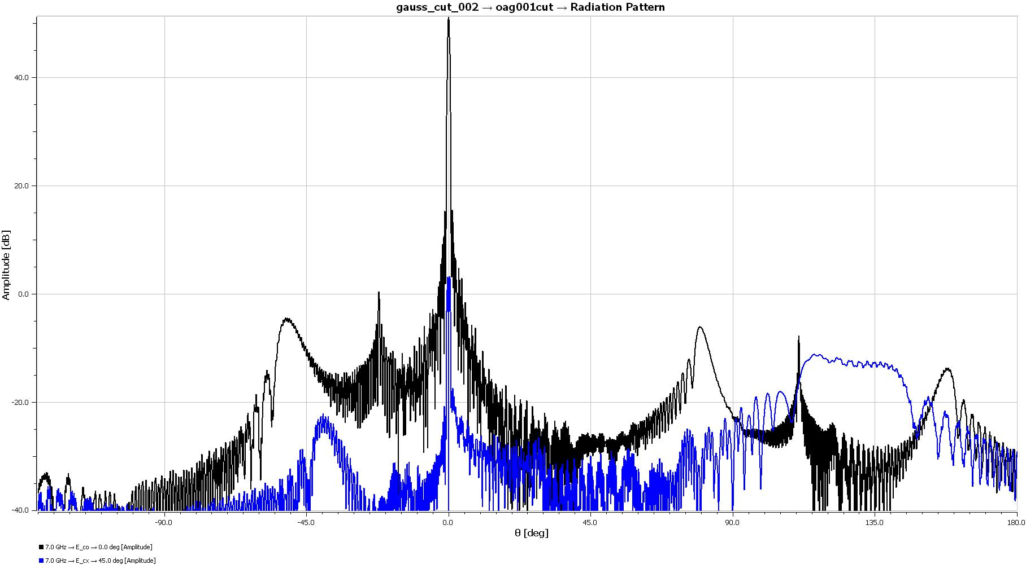
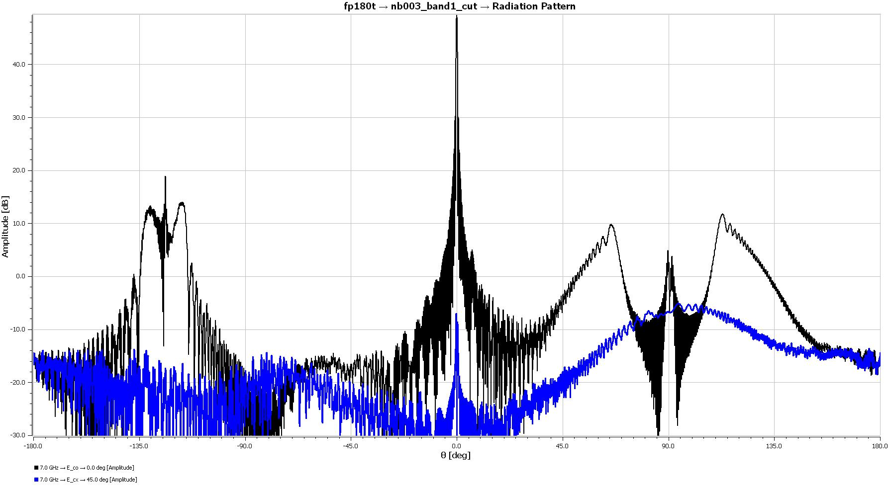
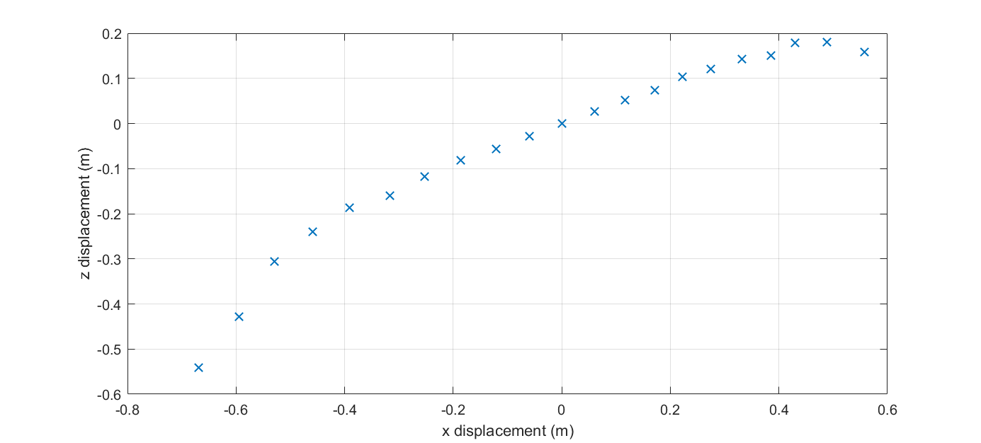
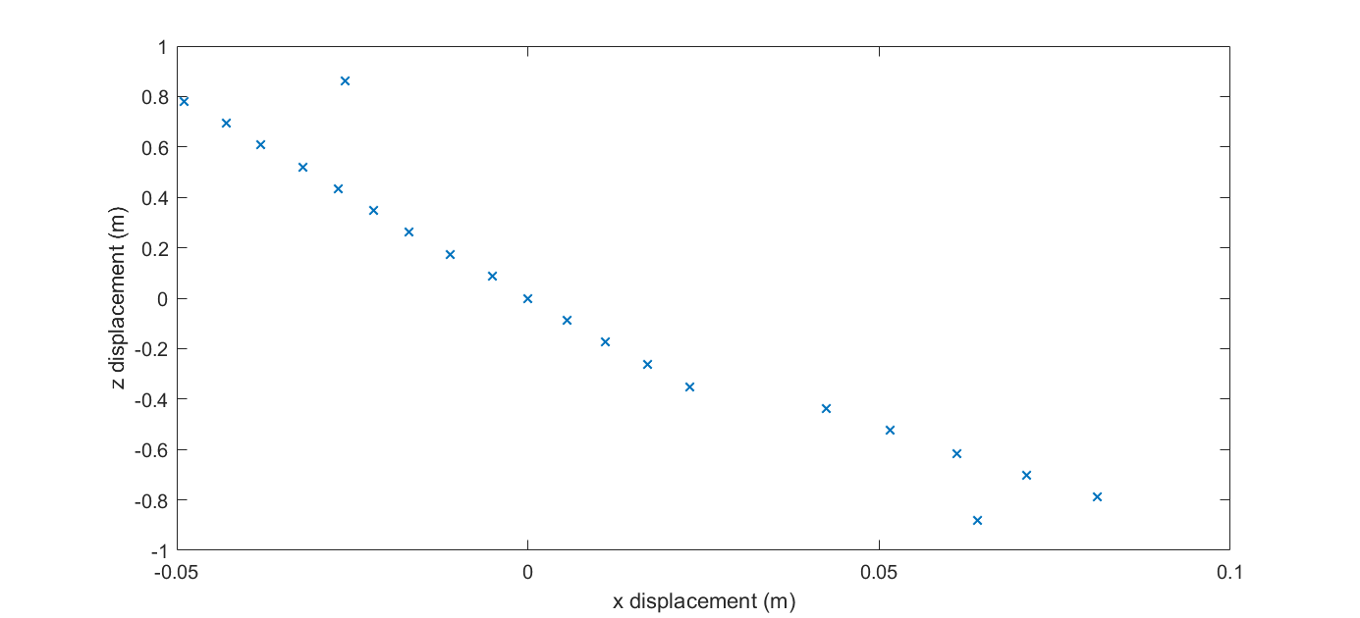
Off-axis Gregorian vs. Cross-Dragone…
40dB
smaller secondary vs …
40dB
-135°
0dB
-45°
135°
90°
90°
0dB
-90°
-90°
... larger, flatter focal plane

Slide 7
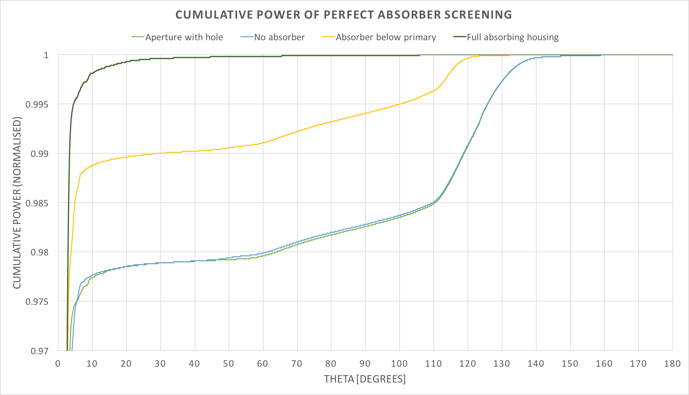
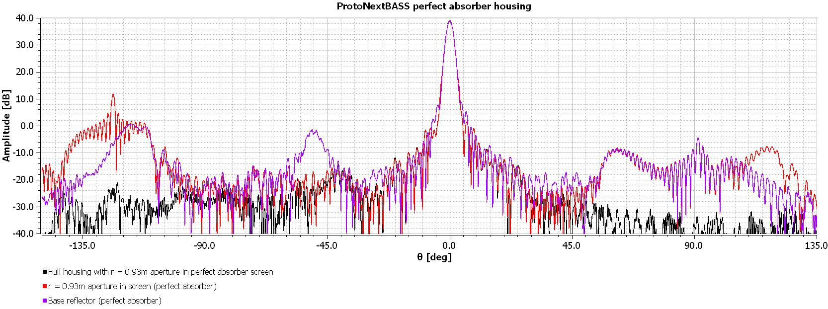

Slide 8
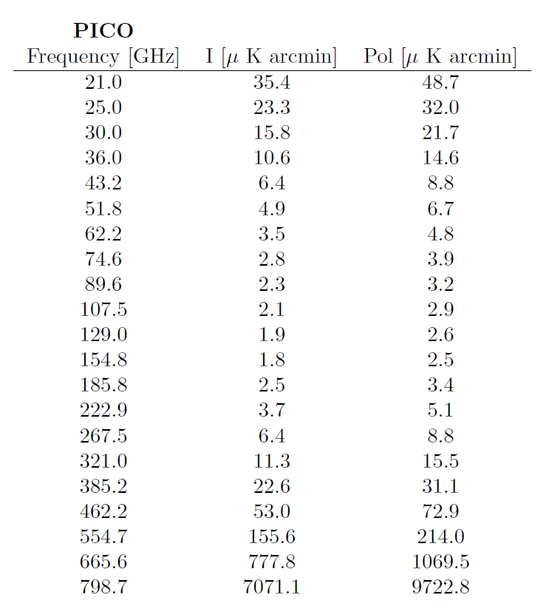
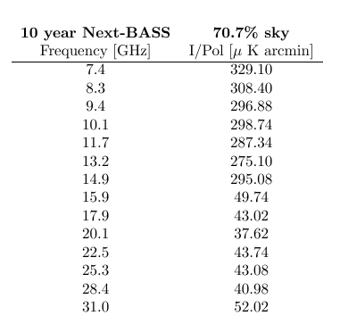
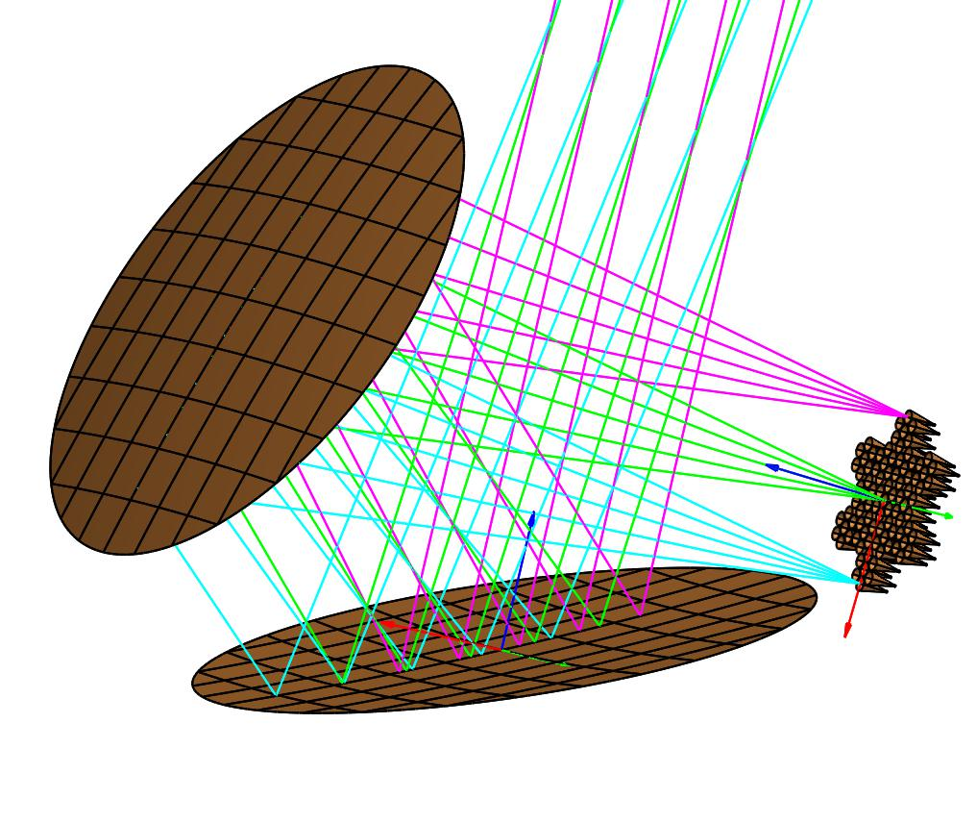
10 years
Observing nights
70.7 % sky
1 feed 7-15 GHz
63 feeds 15-30 GHz
Atacama

Slide 9
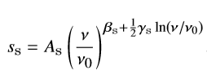
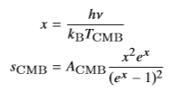
Forecasting
Full Bayesian MCMC method for single pixel simulations
Using appropriate Jeffreys prior for each parameter
Straight and curved synchrotron
Plus a 1% polarized AME component
Spdust AME template
Modified bb dust profile
CMB B-mode polarization set to zero

Slide 10
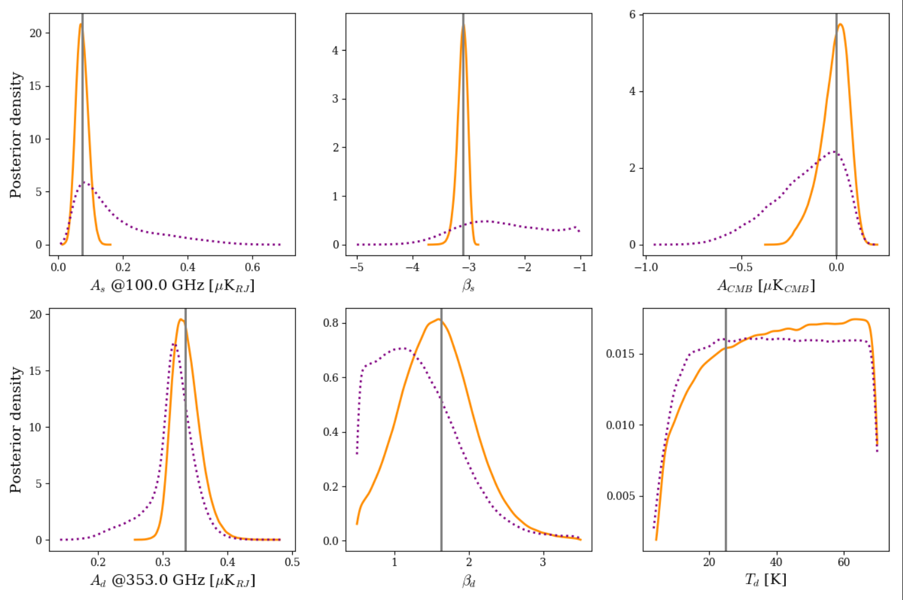
PDE of B mode polarisation with straight synchrotron
dotted line: Planck + Litebird solid line: Planck + C-BASS + Litebird From Jones et al in prep.

Slide 11
PICO RESULTS…
Simple model (straight synchrotron)
Complex sky model (curved synchrotron with AME component)
Looking at PICO with a combination of foreground experiments
PICO
PICO + CBASS
PICO + CBASS + NextBASS
PICO(36GHz+) + C-BASS + NextBASS
Does NextBASS perform as well as the bottom PICO channels?
Can we do this from the ground?

Slide 12
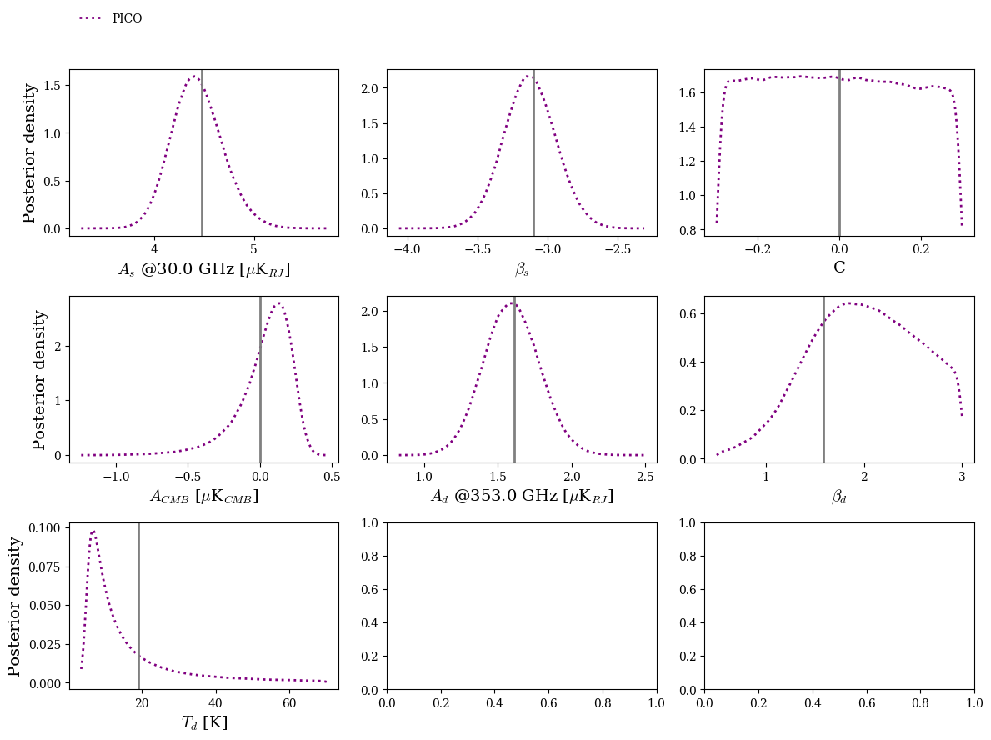
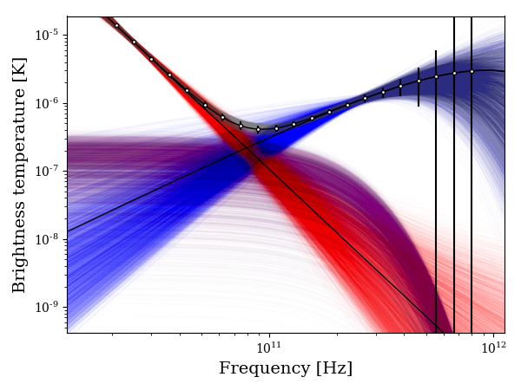
PICO
s0a
nearOrion2

Slide 13
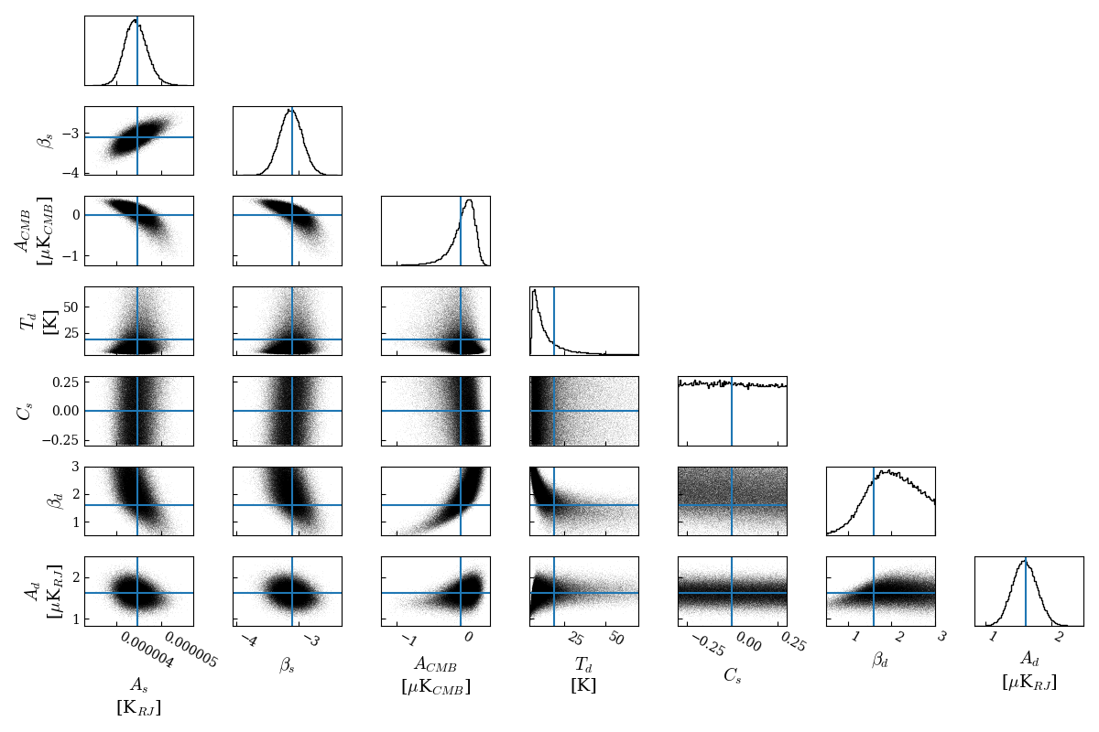
PICO
s0a
nearOrion2

Slide 14
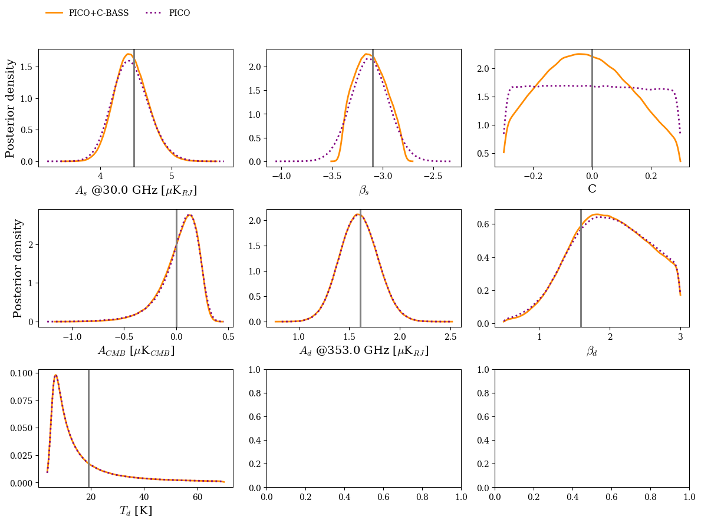
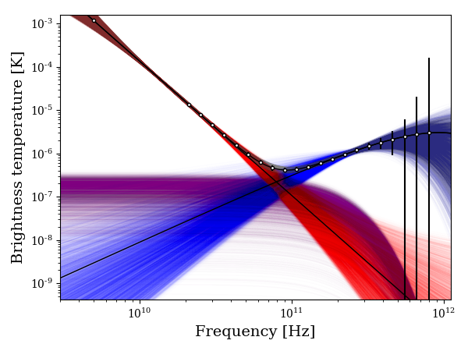
PICO + C-BASS
s0a
nearOrion2

Slide 15
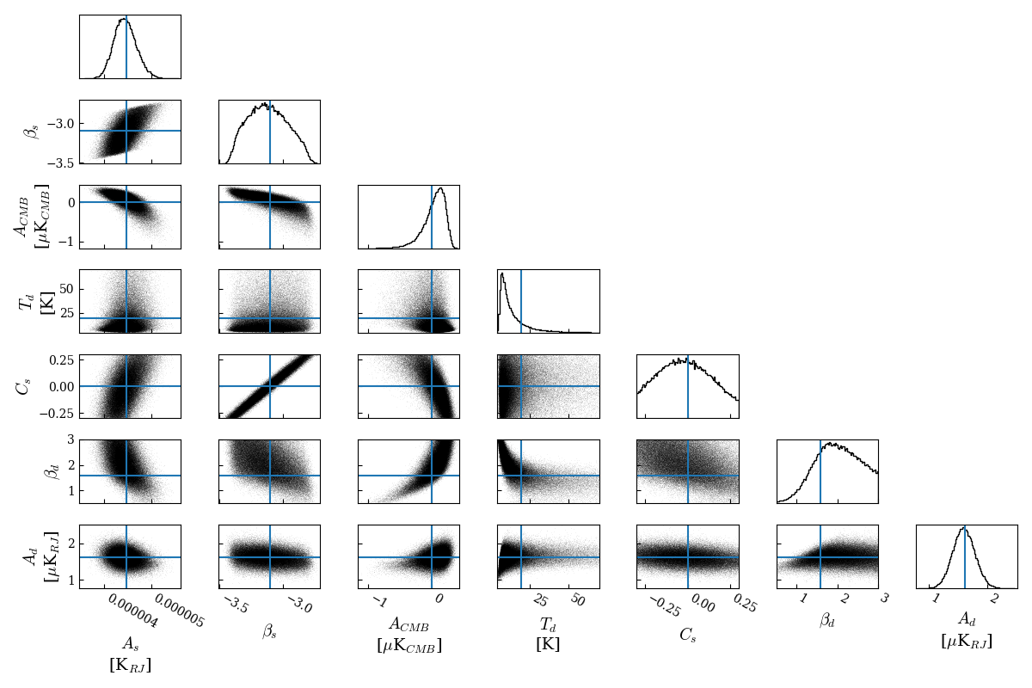
PICO + C-BASS
s0a
nearOrion2

Slide 16
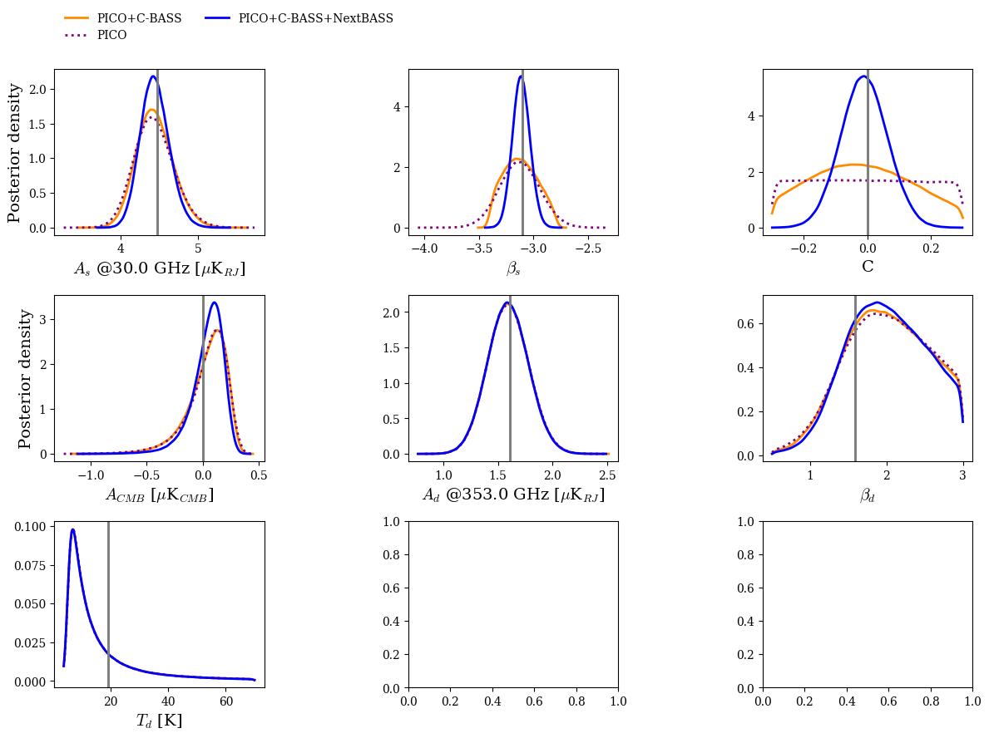
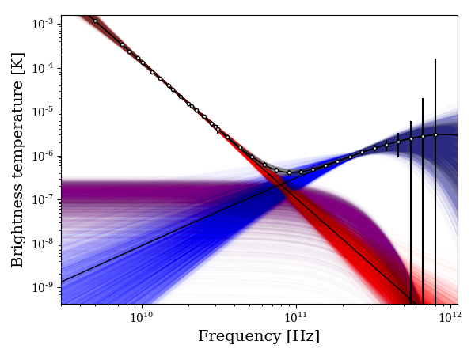
PICO + C-BASS + NextBASS
s0a
nearOrion2

Slide 17
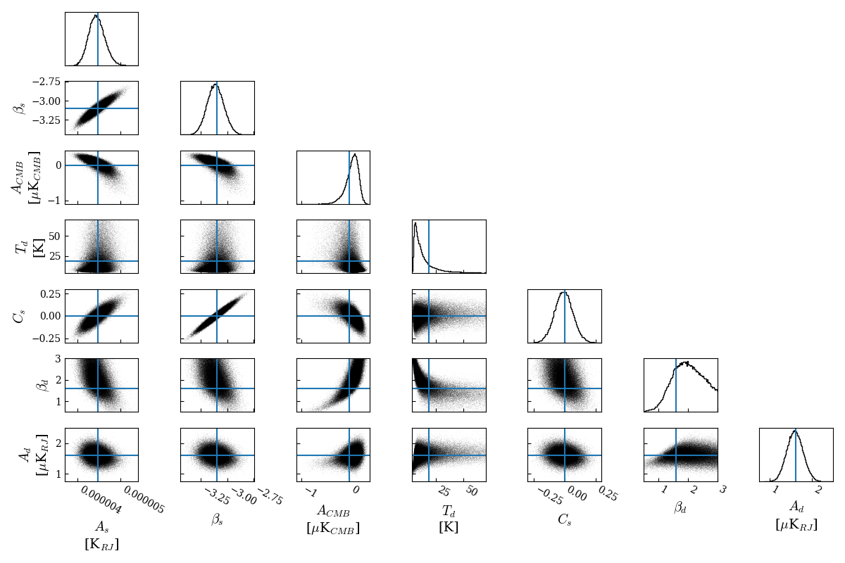
PICO + C-BASS + NextBASS
s0a
nearOrion2

Slide 18
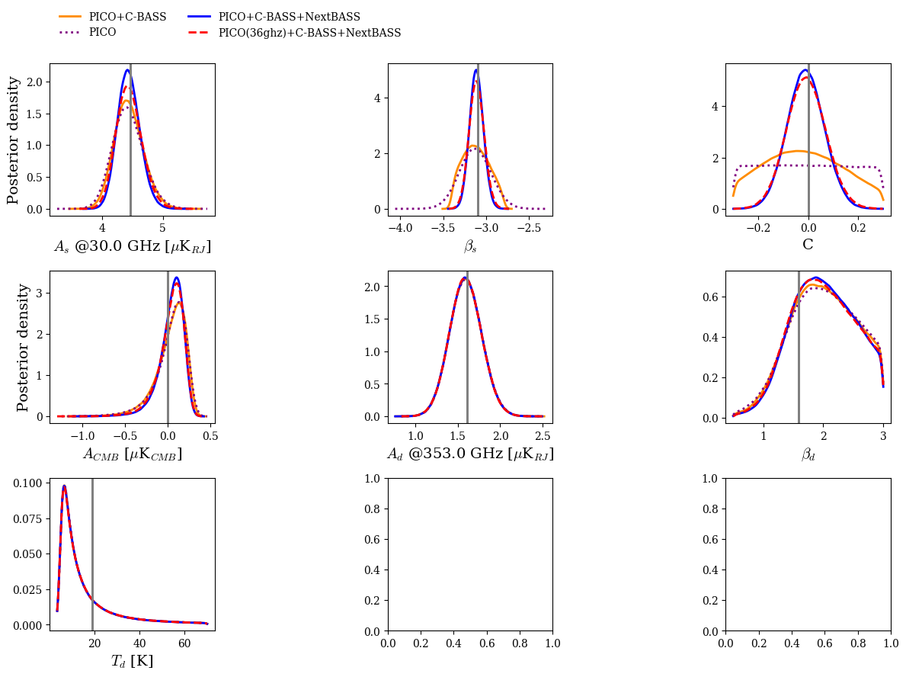
PICO (36GHz+) + C-BASS + NextBASS
s0a
nearOrion2

Slide 19
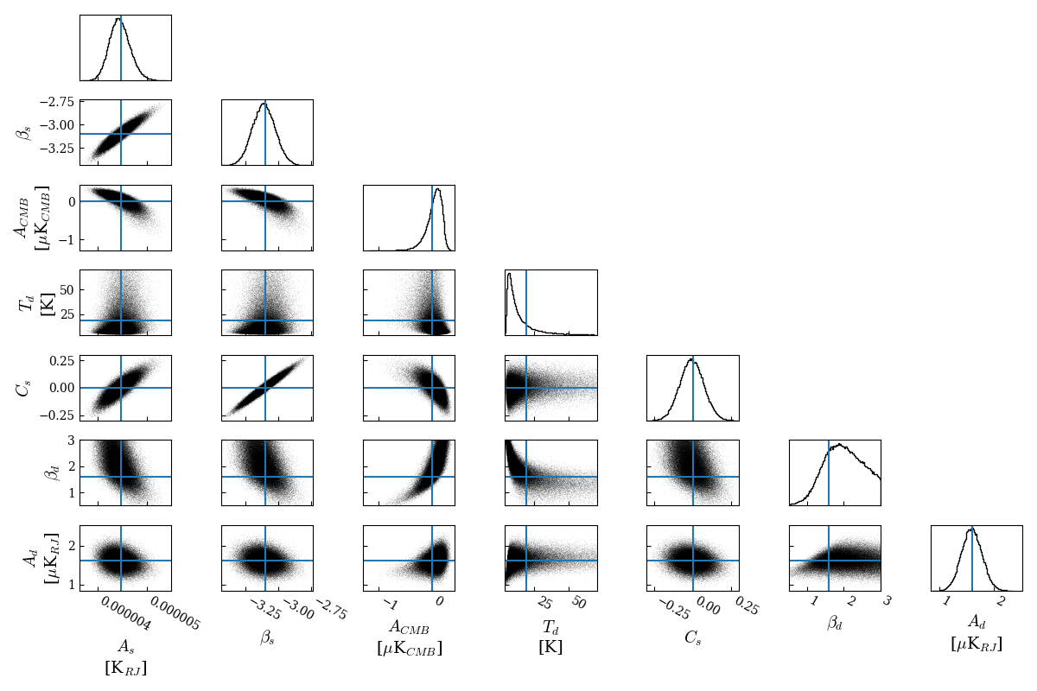
PICO (36GHz+) + C-BASS + NextBASS
s0a
nearOrion2

Slide 20
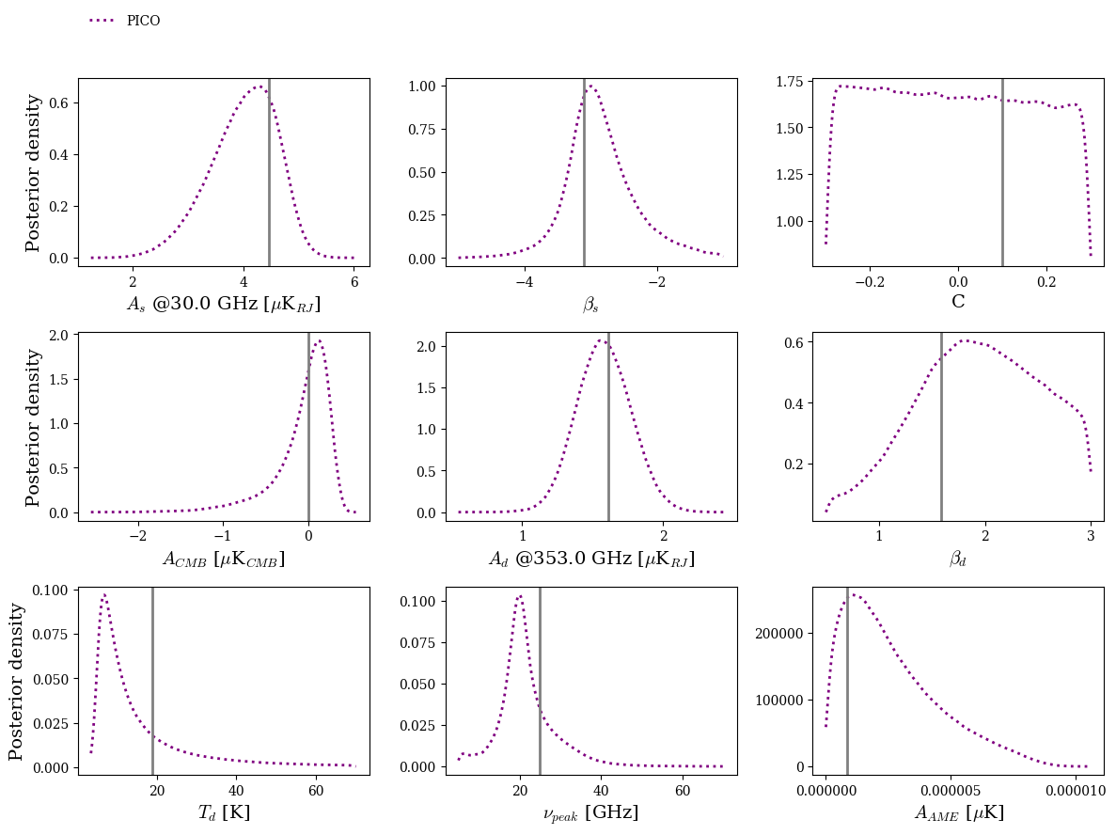
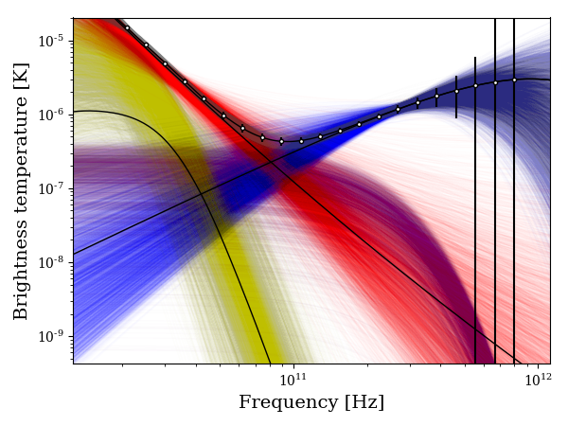
PICO
c1a
nearOrion2

Slide 21
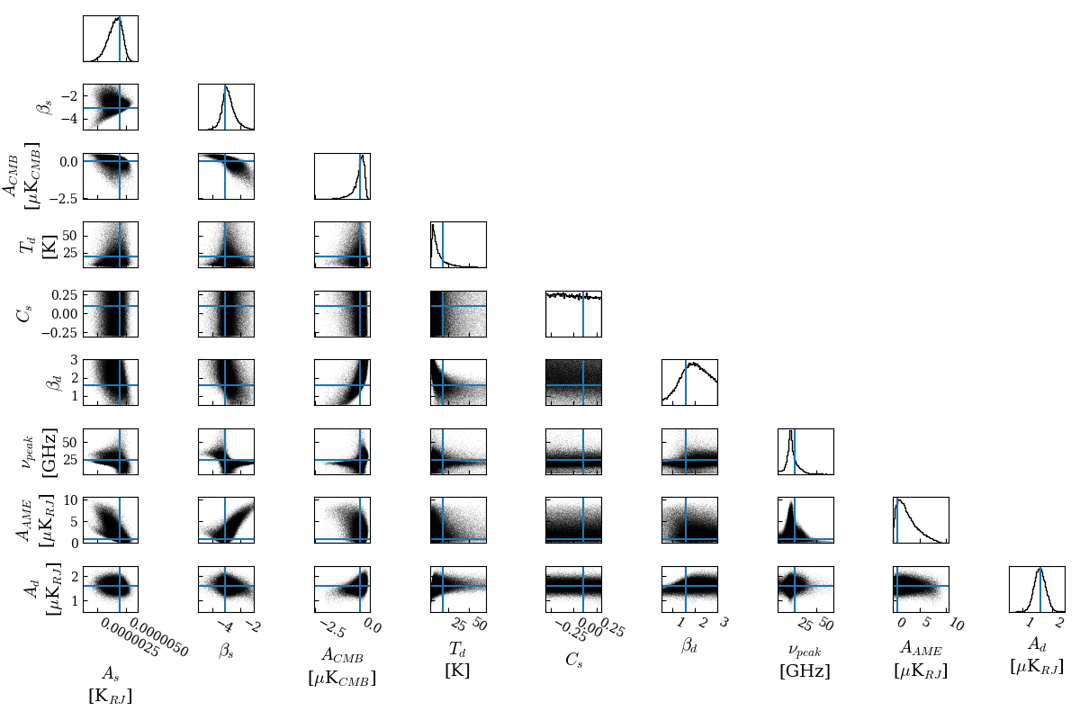
PICO
c1a
nearOrion2

Slide 22
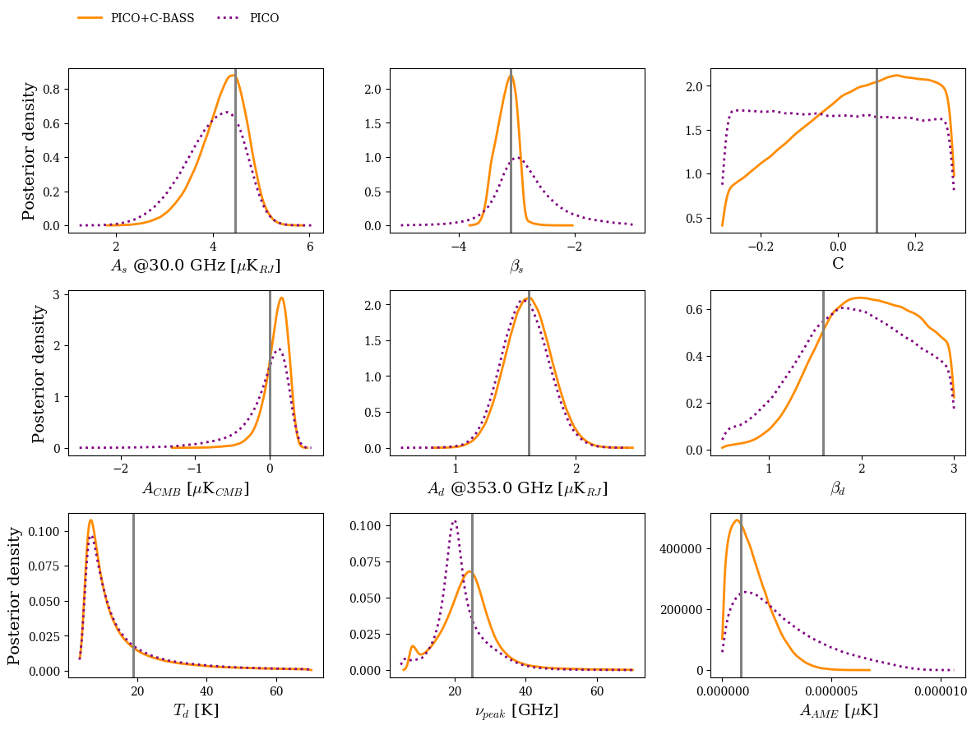
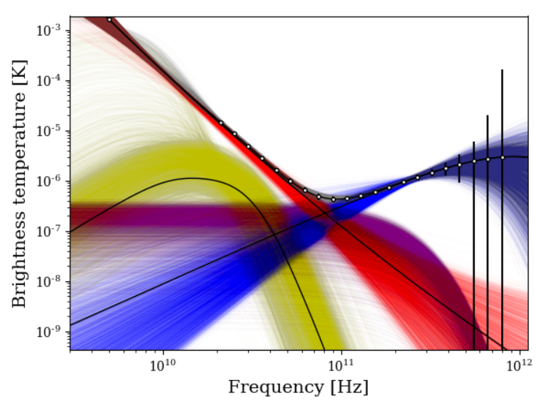
PICO + C-BASS
c1a
nearOrion2

Slide 23
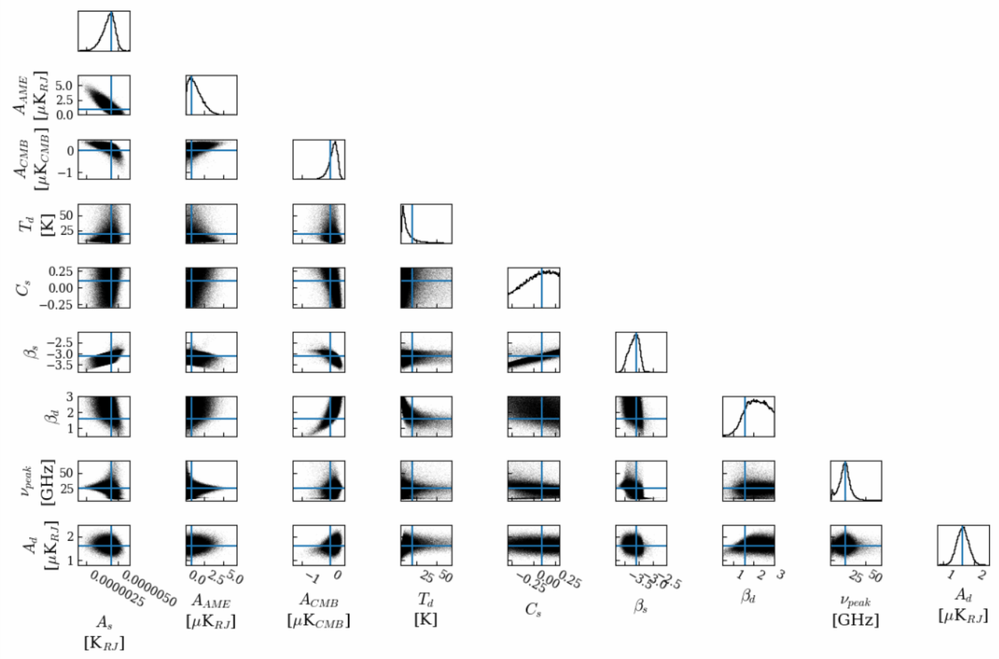
PICO + C-BASS
c1a
nearOrion2

Slide 24
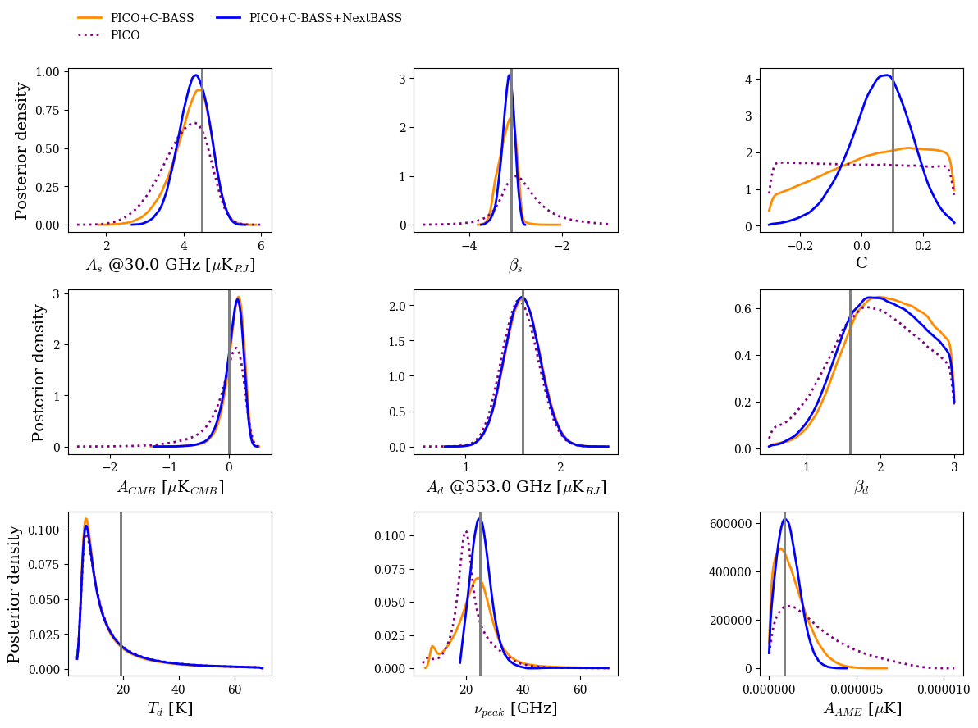
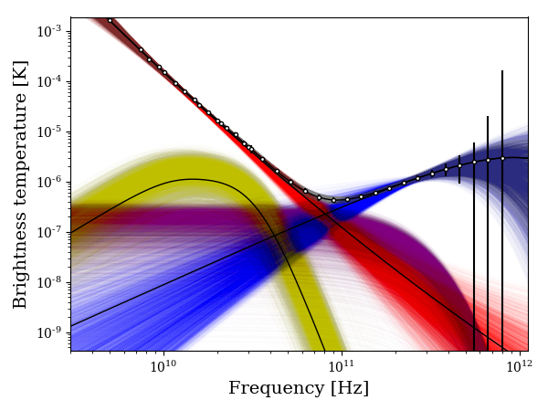
PICO + C-BASS + NextBASS
c1a
offPlane

Slide 25
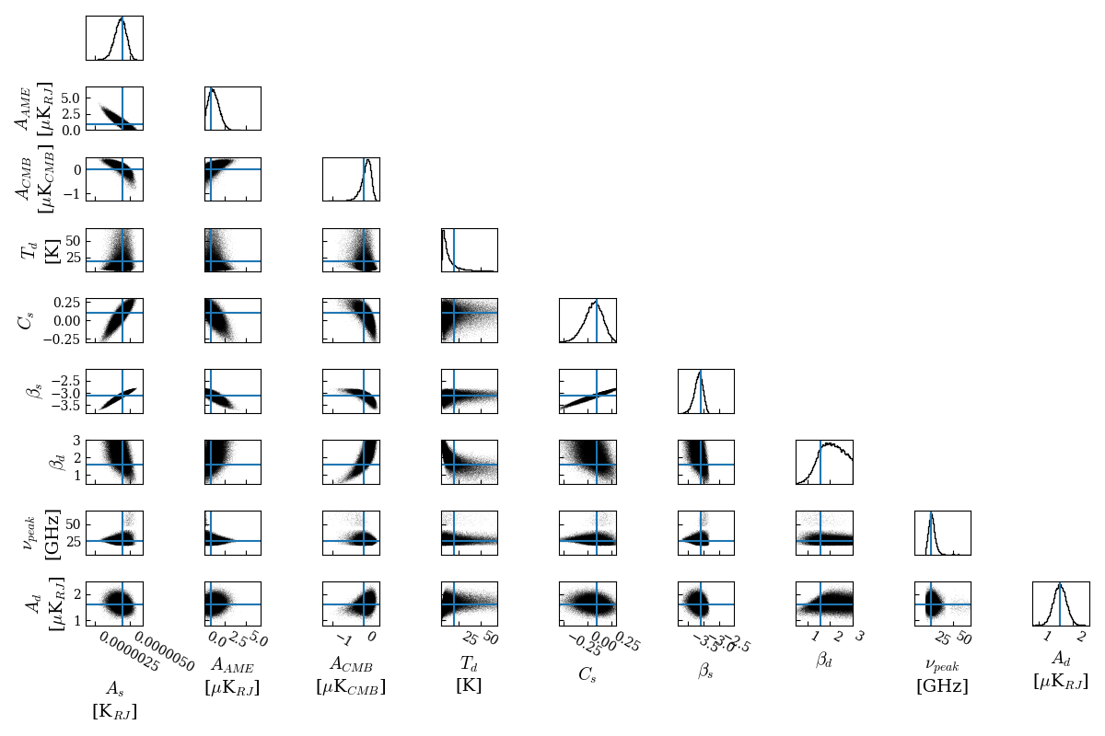
PICO + C-BASS + NextBASS
c1a
nearOrion2

Slide 26
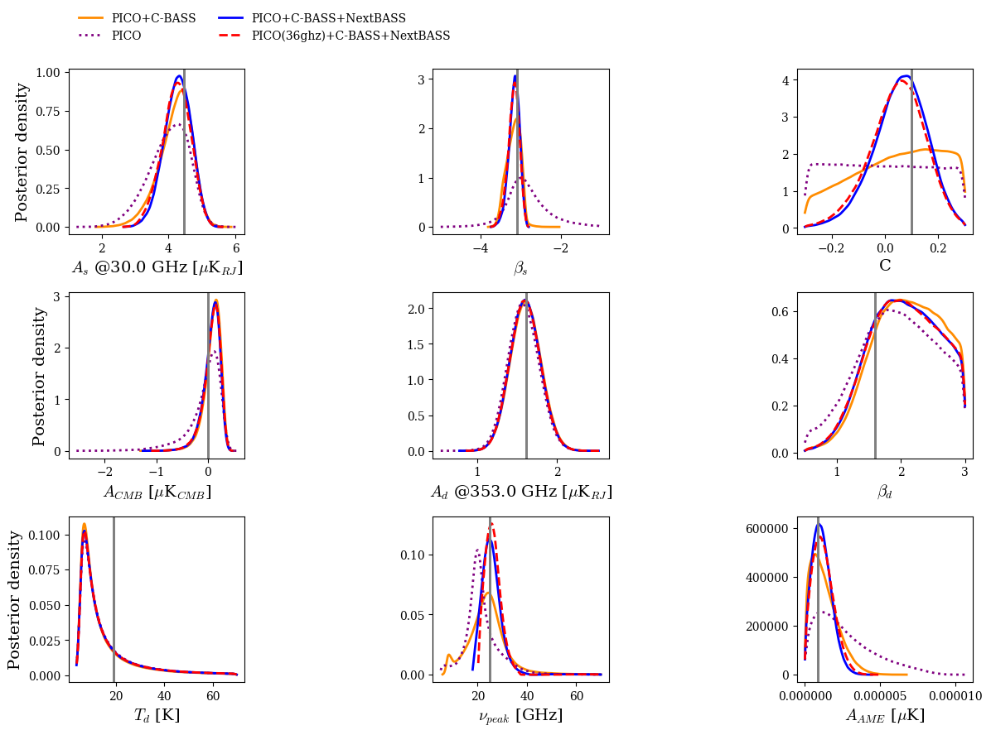
PICO (36GHz+) + C-BASS + NextBASS
c1a
nearOrion2

Slide 27
PICO (36GHz+) + C-BASS + NextBASS
c1a
nearOrion2

Slide 28
Conclusions
Ground can match space at low frequency in raw sensitivity
Feasible? Maybe…
Depends on making accurate maps – can we suppress ground spill/atmospheric conditions?
Try single 7-15 GHz pixel on C-BASS South
More modelling/analysis with C-BASS data on accurate mapping on large scales
Applying for funds for NextBASS!

Slide 29
Thanks!

Slide 30
Additional Results
offPlane c0a
offPlane s1a
galacticPlane c0a
AME c0a
offPlane s0a
offPlane c1a

Slide 31
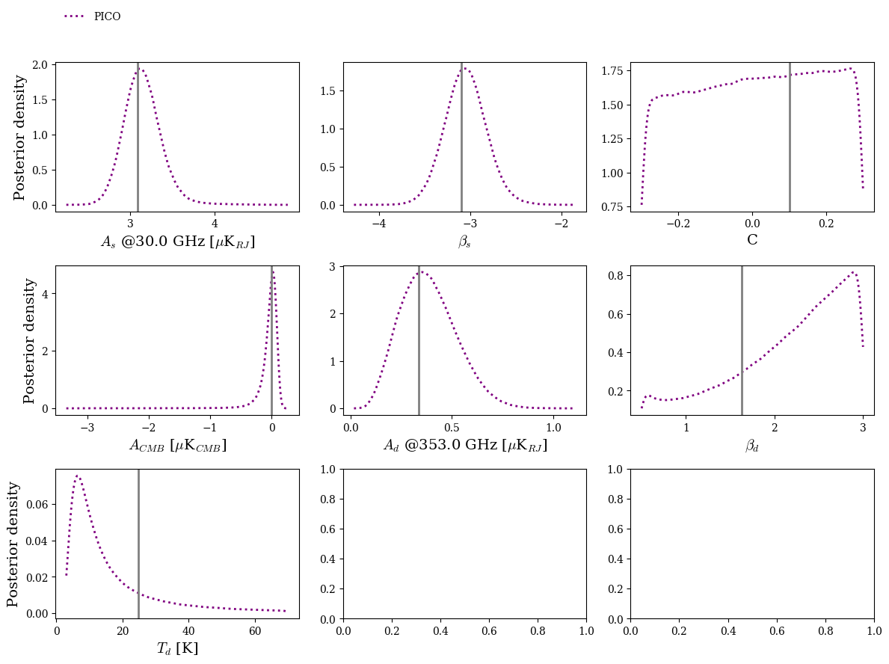
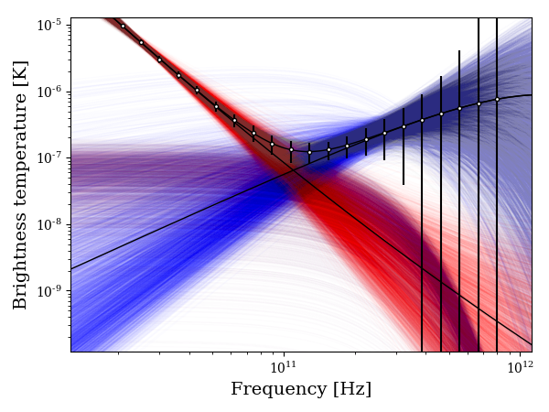
PICO
c0a
offPlane

Slide 32
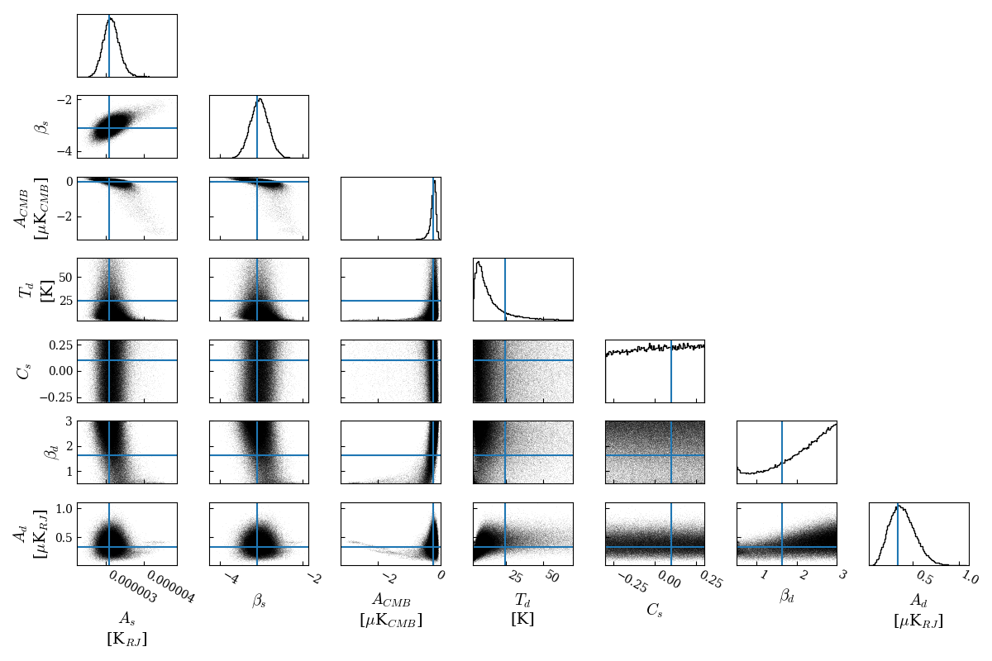
PICO
c0a
offPlane

Slide 33
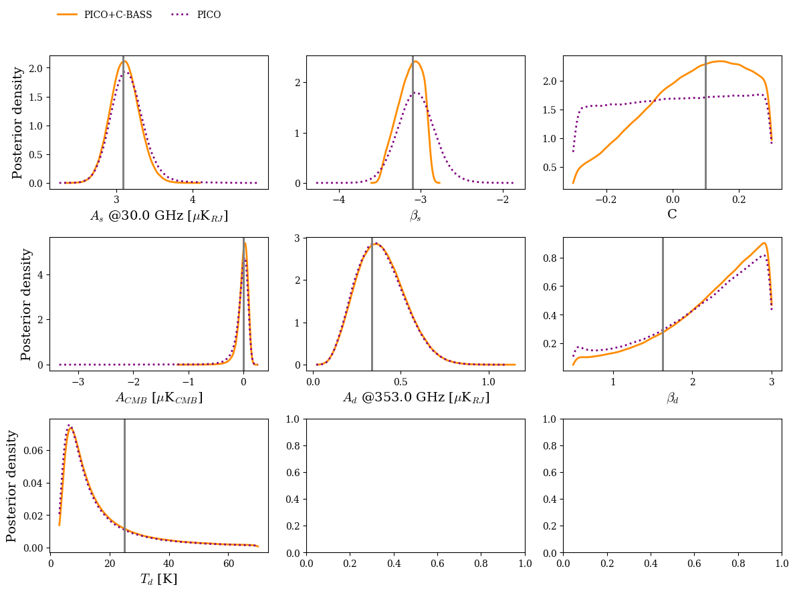
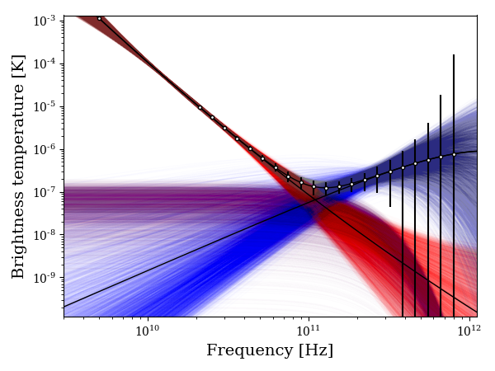
PICO + C-BASS
c0a
offPlane

Slide 34
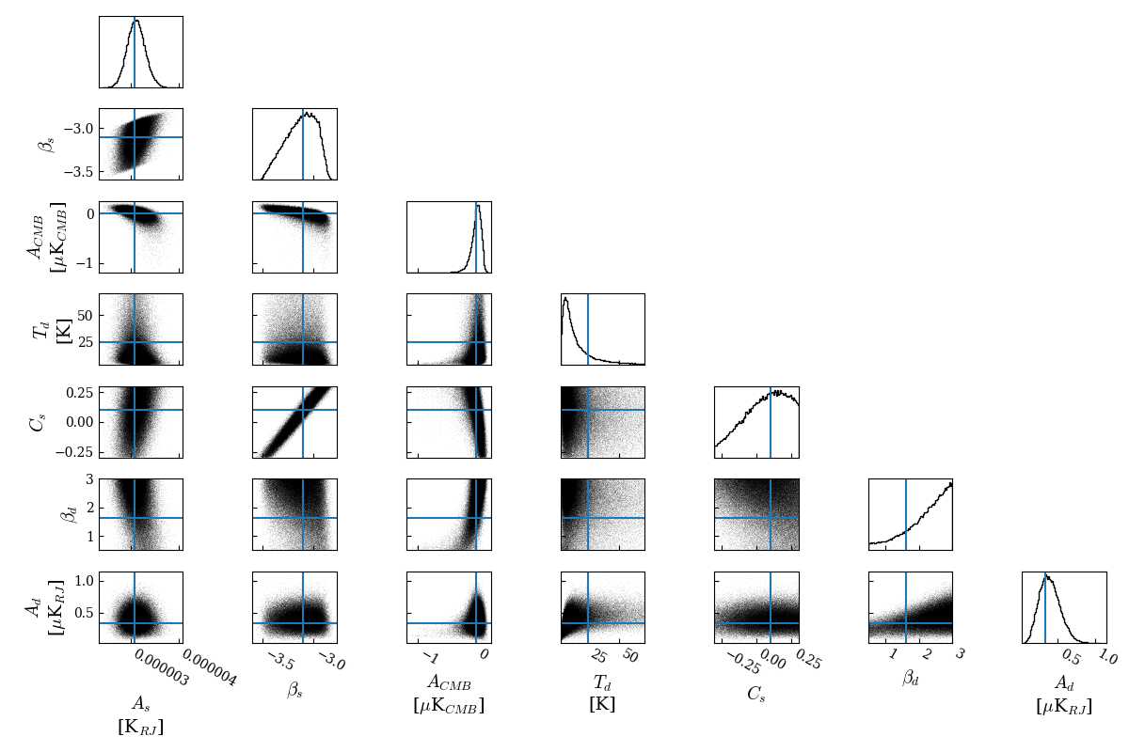
PICO + C-BASS
c0a
offPlane

Slide 35
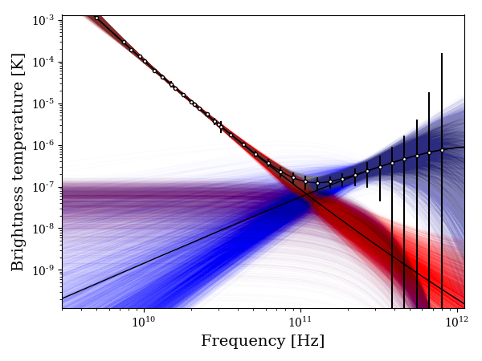
PICO + C-BASS + NextBASS
c0a
offPlane

Slide 36
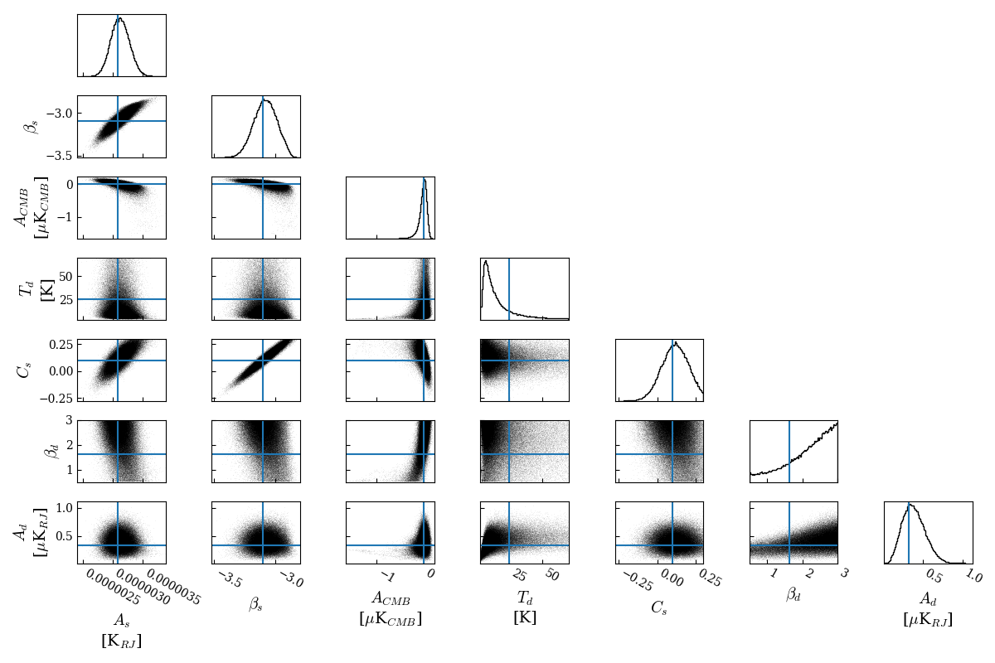
PICO + C-BASS + NextBASS
c0a
offPlane

Slide 37
PICO (36GHz+) + C-BASS + NextBASS
c0a
offPlane

Slide 38
PICO (36GHz+) + C-BASS + NextBASS
c0a
offPlane

Slide 39
PICO
s1a
offPlane

Slide 40
PICO
s1a
offPlane

Slide 41
PICO + C-BASS
s1a
offPlane

Slide 42
PICO + C-BASS
s1a
offPlane

Slide 43
PICO + C-BASS + NextBASS
s1a
offPlane

Slide 44
PICO + C-BASS + NextBASS
s1a
offPlane

Slide 45
PICO (36GHz+) + C-BASS + NextBASS
s1a
offPlane

Slide 46
PICO (36GHz+) + C-BASS + NextBASS
s1a
offPlane

Slide 47
c0a galactic Plane

Slide 48
PICO
c0a
galPlane

Slide 49
PICO
c0a
galPlane

Slide 50
PICO + C-BASS
c0a
galPlane

Slide 51
PICO + C-BASS
c0a
galPlane

Slide 52
PICO + C-BASS + NextBASS
c0a
galPlane

Slide 53
PICO + C-BASS + NextBASS
c0a
galPlane

Slide 54
PICO (36GHz+) + C-BASS + NextBASS
c0a
galPlane

Slide 55
PICO (36GHz+) + C-BASS + NextBASS
c0a
galPlane

Slide 56
PICO (36GHz+) + C-BASS + NextBASS
s0a
AME

Slide 57
c0a AME

Slide 58
PICO (36GHz+) + C-BASS + NextBASS
s0a
AME

Slide 59
PICO (36GHz+) + C-BASS + NextBASS
c0a
AME

Slide 60
PICO (36GHz+) + C-BASS + NextBASS
c0a
AME

Slide 61
PICO (36GHz+) + C-BASS + NextBASS
s1a
AME

Slide 62
PICO (36GHz+) + C-BASS + NextBASS
s1a
AME

Slide 63
PICO (36GHz+) + C-BASS + NextBASS
c1a
AME

Slide 64
PICO (36GHz+) + C-BASS + NextBASS
c1a
AME

Slide 65
PICO
s0a
offPlane

Slide 66
PICO
s0a
offPlane

Slide 67
PICO + C-BASS
s0a
offPlane

Slide 68
PICO + C-BASS
s0a
offPlane

Slide 69
PICO + C-BASS + NextBASS
s0a
offPlane

Slide 70
PICO + C-BASS + NextBASS
s0a
offPlane

Slide 71
PICO (36GHz+) + C-BASS + NextBASS
s0a

Slide 72
PICO (36GHz+) + C-BASS + NextBASS
s0a
offPlane

Slide 73
PICO
c1a
offPlane

Slide 74
PICO
c1a
offPlane

Slide 75
PICO + C-BASS
c1a
offPlane

Slide 76
PICO + C-BASS
c1a
offPlane

Slide 77
PICO + C-BASS + NextBASS
c1a
offPlane

Slide 78
PICO + C-BASS + NextBASS
c1a
offPlane

Slide 79
PICO (36GHz+) + C-BASS + NextBASS
c1a
offPlane

Slide 80
PICO (36GHz+) + C-BASS + NextBASS
c1a
offPlane

