Slide 1
Systematics session: Gain stability
Maurizio Tomasi (UniMI) Andrea Zonca (San Diego Supercomputer Center)
University of Minnesota, May 3rd 2018

Slide 2
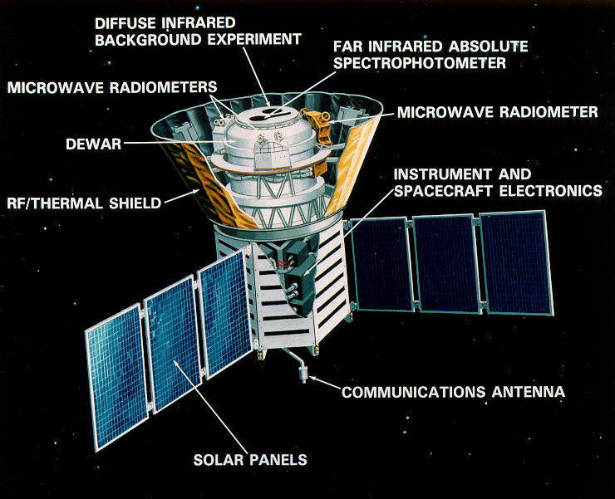
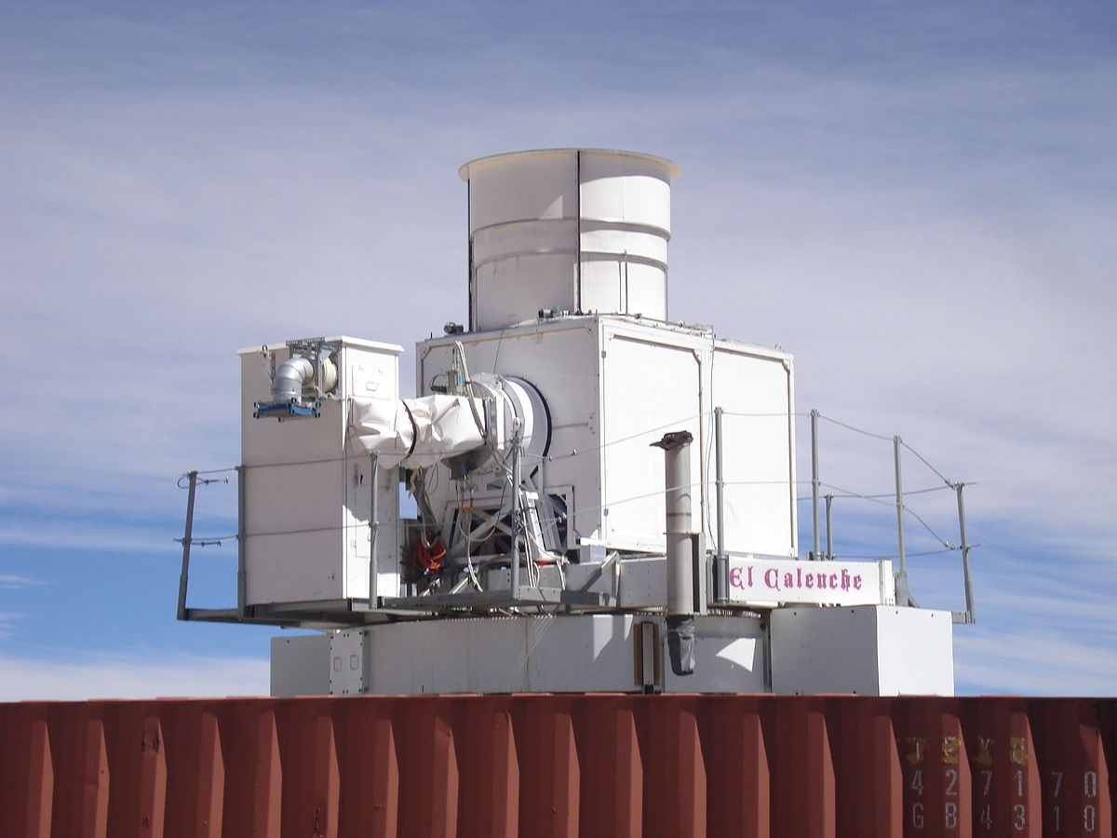
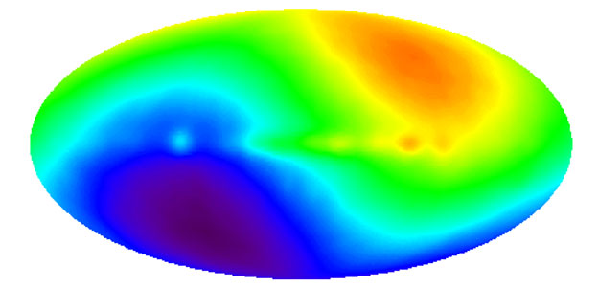
What is photometric calibration?
A way to convert the raw output of a detector into a measurement of the brightness of a source.
How to do it?
Internal calibrator (e.g. FIRAS, BICEP)
Sky sources (incl. atmosphere)
CMB dipole (WMAP, Planck)
Galactic coordinates!

Slide 3
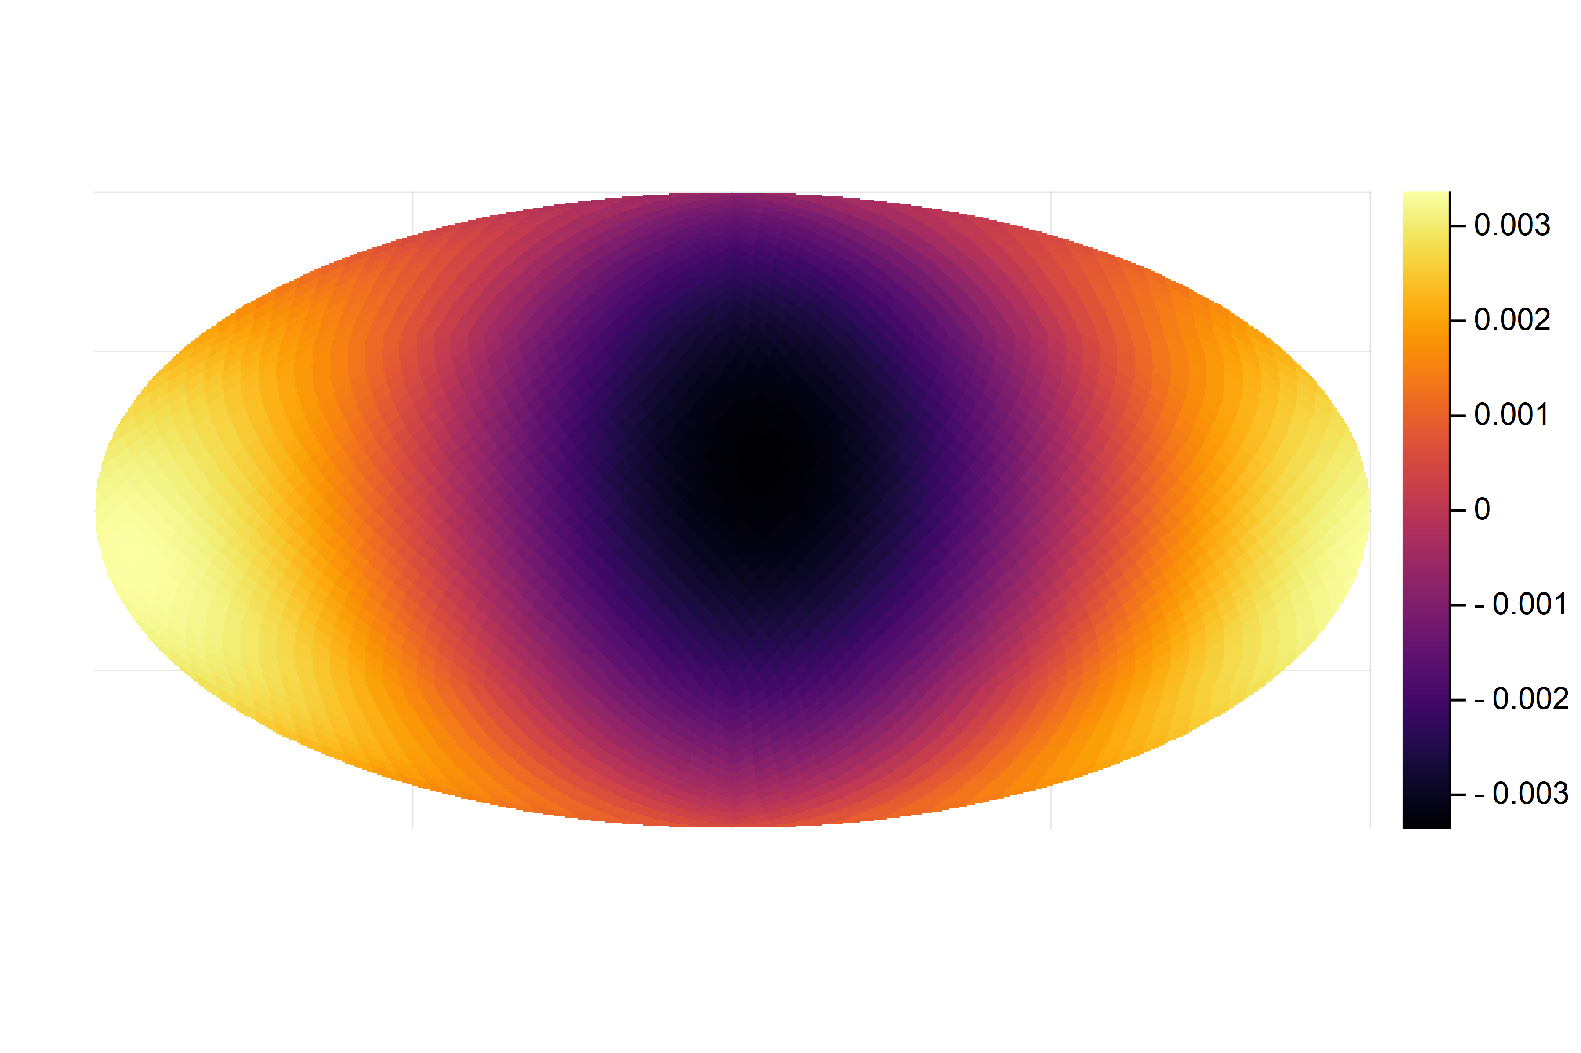
How does the CMB dipole look like?
Ecliptic plane
Thermodynamic temperature [K]

Slide 4
WMAP/Planck comparison
WMAP
Planck
Two telescopes
Differential detectors
Fast precession (1 h)
One telescope with baffle
«Total power» detectors
Slow precession (6 months)

Slide 5
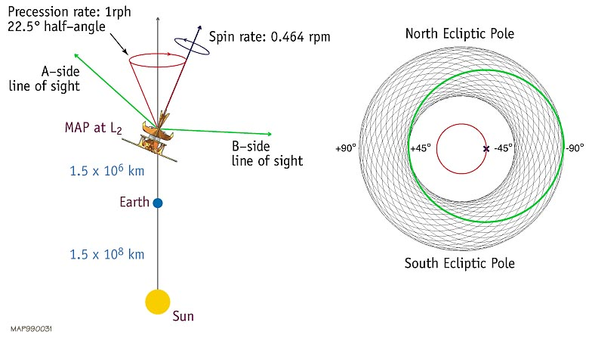
Observing the sky: the WMAP’s way
https://wmap.gsfc.nasa.gov/mission/observatory_scan.html

Slide 6
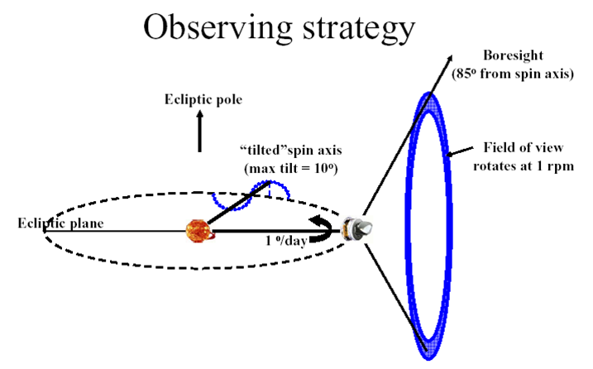
Observing the sky: the Planck’s way
https://wiki.cosmos.esa.int/planckpla/index.php/Survey_scanning_and_performance

Slide 7
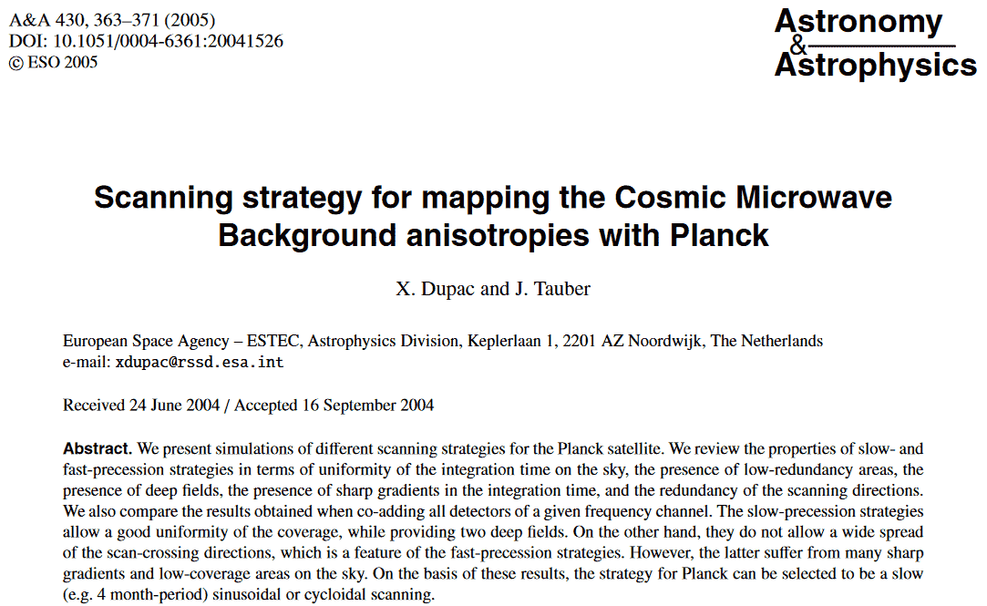
WMAP/Planck comparison
http://dx.doi.org/10.1051/0004-6361:20041526

Slide 8
Observing the sky dipole: the Planck’s way
https://wiki.cosmos.esa.int/planckpla/index.php/Survey_scanning_and_performance

Slide 9
How did Planck observe the sky?
The boresight direction spins once per minute…

Slide 10
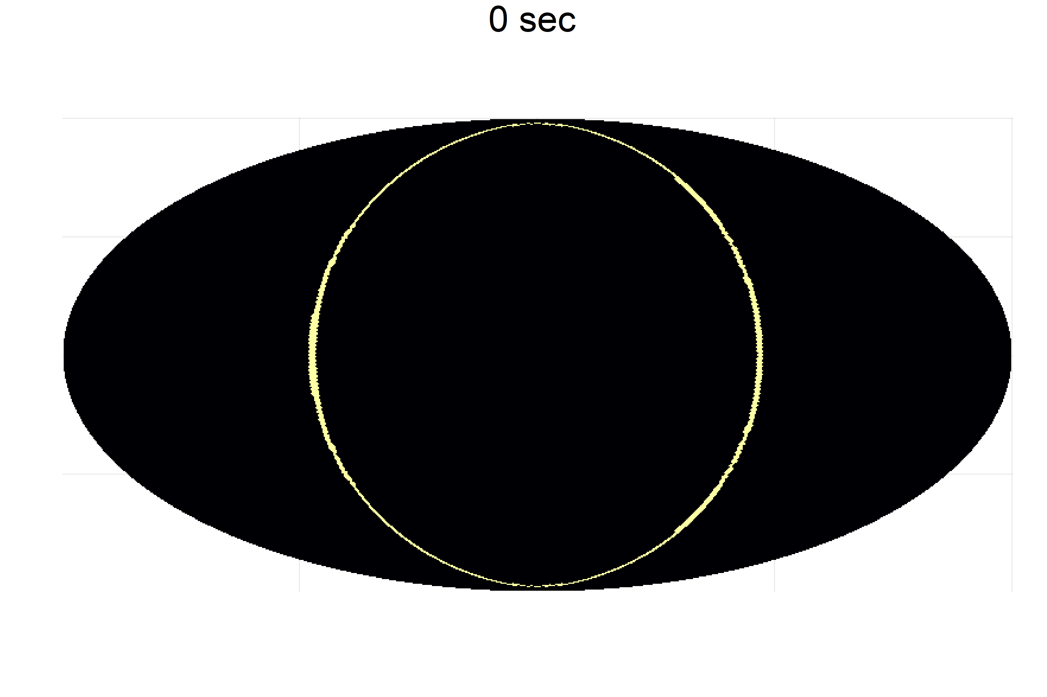
How did Planck observe the sky?
…and the spin axis moves together with the anti-Sun direction.

Slide 11
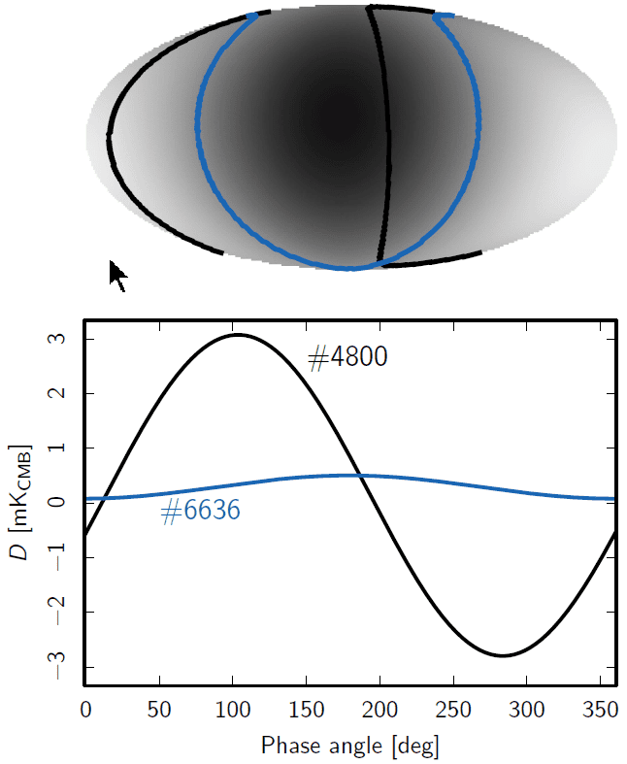
Dipole modulations along circles
Planck 2013 results. V. LFI calibration, http://dx.doi.org/10.1051/0004-6361/201321527

Slide 12
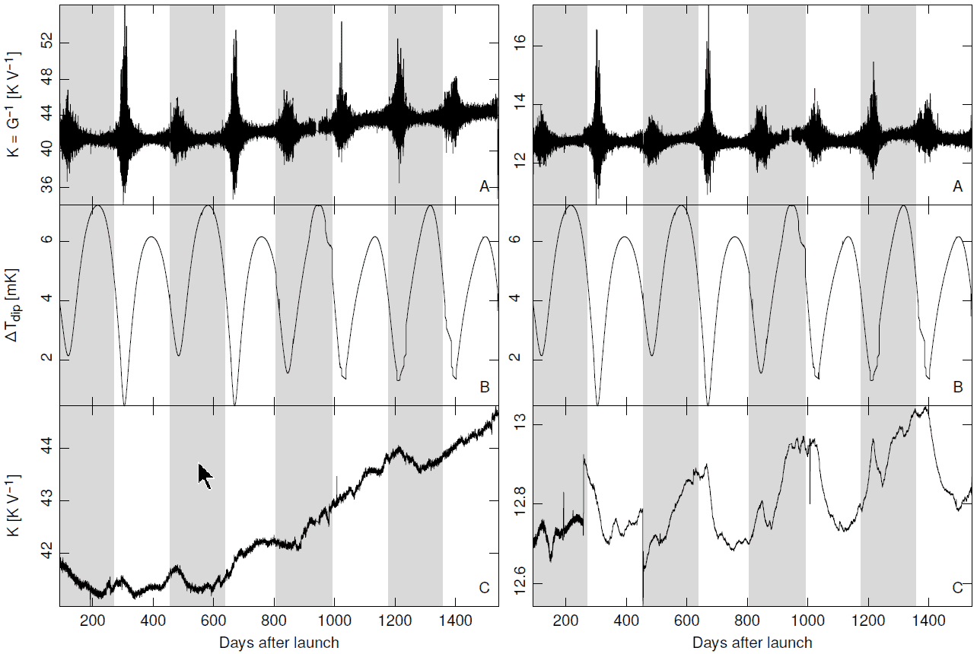
Planck/LFI calibration over 4 years
Planck 2015 results. V. LFI calibration. http://dx.doi.org/10.1051/0004-6361/201526632

Slide 13
Planck/LFI calibration over 4 years
Planck 2015 results. V. LFI calibration. http://dx.doi.org/10.1051/0004-6361/201526632

Slide 14
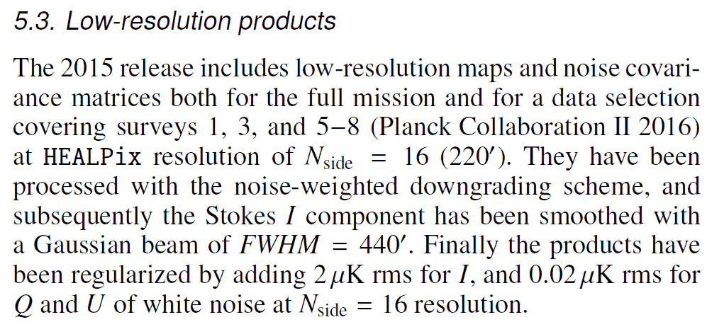
Planck/LFI calibration over 4 years
http://dx.doi.org/10.1051/0004-6361/201525813
http://dx.doi.org/10.1051/0004-6361/201525813
Planck 2015 results. V. LFI calibration. http://dx.doi.org/10.1051/0004-6361/201526632

Slide 15
How does PICO observe the sky?
The boresight direction spins once per minute…
https://zzz.physics.umn.edu/ipsig/optimizingscanstrategy/start

Slide 16
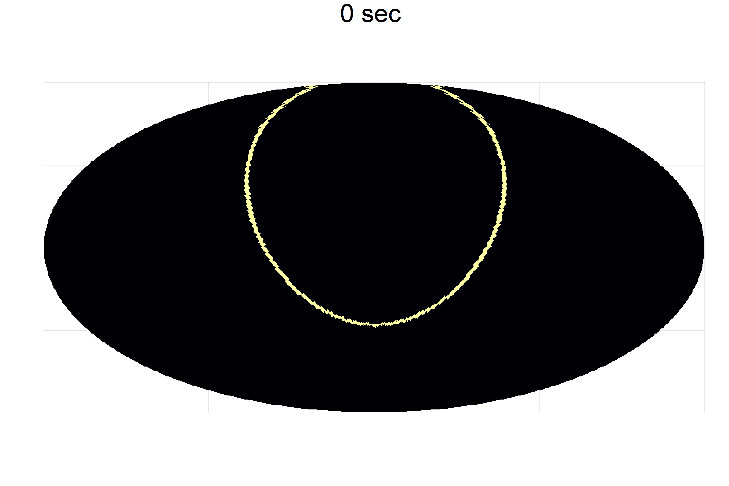
How does PICO observe the sky?
…but the spin axis precesses with a period of 10 hours…
https://zzz.physics.umn.edu/ipsig/optimizingscanstrategy/start

Slide 17
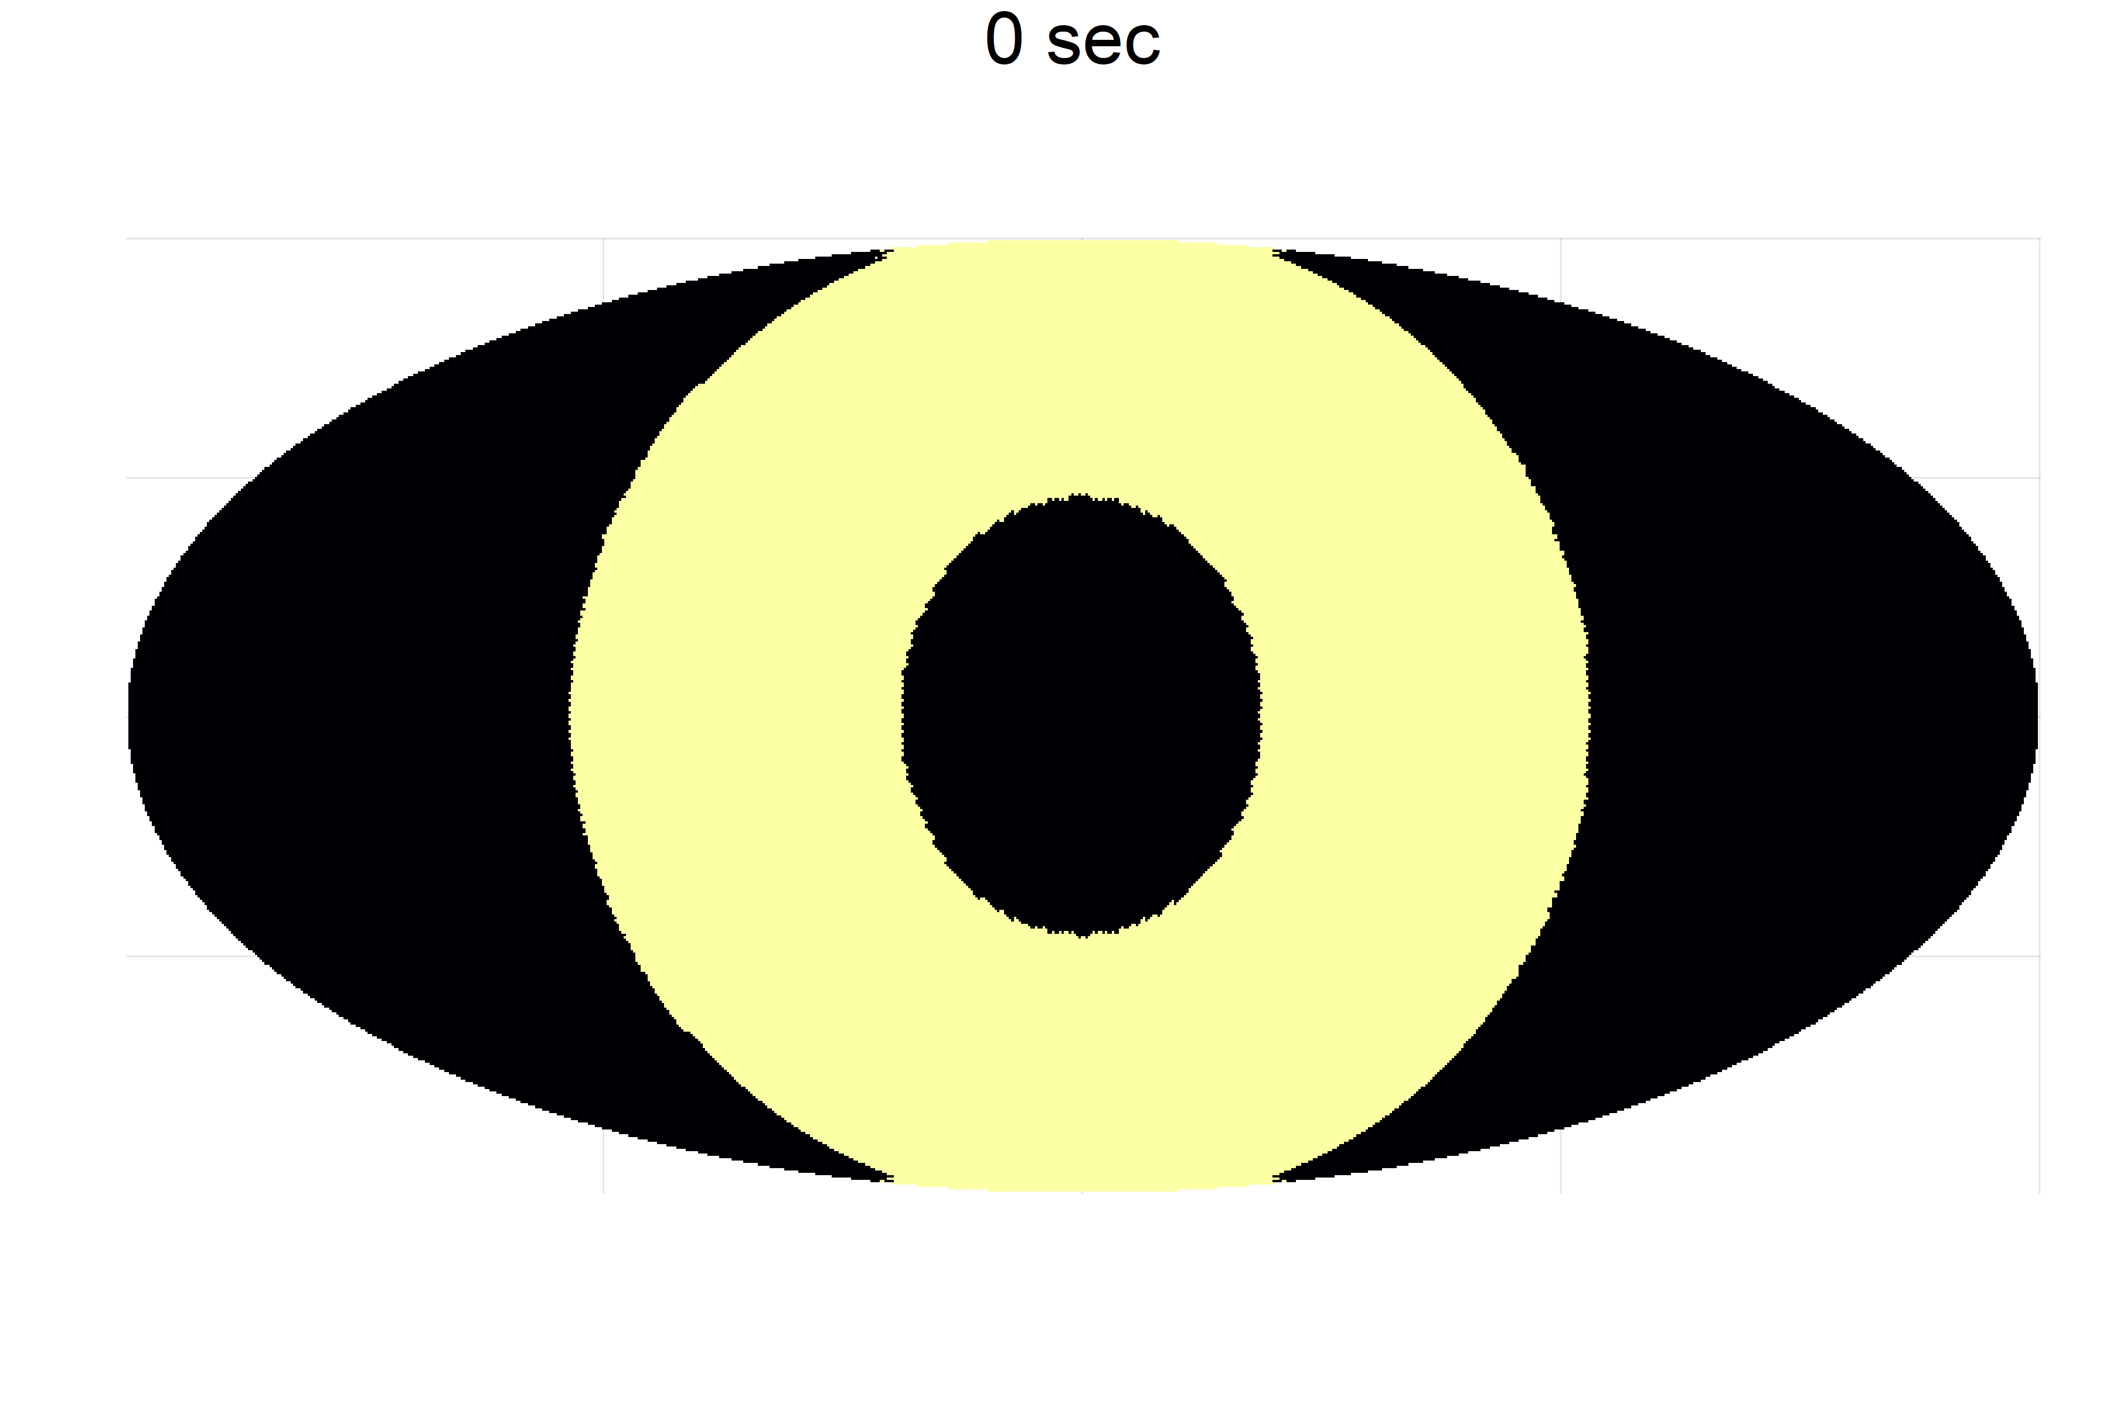
How does PICO observe the sky?
…and the yearly motion of the L₂ point does the rest.
https://zzz.physics.umn.edu/ipsig/optimizingscanstrategy/start

Slide 18
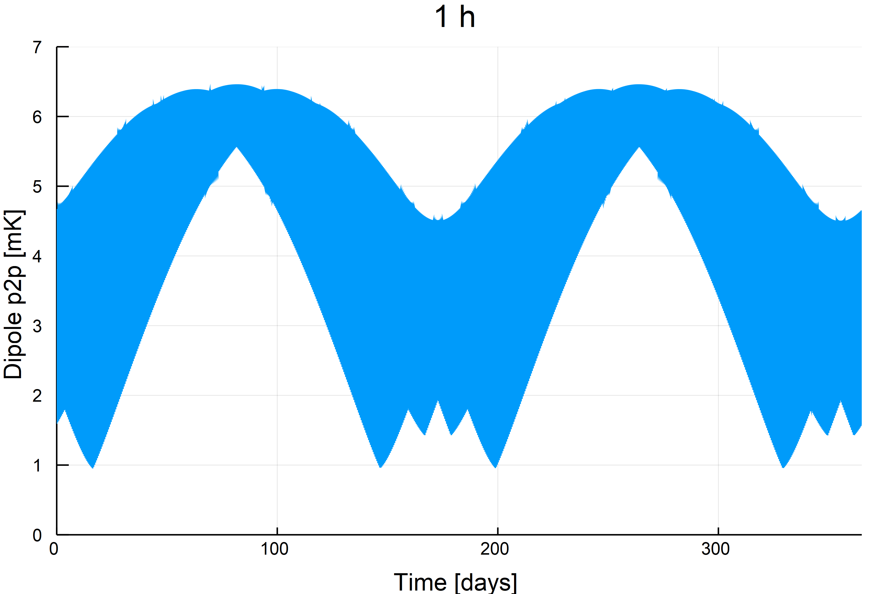
Peak-to-peak dipole amplitude
Varying the time scale of the p2p computation changes the result significantly

Slide 19
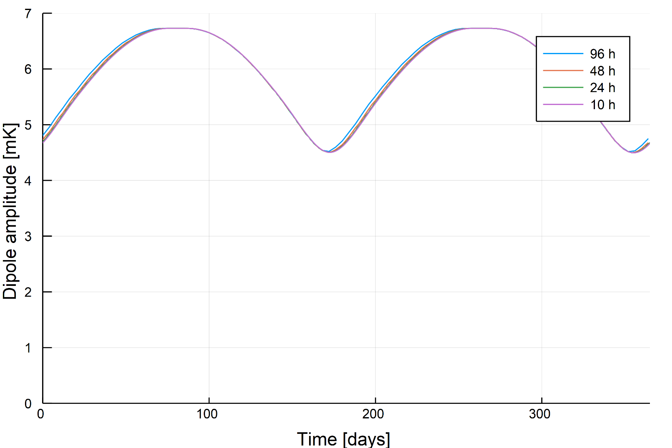
Peak-to-peak dipole amplitude

Slide 20
Which baseline should one choose?
High-frequency oscillations of the p2p should not be a problem…
…but avoiding them places PICO on the safer side.
Low-frequency oscillations are not as bad as Planck.
Good hint: we should have gain stability over periods of ~10 h (precession period).

Slide 21
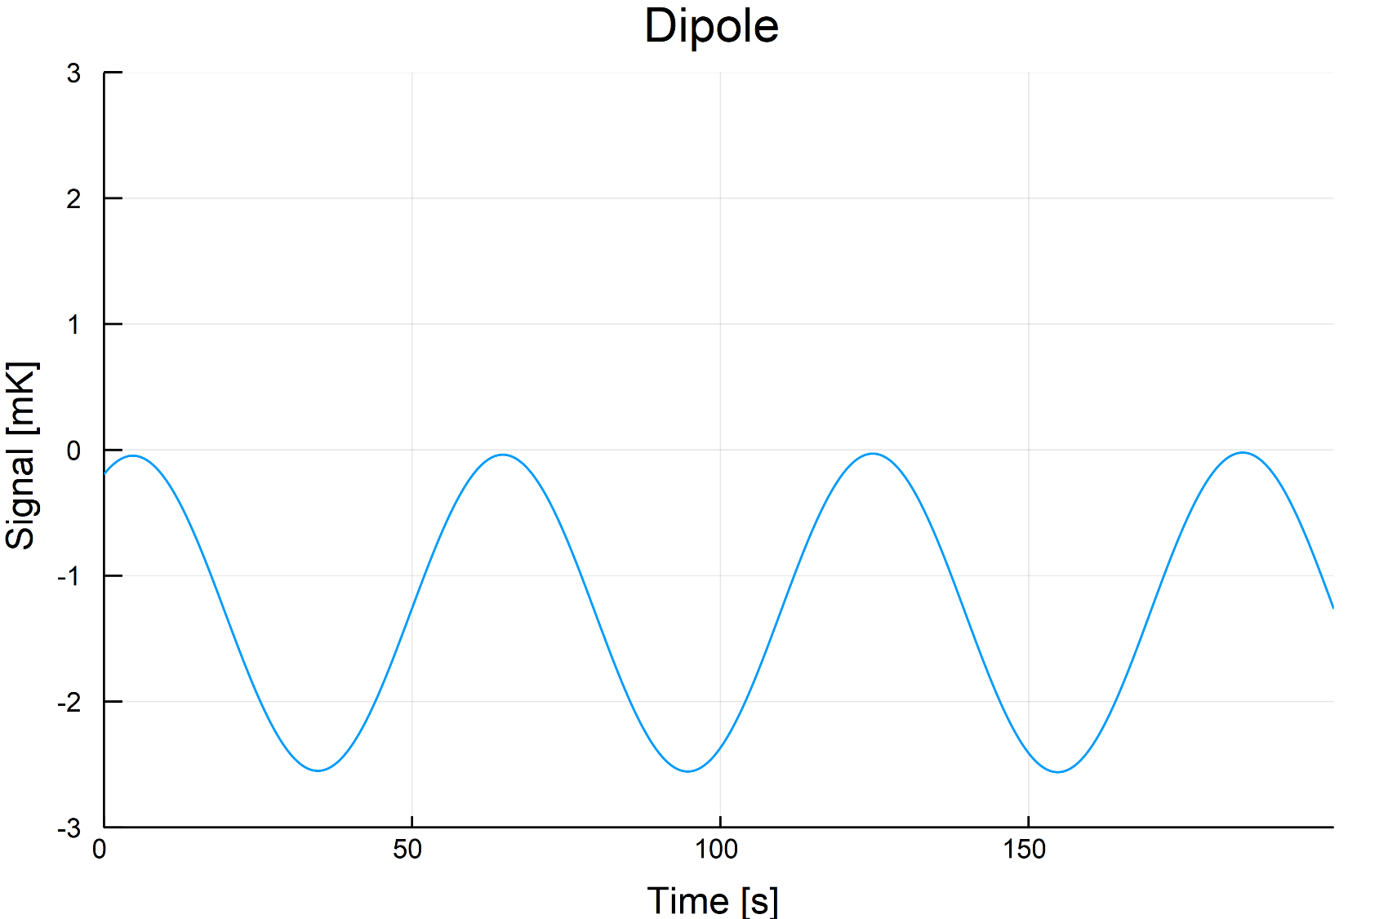
How does a PICO timeline look like?

Slide 22
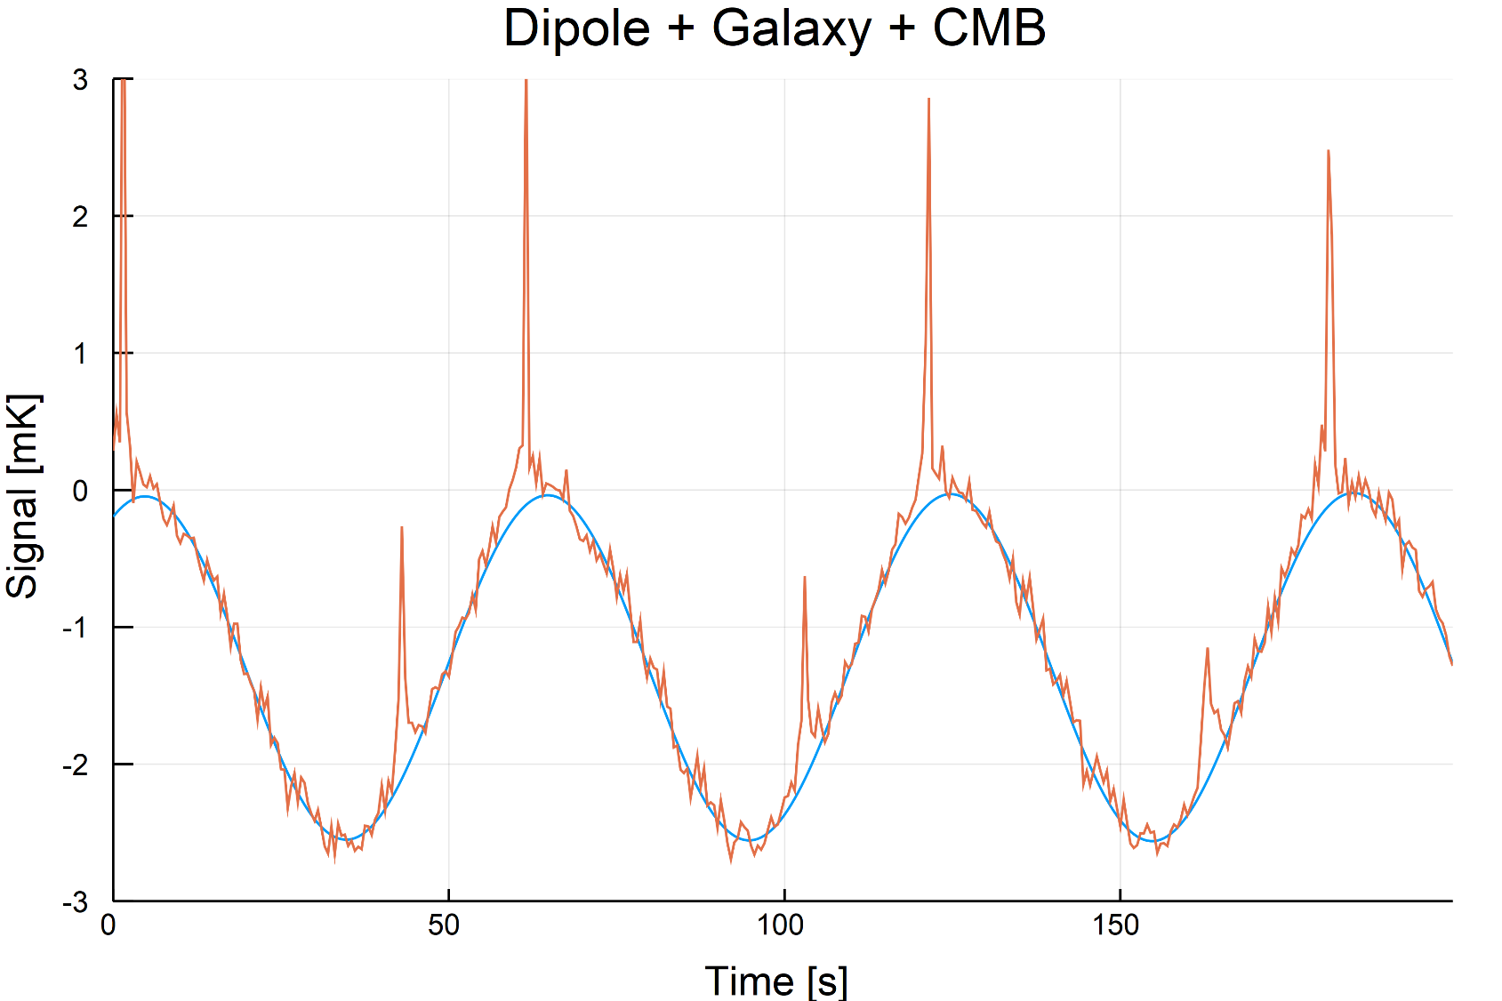
How does a PICO timeline look like?

Slide 23
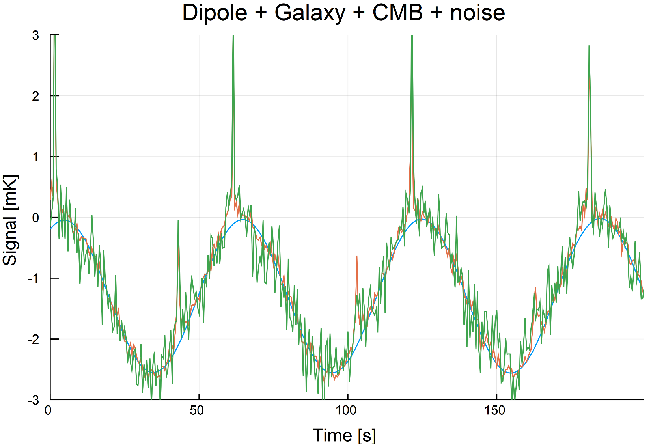
How does a PICO timeline look like?

Slide 24
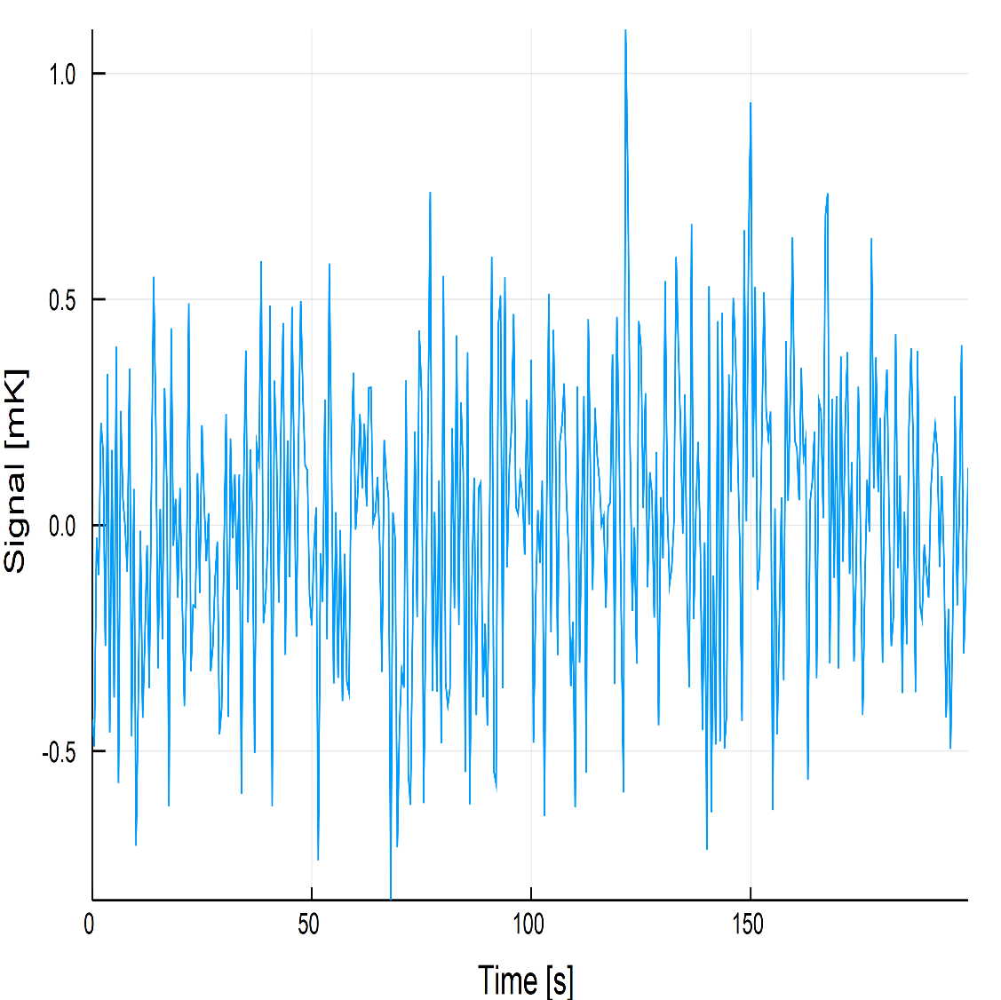
Noise component

Slide 25
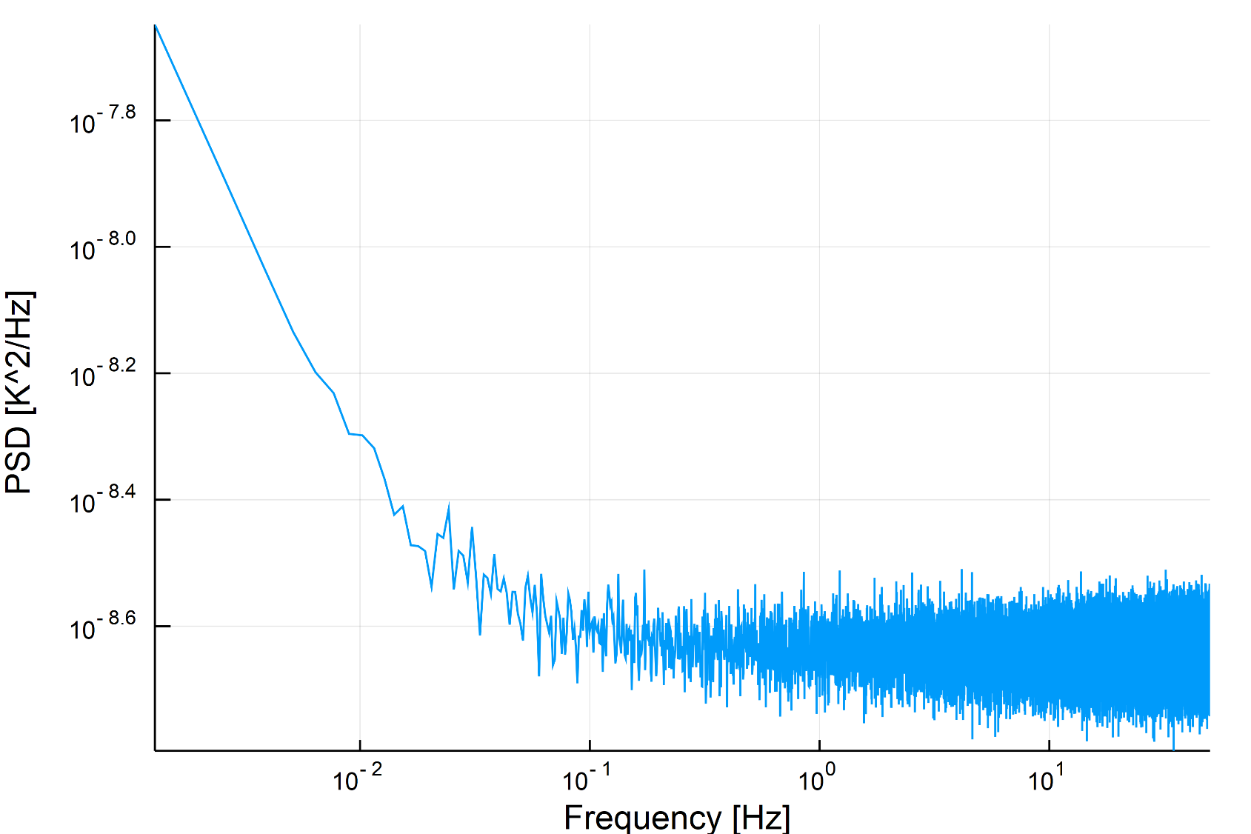
Noise component: WN + 1/f

Slide 26
Realistic calibration
P2P dipole is not the only parameter to consider here!
Galactic contamination
1/f noise
For Planck/LFI, we had to put the following things together:
Dipole fitting
Map-making (destriper)
In the future, component separation should be added as well.

Slide 27
DaCapo
Original C++ code by Elina Keihänen (University of Helsinki), used in Planck/LFI 2015 and 2018 data releases
1/f+gain factor estimation
Analysis must be done on each detector separately
I ported the code to Python 3. Major improvement: baselines for 1/f and gains are disentangled. Full commented source code at https://github.com/ziotom78/dacapo_calibration

Slide 28
Current results
A few bugs in the code generating the TODs prevented me from having results to show here… (the ones on the wiki are wrong and will be soon updated)
My jobs are queued, they should take a few days to run.

Slide 29
What to do next
Once gain estimates are ready and checked, re-run TOAST and calibrate the TODs with the estimated gains
Produce a full-sky map (I, Q, U)
Compare it with the input map on the power-spectrum level
Do this both for a map with the Galaxy and with only CMB map

Slide 30
What to put in the PICO report
Statement about the time scale of detector instabilities: >10 h would be desirable.
Full end-to-end simulation (from TODs to detector maps and power spectra)
Consider the CMB-only case: this is the case of a perfect integration between current DaCapo implementation and a component-separation algorithm.

