Slide 1
Stray light analysis and DLFOV UMN, July 31, 2017
Analysis done by ray tracing in CodeV. No pixel beamforming parameters or diffraction are accounted for.

Slide 2
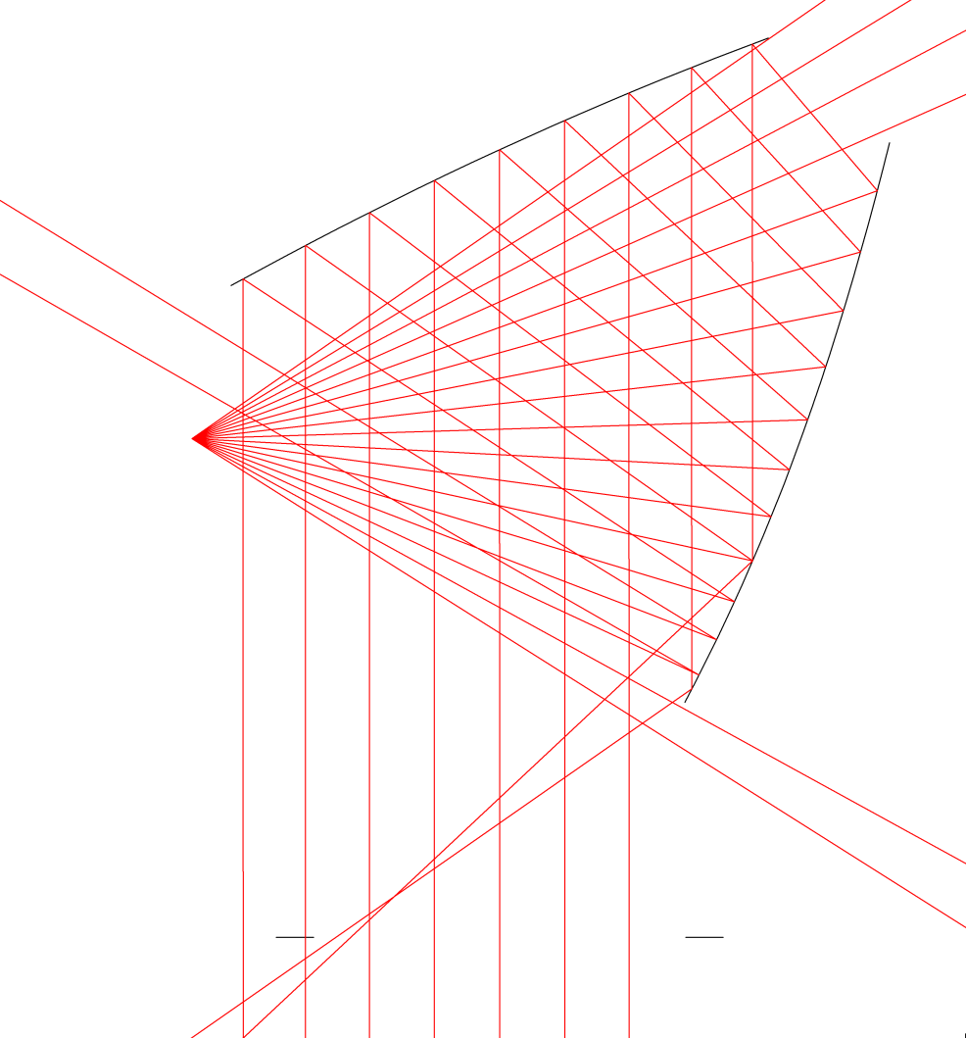
Stray light for 1.4 m crossed dragone
Center feed shown
Rays labeled by their angle from the center ray.
Strong near-field sidelobe.
+23.8 deg
-20.8 deg
Focal plane
Approximate location of the stop
-28.6 deg
+15.4 deg
60 cm
0 deg, center ray

Slide 3
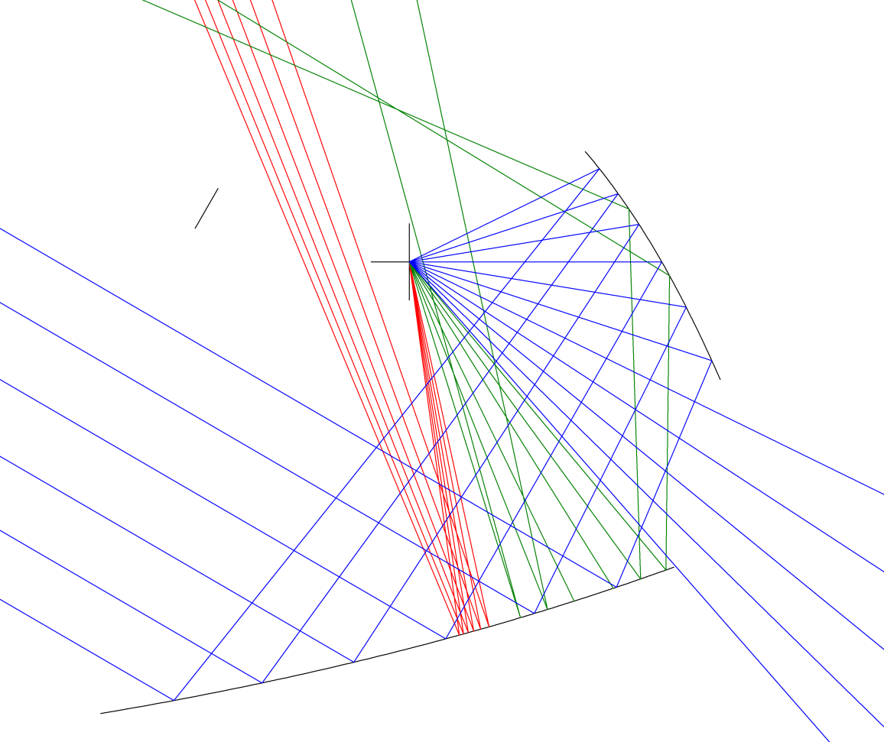
Stray light for 1.4 m open dragone
+49.9 deg
Baffles
red: ~+80 deg
+57.8 deg
Center feed shown
Baffling is simpler than the crossed dragone
Analysis is independent of stop location
miss secondary: -31.8 deg
Focal plane
miss secondary: +20.4 deg
0 deg, center ray
Approximate location of the stop
65 cm

Slide 4
Focal plane size comparisons
Goal: compare DLFOV of optical systems with different f-numbers
Diffraction limited field of view (DLFOV) where Strehl > 0.8
At fixed edge taper (a), pixel size depends on f-number(F) and wavelength,
Number of pixels depends on D (not just wavelength)
To compare systems we assume a=1.
At each lambda we count the number of Dpixel in the DLFOV
# = DLFOV (cm)/ Dpixel (cm)
giving the number of F*lambda diameter pixels that fit in the diameter of the DLFOV
Typical focal plane
Contours at 80 % strehl
300 GHz
150 GHz
90 GHz
D focal plane at 90 GHz = 50 cm

Slide 5
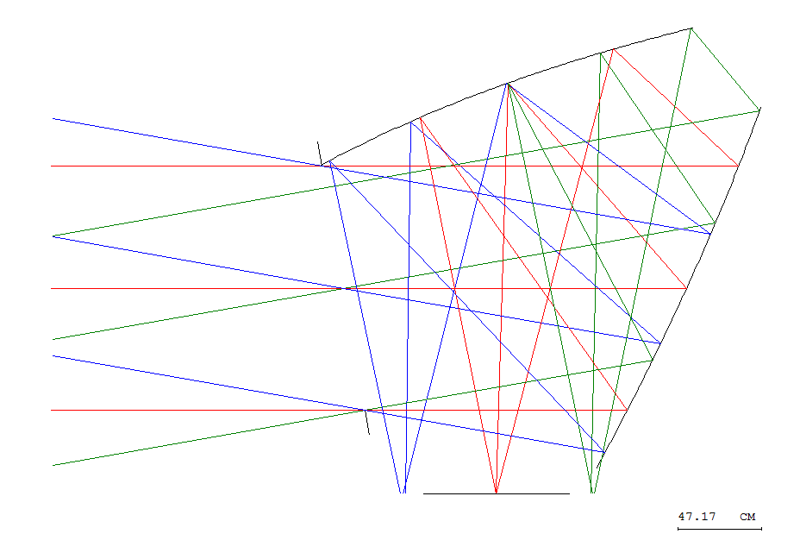
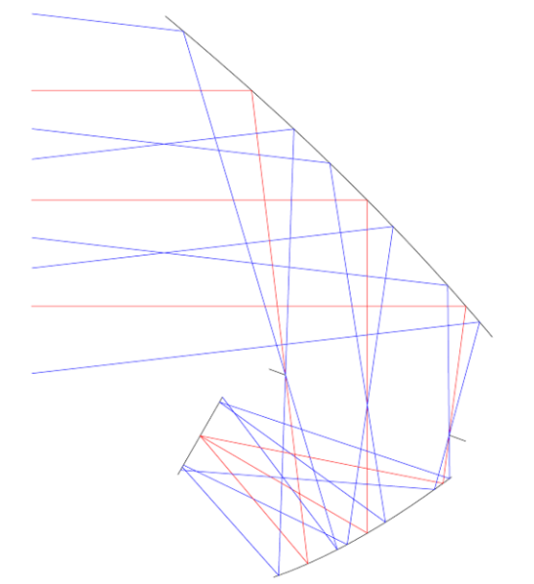
Comparing crossed and open Dragones
1.4 m crossed, F = 2.14
Frequency | Lambda | Focal Plane Diameter |  | Focal Plane Diameter
 |  | X | Y | X | Y
(GHz) | (mm) | (cm) | (cm) | (Fλ) | (Fλ)
70 | 4.285714 | 97.9 | 78.7 | 106.7 | 85.8
100 | 3 | 77.2 | 74.1 | 120.3 | 115.4
150 | 2 | 57.4 | 53.4 | 134.1 | 124.6
220 | 1.363636 | 42.3 | 38.5 | 145.1 | 132.0
350 | 0.857143 | 28.1 | 24.9 | 153.0 | 135.7
500 | 0.6 | 19.6 | 17.0 | 152.8 | 132.5
1.4 m open, stop between mirrors, F = 1.5
Frequency | Lambda | Focal Plane Diameter |  | Focal Plane Diameter
 |  | X | Y | X | Y
(GHz) | (mm) | (cm) | (cm) | (Fλ) | (Fλ)
70 | 4.285714 | 40.4 | 36.4 | 62.8 | 56.5
100 | 3 | 30.9 | 28.3 | 68.7 | 62.9
150 | 2 | 22.0 | 20.8 | 73.3 | 69.2
220 | 1.363636 | 15.6 | 15.2 | 76.4 | 74.3
350 | 0.857143 | 10.1 | 10.1 | 78.3 | 78.3
500 | 0.6 | 7.1 | 7.2 | 78.7 | 79.9

Slide 6
Comparing crossed and open Dragones
In this case, the open dragone provides about 60% the usable focal plane diameter of the crossed.
Re-checking results for CORE
And comparing open and crossed with same f-number to understand performance difference.

