Slide 1
Optics Study 20170807

Slide 2
Topics
Comparing DLFOV for Open/Cross Dragone
Alpha/Beta scan angles as a function of aperture for Open Dragone

Slide 3
DLFOV for Open/Cross Dragone
Use equal aperture and equal f# for both systems
find DLFOV for several frequencies
form ratio open/cross
Verify with several systems that have different tilt angles (all with the same aperture size and f#)

Slide 4
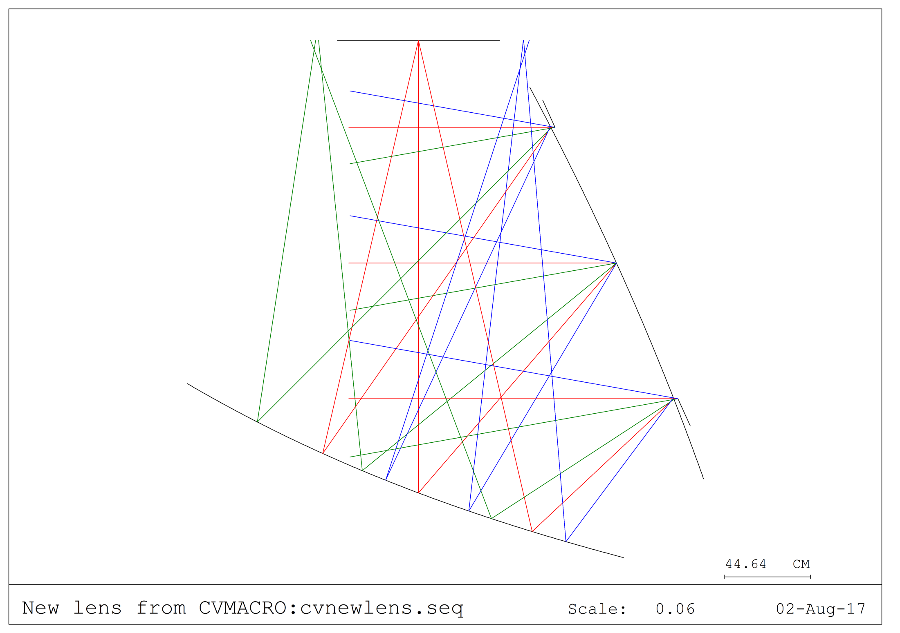
Cross Dragone
Focal Plane
Primary Mirror
Secondary Mirror

Slide 5
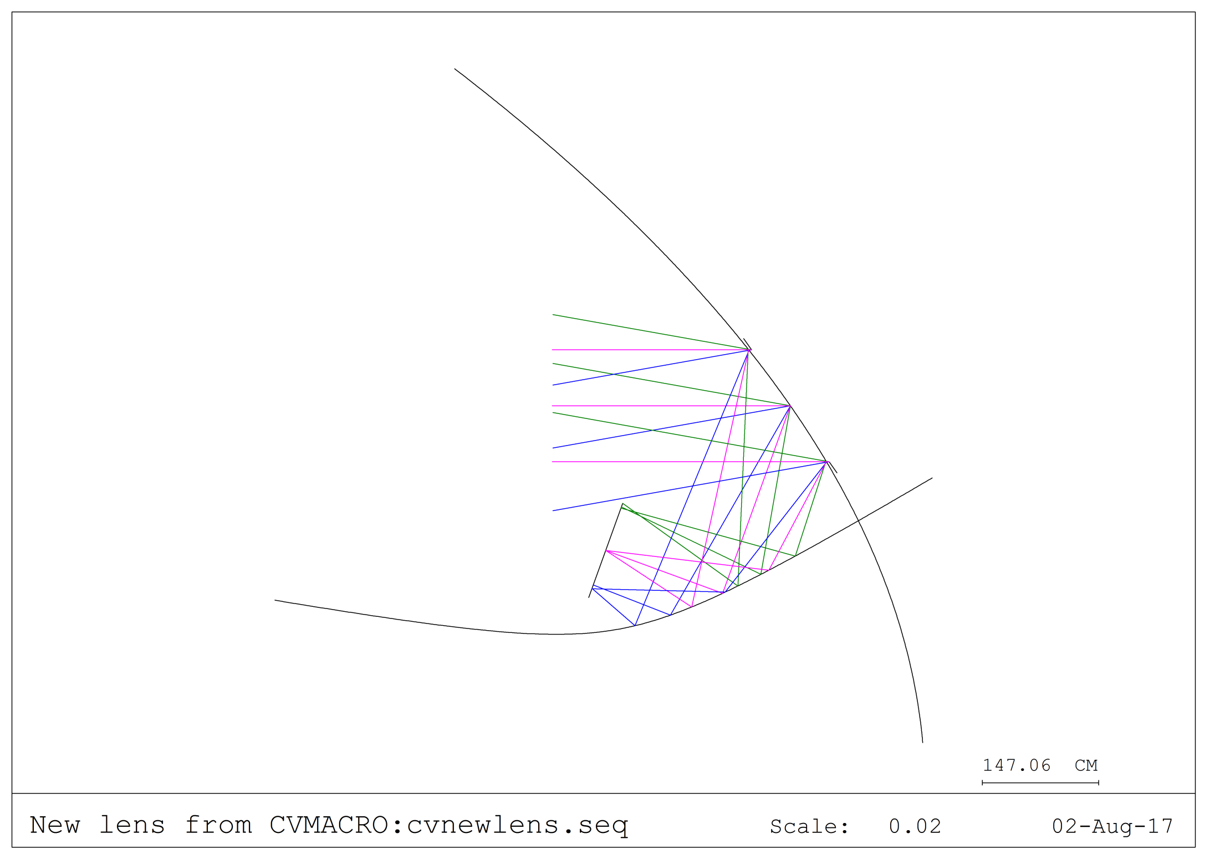
Open Dragone
Primary Mirror
Focal Plane
Secondary Mirror

Slide 6
DLFOV Size Comparisons aperture = 1.4 m, f#=2.20
Frequency (GHz) | Type of Dragone | DLFOV Size (strehl > 0.8)
 |  | X (cm) | Y (cm)
70 | Cross | 111.2 | 86.3
 | Open | 75.2 | 63.3
Open/Cross |  | 0.68 | 0.73
150 | Cross | 66.4 | 54.5
 | Open | 48.1 | 41.0
Open/Cross |  | 0.72 | 0.75
350 | Cross | 33.4 | 30.2
 | Open | 27.7 | 24.3
Open/Cross |  | 0.83 | 0.8
Conclusion: DLFOV for ‘open’ is ~3/4 of ‘crossed’

Slide 7
Alpha/Beta vs. aperture for Open Dragone
Use different aperture sizes
Pack inside shroud with focal plane near bus
Find largest alpha possible
(alpha+beta = 95 deg)

Slide 8
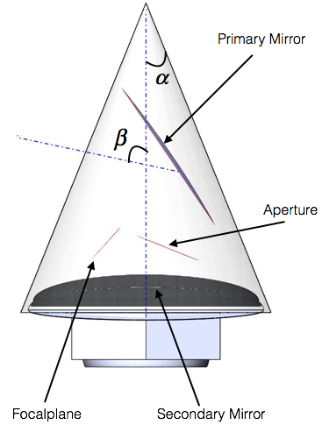
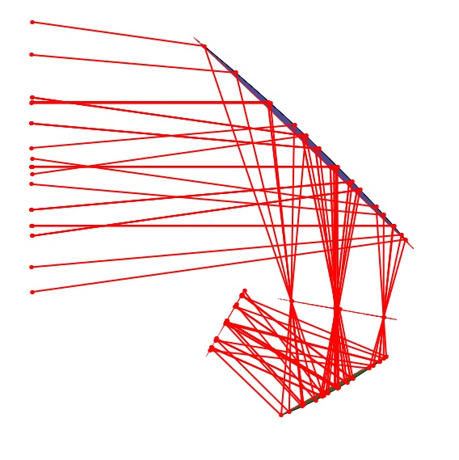
Open Dragone Mid stop
Aperture size (m) | Alpha, focal plane (deg) | Beta
1 | 35 | 60
1.2 | 27 | 68
1.4 | 22 | 73
1.6 | 18 | 77
Conclusion: both ‘open’ and ‘crossed’ have ~7 deg/20 cm aperture tradeoff

