Slide 1
PICO - Probe of Inflation
and Cosmic Origins
Shaul Hanany
University of Minnesota
For the PICO Collaboration
Subscribe: cmbprobe@lists.physics.umn.edu
Learn + participate: https://z.umn.edu/cmbprobe

Slide 2
NASA Prep for Decadal2020
Set up 8 Probe Mission Studies; Probe = $400M - $1000M
Transient Astrophysics Probe (Camp, GSFC)
Cosmic Dawn Intensity Mapper (Cooray, UC Irvine)
Cosmic Evolution through UV Spectroscopy (Danchi, GSFC)
Galaxy Evolution Probe (Glenn, UColorado)
Inflation Probe Probe of Inflation and Cosmic Origins (Hanany, University of Minnesota)
High Spatial Resolution X-Ray Probe (Mushotzky, UMaryland)
Multi-Messenger Astrophysics (Olinto, UChicago)
Precise Radial Velocity Observatory (Plavchan, Missouri State)
https://z.umn.edu/cmbprobe
cmbprobe@lists.physics.umn.edu

Slide 3
Process + Outcomes
Studies are 18 months long
Studies will produce 50 pg. reports
Reports will include cost estimates
NASA will conduct independent cost review
Report + independent cost review will be submitted to the Decadal Panel
Reports are due by 12/2018
Mission start 2023
Mission launch 64 months after start.
https://z.umn.edu/cmbprobe
cmbprobe@lists.physics.umn.edu
Notes:
We are at the end of the study, writing the report.

Slide 4
Taken from Colin Hill’s SO talk
PICO Science Goals and Probes
relativistic species
neutrino mass
primordial fluctuations
galaxy evolution
dark energy
damping tail ➔ Neff (TE, TT, EE)
reionization
lensing potential + tau (EE, EB) ➔ Σmν
large scale B-modes ➔ tensor-to-scalar ratio (BB)
Optical Depth
➔ tau (EE)
Strongly Lensed IR Sources
Lensing, Cluster Counts
credits: ESO
cluster evolution
redshift+1
All with a single instrument, executing a simple repeated scan,
of the entire sky,
with 21 bands (20 - 800 GHz),
with unmatched stability,
and with 0.6-0.9 uK*arcmin
dark matter
Proto Clusters
Milky Way Dynamics and Star Formation
(TT, TE, EE)
Magnetic Field
Notes:
- emphasize that all involve polarization measurements (many of the non-obvious ones are via EB lensing reconstruction), hence all are connected to understanding polarized foregrounds

Slide 5
PICO in Brief
Millimeter/submillimeter-wave, polarimetric survey of the entire sky
21 bands between 20 GHz and 800 GHz
1.4 m aperture telescope
Diffraction limited resolution: 38’ to 1’
13,000 transition edge sensor bolometers
5 year survey from L2
0.87 uK*arcmin requirement; 0.61 uK*arcmin goal (=CBE)
Jet Propulsion Laboratory
Sutin et al. SPIE Vol.10698;
1808.01368
https://z.umn.edu/cmbprobe
cmbprobe@lists.physics.umn.edu
Notes:
PICO is a millimeter/sub-millimeter polarimetric survey of the entire sky. It will produce maps of Stokes I,Q, and U in 21 frequency bands between 20 and 800 GHz, a frequency range that includes emissions from a broad range of galactic, extragalactic, and cosmological sources, including the cosmic microwave background.
It will have a 1.4 meter, two-reflector telescope giving diffraction limited resolution as low as 1’. It will use 12,400 transition edge sensor bolometers and multiplexed readouts, and it will survey the sky for 4 years from L2. The best point of comparison to PICO is the Planck mission, which operated over a similar frequency range. Planck produced polarization maps in only 7 frequency bands, and with 70 times higher polarization noise level. Thus PICO is equivalent to almost 5000 Planck’s.
PICO’s science goals address nearly all goals stated by NASA’s Science strategic plan.

Slide 6
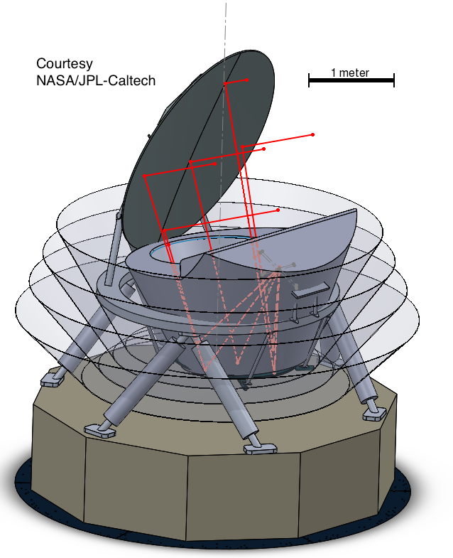
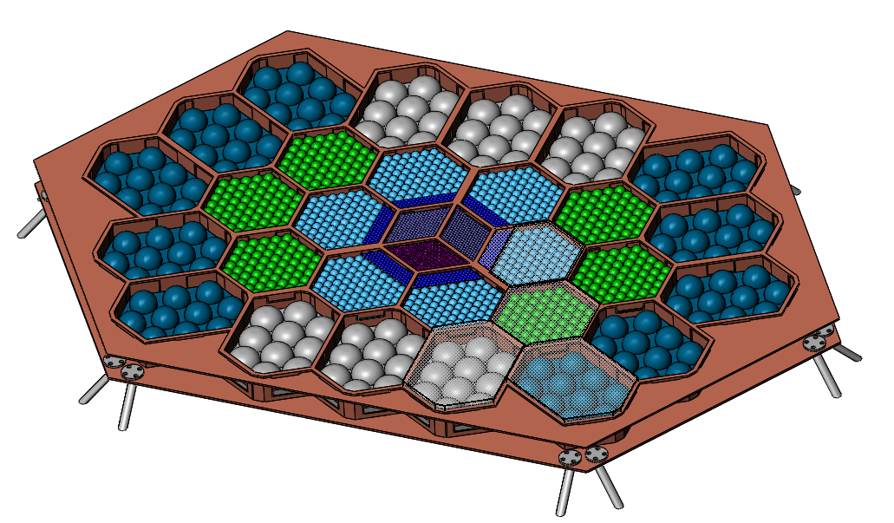
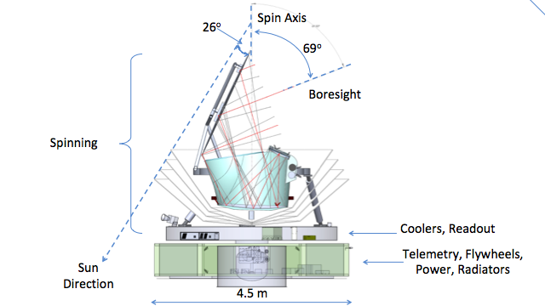
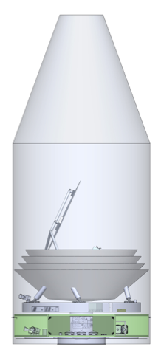
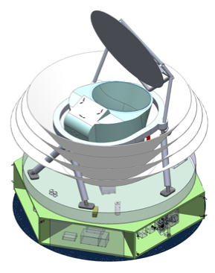
PICO Implementation
center: single color, horn coupled
3-color sinuous antenna coupled
Figure: JPL
2-reflector “Open Dragone” Telescope
Ambient temperature primary
4 K aperture stop
4 K secondary reflector
0.1 K focal plane
Spinning instrument, static bus
Spin: 1 rpm; Precess: 10 hours
50% sky coverage in 10 hours
80 cm; 17 kg
Young et al. SPIE Vol.10698;
1808.01369
Figure: JPL
Figure: JPL
Figure: JPL
Notes:
Here is a current tally of CMB mission concepts. There are two active concepts, LiteBIRD, a Japanese led mission that is currently funded in Japan to conduct a PhaseA study, and PICO, which we are currently studying here in the US.
There are two missions on hold. They are on-hold in the sense that they have been recently proposed, and declined and will likely be proposed again. These are CORE submitted to ESA and by ESA and PIXIE submitted to NASA.
Before I give more details on these missions, let me take a historical perspective, which may be useful for the discussion later.

Slide 7
PICO Responds to all NASA Science Goals
Explore how the Universe began
Discover how the Universe works
Explore how the Universe evolved
Notes:
To summarize:
PICOs science goals of inflation, quantum gravity, particle physics, extragalactic and galactic structure and evolution are all unique and can only be probed with the measurements proposed.
PICO is the only instrument with the combination of sky coverage, resolution, frequency bands, and sensitivity, to achieve this science with one platform.
We had our initial engineering and costing study completed; no significant issues in engineering nor in cost were identified. The technology implementation is a simple extension of today’s technologies. And the mission is a good fit to the cost window.

Slide 8
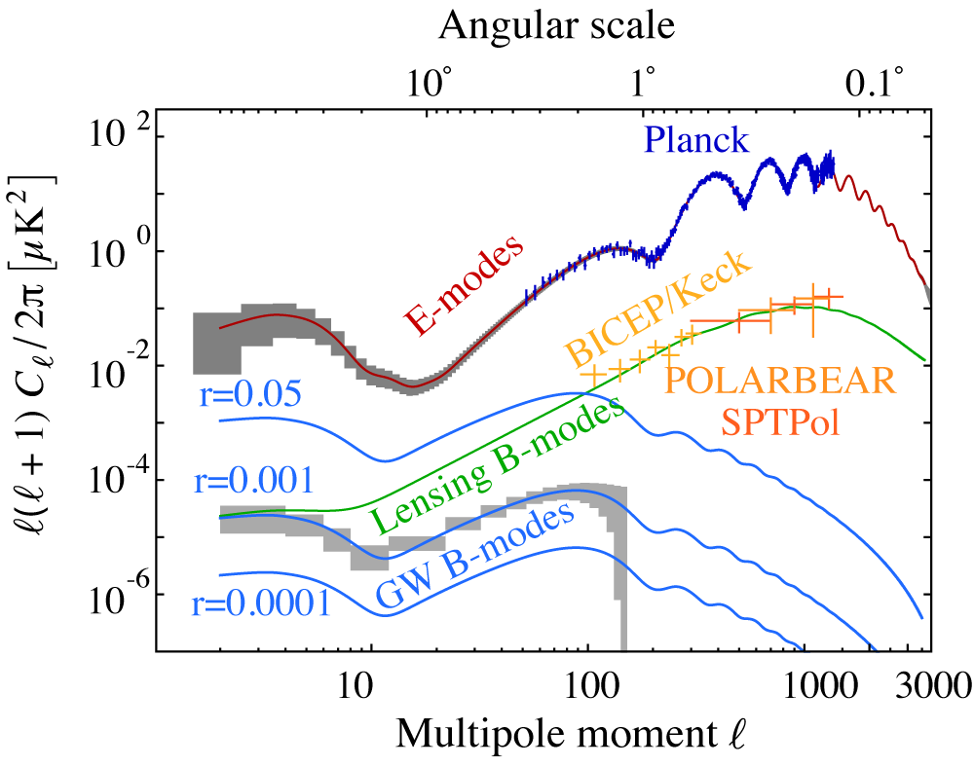
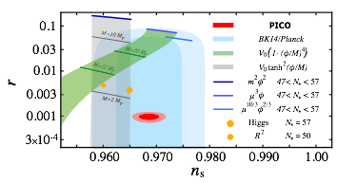
Explore How the Universe Began - Inflation
Detect / set upper bound on the energy scale of inflation; constrain inflation models
Requirement:
CMB4Cast (Fisher), (Feeney + Errard JCAP 2016)
Internal delensing (80%)
Maximum likelihood parametric fitting of Planck 2015-constrained foreground sky
Dust+Synch spectral indices varying (15 deg patches)
60% of sky
Does not include systematic uncertainties
Is not map-based foreground separation
Figure: R. Flauger
projected
1σ errors
Figure: R. Flauger
Figure: R. Flauger

Slide 9
Map Based
Working also with map-based cleaning
7 different full sky models, all consistent with Planck but somewhat different foreground realizations; 100 noise realizations, 50 w/r=0, 50 w/r=0.003; each in various degrees of (fake) delensing levels (1, 0.3, 0.15, 0.003); also PSM
Several component separation approaches
Commander1 (PSM; Remazeilles)
NILC (Basak)
SEVEM (Barreiro)
+ GNILC (Remazeilles), Commander2 (Wehus+), xForecast + multi-patch (Errard)

Slide 10
Map Based Models
Models:
90 - Gaussian dust and synchrotron, uniform amplitude
91 - PySM a1d1f1s1 ; 1608.02841
92 - PySM a2d4f1s3
93 - PySM a2d7f1s3
96 - Brandon’s MHD
98 - Delabrouille ++, Multi-layer dust; 1706.04162
99 - Vansyngel; 1611.02577

Slide 11
The Role of High Frequency Bands
-4 low;
-3 high
(555, 665, 800)
-4 low
(21, 25, 30, 36)
green = input CMB
red = reconstructed
black = input
red = Commander
M. Remazeilles
Synchrotron curvature, Cs = 0.3 over the entire sky, also fitted
Notes:
To summarize:
PICOs science goals of inflation, quantum gravity, particle physics, extragalactic and galactic structure and evolution are all unique and can only be probed with the measurements proposed.
PICO is the only instrument with the combination of sky coverage, resolution, frequency bands, and sensitivity, to achieve this science with one platform.
We had our initial engineering and costing study completed; no significant issues in engineering nor in cost were identified. The technology implementation is a simple extension of today’s technologies. And the mission is a good fit to the cost window.

Slide 12
The Effects of Averaging
-4 low;
-3 high
(555, 665, 800)
-4 low
(21, 25, 30, 36)
Native resolution nside=512
green = input CMB
red = reconstructed
Commander
analysis nside = 16
black = input
red = Commander
Strong bias
Notes:
To summarize:
PICOs science goals of inflation, quantum gravity, particle physics, extragalactic and galactic structure and evolution are all unique and can only be probed with the measurements proposed.
PICO is the only instrument with the combination of sky coverage, resolution, frequency bands, and sensitivity, to achieve this science with one platform.
We had our initial engineering and costing study completed; no significant issues in engineering nor in cost were identified. The technology implementation is a simple extension of today’s technologies. And the mission is a good fit to the cost window.

Slide 13
The Challenge of low \ell Foregrounds - SEVEM
Preliminary Results
B. Barreiro, Model 91
B. Barreiro, Model 92
10⁻¹⁵
10⁻¹⁵
r=0.003
r=0.003
10⁻¹⁶
10⁻¹⁶
10⁻¹⁷
50%
10⁻¹⁷
25% of sky
50%
25% of sky
10⁻¹⁸
10
20
30
100
1000
10⁻¹⁸
10
20
30
100
1000
Experiments with masks
For spectra shown, masks are based on residuals of that model
Notes:
To summarize:
PICOs science goals of inflation, quantum gravity, particle physics, extragalactic and galactic structure and evolution are all unique and can only be probed with the measurements proposed.
PICO is the only instrument with the combination of sky coverage, resolution, frequency bands, and sensitivity, to achieve this science with one platform.
We had our initial engineering and costing study completed; no significant issues in engineering nor in cost were identified. The technology implementation is a simple extension of today’s technologies. And the mission is a good fit to the cost window.

Slide 14
The Challenge of low \ell Foregrounds - NILC
S. Basak - all figures
Blue = input CMB
Red = recovered CMB
Green = Foreground residual
Notes:
To summarize:
PICOs science goals of inflation, quantum gravity, particle physics, extragalactic and galactic structure and evolution are all unique and can only be probed with the measurements proposed.
PICO is the only instrument with the combination of sky coverage, resolution, frequency bands, and sensitivity, to achieve this science with one platform.
We had our initial engineering and costing study completed; no significant issues in engineering nor in cost were identified. The technology implementation is a simple extension of today’s technologies. And the mission is a good fit to the cost window.

Slide 15
The Challenge of low \ell Foregrounds
What’s next
SEVEM - attempting coarser resolution
NILC - more realizations
Graca is estimating parameters
More methods soon

Slide 16
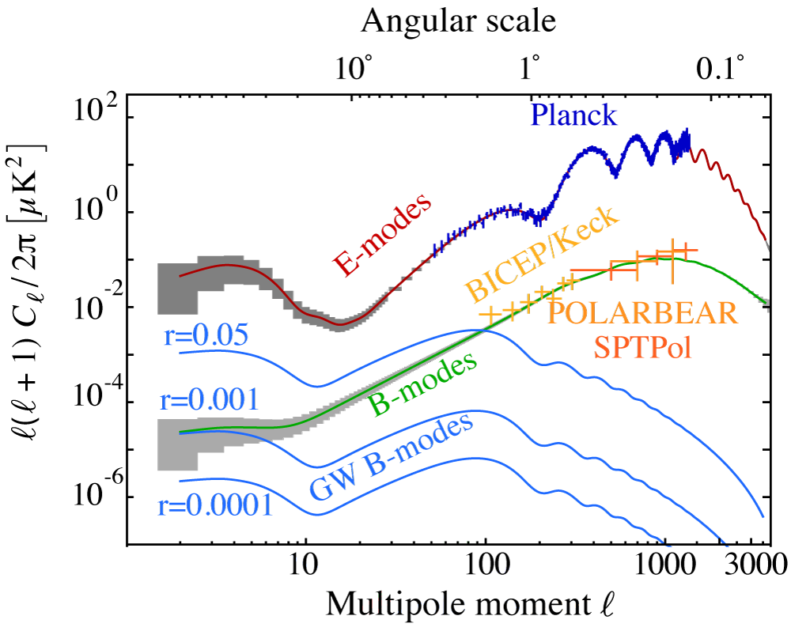
Explore how the Universe Evolved - Reionization
Determine the reionization history of the Universe
CV limited
(Planck, PICO)
(S3, SPT)
Transition from neutral to ionized Universe controlled by ‘IGM Opacity’ and ‘Source Efficiency’
Figure: N. Battaglia
Notes:
PICO will explore how the Universe evolved by determining the reionization history of the Universe. The E-mode power spectrum over the largest angular scales is sensitive to the optical depth to reionization.
Here we show forecasts in a plane of the redshift to reionization and the duration of reionization. We show current constraints by Planck in yellow and exclusion regions by other experiments.
PICO, shown in blue, will measure the optical depth to cosmic variance limits. This measurement is uniquely suited for a space based mission that has an unimpeded view of the entire sky.

Slide 17
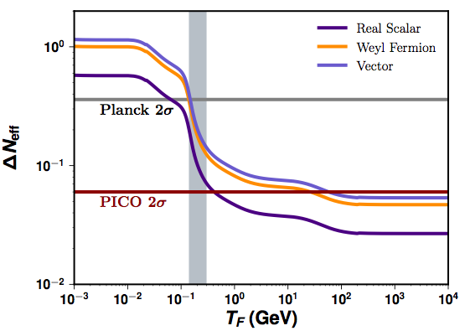
Discover How The Universe Works - Neff
Constrain the number of light relics in the early Universe
Constraint is proportional to number of modes in TT, TE, and EE
Extend range of energy to exclude new species by
x300 for vector particle
x2.5 for scalar particle
Cross the QCD phase transition
QCD
now
with PICO
x300
Figure: D. Green
Figure: D. Green
damping
Amplitude
Phase
Phase
Figure: J. Meyers
Baumann et al. 2017
Notes:
PICO will also determine the number of relativistic species of particles, Neff, also less accurately known as the ‘number of neutrino families’. The canonical Standard Model is 3.046 for a minimum of three known neutrino families. But there may be other particles, for example a light sterile neutrino or dark photons.
With large sky coverage, shown on the vertical axis, and its high sensitivity on the horizontal PICO will reach 6 times the accuracy of Planck.
The PICO constraint pushes our ability to probe the existence of new particles to epochs in the evolution of the universe that are earlier than the QCD phase transition. For example, we would reach an energy threshold that is 300 times higher than the current Planck constraints, for the case of new vector type particles.
The CMB gives the strongest constraints on Neff compared to any other available probe.

Slide 18
Discover How The Universe Works - Neutrino Mass
Determine the sum of neutrino masses
Measurements of the matter power spectrum, primarily through the lensing potential power spectrum (\ell~1000)
Break degeneracy between and with DESI-BAO
4σ or 7σ detection
Similar, independent constraint from PICO cluster counts
PICO gives both tau and lensing
Lensing potential
Req
TT
EB
Estimator noise
CBE
Figure: A. Van Engelen
Figure: D. Green
Notes:
we should be able to show the same lensing potential for different values of tau and sum nu

Slide 19
Foreground Effects on phi-phi and delensing
Lensing potential
s/n = 521
0.8
0.73
Figure: A. Van Engelen + C. Hill
s/n = 650
TT
EB
Estimator noise
Figure: A. Van Engelen + C. Hill
Figure: A. Van Engelen
Colin applies ILC Foreground separation in the power spectrum using PICO noise
(model includes frequency + EE+ BB from planck/WMAP + extrapolated to high \ell)
gives post subtraction (higher) noise levels to Alex
Alex recalculates S/N for phi-phi or for delensing level on BB
Notes:
we should be able to show the same lensing potential for different values of tau and sum nu

Slide 20
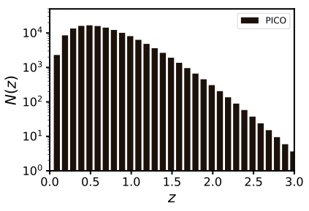
Discover how the Universe Works - Dark Energy
Extract cosmological parameters with 140,000 clusters, 1000 with z>2
using thermal SZ, full sky
Planck: ~2000
S3: 20,000
(x3.5 planck)
30 GHz
150 GHz
217 GHz
300 GHz
Figure: N. Battaglia
Simulated Temperature signature of SZ cluster. Figure: N. Battaglia
(x2.5 planck)

Slide 21
Discover How The Universe Works - Dark Matter
Figure: V. Gluscevic + Z. Li
Gluscevic + Body 2018
Li et al. 2018
Kavanagh 2017
Figure: V. Gluscevic + Z. Li
Gluscevic + Body 2018
Li et al. 2018
Constrain low energy dark matter cross section
Region not accessible to direction detection experiments
x25 improvement relative to PlancK
Notes:
PICO will also determine the number of relativistic species of particles, Neff, also less accurately known as the ‘number of neutrino families’. The canonical Standard Model is 3.046 for a minimum of three known neutrino families. But there may be other particles, for example a light sterile neutrino or dark photons.
With large sky coverage, shown on the vertical axis, and its high sensitivity on the horizontal PICO will reach 6 times the accuracy of Planck.
The PICO constraint pushes our ability to probe the existence of new particles to epochs in the evolution of the universe that are earlier than the QCD phase transition. For example, we would reach an energy threshold that is 300 times higher than the current Planck constraints, for the case of new vector type particles.
The CMB gives the strongest constraints on Neff compared to any other available probe.

Slide 22
Explore how the Universe Evolved
Map magnetic field for our Entire Galaxy
Planck, 5’
PICO, smoothed to 5’
PICO, 1’
Figure: Fissel, Chuss
Notes:
PICO will explore how the universe evolved by determining the relative roles of turbulence and the magnetic field in Milky Way dynamics and star formation efficiency; the information comes from a measurement of the galactic magnetic field.
The map shows the region on the sky in which current Planck data gives polarization uncertainty of less than 0.3%, with its 5’ beams. It is the small fraction of sky shown in yellow. PICO’s data will extend the information over the entire sky at the same resolution; And it will give the same polarization uncertainty at 5 times higher resolution over most of the sky, shown in green.
PICO will map sub-mm emission from the interstellar medium in nearly 100 nearby galaxies to determine how typical the Milky Way is; only a handful have been mapped in the sub-mm to date.
And it will constrain the shape and composition of interstellar dust grains.

Slide 23
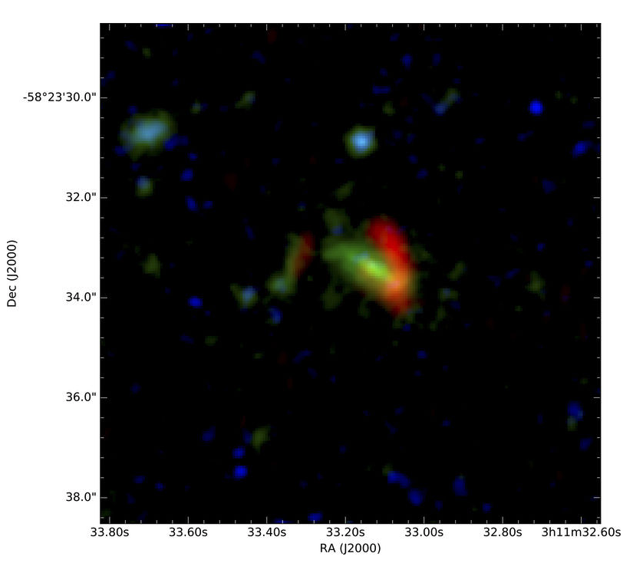
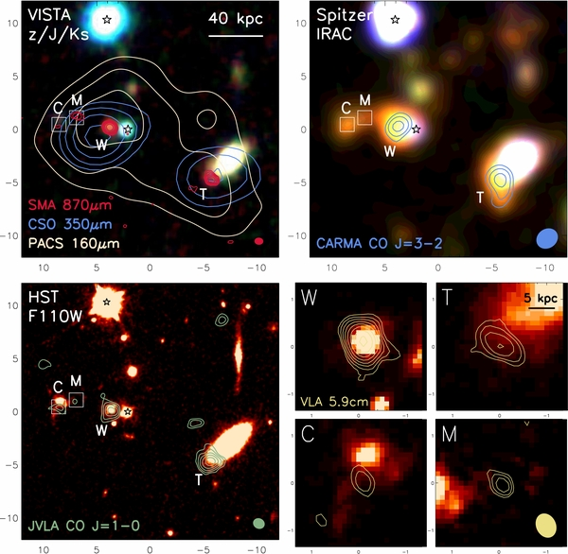
Legacy Science
Discover 4500 highly magnified dusty galaxies at z up to ~5;
Discover tens of thousands proto-clusters extending to high redshift (z~4);
Detect polarization of 4000 radio and FIR-emitting galaxies;
x10-1000 more than known today
Probe star formation history; determine galaxy and cluster formation and evolution; learn about dark matter substructure; and measure properties of jets in radio-loud sources.
NSF News Release Dec. 6, 2017
Marrone et al. 2017; two strongly lensed massive galaxies, z=6.9
(SPT initial detection)
Ivison et al. 2013; proto-cluster core, z=2.4
(Herschel initial detection)
Notes:
PICO will produce a rich legacy data set that will be mined for years. In addition to 21 sky maps of Stokes I, Q, U it is expected to discover 3000 highly magnified dusty galaxies, similar to the one recently discovered in the SPT field, and garnered an NSF press release. It will discover 3000 porto-clusters, 4000 radio and Far IR emitting galaxies and tens of thousands of new clusters. All of these give factors of 10 to 100 improvement over what is known today.
These sources will be used to probe star formation history, determine galaxy and cluster formation and evolution, learn about dark matter substructure, measure the properties of jets in radio-loud sources.

Slide 24
Strengths of a Space Mission
Unparalleled view of the entire sky Access to the lowest
Unparalleled frequency coverage all in one instrument/data set
Bock et al. 2009
Q
U

Slide 25
Strengths of a Space Mission
Bartlett + Melin
Bias affects cluster count cosmology
Unparalleled view of the entire sky Access to the lowest
Unparalleled frequency coverage all in one instrument/data set
Bock et al. 2009
Q
U
ratio of # of S4 SZ sources detected in a redshift bin when including source dust
to # detected when not including source dust in MMF
same as red but including power law dust SED in MMF
MMF = Multifrequency Matched Filter

Slide 26
Systematics - (Absolute) Gain Calibration
B. Barreiro
Figure: M. Tomasi
Notes:
To summarize:
PICOs science goals of inflation, quantum gravity, particle physics, extragalactic and galactic structure and evolution are all unique and can only be probed with the measurements proposed.
PICO is the only instrument with the combination of sky coverage, resolution, frequency bands, and sensitivity, to achieve this science with one platform.
We had our initial engineering and costing study completed; no significant issues in engineering nor in cost were identified. The technology implementation is a simple extension of today’s technologies. And the mission is a good fit to the cost window.

Slide 27
FAQ
Did you consider a spectrometer?
Yes
Did you consider a LiteBIRD type mission
Yes and No
What does ‘endorsing the report’ imply?
That you think there are still opportunities for CMB in space and you encourage NASA to stay in the CMB business
Notes:
To summarize:
PICOs science goals of inflation, quantum gravity, particle physics, extragalactic and galactic structure and evolution are all unique and can only be probed with the measurements proposed.
PICO is the only instrument with the combination of sky coverage, resolution, frequency bands, and sensitivity, to achieve this science with one platform.
We had our initial engineering and costing study completed; no significant issues in engineering nor in cost were identified. The technology implementation is a simple extension of today’s technologies. And the mission is a good fit to the cost window.

Slide 28
PICO Summary
Inflation, quantum gravity, particle physics, extragalactic and galactic structure and evolution:
All unique goals for the PICO measurements
PICO is the only instrument with the combination of sky coverage, resolution, frequency bands, and sensitivity to achieve all of this science with a single, optimally stable platform.
Engineering + costing study complete:
Technology implementation is a straightforward extension of today’s technologies; no technological breakthroughs required
Mission is a good fit to the cost window
We very much hope to see NASA continue to support CMB from space in the next decade
Notes:
To summarize:
PICOs science goals of inflation, quantum gravity, particle physics, extragalactic and galactic structure and evolution are all unique and can only be probed with the measurements proposed.
PICO is the only instrument with the combination of sky coverage, resolution, frequency bands, and sensitivity, to achieve this science with one platform.
We had our initial engineering and costing study completed; no significant issues in engineering nor in cost were identified. The technology implementation is a simple extension of today’s technologies. And the mission is a good fit to the cost window.

Slide 29
Additional Slides

