Slide 1
Slides for CMB probe detectors
Roger O’Brient

Slide 2
Technologies
Detectors:
  TESes
  KIDs/TKIDs
  mm-wave HEMTs
Optical Coupling:
  Horn direct
  Horn/ustrip
  Antenna array
  lens
Readout
  SQUID FDM
  SQUID TDM
  u-wave SQUIDs
  KIDs

Slide 3
Technologies
Detectors:
  TESes
  KIDs/TKIDs
  mm-wave HEMTs
Optical Coupling:
  Horn direct
  Horn/ustrip
  Antenna array
  lens
Readout
  SQUID FDM
  SQUID TDM
  u-wave SQUIDs
  KIDs

Slide 4
TESes
90GHz & 150GHz flew in SPIDER-> CMB-pol maps [1]
Operating temperature: 250mK (can be lower for some noise benefit)
White noise:
  ~25aW/√Hz for 95GHz optical band, stable to 0.02Hz
  Can be extended to extreme frequencies 20GHz-1THz.
  Noise at ~1aW/√Hz is challenging to achieve because legs are mechanically weak.

Slide 5
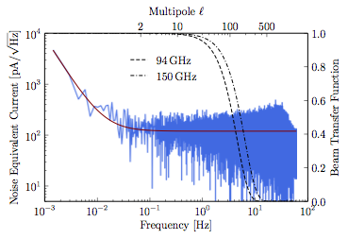
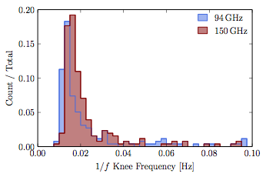
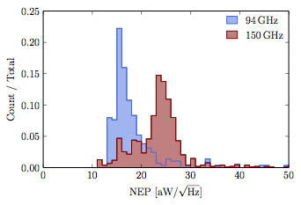
TESes

Slide 6
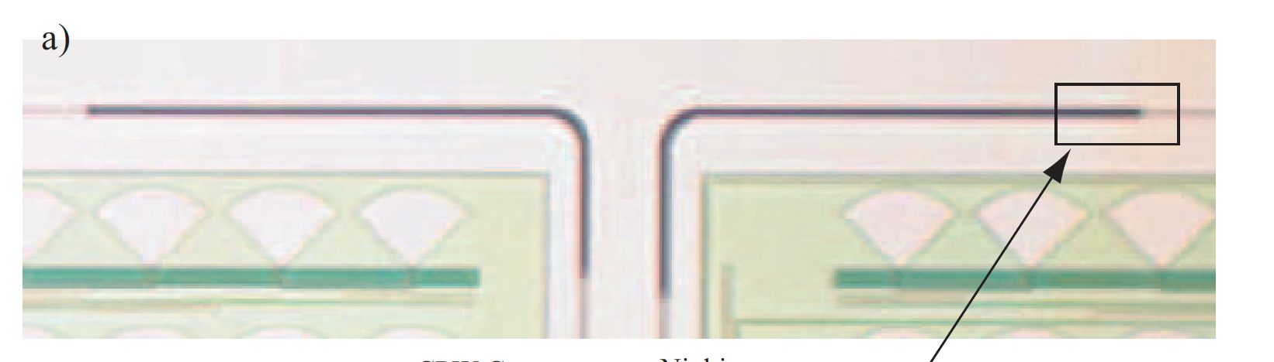
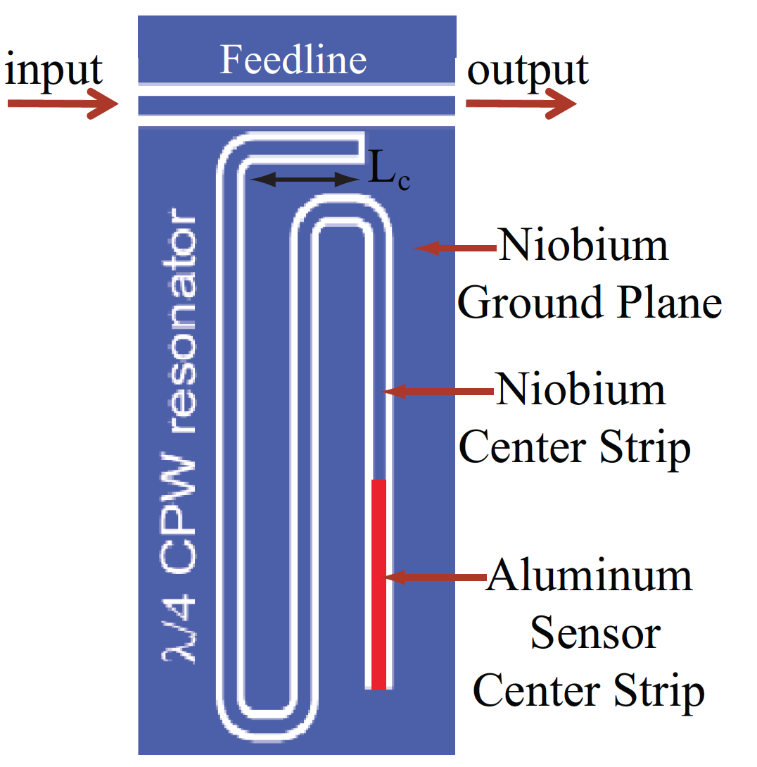
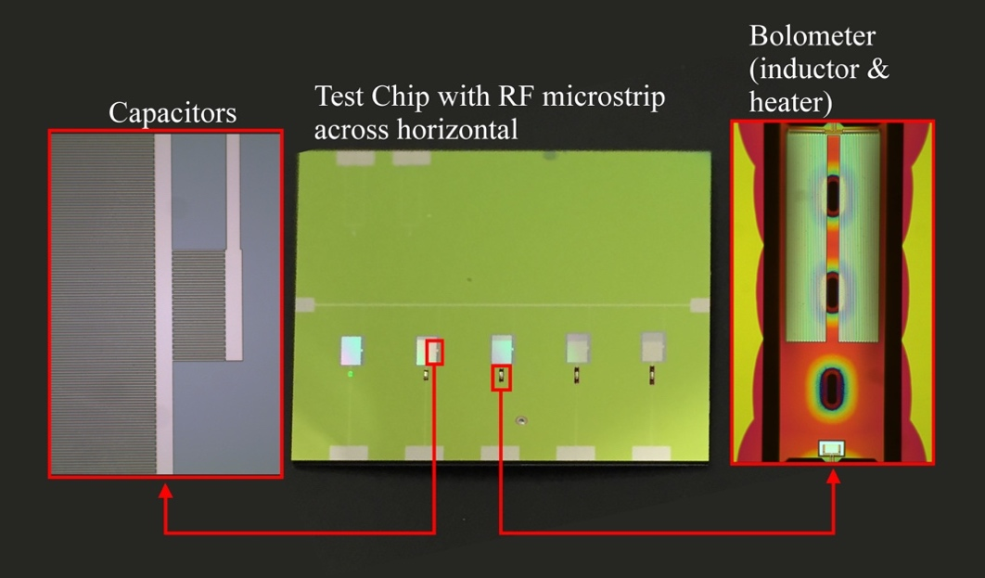
KID Varieties
LEKID
MKID
TKID

Slide 7
LEKIDs
LE= “lumped element”
Operating temperature: 100mK
NIKA2, IRAM Telescope, Pico Valeta (Andalusia) [2]
  150GHz optical band
  1.5 mK/√Hz white, stable to 1Hz in audio time-stream
MAKO, Mauna Kea CSO
  350um, background limited
  850um, not background limited
BLAST-TNG to fly 2018-19[3]. Lab demos suggest:
  1THz optical band
  2×10⁻¹⁶ W/√Hz under 14pW loading
Columbia/ASU lab tests[4]
  150GHz optical band
  30μK√s per det white noise under 4K loading, stable to 1Hz
Aluminum bandgap prevent KIDs from working below 100GHz
  Need more exotic materials, e.g. TiN

Slide 8
MKIDs & TKIDs
M= “microwave” (1-10GHz)
MUSIC (150-300GHz) deployed to CSO
TLS is a problem at these frequencies. Readout becomes power-hungry
T=“thermal.” A bolometer with a KID thermometer
More expensive to fabricate, but avoids some engineering/test challenges
Only lab demos

Slide 9
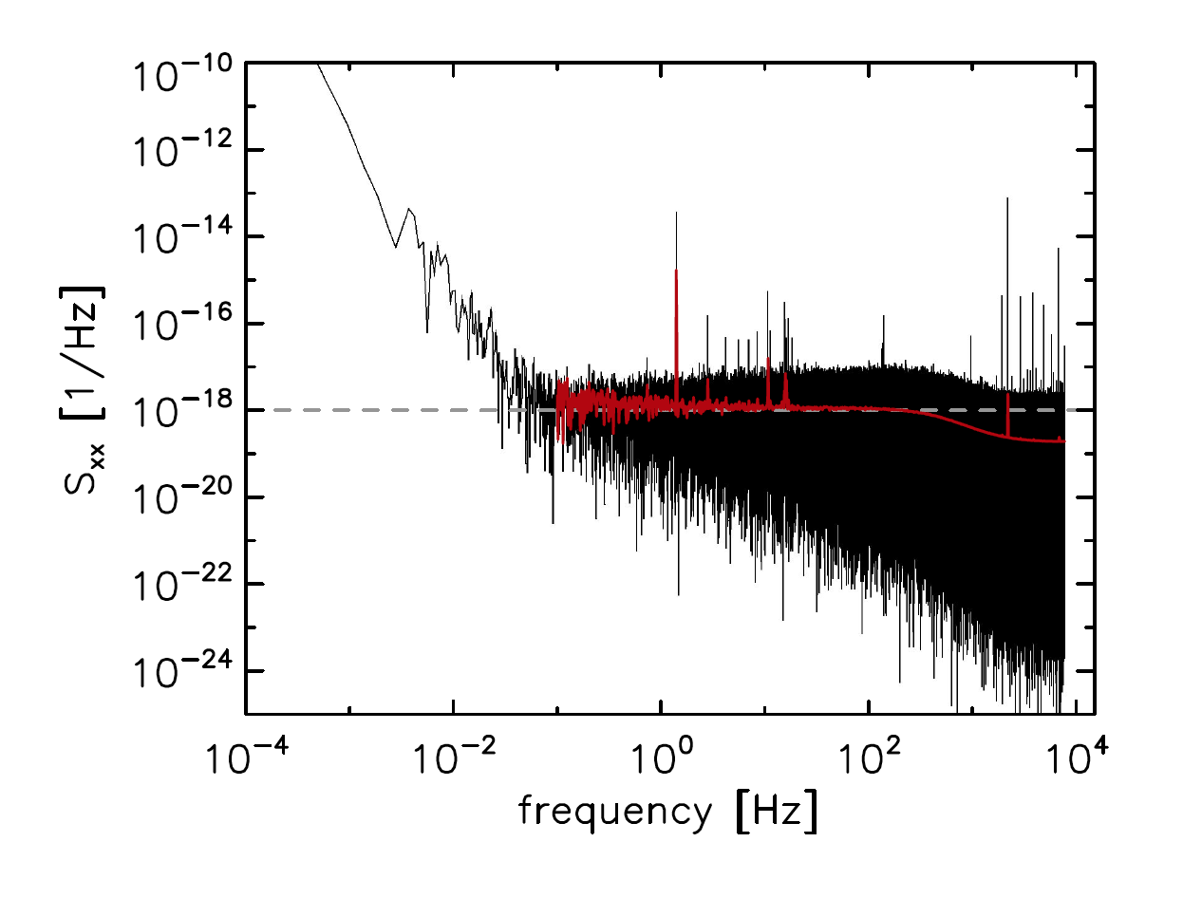
LEKIDs
A flattering noise spectrum, from Johnson group at Columbia (unpublished?).
Calibrated using very bright sources to ensure photon-limited performance

Slide 10
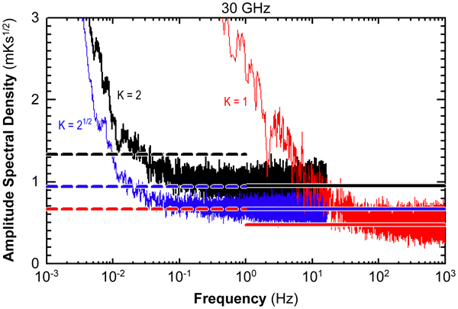
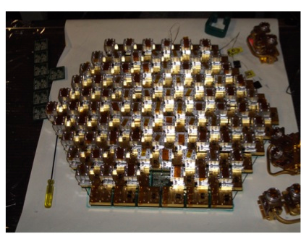
HEMTs
Similar technologies flown in Planck & WMAP.
Modern verson demonstrated in QUIET [5].
Operating temperature: 20K
NET is not background limited above ~90GHz in space
Cryo stage Power dissipation in HUSIR ~1W/feed![6]
QUIET (Atacama)[7]:
  Q-band: 17 element, combined 69 μK√s white noise
  W-band: 84 element, combined 87 μK√s white noise

Slide 11
Technologies
Detectors:
  TESes
  KIDs/TKIDs
  mm-wave HEMTs
Optical Coupling:
  Horn direct
  Horn/ustrip
  Antenna array
  lens
Readout
  SQUID FDM
  SQUID TDM
  u-wave SQUIDs
  KIDs

Slide 12
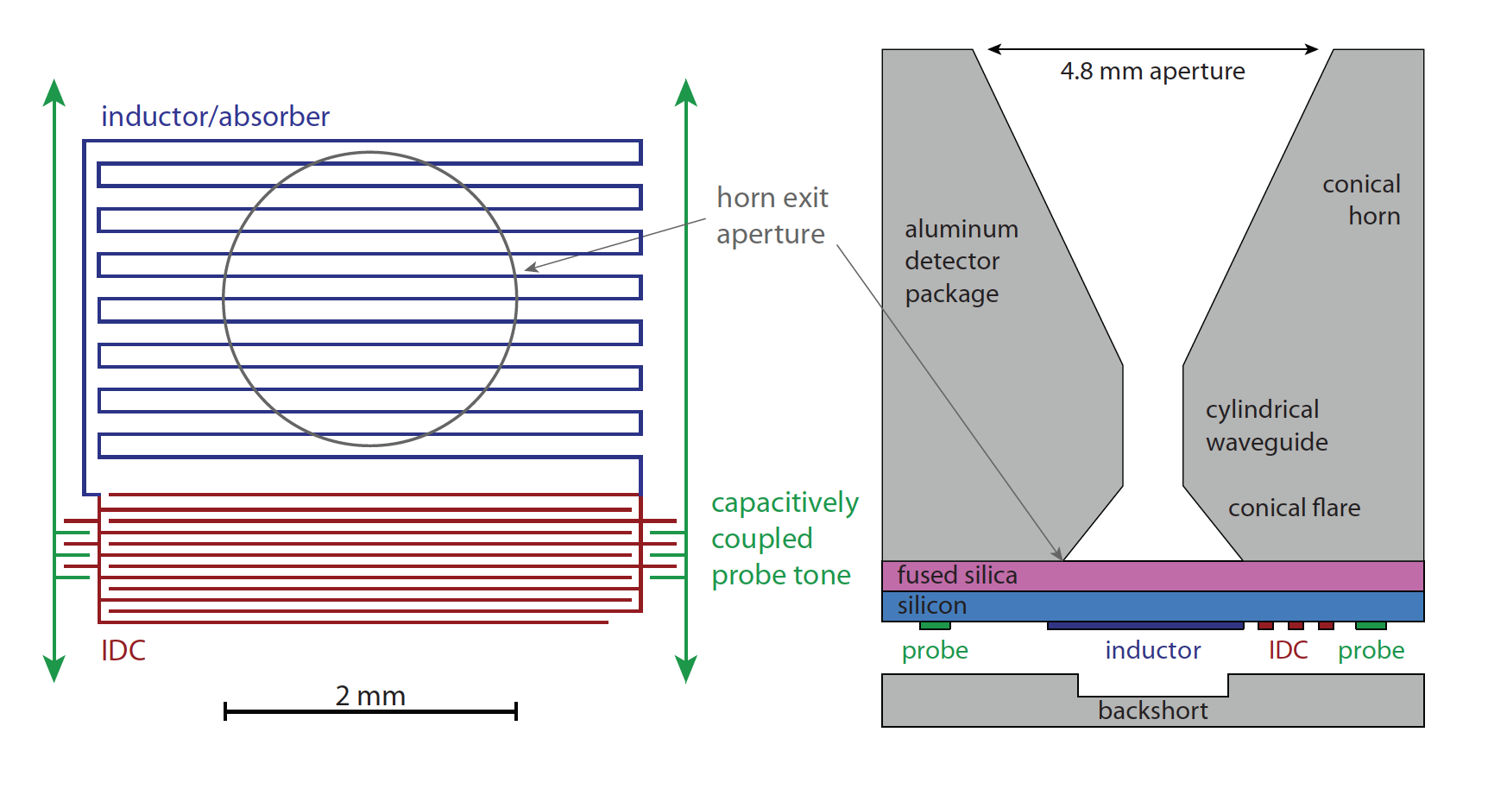
Horn, direct coupling
TRL 9. Used in Planck, SPT-SZ, NIKA, ColumbiaASU-KIDs [8]
Only one color per detector. Dual pol can be tricky
For bolometers, must release large surface area.
No microstrip loss challenges

Slide 13
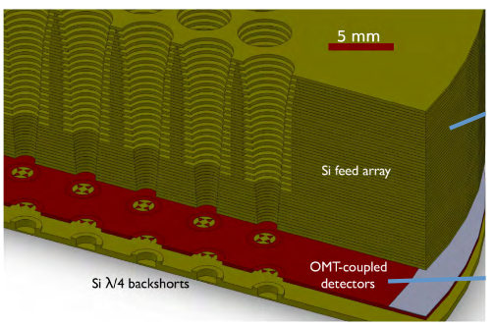
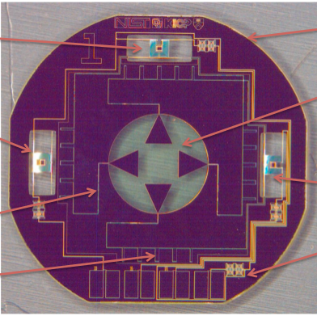
Horn,microstrip
Couple from WG modes to OMT, to CPW, to microstrip [9]
NIST centered collaborations
Used in ACTpol, ABS & SPTpol. Will fly in SPIDER 2019-20
Broadband: Have deployed 90/150GHz channels
Highly symmetric beams
Platelet or mandrel formed

Slide 14
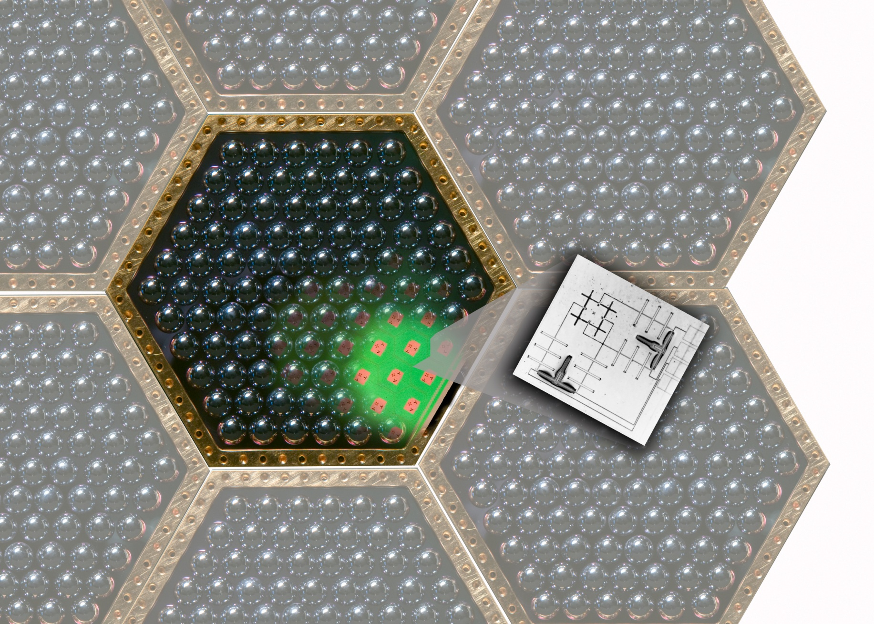
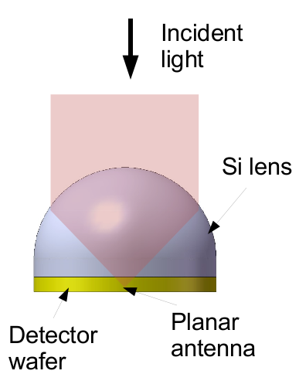
Lens coupled
Use small dual slot antennas, or sinuous antennas [10]
Berkeley centered collaborations
Used in Polarbear/Simon’s Array and SPT-3G
Broadband: Have deployed 90/150/220GHz channels
Structure in beams. Need to see systematics studies.

Slide 15
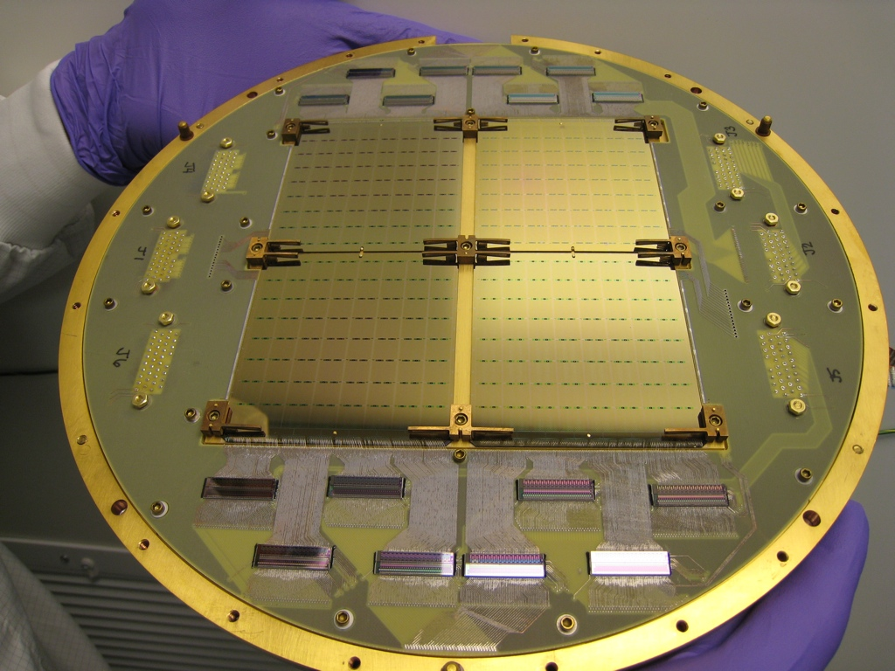
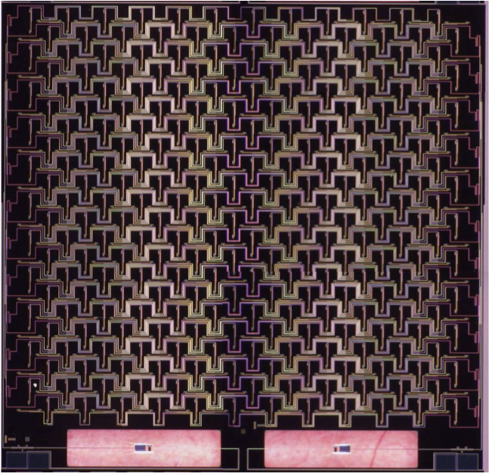
Antenna Array coupled
Use antenna arrays for beam synthesis [1]
Caltech/JPL centered collaborations
Used in BICEP/Keck Array and SPIDER
Broadband under slow development; not scientifically motivated in BICEP program
Beams have some structure so not as pure as horns, but systematics certainly controlled to r~0.001 levels [12]

Slide 16
Technologies
Detectors:
  TESes
  KIDs/TKIDs
  mm-wave HEMTs
Optical Coupling:
  Horn direct
  Horn/ustrip
  Antenna array
  lens
Readout
  SQUID FDM
  SQUID TDM
  u-wave SQUIDs
  KIDs

Slide 17
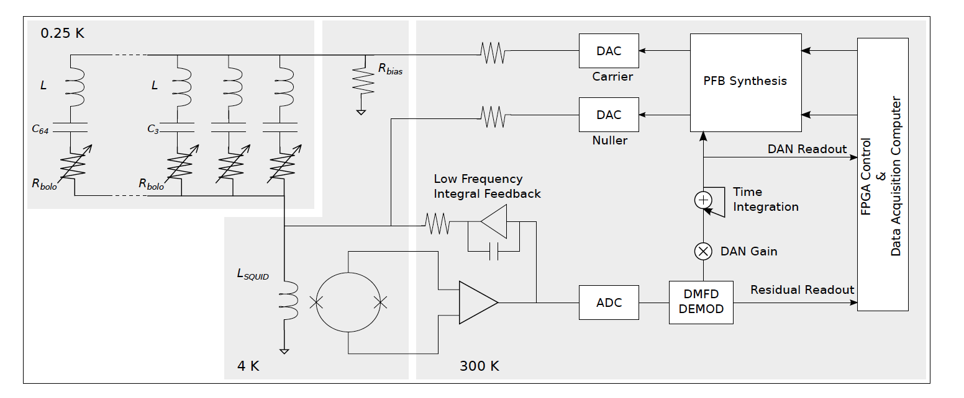
SQUID FDM[12]
AC biased and summed TESes.
Used in Polarbear, EBEX, SPT. Baseline for LiteBIRD
Uses only one SQUID (SSA) per bolo comb.
All detectors continuously sampled. No aliasing.
Active nulling. Account for phase delays in lines.

Slide 18
SQUID FDM
Achieved MUX factors: 68 in SPT-3G
Crosstalk from neighboring tones in PB1: 1%.
Warm electronics power: McGill “ICE” no more than 7.8W/comb (68 tones ea., in SPT3G)
Cryogenic Power dissipation:
  UC: no power consumption (no SQUIDs)
  4K SSA: no more than 1uW/comb (of ~68 tones)

Slide 19
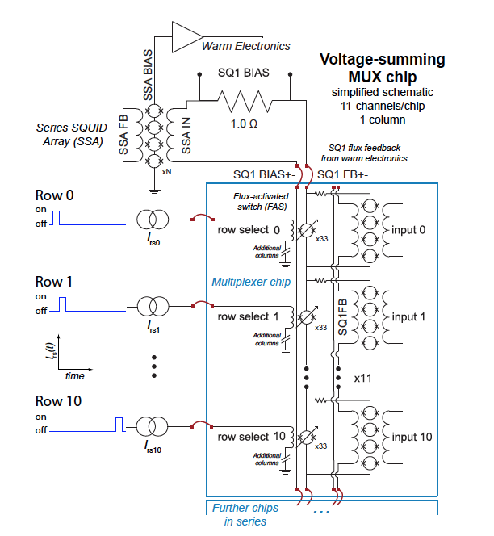
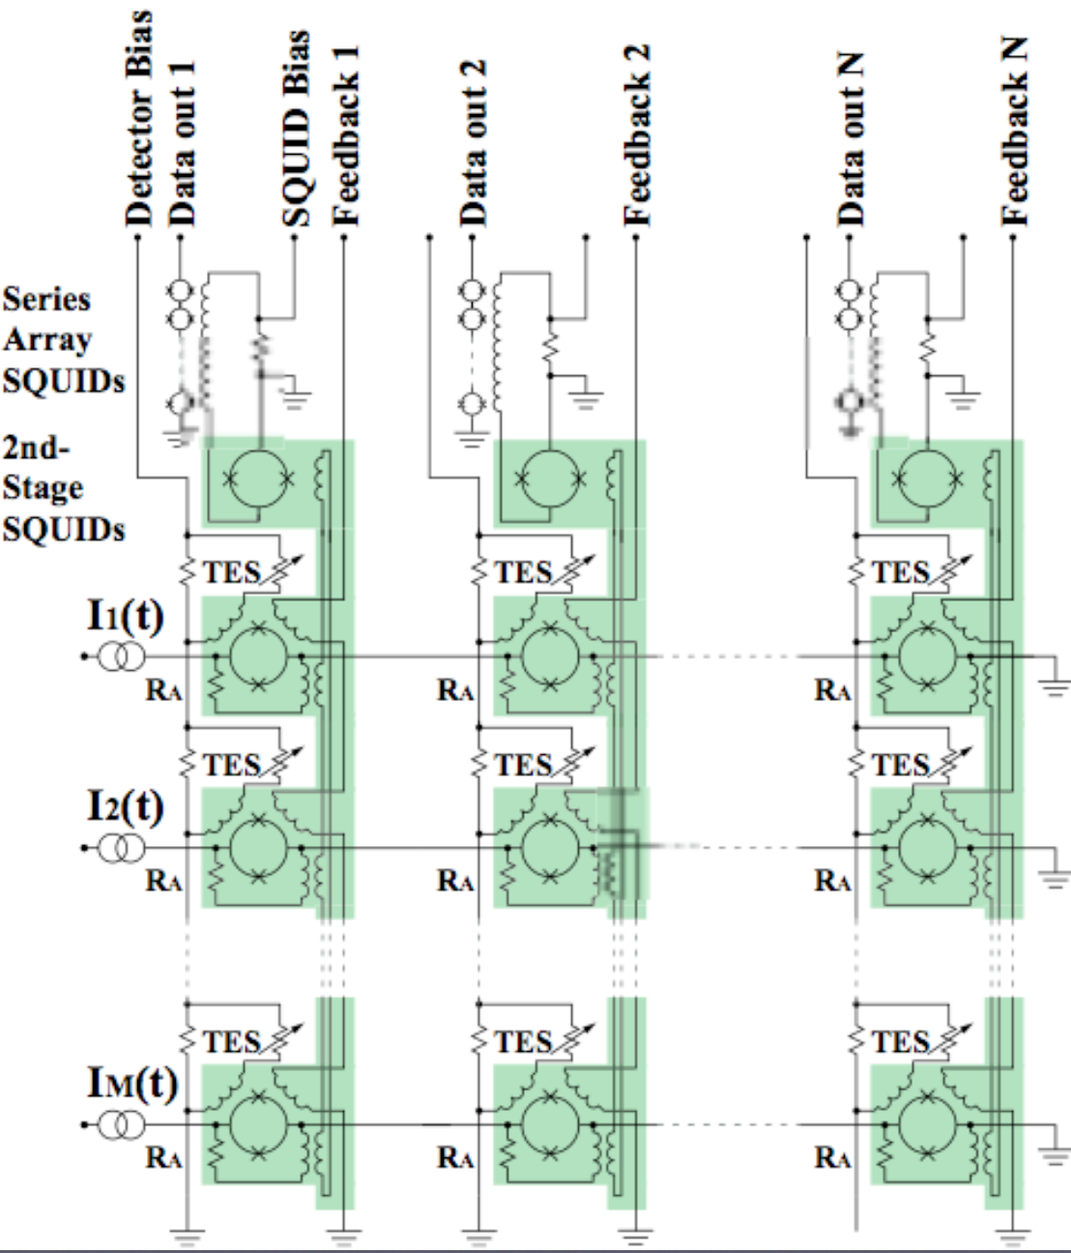
SQUID TDM [13]
Old 3-stage SQUID design
New 2-stage SSA+ Flux Activated Switches

Slide 20
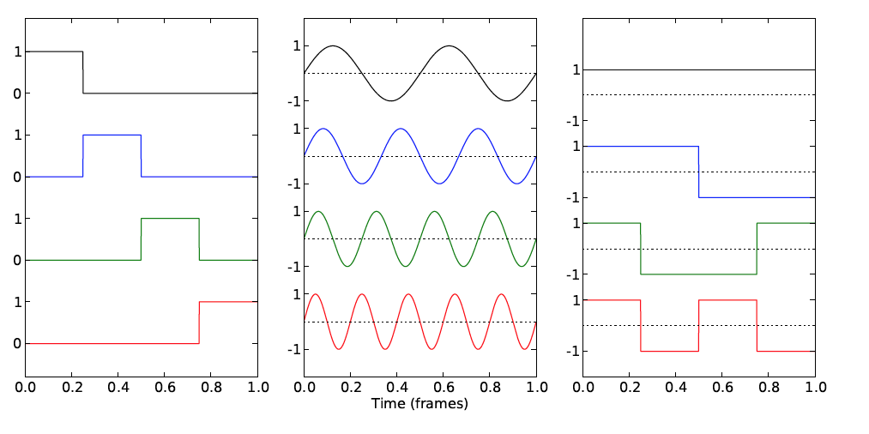
SQUID TDM
ACT, CLASS, BICEP/Keck, SPIDER
MUX factor 64/col achieved in ACT. Claim 128 is possible.
Demonstrated 0.01Hz stability in SPIDER
Inductive Crosstalk: 0.25% btwn adjacent rows in a col for TDM (f/ B2 beam maps). Finite recovery time not a problem for MUX 32 (and, I presume, 64).
\sqrt(N) aliasing noise penalty. Code domain MUX could alleviate this [14]
Cryogenic power dissipation of NIST SQUIDs:
  UC: 2nW/col
  4K SSA: 20nW/col
Warm Power Consumption in UBC MCE: 2.7W/col (MUX factor 64)
TDM FDM CDM

Slide 21
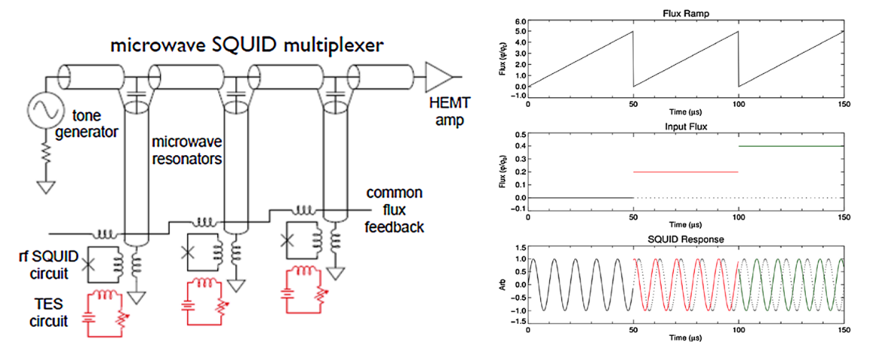
Microwave MUX
Demo in MUSTANG, various DOE x-ray cameras
TES currents couple to SQUID, which couples to resonator termination. So TESes can “act like” KIDs.
Linearize with flux ramping [16].
Ramping acts like a chop, supresses TLS noise (or other low freq noise)

Slide 22
Microwave MUX/KID Readout
TES/ uMUX:
System noise: 17pA/rtHz (subdominant to photons for stage4 atmosphere) above 1Hz
32 tones/comb demonstrated. Could be hundreds in future.
UC power load: 10pW/channel
Cross-talk: 0.1% claims made.
KIDs:
negligible power dissipation at UC.
1000 tones/comb.
Both:
4K power load: 5-10mW from an LNA.
ROACH2/SRON readout: 50-100W, but depends on channel count. Still young technology
NIKA-2 & MAKO each had 400 tones/rf-line.

Slide 23
References
BICEP/SPIDER detectors: arXiv1502.00619
NIKA2 KIDs: arXiv1601.02774
BLAST-TNG KIDs: arXiv1603.02963
ColumbiaASU KIDs: arXiv1510.06609
Planck LFI: http://planck.caltech.edu/lfi.html
HUSIR detectors: www.nrao.edu/meetings/isstt/papers/2007/2007131134.pdf
QUIET Paper: arXiv1207.5562
Direct Coupling: arXiv1603.02963
Horn coupling: arXiv1510.07797
Lens coupling: arXiv1302.0325
BICEP Beam systematics: arXiv:1502.00608
Digital fMUX: arXiv1407.3161
TDM MUX: DOI 10.1007/s10909-015-1373-z
Seminal CDM TES paper: arXiv1110.1608
McGill ICE electronics; arXiv1608.06262
Flux Ramping: doi:10.1007/s10909-012-0518-6

