Slide 1
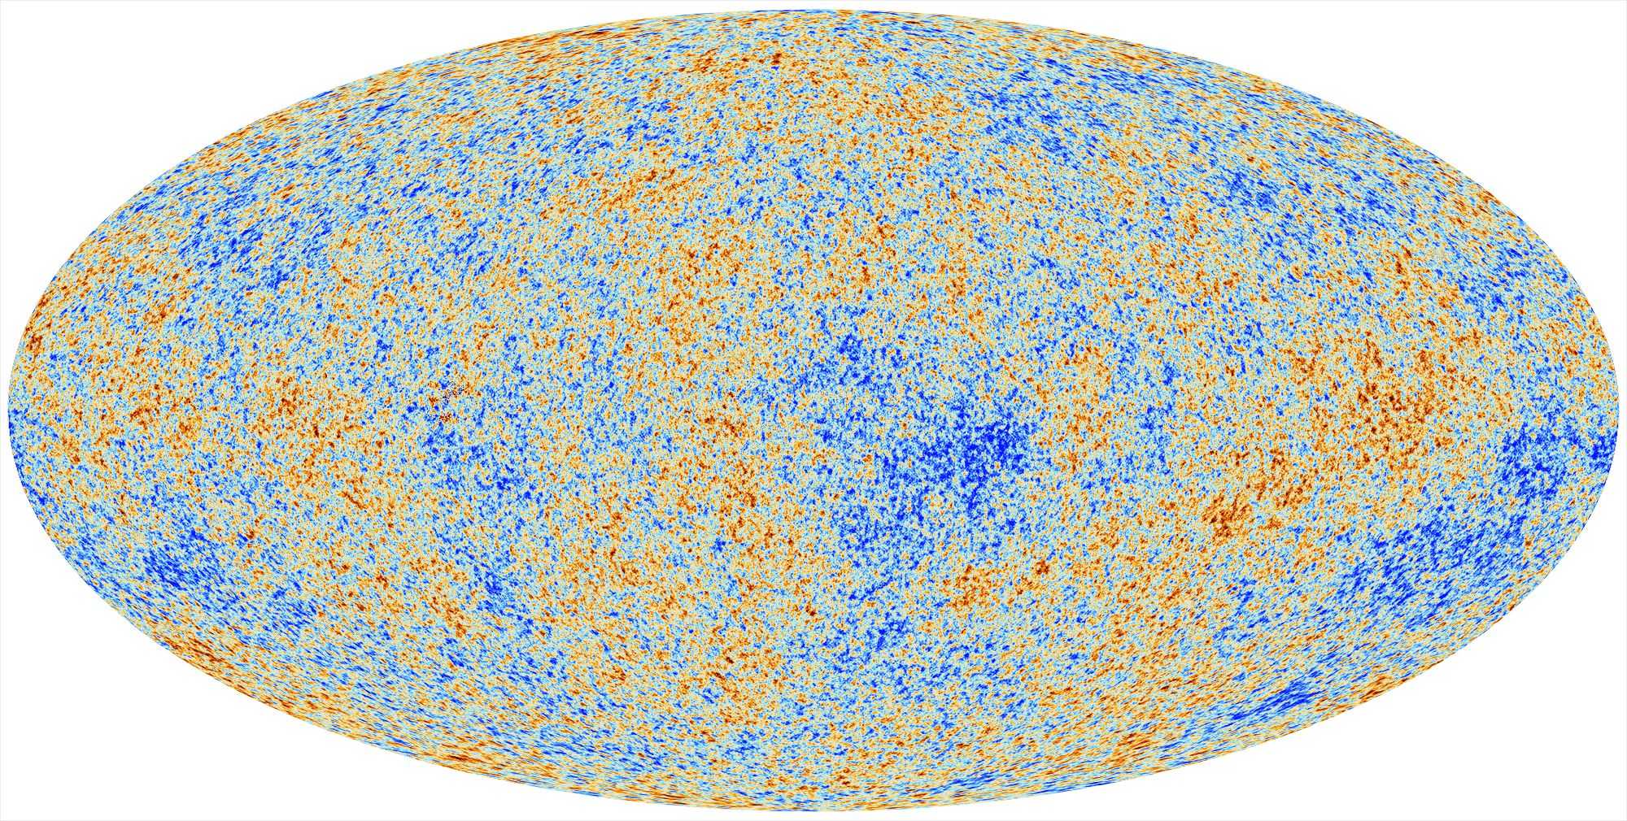
Inflation Probe
S. Hanany, Univ. of Minnesota
Science Goals:
Probe the physics of the big bang and of quantum gravity by measuring the energy scale at which Inflation occurred
Test the Standard Model of particle physics by measuring the number of light particles in the Universe and the mass of the neutrino
Elucidate the nature of dark matter and search for new forms of matter in the early universe
Measure the reionization and star formation history over cosmic time
Determine the mechanisms of structure formation, from galaxy cluster to stellar scales
Mission Description (cont.):
High resolution imager: bolometric camera with transition edge sensors cooled to 0.1 K
Low resolution Fourier transform spectrometer
4 year mission at L2
Mission Description:
Cosmic microwave background polarization imager and spectrometer
All sky survey
Exquisite measurement of foregrounds with 20 frequency bands between 20 – 800 GHz

