Slide 1
Guidance to Astro2020

Slide 2
Statement of Task
The binding guidance is the Statement of Task
Provide an overview of the current state of astronomy and astrophysics science … ;
Identify the most compelling science challenges and frontiers in astronomy and astrophysics … ;
Develop a comprehensive research strategy to advance the frontiers of astronomy and astrophysics for the period 2022-2032 … The strategy should be balanced … ;
Utilize and recommend decision rules … that can accommodate … deviations in the projected budget or changes … precipitated by new discoveries or unanticipated competitive activities;
Assess the state of the profession ... Where possible, provide specific, actionable and practical recommendations to the agencies and community to address these areas. This report shall be made available following the completion of the study.
https://sites.nationalacademies.org/DEPS/Astro2020/DEPS_192912

Slide 3
Statement of Task
The Agencies consider the “Additional counseling for the Committee and staff as they carry out their work” to be part of the Statement of Task
Scope
  In: Ground/Space A&A, Observational/Theoretical/Computational/Laboratory/Archival A&A, Solar Astronomy (ground only), Gravitational Wave Observations, Multi Messenger Astrophysics, Exoplanets
  Out: Fundamental Physics, Dark Matter Direct Detection, Microgravity Research, Projects under construction (JWST, DKIST, LSST, DESI)
  Advise but do not rank: WFIRST, Athena, LISA
Considerations
  Future budget scenarios, Activities of all sizes, Programs of Record, Balanced Program, Other NASA capabilities, Technology needs, Cyber-infrastructure, Existing and proposed U.S. facilities, Non-Federal entities
Approach
  Recipients of advice, Composition of Committee, Use of Panels, Assembling Committee and Panels, Town Halls, Independent cost analysis, Unrealized activities from prior surveys, Binning recommended activities
https://sites.nationalacademies.org/cs/groups/ssbsite/documents/webpage/ssb_190177.pdf

Slide 4
Strategic Missions and Competed Missions
NASA science missions are generally initiated in two different ways
Strategic missions are initiated to respond to specific science objectives
Mission architecture and acquisition strategy is tailored to the science objectives
Project management is generally directed to a NASA Center
Aspects of the mission may be competed through an AO (instruments), ROSES (science team, key science projects), or an RFP (spacecraft, integration and test)
Can be any mission size: Flagship, Medium/Probe, International Contribution, or Small
Astro2020 should recommend strategic missions
Competed missions are initiated through an AO
AO solicits both the science objectives and the implementation plan (architecture, team)
NASA selection of PI-led proposal is generally “take it or leave it”
Can be any size except flagship, though only small (MIDEX, SMEX, MOs) are in the current astrophysics program
Astro2020 should recommend competed programs, but not specific competed missions
Full presentation to Astro2020 available on Astro2020 website

Slide 5
Program of Record
Supporting Research & Technology
Operating Missions
Missions in Development or Under Study
R&A: ADAP, ATP, TCAN, XRP, Hubble Fellows, GO programs
Technology: APRA, SAT, Roman Fellows, Future flagship technologies
Research support: Keck, Balloon project, Astrophysics archives
Explorers: Gehrels Swift, NuSTAR, NICER, TESS
International Partnerships: XMM-Newton
Strategic Missions: Hubble, Chandra, Spitzer, Fermi, SOFIA
Explorers: IXPE, GUSTO, SPHEREx, AO2019, AO2021, etc.
International Partnerships: Euclid, XRISM, Athena, LISA
Strategic Missions: Webb, WFIRST
Notes:
Add it all together ….

Slide 6
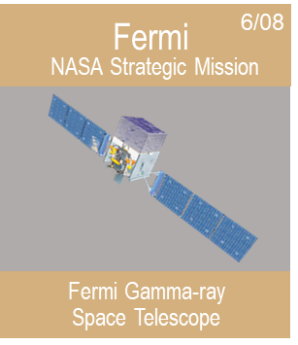
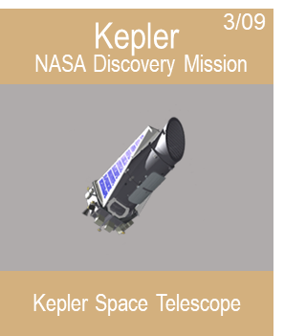
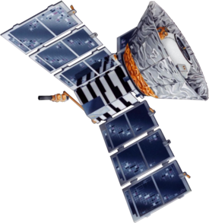
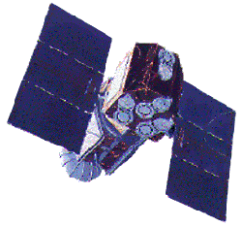
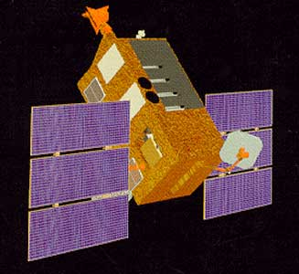
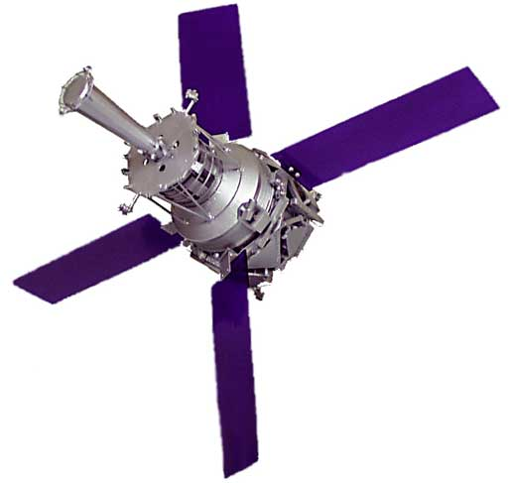
Medium Mission Concepts (Probes)
Probes are strategic missions that have had a strong impact on astrophysics, either through a focused investigation or as a broadly-capable observatory
NASA funded probe studies are available at https://science.nasa.gov/astrophysics/2020-decadal-survey-planning
Options for 2020 Decadal Survey
Do not recommend a medium mission in Astro2020
Recommend specific probe(s) as medium-size strategic missions
Recommend several specific science concepts for an AO (New Frontiers)
Recommend an unconstrained AO (Super-Explorer)
COBE
11/89
EUVE
06/92
Rossi XTE
12/95
GP-B
04/04
NASA Strategic Explorer
NASA Strategic Explorer
NASA Strategic Explorer
NASA Strategic Mission
Cosmic Background Explorer
Extreme Ultraviolet Explorer
Rossi X-ray
Timing Explorer
Gravity Probe B
The Relativity Mission
Notes:
REVISED V7
Probes instead of Explorers
Probes are rare
Probes are appropriate in limited areas
Only 6 probes in 30 years
Probes do not replace flagships
Only US can do flagships
Only flagships impact the whole community
Probes need to be large jump in capability, these four were large jumps

Slide 7
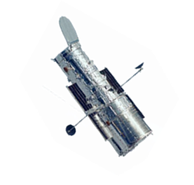
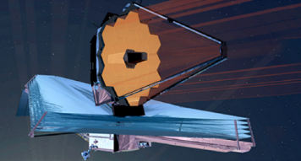
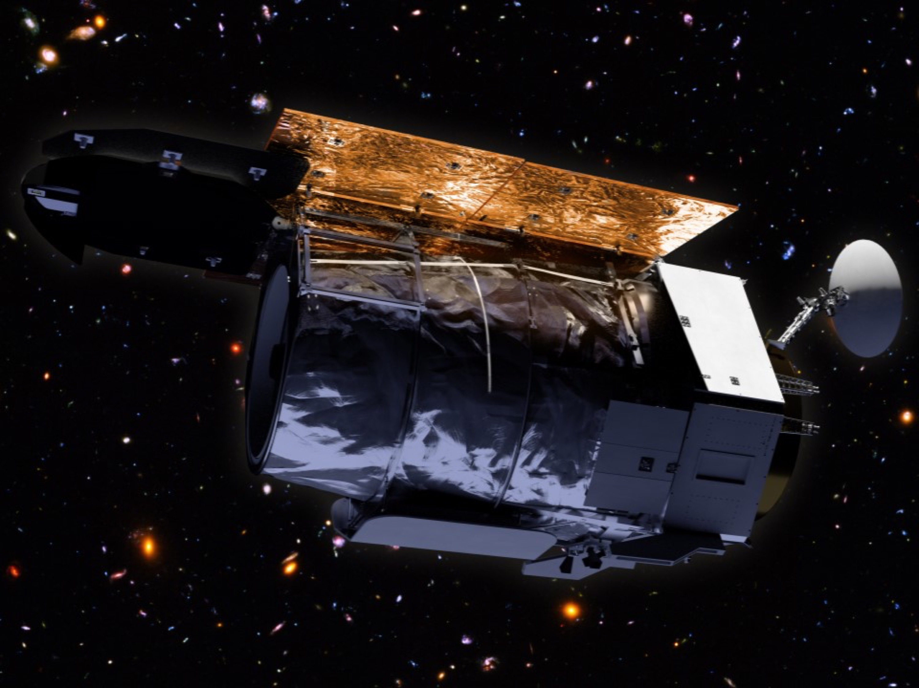
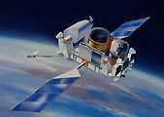
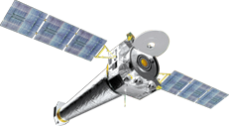

Why Flagships
Flagships drive science
Flagships drive US capabilities and contribute to US leadership
Flagships drive NASA budget and create stakeholder support
Hubble
04/90
Compton
05/91
Chandra
09/99
Spitzer
8/03
Webb
2021
WFIRST
Mid 2020s
NASA Great Observatory
NASA Great Observatory
NASA Great Observatory
NASA Great Observatory
NASA Mission
NASA Mission
Hubble Space Telescope
Compton Gamma Ray Observatory
Chandra X-ray Observatory
Spitzer Space Telescope
James Webb
Space Telescope
Wide Field Infrared
Survey Telescope
Notes:
REVISED V6

Slide 8
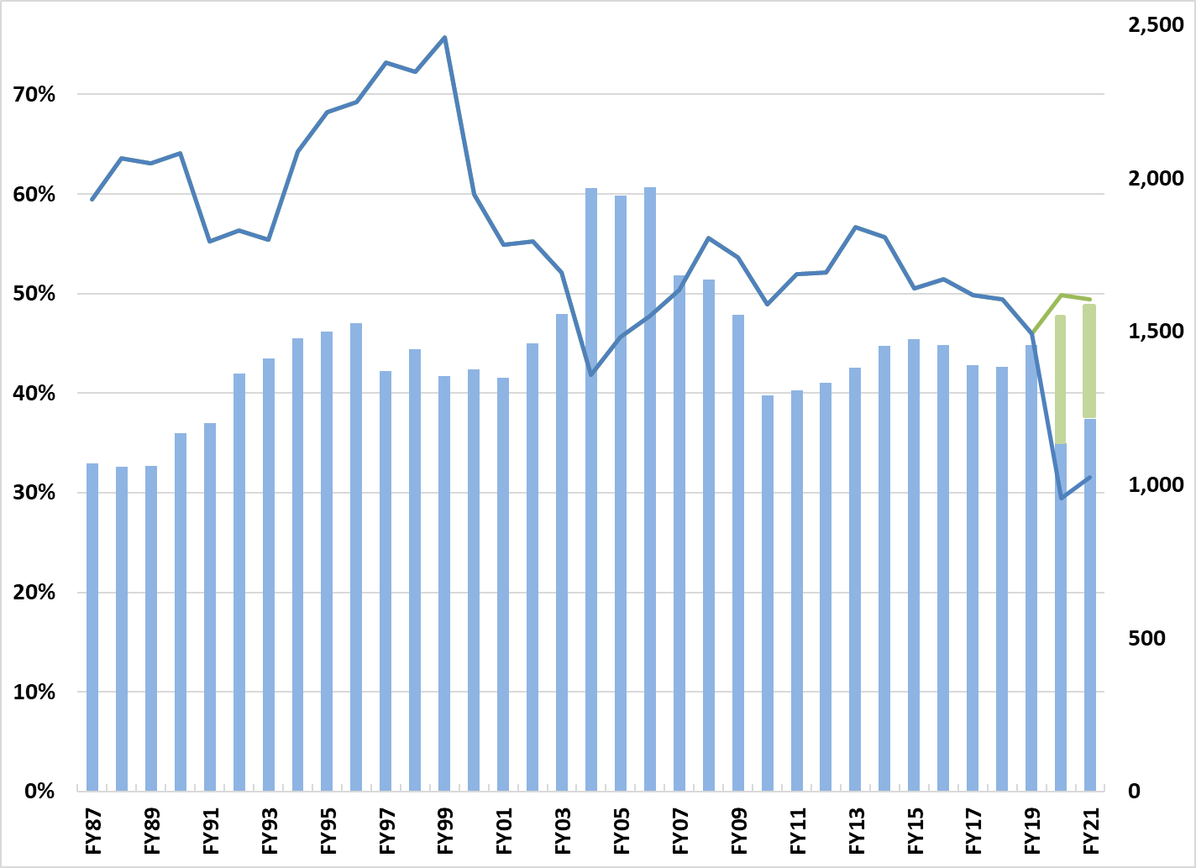
Flagship Fraction of Astrophysics Budget
Large mission fraction (left scale)
Inflation adjusted Astrophysics budget (right scale)
Current planning budget (without WFIRST beyond FY19)
What if WFIRST is funded as needed on top of FY20 President’s Budget Request?
All dollars inflated to FY18$. Development only, no ops.
Notes:
THIS IS WHAT IT TAKES
DID NOT GO UP WITH WEBB OVERRUN
GREAT AMBITION DRIVES GREAT BUDGETS
1986-2000: Hubble, Compton, Chandra, Spitzer
2000-2010: Webb, Fermi, Kepler
2010-now: Webb, WFIRST

Slide 9
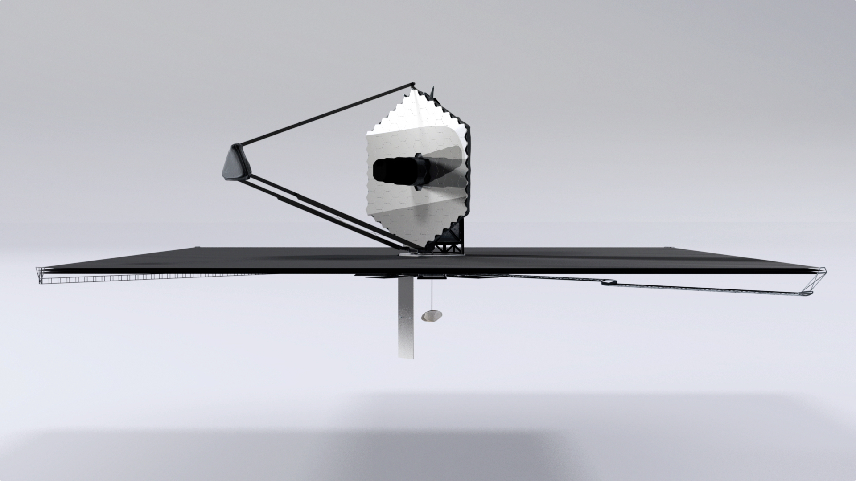
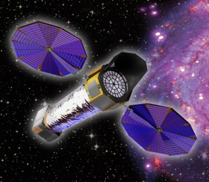
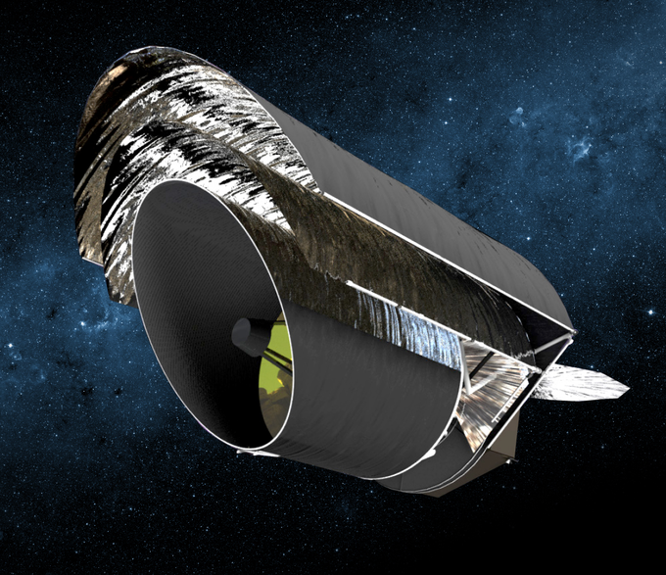
Large Mission Concepts
“NASA should ensure that robust mission studies that allow for trade-offs (including science, risk, cost, performance, and schedule) on potential large strategic missions are conducted prior to the start of a decadal survey. These trade-offs should inform, but not limit, what the decadal surveys can address.” – Powering Science: NASA's Large Strategic Science Missions (NAS, 2017)
HabEx
LUVOIR
Lynx
Origins
Notes:
HOW DEVELOPED, ORGANIC

Slide 10

Large Mission Studies
Links to the concept study reports are posted at https://science.nasa.gov/astrophysics/2020-decadal-survey-planning
and at
https://www.greatobservatories.org/

Slide 11
Guidance on Future Budgets
All guidance is for Astrophysics including Webb Telescope
Lower bound budget projection – Extrapolation of out year planning numbers for President’s FY20 budget request. Average of FY22-FY24 planning numbers is $1.1B/yr
Empirical budget projection – Extrapolation of recent NASA Astrophysics appropriations. Average of FY17-FY19 appropriations is $1.4B/yr
Optimistic budget projection – Empirical budget projection plus 1% inflationary growth in the out years. Budget grows from $1.5B (FY19) to $1.6B (FY25) to $1.7B (FY30)
Upper bound budget projection – Empirical budget projection plus 2% inflationary growth in the out years. Budget grows from $1.5B (FY19) to $1.7B (FY25) to $1.9B (FY30)

Slide 12
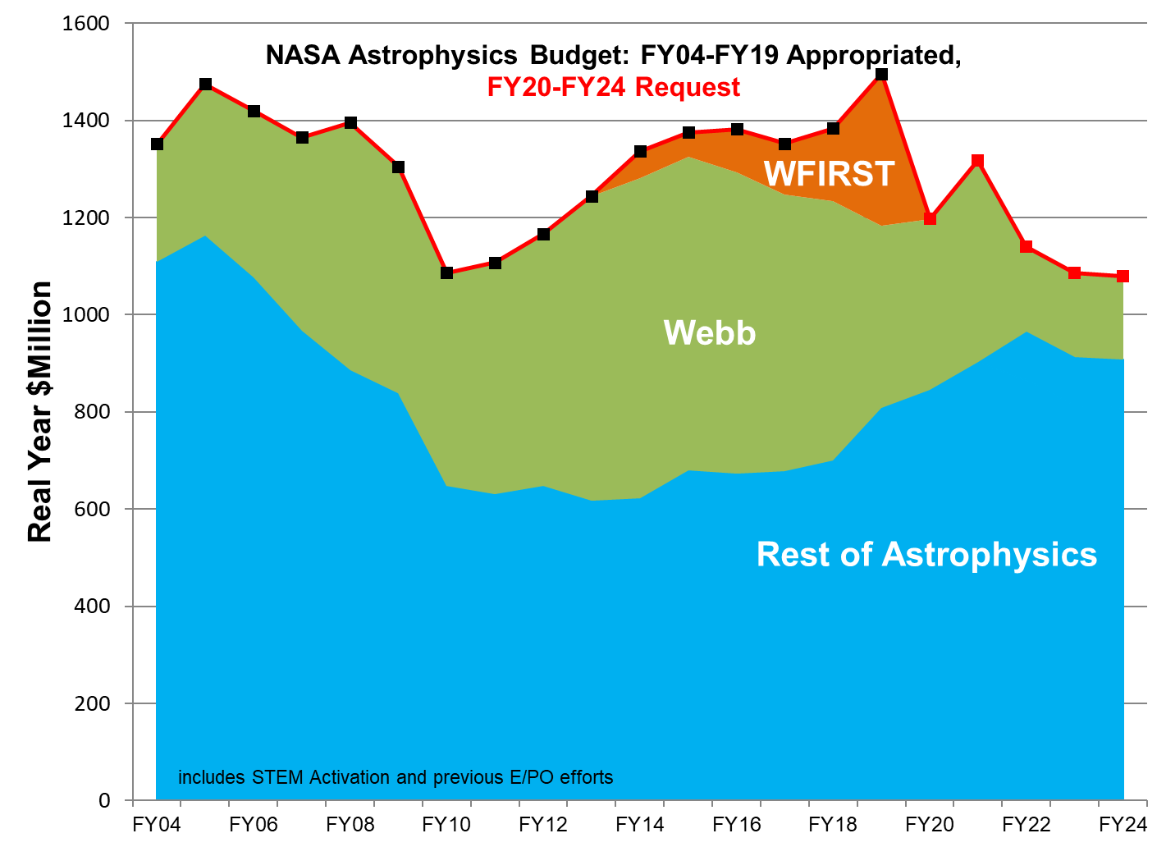
NASA Astrophysics Budget
$2B/decade for strategic initiatives
$1.1B
$0.9B
Current program including Webb operations and 4 Explorers/decade
R&A, Technology, Operating Missions, Explorers, Infrastructure
FY24 FY26 FY28 FY30 FY32
Notes:
NEW V6
Updated March 13, 2019
(Note: this sandchart incorporates the planned FY19 Initial Operating Plan transfer of ~$70M from Astrophysics to Webb)

Slide 13
NASA Astrophysics Budget
$1.45B
$5B/decade for strategic initiatives
$0.9B
Current program including Webb operations and 4 Explorers/decade
R&A, Technology, Operating Missions, Explorers, Infrastructure
FY24 FY26 FY28 FY30 FY32
Notes:
Updated March 13, 2019
(Note: this sandchart incorporates the planned FY19 Initial Operating Plan transfer of ~$70M from Astrophysics to Webb)

Slide 14
NASA Astrophysics Budget
$1.8B
2% inflation
$1.6B
1% inflation
$1.45B
$5B/decade for strategic initiatives
$6.75B/decade for strategic initiatives
$0.9B
Current program including Webb operations and 4 Explorers/decade
R&A, Technology, Operating Missions, Explorers, Infrastructure
FY24 FY26 FY28 FY30 FY32
Notes:
Note: Flagships can take longer than 10 years

Slide 15
Decadal Survey Goal
NASA’s highest aspiration for the 2020 Decadal Survey is that it be ambitious
    The important science questions require new and ambitious capabilities
    Ambitious missions prioritized by previous Decadal Surveys have always led to paradigm shifting discoveries about the universe
  If you plan to a diminishing budget, you get a diminishing program.
    Great visions inspire great budgets.
  Carpe Posterum

