Slide 1
PICO Noise Model
Karl Young, Roger O’Brient, Shaul Hanany,
Qi Wen, Xin Zhi Tan

Slide 2
Assumptions and Methodology
Methodology: Calculate in-band power absorbed by the detector, P_{opt}. From P_{opt} calculate bolometer thermal conductance, then NEP by source, then total NET per detector.
Assumptions
Throughput for detector = lambda ** 2
Bolometers sensitive to single polarization
Spillover is terminated on the stop
Mirror emissivity 0.07% at all frequencies
Consistent with Planck Measurements
All incident power is unpolarized
Gaussian beam emitted by detector has 1/e² angle:
Based on our assumed detector architecture
Gaussian beam varies with frequency within a given pixel (multi-chroic pixels)
Photon Bose noise factor = 1
Bolometer temperature is transition temperature Tc
Bolometer Tc is optimal for given Psat.
Including correlated Bose photon noise when pixel size is smaller than PSF
Readout assumes current electronics as achieved by ground-based instruments, extrapolated to space incident power levels.
End-to-end efficiency is 0.7
Tophat bands

Slide 3
Inputs to the code, Open Dragone
Updated to March 2018 values
Parameter | Value
Band (top hat, no out of band loads) | 21 bands, 21 GHz to 800 GHz
Edge taper of pixel beam on stop (center band of MCP) | 10 dB
Telescope aperture | 140 cm
F-number | 1.42
Mission length, efficiency, sky fraction | 4 yrs, 95 %, full sky
Bolometer attributes (same for all optics cases)
Psat to Popt safety factor | 2.0
T_bath | 100 mK
thermal power law index (n) | 2
Bolometer normal resistance | 1.33 Ohms
Bolometer loopgain | 25
Optical element properties | Reflection loss | Emissivity | Temperature (K)
Bolometer absorption efficiency | 0.3 | 0 | 0.1
Mirror (secondary) | 0 | 0.0007 | 4
Stop | 0 | 1 | 4
Mirror (primary) | 0 | 0.0007 | 40
CMB | 0 | 1 | 2.725

Slide 4
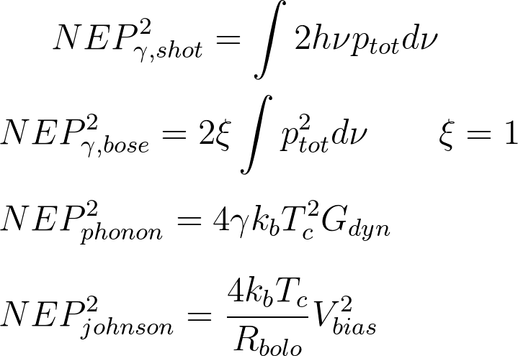
Noise equations
Power spectral density from optical elements and CMB.
2 is due to single polarization
Factor depends on n, T_bath, T_c. Is 0.5 for optimized T_c.
Readout calculated using Francios Aubin’s code with input from Matt Dobbs

