Slide 1
2020 Astrophysical Decadal Survey
Probe Studies
Management and Process v: 1.1
Rita Sambruna, Probe Studies Program Scientist
Shahid Habib, Probe Studies Program Executive
Keith Warfield, ExEP Chief Engineer
Gabe Karpati, PCOS / COR Chief Engineer
Astrophysics Division, NASA Headquarters
June 27, 2017

Slide 2
Outline
Purpose
Funding process for the Probes studies
  Start and End dates
  No-cost Extensions
  Fund Phasing
Oversight Approach and Reporting
  Quarterly report
  Winter 2018 AAS presentation
Final Study Products
  Study Report
  Engineering Concept Definition Package
Technology
Design Guidelines, Rules, Rules of Thumb

Slide 3
Purpose
NASA is supporting the Probe Studies for submission to the Decadal Committee
These Studies are chartered by NASA and the Study PIs are responsible for delivering the final products (a Study Report report and an Engineering Concept Data Package) to NASA
NASA will submit the Studies’ final products to the Decadal Committee, as defined later in this package
The Decadal Committee will have the option to prioritize any of these mission concepts, or recommend a competed line of Probes (similar to Explorers)
Selections will be based on science merit
Notes:
Ask Paul: Is it going to be directed after selection of the PI? Also whats the process if a line AO is selected?

Slide 4
Selected Probe Mission Concept Studies
Points of Contact (POCs) for the Study Teams:
G. Karpati, PCOS/COR
K. Warfield, ExEP

Slide 5
Funding and Extensions
NASA supports the selected Probe Studies via awards to the PIs’ Institutions to conduct an 18-month study. As specified in the PI package distributed earlier, the assigned Points of Contact (POCs) at GSFC and JPL will be monitoring expenditures and reporting to HQ.
NASA supports the PI’s concurrent design lab of choice (either Team-X or the IDC) to perform design lab runs. Each study will get one run at their concurrent lab of choice, funded by NASA. HQ will not provide any more funding for additional concurrent lab work, but the PIs are free to arrange for additional runs at no additional cost to NASA, conditional on the availability of the labs.
Funds phasing:
  PI awards: first 6 months of the study were released in April 2017. In FY18, the remaining balance will be awarded. Your award package provides a starting date for the period of performance. The clock starts ticking then.
  The duration of of the NASA-supported study is 18 months.
  Design Lab: funding is disbursed directly to the Labs by HQ
No-cost extensions: If needed, the Teams can ask HQ for an extension of the study period for a few months, but no additional funds will be awarded by NASA for the additional months beyond the 18 months baseline.
  The final report is due to NASA no later than December 31, 2018. Duration of the no-cost extension needs to meet this deadline.

Slide 6
NASA HQ Oversight
HQ has delegated the day-to-day oversight activities to the POCs listed on slide 4. See Appendix A for a description of their functions.
HQ will maintain oversight of the studies through the POCs who report to HQ regularly.
The Study PIs will provide a quarterly report to their POC with a description of the status of the study. Use template in the next slide for the quarterly report.
  Reports are due to the POCs by (for a nominal duration of 18 months):
    2017: August 1, November 1
    2018: February 1, May 1, August 1, November 1
  Additional reports as needed during no-cost extensions

Slide 7
PROBE TITLE
Quad-Chart Format for Quarterly Reports
PI’s name/Organization
Date
Science / Observations / Measurements:
Brief description of science goals/objectives
Any picture the PI chooses
(illustration, photo, block diagram, chart,
or table, of recent work)
Preferably changing with every submission
Mission Overview:
Brief description of orbit, launch, mission life, and conops
Flight System:
< Brief description of the spacecraft, telescope, instruments, etc.>
Recent Accomplishments:
Key accomplishment 1
Key accomplishment 2
…
Next Milestones:
Milestone or Accomplishment w/ est. completion date
Milestone or Accomplishment w/ est. completion date
…
Issues, Concerns:
Issue or Concern 1
Issue or Concern 2
…
Study Budget
< Bar chart budget by quarter along with actual spending by quarter>

Slide 8
Probe Session at the Winter 2018 AAS
NASA is organizing two back-to-back special sessions at the winter 2018 AAS meeting for the Decadal studies, to inform the astrophysics community of the progress achieved thus far in all NASA-sponsored studies:
  Morning session: Large Scale Studies
  Afternoon session: Probes studies
Special sessions have an allocation of 90 minutes
Each Probe study will have ~10 minutes (including questions) to present the status of the Study, including: science case, activities to date, noteworthy results so far, announcements for workshops, future steps
NASA does not expect that at the time of the 2018 AAS meeting the mission design labs will be completed for the purpose of the presentation, nor that cost estimates will be defined.
NASA has also asked the AAS to allow an adjunct Probes Poster Session for the ten Probe Studies.

Slide 9
Final Study Products
Each 18 month Probe Study is required to generate two major products for submission:
  A Study Report, and
  An Engineering Concept Definition Package
The principal product of the 18 month Probe Study is a Study Report.
  Your Study Report is due at the end of either the 18-months or the no-cost extension, but absolutely no later than December 31, 2018.
  Submit your Study Report to your Point of Contact, your POC will then forward it to HQ with a qualitative internal assessment. HQ will append the Independent Cost Estimate to it and deliver that package to the Decadal Committee.
  At initial delivery, the Decadal will only receive your Study Report and the Independent Cost Estimate, but not your Engineering Concept Definition Package. Upon request from the Decadal, HQ will also deliver to them your Engineering Concept Definition Package after removal of any ITAR sensitive information.
The other major study product is your Engineering Concept Definition Package.
  The Engineering Concept Definition Package is originally generated by the Concurrent Design Lab supporting your Study. You may later choose to create a modified version of it. The final version of your Engineering Concept Definition Package gets submitted to the Independent Cost Estimator organization (SOMA) alongside your Study Report for an independent cost estimate.
  The Independent Cost Estimator organization will see both your Study Report and your final Engineering Concept Definition Package.
For more guidance on your Study Report and your Engineering Concept Definition Package refer to the following pages.

Slide 10
Study Report – Content
The Study Report is the complete standalone definition and documentation of your proposed mission.
The Study Report should be science heavy. The Decadal Panel makes its recommendations based on science, or more specifically based on science for the costs stated. At least half of the Study Report should cover:
  The science case,
  The observations, and
  The science yields.
The Study Report should cover areas similar to a typical AO response, although not with the same emphasis and proportions, as your document should be relatively heavier on science. Recommended contents:
  Executive Overview (suggest 2-4 pages)
  List of Participants
  Science Case
  Observations, Measurements, Design Reference Mission (w/ Science Yield Estimate)
  Instrumentation, Payload, Optics, Detectors, etc.
  Mission Design, Observatory, Spacecraft, Launch Vehicle, Ground Stations, etc.
  Concept of Operations
  Technology, Technology Roadmaps
  Project Schedule
  PI Team’s (or Design Lab’s) Cost Estimate with Justification

Slide 11
Study Report – Page Limits
The maximum page limit for the Study Report is 50 pages
  Strongly suggest keeping the page count between 20 and 40 pages
  Appendices are allowed but not required, and count against the 50 page limit
  The above page counts assume conventional “proposal style” formatting comparable to the THEIA Study Report shown as a sample in Appendix B
Your Study Report may be released to the public by the Decadal Committee. No ITAR sensitive or Proprietary material!
  The responsibility for compliance with ITAR and Proprietary Material regulations rests 100% with the authors. If not sure, request assistance from qualified services at your supporting organization. NASA will not provide additional funds for that activity.

Slide 12
Engineering Concept Definition Package
The primary purpose of the Engineering Concept Definition Package is to demonstrate feasibility of your science.
  It will almost certainly not define as is the mission that will actually fly if your mission is selected by the Decadal Committee
The primary use of the Engineering Concept Definition Package is for an independent cost estimate.
The initial version of your Engineering Concept Definition Package is generated by the Concurrent Design Lab supporting your Study (Team-X or IDC).
  It is possible, but unlikely, that the initial version of the Engineering Concept Definition Package will suit you to serve as your final deliverable as is, without any modifications.
It’s probable that after your Concurrent Lab run, you may need to modify your original concept to meet performance, mass, cost, and other constraints.
  Doing so, you may wish to create a modified version of the Engineering Concept Definition Package to accurately reflect your modified concept.
It is IMPERATIVE that at submission time, the final version of your Engineering Concept Definition Package reflect the mission described in your Study Report with 100% accuracy, as that package serves (alongside your Study Report) as the basis of the independent cost estimate.
  The following slide defines three options for the Engineering Concept Definition Package modifications, all of which are suitable for an independent cost estimate, therefore submissible.

Slide 13
Engineering Concept Definition Package Options
  Three options of the Engineering Concept Definition Package are acceptable for submission to the independent cost estimate:
  Option A: Submit the original Final Products of the Concurrent Labs as is
    This option will be used if the Probe Team gets really lucky, or has planned exceptionally well, and as a result the Final Products of their Concurrent Labs runs are acceptable for submission as is without any modification, as they reflect with 100% accuracy the true Final Configuration of their mission as described in the Study Report.
  Option B: Submit modified versions of the Final Products of the Concurrent Labs, which are very similar in form and style to the original Products of the Concurrent Labs.
    This option will probably be the most “popular” one. It is for Probe Teams that need to modify the Final Products of their Concurrent Labs, and managed to enlist capable engineering help to do so. The modified versions of the Concurrent Lab Products must be similar in form and content to the originals, must document a modified design that “closes”, and must reflect with 100% accuracy the Probe Team’s true Final Configuration as described in their Study Report.
  Option C: Submit the original Final Products of the Concurrent Labs as is, with an appended “Errata” in plain English language.
    This option is for those Teams that needed to modify the Final Products of the Concurrent Labs, but could not enlist sufficient engineering help to execute the modifications properly; nevertheless they need to convey to SOMA that their true Final Configuration as described in their Study Report is not well reflected by the Final Products of the Concurrent Labs. All the differences that should be taken into account in costing are described in the Errata.
    In the Errata, the Probe Team describes as best they can the final configuration of their mission in agreement with the Study Report, enumerate the differences between the Concurrent Labs’ Final Products and their true Final Configuration, and also attempt to account for and describe all derivative effects.

Slide 14
Probe Team – ICE Interface
  If circumstances warrant it, the Probe Teams will have an opportunity to exchange information with the Independent Cost Estimate Organization (SOMA).
    Information exchange between a Probe Team and SOMA gets initiated unilaterally by SOMA _only_:
      If SOMA needs additional information from the Probe Team, or
      If SOMA detects significant unexplained discrepancies between their independent cost estimate and the PI/Probe Team’s “in house” cost estimate (which they have submitted as a part of the Engineering Concept Definition Package)
        Note: The PI/Probe Team’s “in house” cost estimate gets generated originally during the Concurrent Lab runs, and subsequently the PI/Probe Team may further modify or refine it.
  The PI/Probe Team can not initiate an exchange with SOMA
    The PI/Probe Team’s optimal strategy therefore is to provide adequate explanations in their submissions for features and line items which in their view do not follow standard costing curves and algorithms and merit special considerations.
    The good news is: as long as the Probe Team doesn’t hear from SOMA, they can assume no significant cost discrepancies were found.
  The information exchange between SOMA and the PI/Probe Team will be conducted as a telecon or WebEx meeting, and will be preceded by written Q&A exchanges between the parties.

Slide 15
Technology for Probes Mission Concepts
The funding for the selected Probe Study does not include funds for technology maturation. NASA will not provide separate funds for technology maturation to the study teams. Technology maturation is being accomplished through the normal APRA and SAT processes. Decadal prioritization will be needed first to change current technology maturation funding priorities.
The final Study report should provide a list of technologies needed to accomplish the mission (a “Technology gap” list), and a roadmap for its maturation should the Probe mission concept be prioritized by the Decadal
NASA will include planning for the maturation of technologies needed for all Decadal Survey prioritized activities (including large and medium missions) in its planning for the 2020s that will follow the Decadal Survey.
The Independent Cost Estimators (SOMA) will generate independent estimates of the costs required to mature to TRL 5 the technology gaps described in the Probe Study’s Technology Roadmaps
  TRL-5 must be reached by Phase-A start date, assumed to be 10/1/2023
  TRL-6 must be reached by PDR
  The independent technology maturation cost estimates will be treated entirely separately from the Probes’ Independent Cost Estimates, and will only be used by HQ and the Decadal as secondary or advisory information

Slide 16
Design Guidelines - Overview
Aerospace Corp. has reviewed the Design Guidelines used in the Concurrent Design Labs the Probe Studies will use (IDC and Team-X), in order to assess if their processes are robust enough for an independent cost estimate.
  Their review was actually conducted in preparation for the CATE effort for the Large Studies, however its findings are equally applicable to the Probe studies.
The guidelines reviewed were:
  “IDL/MDL Design Guidelines” - for the Probes Studies assigned to GSFC’s IDC
  “JPL Design Principles” - for the Probe Studies assigned to JPL’s Team-X
Overall, the Aerospace review found that the IDC and Team-X guidelines were in reasonable agreement with its own guidelines, but the following additional mass and power guidelines should also be considered:
  ANSI/AIAA-G-020-1992 entitled “Estimating and Budgeting Weight and Power Contingencies for Spacecraft Systems” provides guidance at the system level for new designs in conceptual design stage
  ANSI/AIAA-S-120A-2015 entitled “Mass Properties Control for Space Systems” provides additional guidance at the subsystem level for different levels of design maturity
6/27/2017
16

Slide 17
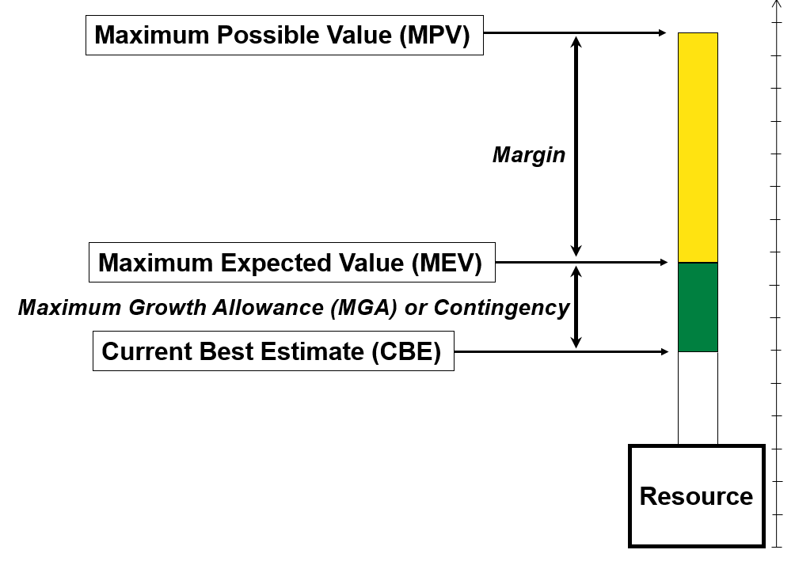
Contingency and Margin Definitions
Contingency: a possible occurrence or result
Margin: an amount beyond the necessary

Slide 18
ANSI/AIAA-G-020-1992 Mass Contingency Guidelines
*
*Note: Class 1 = New Design, Class 2 = Generational, Class 3 = Production
6/27/2017
18

Slide 19
ANSI/AIAA-G-020-1992 Power Contingency Guidelines
Power
*
*Note: Class 1 = New Design, Class 2 = Generational, Class 3 = Production
6/27/2017
19

Slide 20
ANSI/AIAA-S-120A-2015 Mass Contingency Guidelines
* Note: “Estimated” design maturity is appropriate for pre-phase A conceptual designs given that the requirements are still in flux and the concept itself will also change
6/27/2017
20

Slide 21
Design Guidelines - Summary
Overall it is best to provide higher Contingencies in early conceptual design, as they provide more robust and flexible development envelopes to address future unknown development issues
Aerospace suggests using ANSI/AIAA guidelines for mass and power Contingencies in early conceptual design
System level Margin is always accounted for above and beyond the sum of all Contingencies
MASS:
  The mass Contingencies from ANSI/AIAA-G-020-1992 are 30% to 35%
  Mass margin (the difference between the LV throw mass capability and the wet launch mass of the Observatory) is the last defense against unknown unknowns, and is usually 5-10% of the wet launch mass.
POWER:
  Total system level Contingency from ANSI/AIAA-G-020-1992 are 40% to 80%
  Subsystem guidance provided from ANSI/AIAA-S-120A-2015
Projects should consider establishing higher mass and power Contingencies to science instruments given that those are typically more developmental and experience higher mass and power growth than spacecraft busses: 50% mass and 75% power Contingencies suggested
Projects don’t have to use identical guidelines, but should provide a rationale for basis of Contingency stated.
6/27/2017
21

Slide 22
Mandatory Rules
MISSION CLASS: All 2020 Decadal Probes shall be CLASS-B
  That is “pure” unmodified Class-B
LAUNCH VEHICLE COSTS: All probe studies shall use $150M as their EELV Launch Vehicle cost
  The $150M only applies to all EELV’s, any version, any configuration (incl. DPAF). It includes all launch services.
  The above cost doesn’t apply to the SLS, the Falcon 9 Heavy, and other “Heavies”. If you plan to use any of those LV’s, contact your POC.
  You may only use US LV’s listed in NASA’s LV “stable”
COST RESERVES: Unencumbered cost reserve shall be 25% of the Phases A/B/C/D cost
  Unencumbered reserve are reserves that are free of liens and are held for risks that may be realized during project execution.
  Concepts that are unable to show adequate unencumbered cost reserves are likely to be judged a high cost risk and not selected.
DOLLAR YEAR: All cost numbers, including the $1B grand total lifecyle cost, are/shall be presented in FY18 dollars.

Slide 23
Mandatory Rules (cont’d)
START DATE: The Start Date for Phase-A of your hypothetically selected mission shall be 10/1/2023
  The 10/1/2023 start date shall be used in all Probe studies’ design, schedules, and cost estimates.
  That start date is based on the anticipated release of the Decadal Survey Report in 2021, followed by a two year Congressional Budget Cycle, putting the earliest conceivable start date of a Probe mission at October 1, 2023.
TRL:
  All technology used in the Probe mission shall be at TRL-5 or higher at the start of Phase A
  All technology used in the Probe mission shall be at TRL-6 or higher at PDR
ITAR and PROPRIETARY MATERIAL: Any material delivered to the Decadal Panel, including the Study Reports, may be released to the public, therefore shall contain no ITAR sensitive or Proprietary information.
  The burden of the Study Reports’ ITAR and Proprietary Material compliance rests 100% with the authors.
  If not sure, request assistance from qualified professionals at your supporting center.

Slide 24
Costing Rules of Thumb (cont’d)
The spacecraft and payload costs are about or less then half of the total cost of the mission:
  The total of Launch Vehicle and Reserves are usually well over 1/3 of the $1B total budget
    Non-hardware costs have limited potential for savings
    Launch mass becomes a significant cost driver

Slide 25
Costing Rules of Thumb (cont’d)
A spacecraft bus comparable to the Kepler bus would cost today ~$160M to $170M
OTS S/C bus able to handle a 500kg payload costs $80-$180M
  Costs based on a 2011 Team X survey of OTS S/C vendors
  All will likely need uncosted upgrades to meet pointing and other requirements
  Cost includes ATLO
  Generally, lower cost equals lower capability
Instruments typically cost $800-1000k/kg
  Based on NASA Instrument Cost Model (NICM) actual instrument costs
  Assumes Class B Earth orbiting mission
  Does not include telescope
  Does not include technology development
An on-axis 1.0-1.5m telescope costs $50-110M
  Based on 2013 cost model inflated into $FY15
  Assumes 1st unit and visible spectrum
  Off axis costs a bit more and is heavier
Second unit cost is about 50% of the first unit cost
  Based on NICM instrument re-flight data and 1996 Aerospace Small Satellite Subsystem Cost Model ver. 2.0 data
  Varies between 20-80% but averages around 50%
  The second unit should be close in time to the first unit to be credibly build-to-print

Slide 26
Misc. Rules and Rules of Thumb
Instrument mass/power ratio is typically 1 kg/W
Electronics in card boxes typically have mass/volume = density of water i.e. 1 kg/liter (1000 kg/m^3)
Acceptable spacecraft bus densities are 250 – 400 kg/m^3. At higher densities I&T becomes complicated and expensive.
More mass can be delivered to Earth-Sun L2 or Earth Trailing/Leading orbits than to Geostationary due to the delta-v cost of raising periapsis
Radiation at Geostationary is much worse than Earth-Sun L2, Heliocentric, or LEO
Geostationary has eclipses. Earth-Sun L2 not necessarily, not even partial, ever, for suitably selected orbits

Slide 27
Appendix A: POCs Roles and Functions
(from the PI Package)
  Responsible for communication with the PI study teams to ensure consistent and complete information is provided to all
  Develop an integrated plan for the multiple studies in the Design Lab and broker the dates and durations for each study with the PIs and the Labs (before April 30, 2017).
  Collect quarterly status from and monitor progress of the PI study teams. Convey status and progress on all studies to HQ
  Assist the PI in the definition of and preparation for the Design Lab studies. The PO will support the study runs in the Design Labs. The PO may suggest synergies between the studies to take advantage of commonalities of designs/requirements and economize the design lab expenditures. PIs have the prerogative not to accept the PO recommendations
  Monitor the expenditure of funds at the Design Labs and report regularly to HQ
  Organize teleconferences with all the selected Teams to facilitate synergies and cross pollination of ideas.
  Review the Study Teams’ Study Reports and Engineering Concept Definition Packages for self-consistency, and in the event of disconnects, work with each Team to clarify the disconnects in a separate Errata Brief.
  Produce an integrated Executive Summary report of all studies summarizing salient features and costs and deliver it to HQ.

Slide 28
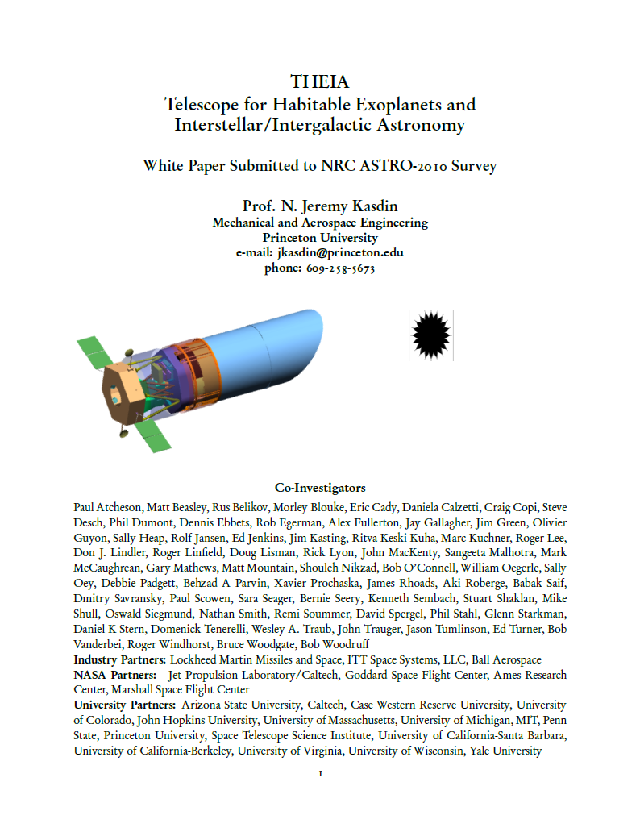
APPENDIX B:
Sample Final Deliverable:
- the THEIA Study Report https://www.princeton.edu/~hcil/papers/theiaWhitePaper.pdf
- This was an actual submission to the 2010 Astrophysical Decadal Survey -

