Slide 1
AAAC Proposal Pressures
Study Group
Priscilla Cushman (AAAC Chair)
University of Minnesota
March 17, 2015 NASA APS Meeting

Slide 2
AAAC Proposal Pressures Study Group
Established Summer 2014
Gather relevant proposal and demographic data from both the agencies and the community in order to understand how the funding environment over the last 10 years has affected researchers and projects. We will compare funding models across agencies and determine appropriate metrics for evaluating success. This will allow us to provide data-driven projections of the impact of such trends in the future, as well as that of any proposed solutions.
Members
Priscilla Cushman (AAAC Chair ) Minnesota.
Jim Buckley (AAAC) Washington U.
Angela Olinto (AAAC) Chicago
Todd Hoeksema (AAS CAPP) Stanford
James Lowenthal (AAS CAPP) Smith College
Brad Peterson (NASA NAC) Ohio State
Keivan Stassun (APS) Vanderbilt University
Agency Contact Persons
NSF/AST: Jim Ulvestad, (Daniel Evans)
NSF/PHY PA: Jim Whitmore, Jean Cottam
NASA/APD: Paul Hertz, Hashima Hasan,
Linda Sparke
DOE/HEP Cosmic Frontier: Kathy Turner
NASA/HPD: Arik Posner
NASA /PSD: Jonathan Rall
AAS: Joel Parriott
NRC (NAC): David Lang, James Lancaster

Slide 3
What Population Pressures?
Rising Number of Proposals + Budget not keeping up ➔ Declining selection rates
    Many areas of scientific research are experiencing this trend
AAAC interacts primarily with NSF/AST, NASA/APD, DOE/HEP Cosmic Frontier
but there is increasing overlap with NSF/PHY program in particle astrophysics
and gravitational physics, planetary and helio science in both NSF and NASA,
and the NSF polar program.
Collect data from:
NSF Division of Astronomical Sciences: Very extensive database, all proposals traced by reviewer and proposer. Demographic data kept. Queries need to be properly formulated.
NSF Division of Physics: Access to NSF database, but not as extensively mined.
NASA Astrophysics: Segregated by competition. (e.g. linking ATP-2012 with anything else has to be done by hand). Some has been done for certain years, but trends are more difficult. Demographic data is not available.
DOE High Energy Physics: Hard to connect new comparative review process (2012) to old.
Mostly spreadsheet data from the proposal panel organizers.
http://www.nsf.gov/attachments/131083/public/Dan-Evans_AST_Individual_Investigator_Programs-AAAC_Meeting.pdf

Slide 4
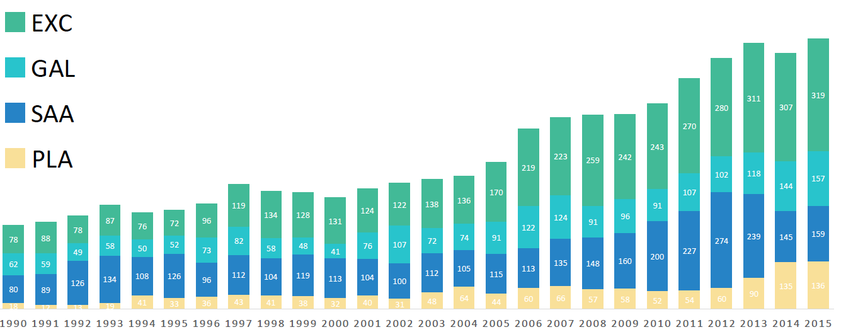
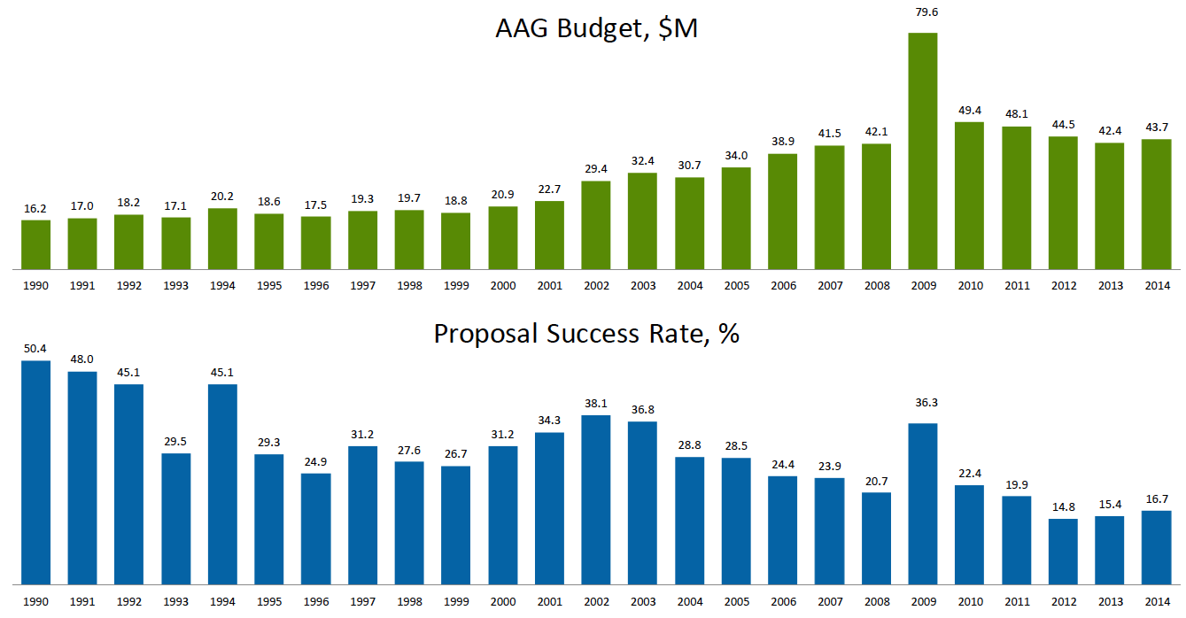
Proposal Pressure in NSF/AST
In the Astronomy & Astrophysics Grant Program
771
2004
379
238
Number of AAG Proposals by program and year
$44M
$31M
$16M
AAG Budget $M
50%
ARRA
30%
AAG Proposal Success Rate
16%

Slide 5
Proposal Pressure in NSF/AST
Divestment of Facilities will help, but not solve the problem
If divestment continues on schedule and the budget continues flat,
the success rates will remain at roughly15%.
2004
⬅ 10%
Projected NSF/AST (AAG) proposal success rate in the absence of facility divestment.

Slide 6
Proposal Pressure in NASA/APD
30%
18%

Slide 7
Proposal Pressure in NASA Planetary Science
Budget (inflation-adjusted): $1,731M (2004) ➔ $1,380M (2015)
~ 40%
by eye
~ 20%

Slide 8
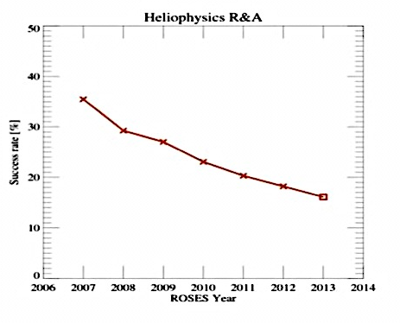
Proposal Pressure in Heliophysics (NASA)
Overall Selection Rate is falling across NASA/HPD ROSES
35%
15%
Only full proposals, not step-1 proposals

Slide 9
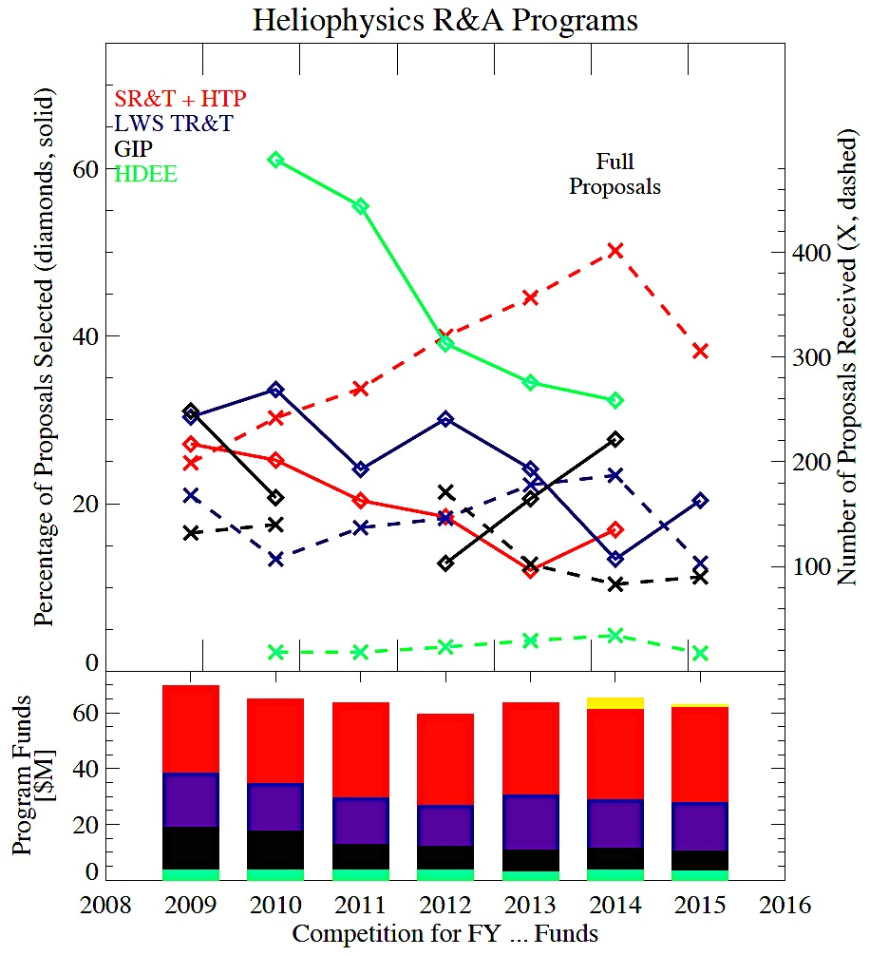
But its complicated : Breakdown by Program
Avg size of annual awards increased
Over 50% of these are “unique PI”
i.e. the only proposal submitted
The more programs open, the higher
the multiple proposal submissions
The balance in gender ~83% male
- if identified !
Heliophysics Guest Investigator Program suspended in 2011
Heliophysics Guest Investigator program.
Living With a Star Targeted Research and Technology program.
Heliophysics Supporting Research and Technology program Heliophysics Theory program.
Heliophysics Data Environment Enhancements program.
SR&T Heliophysics Cubesats

Slide 10
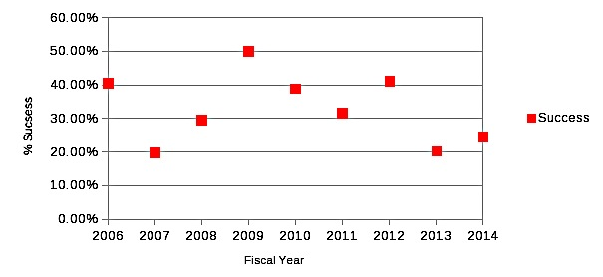
Proposal Pressure in NSF Heliophysics
Proposals submitted to NSF/AGS Solar-Terrestrial Research Program
Evolved and grown somewhat since 2009, but highly variable.
The number of awards averaged about 25
Average award size has grown from $90K/yr (2009) to $114K/year (2014)

Slide 11
Proposal Pressure in NSF/PHY Particle Astrophysics
Astronomy and Astrophysics with Particles (began in 2000)
PA budget has been a steady percentage of the NSF/PHY budget, around 7%
cosmic rays (Auger) cosmic neutrinos (IceCube)
gamma-rays (VERITAS, HAWC) dark matter (Xenon, SuperCDMS)
2005 ➔ 2014 Number of proposals doubled (from 30 to 70)
Funding increased ~34%
Average success rate: 45% (2005-7) ➔ 39% (2012-2014)

Slide 12
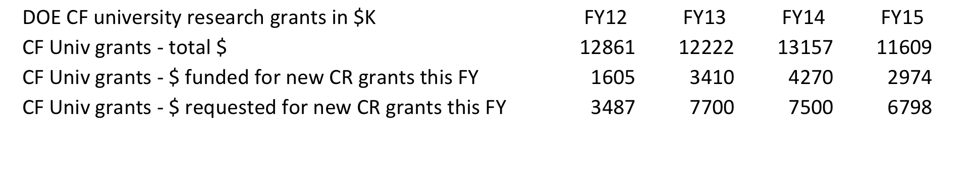
DOE High Energy Physics at the Cosmic Frontier
Success rates much higher. Proposal Acceptance going up
but may be ~ 50% in FY15
Mostly block grants with multiple PIs.
Stable number of Universities, applying every 3 yrs, staggered by years
$$ awarded depends on who is up for renewal
Comparative review process began in 2012
Energy, Intensity, Cosmic separately reviewed

Slide 13
Summary of Population Pressure
The proposal selection rate for NSF Astronomical Sciences and NASA Astrophysics has dropped from approximately 30% to 15% in the last decade.
Similar trends observed in NASA Heliophysics and Planetary Science Divisions
Trends can be seen overall, but details in individual programs are complicated
Programmatic changes or cancellations/suspensions
Less statistics
Size of awards
NSF Particle Astrophysics and Heliophysics programs are highly variable
Again, program size makes statistics difficult
Trend is downward
DOE High Energy Physics Program has a different funding model
Success rate has stayed stable above 50% in Cosmic Frontier
Only 3 years of comparative review panel data available
Next, drill down to understand demographics

Slide 14
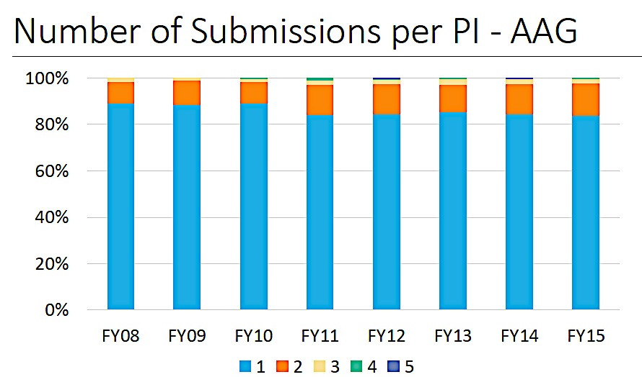
Most NSF/AST and NASA/APD Proposals are Single Proposals
Proposal Increase ➔ The actual number of Unique PIs is going up
NSF Astronomy Only ~ 15% Multiple Proposals

Slide 15
Multiple Proposals in NSF Planetary Sciences
NASA/PSD funding is distributed over 34 programs
Multiple proposals rose from 40% to 60% starting around 2005
1.6
Proposals
per Individual
1.3
2004
2013
Recently began using two-step process, where
First Step = Direct proposals to the proper program
and look for largely identical proposals submitted more than once

Slide 16
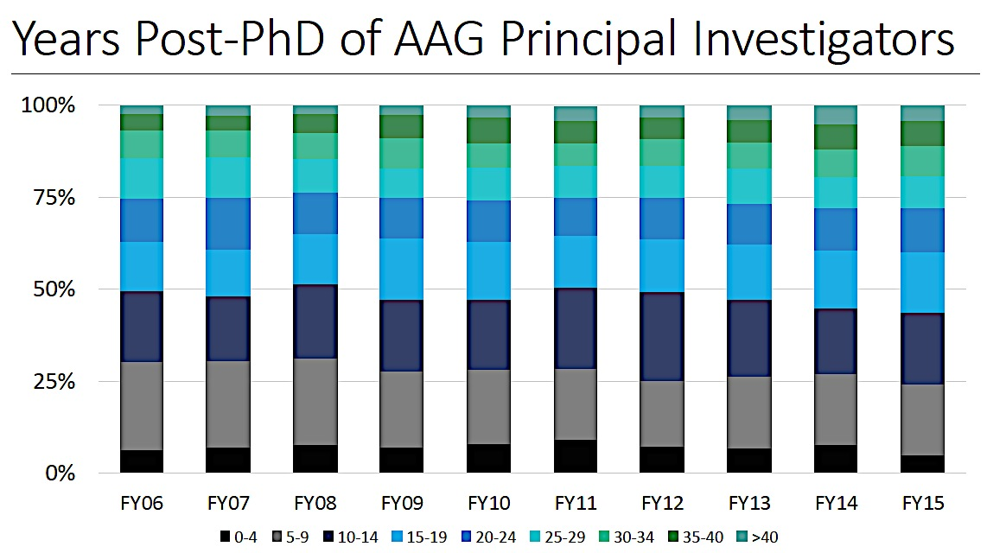
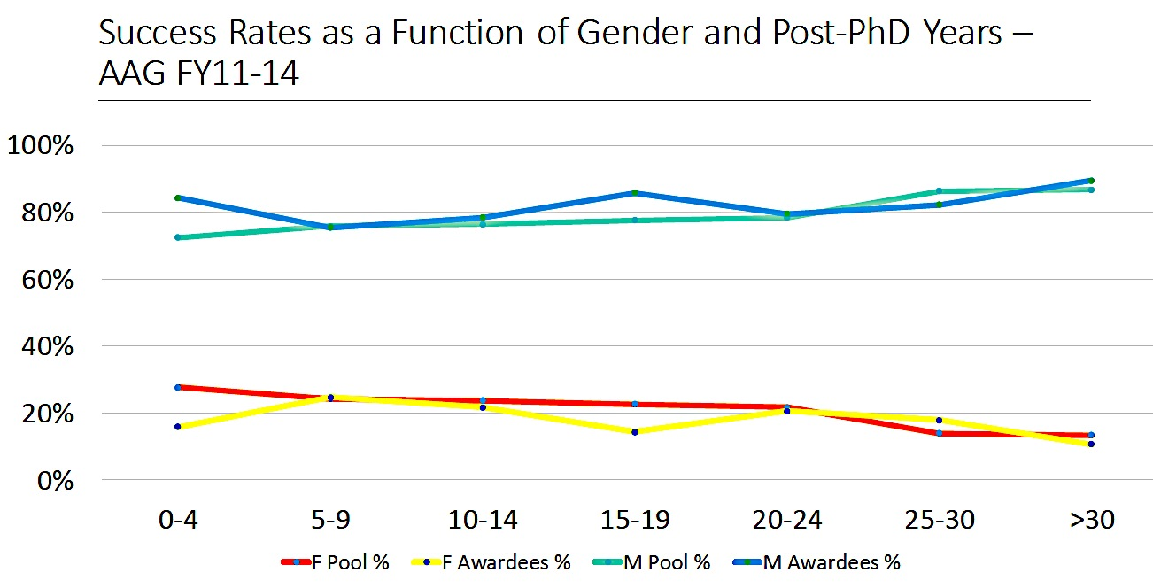
Fraction of Proposals by age of PI (NSF/AST)
No “Postdoc Problem”
The suggestion that recent generous postdoc fellowship programs and targeted encouragement have boosted one segment of the population that is now moving through the system as an increased PI pool
… is NOT true.
M
Result doesn’t depend on gender. Slight increase in women in the younger pool is encouraging.
F

Slide 17
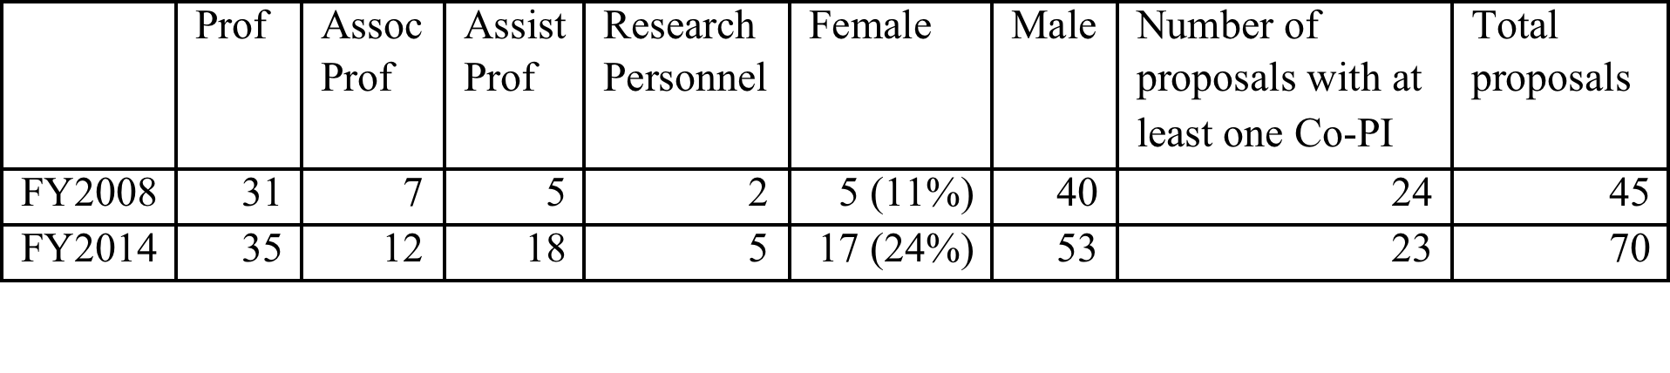
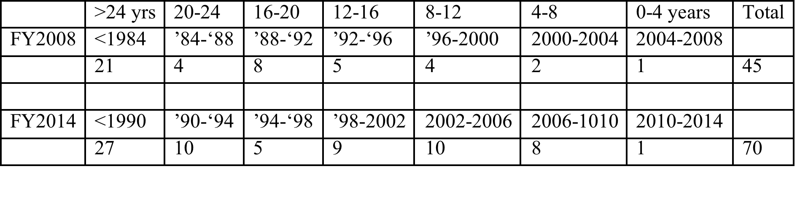
Fraction of Proposals by age of PI
NSF/PHY Particle Astrophysics is slightly different
Fraction of women Pis is rising: 11% (2008) ➔ 24% (2014).
Fraction of younger PIs is rising: 10% (2008) ➔ 27% (2014)
defined as <12 years from PhD.
BUT 2008 NSF/PHY PA proposers is heavily weighted toward senior PIs.
2014 NSF/PHY PA age fraction now matches the more stable NSF/AST distribution.
Low statistics

Slide 18
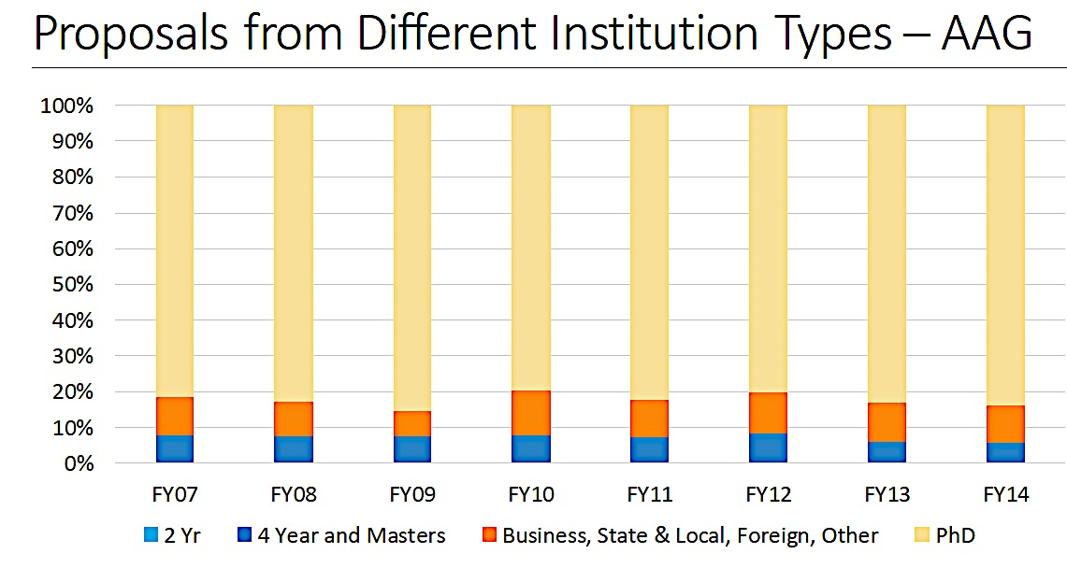
Institutional Affiliation (NSF/AST and NASA)
Suggestion:
More proposers from smaller non-traditional institutions?
NOT true.

Slide 19
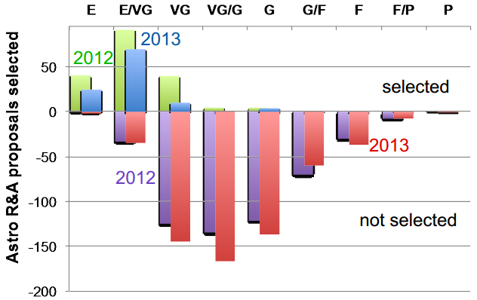
Is the number of Excellent Proposals funded going down?
Quantifying this takes a figure of merit
Reviewer rating is not a good merit indicator for NSF or DOE/HEP Cosmic Frontier
NASA reviewer ratings are more reliable,
but anecdotal evidence for NSF and DOE is in line with data from NASA
2012 ➔ 2013
Fraction of proposals rated ≥ VG
46.7% ➔ 41.9% (-10%)
Decrease in success rate ≥ VG
51% ➔ 39% (-24%)
All SMD ROSES: Number of funded proposals in the VG category was 45% in 2007-2008
Funded from Plot : 25% VG (2012) ➔ 7% (2013)
The Loss is in the VG category, while VG/E and E remain stable at >75% and >90% respectively
http://science.nasa.gov/media/medialibrary/2014/04/09/2014.03.27_ApS_RA_final-2.pdf

Slide 20
Is Selection Rate being driven by Repeat Proposals?
Number of unique PI per year > 1/3 of unique PI over 3 yr
Unsuccessful proposals are being resubmitted.
Modeling the data:
Number of non-repeat proposals remains steady.
Successful ones removed from pool, unsuccessful ones reapply next year
Apply the actual success rates each year to the mix of new and repeat proposals.
A best fit ➔ 70% of the unsuccessful proposals reapply in the following year.
If repeats at at 50% in 2008, by 2014 repeats will be at 60%
Evil spiral: Ever more unique Pis reapply in consecutive years,
accelerating the rise in proposal numbers and falling selection rate

Slide 21
Summary of Demographics
Only collected for NSF and NASA
The number of proposers is going up, not just the number of proposals.
Multiple proposals from the same PI is mostly not a driver
The rise in the number of proposers is not coming disproportionately
from new assistant professors or research scientists
or from non-traditional institutions
They do not represent a shift in gender or race
The merit category that is being depleted has a rating of VG
Very Good proposals are not being funded
Unsuccessful proposals are being resubmitted at a higher rate

Slide 22
Impact on Agencies (NSF/AST)
Managing review panels.
NSF/AST staff FTEs have remained relatively flat
But they are running more panels
Each panel has a higher number of proposals.
Organization and execution of each panel takes 130+ hours (NSF Program Officer)
“NSF has developed new tools to optimize internal review processes, but another 30%
increase in proposal volume over the next five years would not be sustainable.”
Recruitment of reviewers and Conflict of Interest
An individual listed as PI or co-PI on an NSF/AST AAG proposal cannot serve as a reviewer.
1,100 qualified individuals are prohibited from joining a panel.
Hard to find un-conflicted senior members of the community to join the panels.
Declining reviewer acceptance rates; 20-25% of reviewers agree to serve
Drives up the time program staff spend on appointing panelists.

Slide 23
Impact on Agencies (NASA/APD)
(statistics courtesy of H. Hasan)
COST (2014)
832 proposals handled in core R&A programs.
Estimated cost: ~ $ 3M
NASA staff time, direct expenses for reviewer travel, meeting space,
plan, execute, and document the evaluation and selection process
Basis of estimate clearly delineated in spreadsheet.
this cost does not include the cost of the GO program TAC reviews that handle three times as many proposals
FINDING REVIEWERS
Statistics currently: 50% of prospective reviewers accept when asked 4-6 mo. 20% when asked 3-4 weeks ahead
Will this change in the future?
CONFLICT OF INTEREST
Currently not a problem.
COI issues can often be mitigated by putting the reviewer on a different panel from the problematic proposal

Slide 24
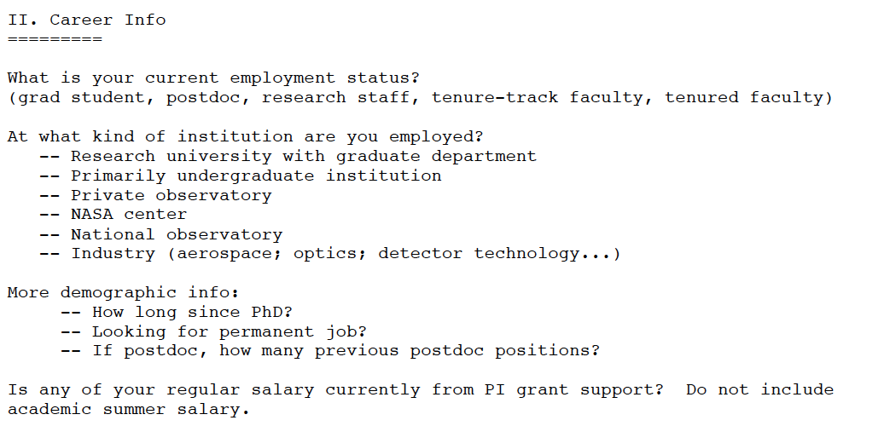
Impact on Researchers
Requires a Survey
Draft a set of questions in conjunction with AAS (Todd Hoeksema, James Lowenthal)
Put in a Proposal to AAS for preparing a Survey
If accepted, AAS provides funding to AIP to
professionally develop and manage and administer survey
Etc…

Slide 25
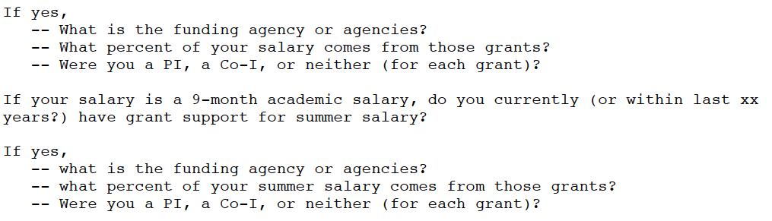
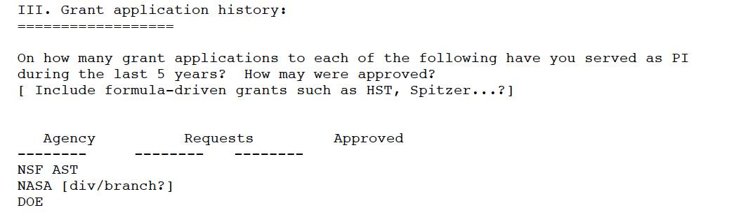
Impact on Researchers
Requires a Survey
Etc…

Slide 26
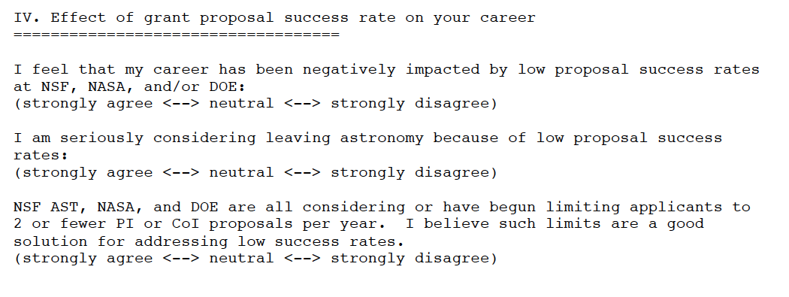
Impact on Researchers
Requires a Survey
A series of multiple choice statements with 5 choices.
Etc…

Slide 27
FUTURE PLANS
Survey administered this summer to AAS, APS members
Continue to refine data from Agencies
Final Report by end of calendar year
Our hope is to have data-driven answers
Not on what the agencies SHOULD do,
but what are the likely results of Actions like
Do nothing
RFP every other year
Limit number of proposals per PI
Limit funding available per proposal
Initiate pre-proposals or sifting method
Other… ?

