Slide 1
DOE High Energy Physics (HEP) Program Cosmic Frontier Program Presentation to the University PI Meeting Rockville, MD 16 June 2014
OFFICE OF SCIENCE
Kathy Turner, Anwar Bhatti (IPA), Michael Salamon
Cosmic Frontier Program Managers

Slide 2
Outline
HEP Program
Organization, Mission, Model, Guidance
Budget & Issues
Cosmic Frontier
Executing the program
Program Status, Budget
Strategic Planning: P5 recommendations & HEP response
Grants process & results

Slide 3
HEP Program Organization, Mission, Guidance

Slide 4
HEP Organization Chart

Slide 5
Cosmic Frontier – Program Manager Roles & Responsibilities
Cosmic Frontier program managers: Michael Salamon, Kathy Turner, Anwar Bhatti + contributions from many others for overlapping efforts, project execution etc.
Program Planning
Use guidance from FACA panels (HEPAP, AAAC), Community input, Task forces, NAS, other studies
Reviews help determine portfolio
Interagency planning & coordination
Budget Formulation and Execution
We love spreadsheets!
Research efforts
Grants – reviews, processing, oversight
Labs – reviews, processing, oversight
Experiments
Setting up the experiment/project, interagency planning & coordination, push it through the system to get it to the fabrication phase and then oversee/manage it during the operations phase.
Oversee science planning and analysis activities throughout the entire experiment
Oversee R&D, Fabrication (small experiment), Operations activities using Joint Oversight Groups, Finance Boards, Regular meetings & status reports, Reviews
Manage efforts for budget codes:
Research: supports scientists at universities, labs in all phases of the experiments/projects
Experiments: supports technical personnel, M&S and equipment
For R&D, small experiment fabrication, experiment operations
* Fabrication of Projects during CD process is managed by Facilities/Projects Division
Other responsibilities of Cosmic Frontier Program Managers:
Kathy Turner – program manager for DES, DESI during project phase
Michael Salamon – HEP international agreements
5
Notes:
5

Slide 6
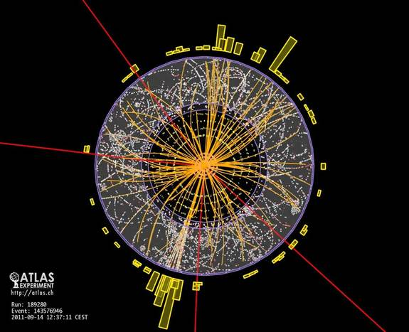
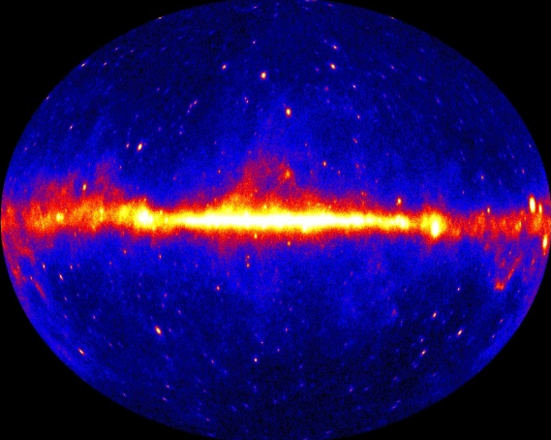
HEP’s Mission: To understand how the universe works at its most fundamental level, which is done by discovering the elementary constituents of matter and energy, probing the interactions between them, & exploring the basic nature of space and time.
Research at the Energy Frontier: HEP supports research where powerful accelerators such as the LHC are used to create new particles, reveal their interactions, and investigate fundamental forces, and where experiments such as ATLAS and CMS explore these phenomena.
Research at the Intensity Frontier: Reactor & beam-based neutrino physics experiments such as Daya Bay and LBNE may ultimately answer some of the fundamental questions of our time: why does the Universe seem to be composed of matter and not anti-matter?
Research at the Cosmic Frontier: Through ground-based telescopes, space missions, and deep underground detectors, research at the cosmic frontier aims to explore dark energy and dark matter, which together comprise approximately 95% of the universe.
Theory and Computation: Essential to the lifeblood of High Energy Physics, the interplay between theory, computation, and experiment drive the science forward. Computational sciences and resources enhance both data analysis and model building.
Accelerator Science: Supports R&D at national labs and universities in beam physics, novel acceleration concepts, beam instrumentation and control, high gradient research, particle and RF sources, superconducting magnets and materials, and superconducting RF technology.
➔More than 20 physicists supported by the Office of High Energy Physics have received the Nobel Prize.

Slide 7
HEP Program Guidance
FACA panels & subpanels – official advice:
High Energy Physics Advisory Panel (HEPAP)
reports to DOE and NSF
provides the primary advice for the HEP program
create subpanels for detailed studies (e.g. PASAG, P5)
Astronomy and Astrophysics Advisory Committee (AAAC)
– reports to NASA, NSF and DOE on areas of overlap
Recent Subpanels:
P5 (2008) and now P5 (2014) – for strategic planning
Particle Astrophysics Program Assessment Group (PASAG, 2009)
Other Interactions with community:
National Academies of Science
APS Division of Particles and Fields (DPF)
– Snowmass community science planning study (2013)
Specific studies, task forces also provide input to the program

Slide 8
HEP Program Budget & Issues

Slide 9
HEP Budget Timeline
In the last few years --
Budget philosophy is to enable new world-leading HEP capabilities in the U.S. through investments on all three frontiers: Accomplished through ramp-down of existing project operations and Research (~ -6%)
Impact of these actions: Workforce reductions at universities and labs; Several new efforts were delayed
Program planning has been very difficult due to unstable budget environment.
FY 2013 Budget:
We were not able to start new Major Item of Equipment (MIE) projects, including LSST-camera or Belle-II.
FY 2014 Budget enacted:
MIE-fabrication start approved for LSST-camera, Belle-II, Muon g-2
Project Engineering & Design (PED) & Construction funds approved for Muon to Electron conversion (Mu2e) experiment
Specific guidance in approved Budget for the additional $21M provided over the Request:
Long Baseline Neutrino Experiment (LBNE) – $26M in R&D & PED funds ($16M in PED over Request)
Homestake Mine Operations - $15M provided (specific guidance was $5M over Request)
FY 2015 Budget Request – request supports:
Full operation of existing HEP facilities and experiments
Continue planned funding profiles of existing projects: LSST-camera, muon g-2, Belle-II, Mu2e
New MIE-fabrication start requests: ATLAS and CMS detector upgrades
Accelerator Stewardship subprogram initiated in FY2014
Continue design studies for Long Baseline Neutrino Experiment (LBNE), DM-G2 and DESI projects
(Note: DESI, DM-G2 do not have MIE-fabrication start requests)
Notes:
The FY15 Request was developed before P5 Strategic Plan announced
FY15 Request is below P5 Scenario A; FY14 Appropriation above Scenario B;
We are working to make adjustments to align to P5 recommendations and argue for Scenario B funding.

Slide 10
HEP Budget History (FY12-15)
 | FY2012 | FY2013 | FY2014 | FY2014 | FY2014 | FY2014 | FY2014 | FY2015
Budget (in $M) | actual | actual | President's request | Initial plan in CR | House mark | Senate mark | Final Approp. | President's request
HEP available | 770.5 | 727.5
SBIR/STTR (~ 3%) | 20.3 | 20.8
HEP Total | 790.8 | 748.3 | 776.5 | 748.3 | 772.5 | 806.6 | 797.5 | 744.0
Office of Science (SC) | 4,874.6 | 4,621.1 | 5,152.7 |  | 4,663.0 | 5,152.7 | 5,071.0 | 5,111.2
Program planning in this budget environment is very difficult due to not having a stable budget.

Slide 11
FY 13-15 High Energy Physics Budget (dollars in thousands)
*The FY 2013 Actual is reduced by $20,791,000 for SBIR/STTR, so ~ $748.3M should be used to compare to FY14/15.

Slide 12
FY 13-15 High Energy Physics Funding by Activity (dollars in thousands)
*The FY 2013 Actual is reduced by $20,791,000 for SBIR/STTR, so ~ $748.3M should be used to compare to FY14/15.

Slide 13
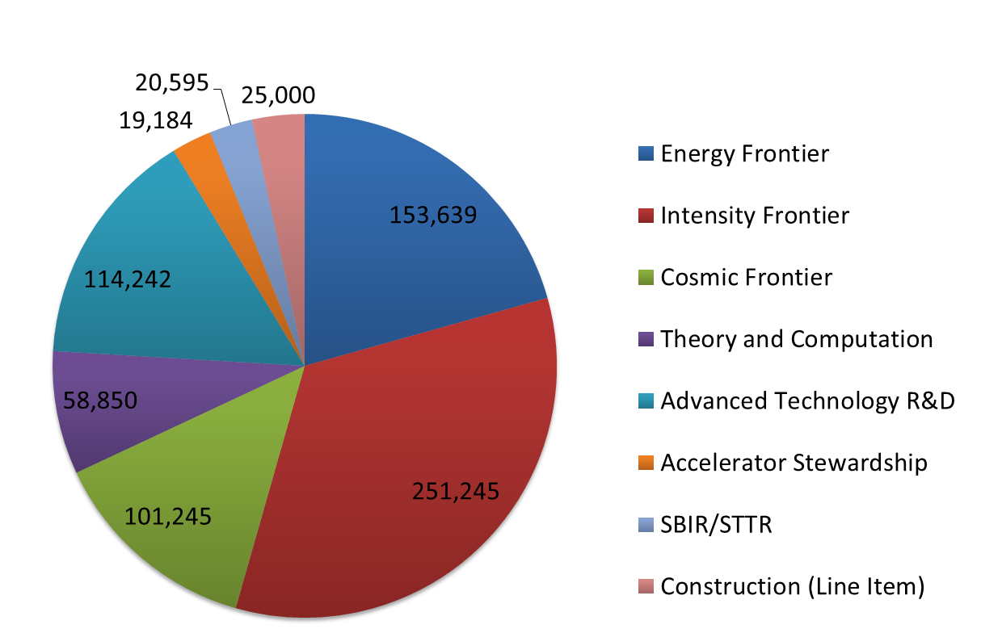
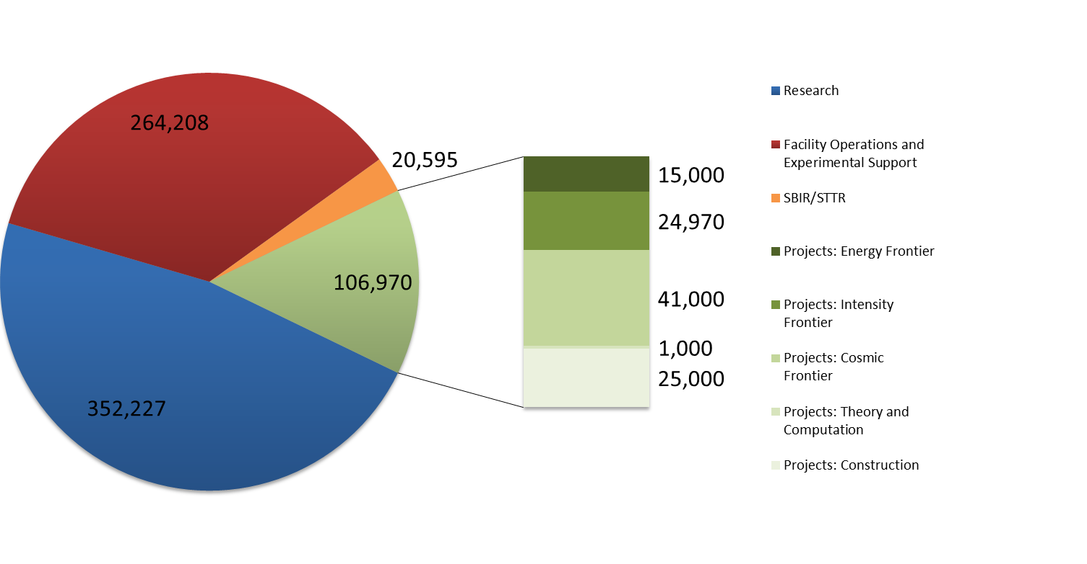
FY 2015 High Energy Physics Budget Request (dollars in thousands)
By Area
By Activity

Slide 14
Cosmic Frontier Program
PASAG Prioritization Criteria
The science addressed by the project is necessary
Addresses fundamental physics
At least one compelling result or preponderance of solid, important results. Check that anticipated results would not be marginal...
Discovery space: large leap in capabilities, significant new discovery space, possibility of important surprises
Particle physicist participation is necessary
Transformative techniques and know-how have a major, visible impact; project would not happen otherwise
Leadership is higher priority than participation
Scale matters, particularly for projects at the boundary of particle physics and astrophysics
Relatively small projects with high science per dollar help ensure scientific breadth while maintaining program focus on the highest priorities
Programmatic issues
International context: cooperation vs duplication/competition
Readiness, risk, timeliness
14

Slide 15
Cosmic Frontier Executing the program

Slide 16
Cosmic Frontier - Experimental Program
Cosmic Frontier — Through ground-based telescopes, space missions, and deep underground detectors, research at the cosmic frontier aims to explore dark energy and dark matter, which together comprise approximately 95% of the universe.
Program is divided into THRUSTS:
Studies of the nature of Dark Energy using imaging and spectroscopic surveys
Direct detection searches for Dark Matter particles
Study of the high energy universe and indirect dark matter Searches using Cosmic-ray, Gamma-ray experiments
Other efforts, including small contributions to
CMB experiments to study the nature of inflation, neutrino properties, and dark energy;
computational cosmology efforts;
other experiments
2011 Nobel Prize !!
Future program: Consider other possibilities and further develop & optimize the program following the P5 report
16
Notes:
16

Slide 17
Cosmic Frontier – Budget Management
➔ Cosmic Frontier program managers plan and execute budgets for:
Research:
University Research
Lab Research
→The Research budgets cover scientists (including students & postdocs) & their expenses, for participation in all phases of the experiments. Small amounts of engineering, technical and Materials & Supplies (M&S) is in the budget too.
Projects/Experiments:
Operations – operations costs of experiments during fabrication, commissioning, data-taking and analysis phases
Fabrication – for experiments below the Major Item of Equipment (MIE) Project $ threshold
Future R&D – includes R&D for Projects until Critical Decision 1 (CD-1) approval
→The Project budgets include engineering, technical, computer and other professional personnel & their expenses, M&S, consumables, and sometimes travel for scientists to participate on project activities.
CF MIE Projects – Fabrication for MIE projects is managed by Facilities/Projects Division from CD-1 to CD-4.
17

Slide 18
HEP Program Execution - Reviews
Cosmic Frontier program managers manage and/or support reviews:
HEP Comparative Research Grants Program
Panel reviews of all proposals to 6 different subprograms (Cosmic, Energy, Intensity, Theory, Accel. R&D, Detector R&D)
The 6 panel reviews are held ~ November each year & successful grants start ~ May
Office of Science (SC) Early Career program
This is an SC-wide program but each office holds separate panel reviews
Both universities and laboratories can submit proposals.
OHEP’s are held ~ January each year; funding starts in the summer
HEP Comparative Review of Laboratory Research programs
Panel review for each subprogram held every 3 years to comparatively review lab research programs
Each subprogram is reviewed every 3 years (Cosmic Frontier Sept. 2013)
HEP reviews of Lab programs
Individual program and operations reviews
Project reviews – as needed
Depending on size of project, will have Lehman or HEP-run reviews of design & fabrication activities
Cosmic Frontier Experimental Operations
Panel review of operating, or about-to-start experiments; will do this ~ biannually (Sept 2012, Fall 2014)
Review each experiment’s operating status, budget, schedule & science reach within the context of the overall program.
Program reviews – as needed
Dark Matter Generation 2
Comparative review of R&D proposals (Sept. 2012), and “downselect” to move to fabrication phase (Dec. 2013)

Slide 19
Cosmic Frontier Program Status, Budget

Slide 20
Cosmic Frontier
Program thrusts:
Study the nature of Dark Energy
Direct Detection searches for Dark Matter particles
Cosmic-ray & Gamma-ray studies – particle properties, high energy acceleration mechanisms, indirect searches for dark matter particles
Other: small efforts in CMB, computational cosmology, etc.
Future program:
Consider other possibilities and further develop/optimize program following the P5 report

Slide 21
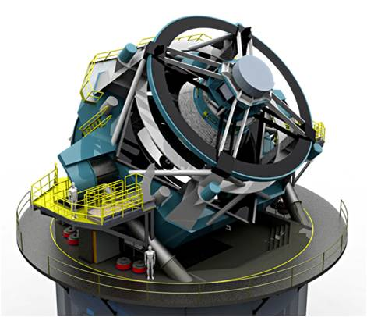
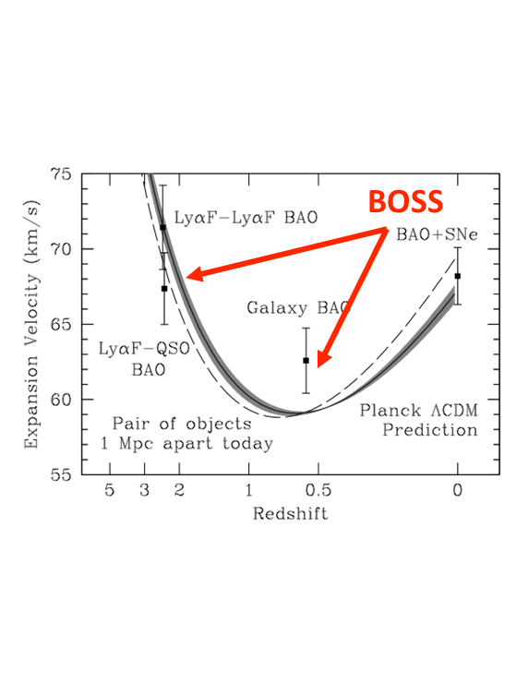
Dark Energy Program Status
Make precision measurements to differentiate between Cosmological Constant and modification to General Relativity
Operating complementary suite of imaging, spectroscopy and supernova surveys
Fabrication and future planning for next generation underway
Operating
Baryon Oscillation Spectroscopic Survey (BOSS)
5 year ops completes in FY14
Dark Energy Survey (DES)
5 year ops started Sept 2013
DOE/NSF partnership; DOE responsible for camera
Supernova surveys continue operations
Fabrication
Large Synoptic Survey Telescope (LSST) – DOE responsible for the camera
DOE & NSF partnership w/MOU; Fabrication-start approved in FY2014
CD-3a approved (June 2014)
Dark Energy Science Collaboration (DESC) formed to support science planning for precision dark energy results
P5 recommended completing LSST as planned.
Dark Energy Survey – Data-taking started Aug. 2013
LSST
Future planning
Dark Energy Spectroscopic Instrument (DESI)
Stage-IV experiment using BAO and Redshift Space Distortion (RSD) methods
P5 recommended DESI as last project to cut when moving from funding scenario B to A (lowest)
Discussions with NSF for possible host telescopes
CD-1 review planned for Sept. 2014; R&D continuing in FY2015

Slide 22
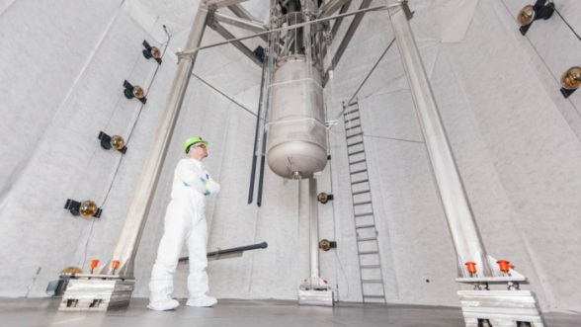
Direct Detection Dark Matter (DDDM) Program Status
→Learn the identity and nature of Dark Matter - Staged program
Current experiments test multiple technologies to determine most powerful method for future generation
Currently Operating: DM-G1
Weakly Interacting Massive Particle (WIMP) searches
SuperCDMS-Soudan (cryogenic germanium)
LUX (liquid xenon)
Top story of the year in Nature Magazine “2013 in Review”
DarkSide-50 (liquid argon)
COUPP-60 (bubble chamber fluids)
Search for Axions (Primakov effect: axion conversion to photon in magnetic field)
ADMX-2a
Next: Generation 2 (DM-G2)
- P5 recommended an expanded DDDM program including DM-G2 experiments and continuing R&D activities.
Select at least two DM-G2 experiments to move to fabrication phase:
Goal is to improve sensitivity by one or more orders of magnitude
CD-0 in Sept. 2012; Down select review in Dec. 2013
Plan to announce selection ~ end of June, 2014
The overall DDDM program will need to include DM-G2 project(s), operations of current experiments, background and material studies, and future R&D efforts.
Future
- P5 recommended supporting one or more DM-G3 experiments as part of a global program.
DM-G3 R&D will be part of a new DDDM R&D program.
CDMS
LUX

Slide 23
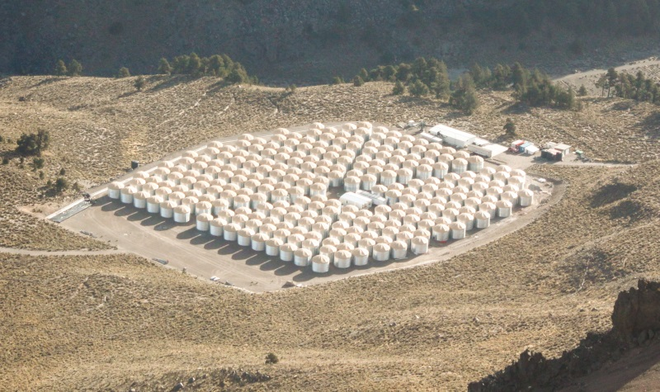
High Energy Cosmic-ray, Gamma-ray Experiments
Explore mechanism for acceleration of space-time expansion and perform indirect searches for dark matter
Operating
Alpha Magnetic Spectrometer (AMS)
Cosmic ray observatory on the International Space Station (ISS)
April 2013: High energy positrons consistent with either dark matter or pulsar origin
Fermi Gamma-ray Space Telescope (FGST)
Gamma-ray observatory in space
Origin of Cosmic Rays result one of Science Magazine’s 2013 “Top 10 Science Breakthroughs of the Year”
VERITAS - Gamma-ray array in Arizona
Discovery of unexpected very high energy emission from the Crab Pulsar
Fabrication
HAWC - Gamma ray array in Mexico
Partial operations now; full operations starting end FY2014
Future Planning
Cherenkov Telescope Array (CTA)
Next generation international gamma ray observatory
P5 recommended a de-scoped US contribution only if NSF-AST moves ahead with the project.
AMS on the International Space Station
HAWC – completed array (May 2014)
23

Slide 24
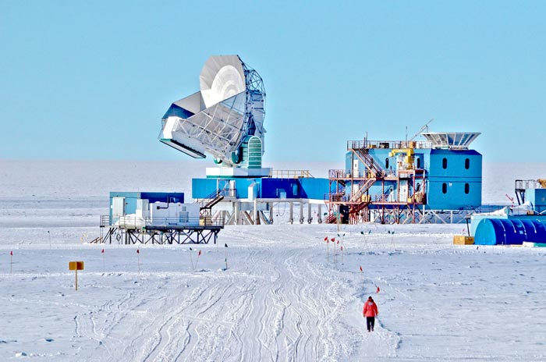
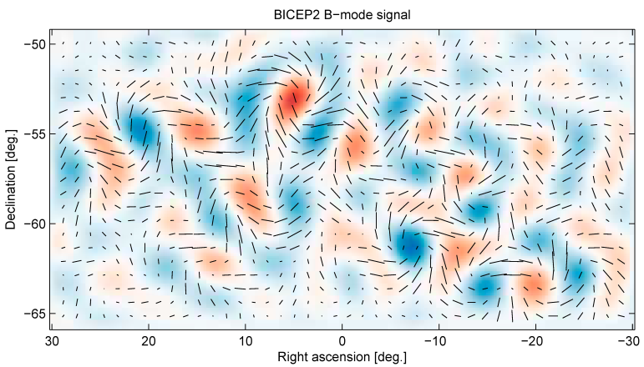
Cosmic Microwave Background (CMB)
Gain insight into the evolution of the universe by understanding the oldest visible light
Operating
South Pole Telescope polarization (SPTpol)
HEP provided outer-ring detectors
July 2013: first measurement of “B-mode” polarization in the CMB -- In Physics World “Top Ten Results of 2013”
Research-only Contributions
BICEP II
March 2014: DETECTION OF B-mode POLARIZATION in CMB →Signal of inflationary gravitational waves
First direct confirmation of inflation and first detection of quantum gravity effects; Physics at 10¹⁶ GeV!!
Planck space mission:
HEP has MOU with NASA to provide supercomputing resources at NERSC & supports researchers
South Pole Telescope (SPT)
BICEP2 results (March 2014)
Future Planning
SPTpol-3G - HEP is planning participation in major upgrade of the camera to greatly increase sensitivity; review being scheduled for September 2014.
CMB Stage-IV (CMB-IV) experiment
Community is developing science case & concept
P5 recommended that CMB experiments be part of the core particle physics program.

Slide 25
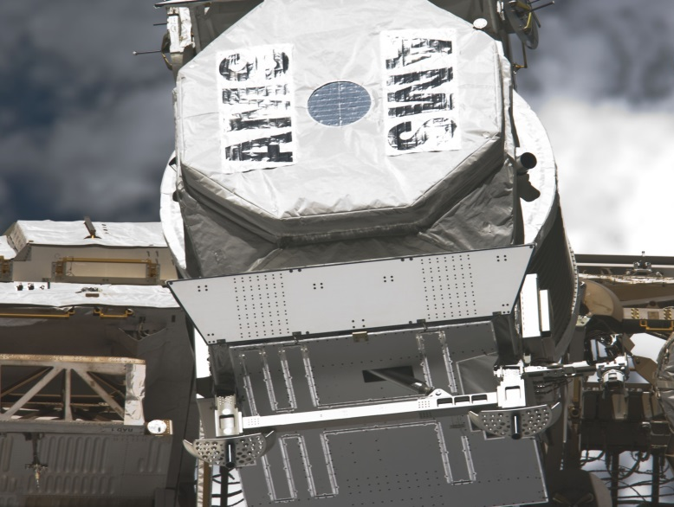
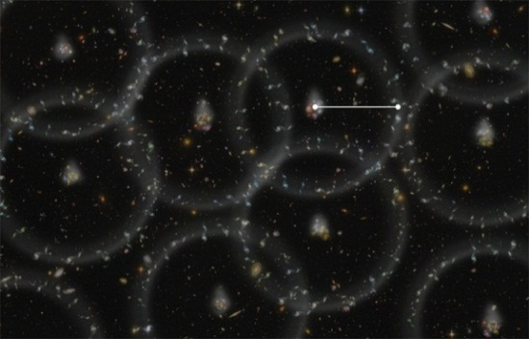
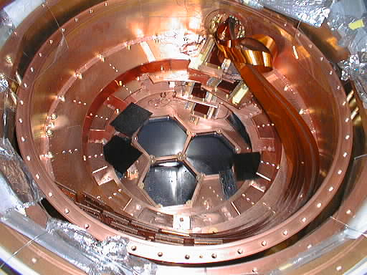
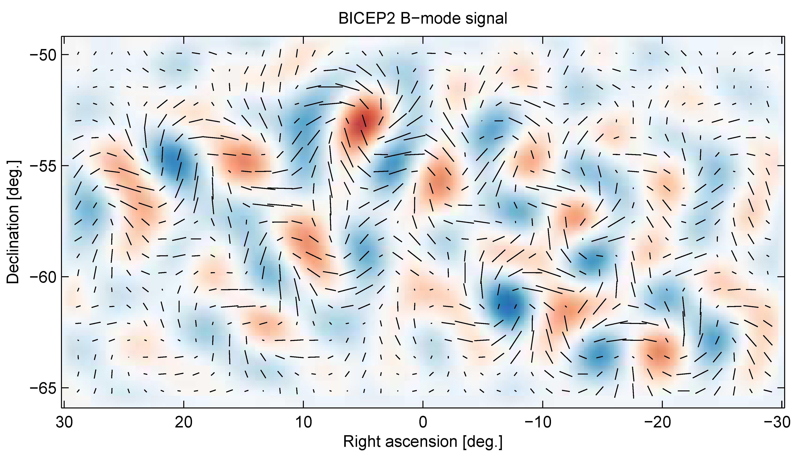
Recent Major Accomplishments: Cosmic Frontier
April 2013: The Alpha Magnetic Spectrometer (AMS) on the International Space Station observes structure in the cosmic ray positron spectrum
Consistent with massive (> 500 GeV) Dark Matter particle (DM) annihilation in the Galactic halo
Need several more years of operation to achieve an “indirect detection,” or determine if the origin is from “conventional” astrophysics (e.g., pulsars)
October 2013: First results from LUX released
World’s best limits for DM masses near 33 GeV
Results don’t favor hints of DM signal seen by other experiments
February 2014: New results from Baryon Oscillation Spectroscopic Survey (BOSS)
Scale of the universe measured to 1% accuracy
Precision measurements with a variety of methods are the key to determining the nature of dark energy
February 2014: SuperCDMS-Soudan results
Initial results rules out the favored region of the excess events seen in April 2013
February 2014: SuperCDMS-Soudan improves limits for low mass WIMPs
March 2014: BICEP2
First measurement of the B-mode signal due to primordial gravitational waves produced during the inflationary epoch – direct evidence of inflation! (HEP supports Chao-Lin Kuo, SLAC/Stanford)

Slide 26
HEP Cosmic Frontier Program Experiments – current, planning
June 2014
Experiment | Location | Description | Current Status | # Collaborators (# US, HEP) | # Institutions (# US, HEP) | # Countries
Baryon Oscillation Spectrosopic Survey (BOSS) | APO in New Mexico | dark energy stage III (spectroscopic) | operating through FY14 | 230 (150 US, 40 HEP) | (22 US, 8 HEP) | 7
Dark Energy Survey (DES) | CTIO in Chile | dark energy stage III (imaging) | operations started Sept. 2013 | 300 | 25 (13 US, 9 HEP) | 6
Large Synoptic Survey Telescope (LSST) - Dark Energy Science Collaboration (DESC) | Cerro Pachon in Chile | dark energy stage IV (imaging) | science studies | 232 (200 US, 134 HEP) | 53 (41 US, 16 HEP) | 3
Large Synoptic Survey Telescope (LSST) - LSSTcam Project | Cerro Pachon in Chile | dark energy stage IV (imaging) | CD1 for LSSTcam approved; FY14 Fabrication start ; CD3a approved June 2014 | 142 (111 US, 111 HEP) | 17 (11 US, 11 HEP) | 2
Dark Energy Spectroscopic Instrument (DESI) | KPNO in AZ ?? | dark energy stage IV (spectroscopic) | CD0 approved Sept 2012; CD1 review Sept. 2014 | 180 (95 US, 72 HEP) | 42 (23 US, 18 HEP) | 13
Axion Dark Matter eXperiment (ADMX-IIa) | Univ Washington | dark matter - axion search | operating | 24 (20 US, 17 HEP) | 7 (6 US, 3 HEP) | 2
Chicagoland Observatory for Underground Particle Physics (COUPP-60) --> PICO | SNOLab in Canada | dark matter - WIMP search | operating | 60 (26 US, 8 HEP) | 14 (6 US, 1 HEP) | 5
DarkSide-50 | LNGS in Italy | dark matter - WIMP search | operating | 122 (66 US, 12 HEP) | 26 (12 US, 3 HEP) | 7
Large Underground Xenon (LUX) | SURF in South Dakota | dark matter - WIMP search | operating | 102 (86 US, 56 HEP) | 17 (13 US, 9 HEP) | 3
Super Cryogenic Dark Matter Search (SuperCDMS-Soudan) | Soudan in Minnesota | dark matter - WIMP search | operating | 83 (70 US, 38 HEP) | 19 (16 US, 6 HEP) | 3
Dark Matter Generation 2 (DM-G2) experiment(s) | TBD | dark matter Gen 2: 1+ direct detection experiments selected in June 2014 to move forward to fabrication | CD0 approved Sept 2012; planning CD1 in FY14
Very Energetic Radiation Imaging Telescope Array System (VERITAS) | FLWO in AZ | gamma-ray survey | operating | 92 (74 US, 32 HEP) | 20 (15 US, 5 HEP) | 4
Pierre Auger Observatory | Argentina | cosmic-ray | operating | 463 (51 US, 12 HEP) | 100 (20 US, 5 HEP) | 18
Fermi Gamma-ray Space Telescope (FGST) Large Area Telescope (LAT) | space-based | gamma-ray survey | June 2008 launch; operating in space | 319 (157 US, 73 HEP) | 49 (14 US, 3 HEP) | 9
Alpha Magnetic Spectrometer (AMS-02) | space-based (on ISS) | cosmic-ray | May 2011 launch; operating | 600 | 60 (6 US, 2 HEP) | 16
High Altitude Water Cherenkov (HAWC) | Mexico | gamma-ray survey | Fabrication; Operations starts late FY2014 | 111 (54 US, 8 HEP) | 31 (16 US, 2 HEP) | 2

Slide 27
Cosmic Frontier Strategic Planning: P5 recommendations & HEP response

Slide 28
P5 report
HEPAP is our primary panel for providing advice to us on the status and direction of the field.
→ P5 subpanel guides our strategic plan.
The P5 report “Strategic Plan for US Particle Physics in the Global Context” was presented to HEPAP on May 22, 2014.
-- The report represents a consensus vision developed by the particle physics to identify the most exciting and productive areas of research and how we pursue them. P5 recommended that we “pursue the most important opportunities wherever they are”, “host unique, world-class facilities that engage the global scientific community” and “pursue a program to address the 5 science drivers”.
Use the Higgs boson as a new tool for discovery
Pursue the physics associated with neutrino mass
Identify the new physics of dark matter
Understand cosmic acceleration: dark energy and inflation
Explore the unknown: new particles, interactions, and physical principles.
The report recognizes the reality of a challenging funding landscape, where choices have to be made and resources stewarded carefully, and confronts those challenges head on.
The promise/potential of high energy physics has never been greater – exciting science on the horizon.
Plan includes a well-balanced portfolio of small, medium and large-scale projects for the future.
- will provide the required balance of short-term and longer-term science goals

Slide 29
Cosmic Frontier – Dark Energy, CMB (P5 Recommendations, OHEP Response)
P5 #16: Build DESI as a major step forward in dark energy science, if funding permits
- DESI should be the last project cut if budgets move from Scenario B to Scenario A (lowest)
The P5 recommendation will be used to highlight the importance of the DESI and argue for the additional funds needed to implement it as a high priority.
A successful Independent Project Review (IPR) will be used to show that DESI is ready to receive funding if it becomes available. The IPR is scheduled for Sept 9-10, 2014 to evaluate DESI’s readiness for CD-1. (Fabrication funding is not in the FY15 Request)
HEP will move forward in planning DESI in coordination with NSF.
P5 #17: Complete LSST as planned.
Detailed plans by both DOE and NSF to carry out LSST exist. We will continue to execute the project according to the DOE-NSF agreement. Start of fabrication funding approved in FY14.
P5 #18: Support CMB experiments as part of the core particle physics program. The multidisciplinary nature of the science warrants continued multi-agency support.
HEP will use this recommendation to open discussions with traditional CMB research support agencies (NSF, NASA) to come to agreement on DOE’s role.
Going forward, these meetings would be followed by community planning meetings.

Slide 30
Cosmic Frontier – Dark Matter (P5 Recommendations, OHEP Response)
P5 #19: Proceed immediately with a broad second-generation (G2) dark matter direct detection program with capabilities described in the text. Invest in this program at a level significantly above that called for in the 2012 joint agency announcement of opportunity.
Coordinated HEP/NSF portfolio for the Direct Detection of Dark Matter (DDDM) will continue to be developed and implemented.
The overall DDDM program will need to include DM-G2 project(s), operations of current experiments, background and material studies, and future R&D efforts.
Selection of DM-G2 concept(s) will be announced soon (~ end of June).
The P5 recommendation will be used to highlight the importance of an expanded DDDM program and argue for the additional funds needed to implement it as a high priority.
P5 #20: Support one or more third-generation (G3) direct detection experiments, guided by the results of the preceding searches. Seek a globally complementary program and increased international partnership in G3 experiments.
HEP will concentrate on getting the DM-G2 experiment(s) successfully started. Actions for a specific DM-G3 program will take place later on.
A robust Dark Matter R&D program is planned that will be directed in part to potential G3 technologies.

Slide 31
Cosmic Frontier – Cherenkov Telescope Array (CTA) (P5 Recommendations, OHEP Response)
P5 #21: Invest in CTA as part of the small projects portfolio if the critical NSF Astronomy funding can be obtained.
P5 Comments:
CTA has a broad science reach that transcends fields, with the dark matter detection capabilities of direct importance to particle physics
Using P5 Criteria, a de-scoped US component should be shared by NSF-AST, NSF-PHY and DOE.
NSF-AST has said publicly that its budget is unable to accommodate this project as a strategic initiative; Only possibility is the competed mid-scale program.
➔HEP doesn’t plan to continue support of research or R&D efforts on CTA.
This could be re-considered if NSF moves forward on the project and requests a partnership with DOE, based on priorities, funding etc.

Slide 32
Cosmic Frontier P5 response – notes, plans, comments
Projects:
The Cosmic Frontier has high priority projects ready to go in the near term (DESI and DM-G2) and HEP is working towards getting the additional funds (over the lowest funding scenario) to do DESI and an expanded dark matter program.
Operating experiments:
To review the status of the operating experiments and ensure alignment with the P5 vision, we are planning a review of Cosmic Frontier operating experiments later in 2014 (last review was end of FY12).
Priorities for funding:
Following the P5 criteria, it will be a priority to support projects in which HEP has a major/visible role and in which there are significant leaps in capabilities and/or science.
The priority for research funding will be to sufficiently support the science collaborations to carryout the project fabrication + operations and to deliver the science.
Ensure some room in the research program for development of ideas for new projects that are aligned with the science drivers.
Research efforts on projects that are aligned with P5 science drivers, but which don’t have HEP participation, will also be considered, taking into account the above and based on funding availability.
P5 #4: Maintain a program of projects at all scales (recommendation 4)
The suite of projects recommended by P5 fulfills this recommendation & HEP will work to bring these projects to successful completion.
As these projects complete, HEP will use a new project evaluation mechanism (e.g. the National Program Advisory Committee being considered by HEPAP) to select the next round of projects. We expect that the program will have a variety of project sizes as needed to address the science drivers.

Slide 33
Cosmic Frontier Grants process & results

Slide 34
Solicitations for Funding Support
Research Opportunities in HEP (“Comparative Review”)
Annual solicitation that is the funding vehicle for HEP research support
FY15 FOA to by released in a number of weeks.
Office of Science Early Career Awards
Annual competition for young investigators
Within 10 years of Ph.D., 3 tries
$150k/$500k per year for 5 years (university/lab)
Office of Science Continuing Solicitation
No deadline; renews every FY
Project R&D, small experiments (fab, operations), conferences, even research (lowest priority).
Ad hoc, topical solicitations (e.g., Second Generation DM)
Research Opportunities in Accelerator Stewardship
[Small Business Innovation Research]
[Science Discovery through Advanced Computing (SciDAC)]

Slide 35
Cosmic Frontier: Comparative Grant Review Statistics
Statistics on Received & Funded proposals:
 |  | FY12 |  |  | FY13 |  |  | FY14
 | Amount | # proposals | # PI's | Amount | # proposals | # PI's | Amount | # proposals | # PI's
Request | $3.3M | 11 | 21 | $7.7M | 28 | 53 | $7.5M | 29 | 40
Funded | $1.6M | 5 | 12 | $3.4M | 20 | 28 | $3.2M | 19 | 25
Success rate | 48% | 50% | 60% | 44% | 71% | 53% | 43% | 65% | 63%
* Note that $4.4M was actually provided in FY14 when taking into account fully forward-funded grants.
There is a lot of pressure on the Cosmic Frontier program with respect to the support requested vs. funded. This is good. Lots of good people are interested in the program. We hope the program will grow to sufficiently support the growing portfolio of projects, as people redirect their efforts and new people join.

Slide 36
Cosmic Frontier – University Research Grant Funding by Thrust
Cosmic Frontier University Research Grants - all funding ($K) |  | FY12 | FY13 | FY14
 |  | actual | actual | current
 | Dark Energy | 2856 | 3087 | 4451
 | Dark Matter | 3366 | 3599 | 4993
 | Cosmic, Gamma-ray | 5591 | 5542 | 3670
 | CMB, Other | 0 | 0 | 0
 | Total | 11813 | 12228 | 13114
Note: This includes all University Research funding for new/renewal comparative review grants, early careers, continuations and supplements. Support for lab research and projects (R&D, fabrication, operations is not shown).
36

Slide 37
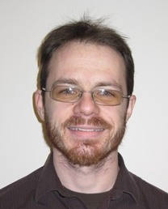
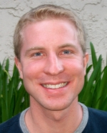
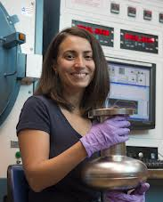
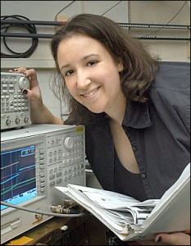
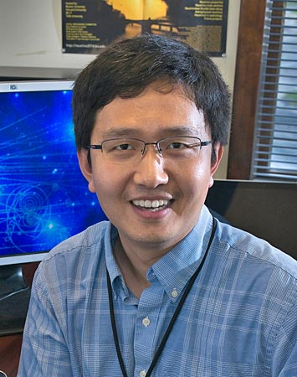
FY14 HEP Early Career Awards
Eric Dahl, Northwestern University
A Scintillating Xenon Bubble Chamber for Dark Matter Detection
Peter Graham. Stanford University
New Searches for Ultralight Particles
Anna Grassellino, Fermilab
Impurity Doping of Niobium for Ultra Efficient Superconducting RF Cavities
James Hirschauer, Fermilab
Search for new phenomena at the 13 TeV LHC: Fast start and strong finish
Stephanie Majewski, University of Oregon
Search for New Physics with Top Quarks and Upgrade to the ATLAS Liquid Argon Calorimeter
Xin Qian, Brookhaven National Laboratory
Detector Development towards Precision Measurements of Neutrino Mixing

Slide 38
Cosmic Frontier – Early Career Review Statistics
Awards:
FY10
Newman (Pitt)
Mahapatra (TAMU)
FY11
Chou (FNAL)
Slosar (BNL)
Hall (Maryland)
FY12
Mandelbaum (CMU)
Padmanabhan (Yale)
Carosi (LLNL)
FY13
Bolton (Utah)
Chang (ANL)
FY14
Dahl (Northwestern)
Statistics on Received & Funded proposals:
 | FY10 | FY11 | FY12 | FY13 | FY14
# received - Univ | 11 | 8 | 12 | 16 | 6
# received - Lab | 10 | 4 | 7 | 9 | 7
# funded - Univ | 2 | 1 | 2 | 1 | 1
# funded - Lab | 0 | 2 | 1 | 1 | 0
38

Slide 39
Summary

Slide 40
Summary
An exciting time for HEP and the field
P5 developed compelling, realistic strategic plan with a consensus vision for US HEP
Cosmic Frontier priorities: Dark Energy, Dark Matter, CMB
HEP will be moving forward to implement a program aligned with the P5 strategic plan.

Slide 41
Backups

Slide 42
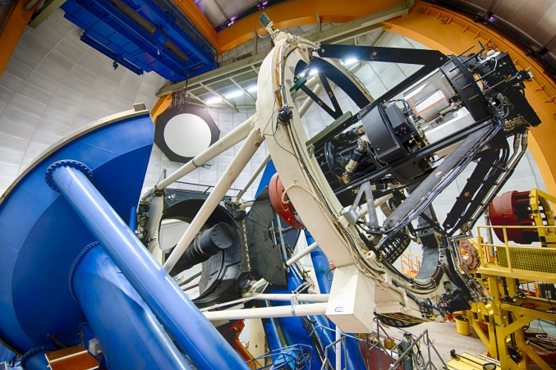
Cosmic Frontier Status
Dark Energy
Several operating experiments using existing telescopes and cameras
BOSS (spectroscopic), DES (imaging), supernova surveys
Fabrication: Large Synoptic Survey Telescope (LSST) - ground-based Stage IV Dark Energy measurements using imaging survey; CD-3a approved June 2014
Future Planning: Mid-scale Dark Energy Spectroscopic instrument (DESI) Stage IV spectroscopic survey to complement LSST; CD1 review Sept. 2014
Dark Matter
Several 1st generation (G1) experiments operating
ADMX, LUX, CDMS-Soudan, DarkSide, COUPP
Planning: 2nd-Generation Dark Matter (DM-G2) experiments to probe most of preferred phase space; experiment(s) selection in ~ end June 2014
Cosmic-ray, Gamma-ray
Operating experiments: Fermi/GLAST, VERITAS, Auger, AMS
Fabrication: High Altitude Water Cherenkov (HAWC) gamma-ray observatory starts full science operations in late FY2014
Community planning on Cherenkov Telescope Array
Cosmic Microwave Background (CMB)
Operating - South Pole Telescope polarization (SPTpol)
Community planning for a CMB Stage IV experiment
DES Data taking started Aug. 2013

Slide 43
Office of Science Continuing Solicitation
Office of Science-wide Continuation of Solicitation affords the opportunity for proposal submission at any time to any of the Office of Science programs.
Research proposals may be submitted, but nearly all available research funds are provided through the Comparative Review process.
Conceptual R&D, project efforts (< MIE threshold), experimental operations, conferences/workshops and others may be proposed via this solicitation.
See http://science.energy.gov/hep/funding-opportunities/ and select the Continuing Solicitation FOA.
43

Slide 44
Cosmic Frontier – Program Considerations
Build Program with:
Staged implementation & results
Mix of smaller, larger projects, using multiple methods and technologies as needed
Balance between thrusts
Balance of speculative efforts with ones that guarantee results
Considerations: PASAG Criteria!
Science goals and how it will address DOE-HEP goals?
Experiments which are directly-aligned with goals
Experiments in which only part of the data is of interest to the HEP program
What does HEP Community bring to the experiment? Visible, leadership contributions?
Are HEP project contributions in line with % of the project relevant to our science goals?
Are roles and responsibilities on the project in line with our contributions?
Partnerships - plusses and minuses
Don’t “mayonnaise” funds all over many small efforts.
Domestic vs off-shore
The PASAG criteria and the above considerations can be applied to determining what projects we support at what level as well as research funding priorities.
44

Slide 45
Cosmic Frontier: Research Support
Cosmic Frontier experimental research budget covers:
Scientist support for our program
Faculty, research scientist, postdoc, graduate student, & their expenses
Small technical, engineering, equipment, etc for their efforts in their lab
What’s not supported by research grants
Any significant operations and/or project-related activities:
Engineering, Technicians, computer programming, other project/related personnel support, top-level project management, M&S, major items of equipment, consumables
These are typically supported through the central Project funding
Non-HEP related efforts:
e.g. Gravity waves (LIGO), Heavy Ion (RHIC), AMO Science, etc.
45

Slide 46
Cosmic Frontier: Research Funding details
Notes
Faculty support
Typically, DOE “buys” full research time of the faculty member on all activities by providing summer by providing summer salary and group support. Reduced levels of effort typically have reduced support.
Research Scientists
Support may be provided on case-by-case on merits:
whether the roles and responsibilities are well-matched with individual capabilities and cannot be fulfilled by a term position
Efforts are related towards research; not long-term operations and/or project activities
Typical HEP researcher:
Involved in “service” work for the experiment as well as science research
Has program of experiments and plan from one experiment to the next
Not funded for one particular study or effort here and there
Makes long term commitments to our experiment/science – he/she has specific commitments & responsibilities for our projects/experiments that may include analyzing data with one experiment while planning the next one.
46

Slide 47
Cosmic Frontier – Research Support Considerations
In practice, HEP traditionally supports teams/collaborations of scientists with the necessary expertise and responsibilities to take experiments through all phases, from R&D, Fabrication, Operations, & Data Analysis
-- Science planning is expected throughout all phases to end up with coordinated data analysis by a collaboration (One precision result rather than 100 independent, not so precise, results)
-- It is Understood that people have different strengths and are involved in different aspects of project.
-- Support theory/simulations/phenomenology/computational efforts in direct support of our experiments (otherwise should be proposed to the Theory program).
Peer reviews and program planning reflect these traditions – considerations :
Is the activity in direct support of our science/experiment and priorities?
For experiments with broad science program, is the effort are needed to support OHEP science interests? - Need to ensure that we are concentrating on the most important efforts for HEP program (e.g. dark energy on multi-use facility).
What are the priority efforts needed now for a particular experiment?
What is the experience, responsibilities and commitment (% time) of the researcher? Will they have time to make significant contribution?
Are people supporting the collaboration carrying out the project/experiment?
Will they work in the “HEP model” by making significant, continuous contributions to the experiment, in addition to their own data analysis?
Funding isn’t optimized by funding small fractions of lots of different people that aren’t making large or continuous contributions to the experiment, in addition to their own data analysis.
47

Slide 48
HEP Program Model
We are a science mission agency
Provide science leadership and support to enable significant advances in specific science areas
Provide lab environment with a variety of resources needed to design, build, operate selected facilities and projects
Provide lab infrastructure, including computing facilities (NERSC, SCiDAC program etc) to support these projects
Encourage scientific teams with expertise in required areas to participate in all phases, all the way to science results.
Partnerships as needed to leverage additional science and expertise (e.g. use other agency’s facilities)
In Particular
We develop and support a portfolio of selected facilities and experiments to obtain the science results.
We support a science collaboration in all stages of the project, leading to the best possible science results.

Slide 49
HEP - Recent Funding Trends
Ramp up ILC and SRF R&D programs
Trading Projects for more Research
In the late 90’s the fraction of the budget devoted to projects was about 20%
Many projects started since 2006 are coming to completion
New investments are needed to continue US leadership in well defined research areas

Slide 50
HEP Budget - Cosmic Frontier
Cosmic Frontier Funding (in $K) | FY 2012 Actual | FY 2013 Actual | FY 2014 Request | FY 2014 Current (May 2014) | FY2015 Request
Research - univ + lab |  |  | 46,840 | 49,271 | 45,435
Research - univ | 12,881 | 12,233
Research - lab | 34,962 | 36,419
Facilities - operating | 8,505 | 10,111 | 7,500 | 9,615 | 7,238
Projects - MIE - HAWC | 1,500 | 1,500
Projects - MIE R&D, LSST camera | 5,500 | 8,000 |  | 3,000
Projects - MIE fabrication, LSST camera |  |  | 22,000 | 19,000 | 35,000
Projects - future R&D, small fabrication (incl. DESI, DM-G2, etc) | 5,891 | 9,659 | 14,694 | 9,700 | 6,000
TOTAL - Cosmic available | 69,239 | 77,922 | 91,034 | 90,586 | 93,673

Slide 51
HEPAP – Strategic Planning
Strategic Planning Goals:
A realistic, coherent, shared plan for US HEP
Enabling world-leading facilities/experiments in the US while recognizing the global context and the priorities of other regions
Recognizing the centrality of Fermilab while maintaining a healthy US research ecosystem that has essential roles for both universities and multipurpose labs
Articulating both the value of basic research and the broader impacts of HEP
Maintaining a balanced and diverse program that can deliver research results consistently
→HEP needs to have a compelling and executable strategic plan, with the community behind it
Process:
APS-DPF led community planning process in 2013 (“Snowmass”)
HEPAP P5 Subpanel (Steve Ritz, Chair) used Snowmass and other inputs to develop a strategic plan for the field within different funding scenarios.
P5 report was delivered and approved by HEPAP in the May 22-23, 2014 meeting.
→DOE is extremely grateful to P5 and the community for developing a consensus vision

Slide 52
FY2015 HEP Budget Request
Key areas
The HEP program requires new experiments to move the science forward
Need to maintain forward progress on new projects while minimizing the impact of research reductions to the extent possible
The FY 2015 budget request supports:
Full operation of existing HEP facilities and experiments
Continue planned funding profiles of existing projects, LSST-camera, muon g-2, Belle-II
Planned construction funding profile for the Mu2e - completes its design phase in FY 2015 and move into full construction
Only able to implement two new MIE fabrication starts in FY2015 request – for the ATLAS and CMS detector upgrades (these weren’t started in FY2014 and are now requested in FY2015)
Accelerator Stewardship subprogram initiated in FY2014; new funding opportunities and pilot programs expected in 2015 to address high-impact R&D topics
The Long Baseline Neutrino Experiment (LBNE) continues its design phase; investigate enhanced capabilities partnership contributions.
R&D efforts continue on other projects, including DM-G2 and DESI projects in the Cosmic Frontier
P5 report will impact prioritization of future projects

Slide 53
FY15: Funding Opportunity Announcements – Comparative Review Process
During FY2015, DOE/HEP will continue the large-scale comparative review of research proposals submitted by US academic institutions.
This will be the 4th year of such reviews conducted within the HEP research program.
DOE/HEP is currently preparing the FY2015 Funding Opportunity Announcement (FOA) for these comparative reviews
Expect it to be issued in next couple of weeks.
FOA will address suggestions & recommendations raised by the 2013 HEP Committee of Visitors (COV)
Deadlines for applicants:
Letter of Intent (strongly encouraged) on overview of research proposals: planned for mid-July 2014
Final Application: planned for early-September 2014
Exact dates will be provided in the FOA, once issued
Independently, an Accelerator Stewardship FOA is planned to be issued synchronously
Specifically for accelerator R&D which predominantly impacts non-HEP applications
A letter of intent is required, which will result in an encourage/discourage response
Eligibility will include academia, national labs, and industry

Slide 54
HEP Budget Impacts : FY15
Note HEP FY15 Request was developed before P5 Plan was announced, so there was little ammunition available to argue for higher budget levels
FY15 Request is slightly below P5 Scenario A level.
FY14 Appropriation is above Scenario B.
It is impossible at this stage to know which Scenario we are working in
Since we have already been working in this budget framework, only relatively small adjustments are needed for FY15 Request to “fit” P5 plan
We have communicated these adjustments to Congress at their request
We have also made the arguments for Scenario B funding levels
We expect House and Senate mark-ups to be released soon
We hope P5 plan + positive community reaction will help support more robust HEP budget generally
Users groups and DPF have been very active in supporting the plan
How much of the near-term plan can be achieved will depend largely on FY15 Appropriation

Slide 55
P5 Report – Program & Project Criteria
HEP will use P5 criteria (similar to PASAG) to develop the program and determine which projects to invest in.
• Program optimization criteria
– Science: based on the Drivers, assess where we want to go and how to get there, with a portfolio of the most promising approaches.
– International context: pursue the most important opportunities wherever they are, and host world-leading facilities that attract the worldwide scientific community; duplication should only occur when significant value is added or when competition helps propel the field in important directions.
– Sustained productivity: maintain a stream of science results while investing in future capabilities, which implies a balance of project sizes; maintain and develop critical technical and scientific expertise and infrastructure to enable future discoveries.
• Individual project criteria
– Science: how the project addresses key questions in particle physics, the size and relevance of the discovery reach, how the experiment might change the direction of the field, and the value of null results.
– Timing: when the project is needed, and how it fits into the larger picture.
– Uniqueness: what the experiment adds that is unique and/or definitive, and where it might lead. Consider the alternatives.
– Cost vs. value: the scope should be well defined and match the physics case. For multidisciplinary/agency projects, distribution of support should match the distribution of science.
– History and dependencies: previous prioritization, existing commitments, and the impacts of changes in direction.
– Feasibility: consider the main technical, cost, and schedule risks of the proposed project.
– Roles: U.S. particle physics leadership

Slide 56
Our P5 “Elevator Speech” (1st Draft)
This report represents a consensus vision developed bottom-up by the physics community with extensive consultation to identify the most exciting and productive areas of research and how we pursue them.
The report recognizes the reality of a challenging funding landscape, where choices have to be made and resources stewarded carefully, and confronts those challenges head on.
The promise/potential of high energy physics has never been greater – far from “settling” the big questions in high energy physics, the discovery of the Higgs boson and other recent milestones in physics have opened many more doors to exploring and understanding our universe.
Even given funding challenges, much important fundamental work can be accomplished and many tremendous scientific opportunities pursued, if we make the right strategic choices as a community.
This is a time of excitement and intellectual fervor that can engage young scientists and provide directions for a rewarding and fulfilling career.

Slide 57
HEP Response to P5 →Next Steps
Management responsibility to align program along directions of the P5 advice.
DOE engaging laboratory management help
This will take some time, many discussions with partners and stakeholders
This is not an “on/off” switch but we will move as quickly as feasible (e.g., Dark Matter G2 downselect, Accelerator R&D subpanel)
Other critical areas where we need your engagement
Communications to HEP (“P5 plan rollout”)
FNAL User Meeting June 11-12
HEP PI Meeting June 16-17 (this meeting)
Communications outside HEP
DPF actively organizing several efforts here
recall the “Do’s and Don’ts” from last HEPAP meeting
“Broader Impacts” of HEP science and technology
The task force reports were just the beginning…

Slide 58
HEP Budget - Cosmic Frontier
Funding (in $K) |  | FY 2012 Actual | FY 2013 Actual | FY 2014 Enacted | FY2015 Request
Research - univ + lab |  |  |  | 46840 | 45435
Research - univ |  | 12,881 | 12,233
Research - lab |  | 34,962 | 36,419
Facilities - operating |  | 8,505 | 10,111 | 7,500 | 7,238
Projects - MIE - HAWC |  | 1,500 | 1,500
Projects - MIE R&D, LSST camera |  | 5,500 | 8,000
Projects - MIE fabrication, LSST camera |  |  |  | 22,000 | 35,000
Projects - future R&D, small fabrication |  | 5,891 | 9,659 | 14,694 | 6,000
TOTAL - Cosmic available |  | 69,239 | 77,922 | 91,034 | 93,673
Other |  |  |  | 8,046 | 7,572
TOTAL - Cosmic |  |  |  | 99,080 | 101,245

Slide 59
P5 Rollout Timeline
Date | DOE/HEPAP effort | Date | Other effort
Now | Developing implementation strategies | Now | Media advisories and other P5 “advertising”
May 22-23 | HEPAP Meeting (incl press briefing, auxiliary mtgs) |  | Press release (?); emails to community
Late May | Key stakeholder briefings | Late May | Letters from DPF exec, CERN
 | Request lab P5 responses | June 2 | Ritz community presentation
Early June | Meet with DPF exec? | June 4-6 | DPF Congressional visits
 | Lab SC briefings | June 10 | House Science hearing
June 10 | AAAC meeting
June 11-12 | FNAL User Meeting
June 16-17 | HEP PI Meeting (Rockville) | June 18 | PI Congressional visits
June 23-24 | Funding Agency Mtg (Paris)
Mid-July | HEP lab meeting (DC) | July 15 | DPF Capitol Hill event “Future of US particle physics”
August | FY15 initial finplan | August | Congressional visits (in home districts)

Slide 60
Cosmic Frontier – PASAG guidance
In planning the program, we are following guidance from the Particle Astrophysics Science Advisory Group (PASAG) HEPAP Subpanel (Oct. 2009) ➔
Recommended an optimized program over the next 10 years in 4 funding scenarios
Dark matter & dark energy remain highest priorities; but don’t zero out everything else
HAWC in any funding scenario
Defined Prioritization Criteria - make contributions to select, high impact experiments:
That directly address HEP science goals
That will make a visible or leadership contribution
For which the HEP community makes contributions – instrumentation, collaborations, analysis techniques etc.
PASAG Criteria can also be applied to research efforts on projects in the program:
will the effort will significantly advance HEP science goals?
will the researcher(s) make significant/visible/leadership impact & contributions
60

Slide 61
Cosmic Frontier NWNH (Astro2010) guidance (August 2010)
Budgetary scenarios
Levels given by agencies: Level used by Astro2010 for recommendations:
DOE, NSF – constant with inflation DOE, NSF – doubling trajectory
NASA – constant dollars NASA – constant with inflation
Recommended a coordinated ground/space-based Dark Energy program
Highest priority in space: WFIRST
Highest priority on ground: LSST
Recommendations to DOE :
The optimistic funding profile allows investment in:
LSST – DOE should partner with NSF
WFIRST – DOE should contribute (note that this is not a dedicated dark energy mission)
At lower funding level:
LSST is recommended as the priority because DOE role is critical
Other identified opportunities:
Contributions to NSF mid-scale experiments (2nd priority in ground-based)
e.g. BigBOSS, CMB, HAWC experiments, etc.
NSF & DOE contribute as a minor partner (4th priority in ground-based)
to a European-led AGIS/CTA ground-based gamma-ray observatory
61

Slide 62
Backups - Grants

Slide 63
Comparative Review: Subprogram Review Panels
The Comparative Review process is very competitive and hard choices have to be made based on the reviews, as well as to fit into our limited funding availability
The process by definition implies that certain proposals and investigators will be ranked at the top, middle, and bottom.
It is understood that the vast majority of people applying are working hard and their efforts are in support of the HEP program. Due to the rankings & comments by the reviewers and our constrained budgets, some people whose research activities and level of effort who are ranked lower in terms of priority and impact relative to others in the field will not be funded on the grant
This does not necessarily mean the person cannot continue working on the experiments; they are not being funded by the grant to do it. It could be that the person has a critical role in the program but this did not come out in the proposal or review process. That is why it is imperative to respond to the FOA solicitation and detail each person’s efforts.
The subprogram review panel sees all of the proposals and will make recommendations and rankings relative to each other. When the panel is faced with comparing efforts, impacts and a limited budget, rather than rank the whole proposal low, they may provide guidance regarding details of the proposals
e.g., person X should not be funded; do not add additional postdoc on this effort

Slide 64
Programmatic Considerations
Generally very useful to have head-to-head reviews of PIs working in similar areas, particularly for large grants
Lots of discussion of relative strengths and weaknesses of individual proposals and PIs
Many factors weigh into final funding decisions
Compelling research proposal for next ~3 years
Interesting? Novel? Significant? Plausibly achievable?
Incremental? Implausibly ambitious? Poorly presented?
Significant recent contributions in last 3-4 years
Synergy and collaboration within group (as appropriate)
Contributions to the research infrastructure of experiments
Alignment with programmatic priorities
Supportive of excellent people, including excellent new people, even when times are tough!

Slide 65
FY14 Comparative Review Data ― by Proposal
 | HEP Subprogram |  |  |  |  |  | HEP Total
 | Energy | Intensity | Cosmic | Theory | Acc. R&D | Det. R&D
Received | 20 | 26 | 29 | 33 | 31 | 16 | 129
Declined Without Review | 0 | 0 | 1 | 0 | 2 | 2 | 5
Reviewed | 20 (7) | 26 (11) | 28 (14) | 33 (17) | 29 (20) | 14 (4) | 124 (71)
Funded | 16 (4) | 17 (3) | 19 (5) | 16 (1) | 11 (4) | 7 (0) | 60 ^{(a)} (17)
Declined | 4 (3) | 9 (8) | 9 (9) | 17 (16) | 18 (16) | 7 (4) | 62 (54)
“Success Rate” (%) (Previous/New) | 80 | 65 | 68 | 48 | 38 | 50 | 48 (81/24)
NOTES:
Single proposals with multiple research thrusts are counted multiple times [1 /thrust]
( ) indicates number of proposals from research PI/groups that did not receive DOE HEP funding in FY13.
“Success Rate” is = # Funded/ # Reviewed.
Most proposals are not fully funded at the “requested” level.
About 43% of the proposals reviewed were from research groups that received DOE HEP funding in FY13.
Overall success rate of reviewed proposals for previously (newly) funded groups was 81% (24%).
For Ref: FY13 Comp. Review proposal success rate was 62%; previously (newly) funded was 78% (34%).
^{(a)} Total does not include 2 proposals currently ‘on-hold’ pending funding decisions from separate federal funding agency.
5

Slide 66
FY14 Comparative Review: Submitted Proposals
For the FY 2014 cycle, 141 proposals requesting support totaling $196.138M in one or more of the 6 HEP subprograms were received by the September 9, 2013 deadline in response to the Funding Opportunity Announcement (FOA) “FY 2014 Research Opportunities in High Energy Physics” [DE-FOA-0000948].
8 proposals were withdrawn by the respective sponsoring institutions:
7 were duplicate submissions + 1 was withdrawn at request of the PI
After pre-screening all incoming proposals for responsiveness to the subprogram descriptions and for compliance with the proposal requirements, 9 were declined before the competition:
2 proposals declined without review for reasons of exceeding page limits
hard page limits and other requirements for application are given in FOA. Proposals not respecting the page limits or other requirements were NOT reviewed.
3 were outside the scope of DOE/HEP supported research
4 proposals were non-responsive
3 proposals on development of future earth and human ecosystems ($0 requested)
1 proposal on starting a non-profit organization ($0 requested)
PIs with proposals that were rejected for “technical” reasons could re-submit to general DOE/SC solicitation
3

Slide 67
FY14 Comparative Review: Reviewers & Panels
For the FY14 HEP Comparative Review process, 124 proposals were reviewed, evaluated and discussed by several panels of experts who met in the:
16 of the proposals requested research support from two or more of the six sub-programs, e.g. “umbrella” proposals, in which case the proposal was sent in its entirety to all relevant panels.
However, the panels were asked to explicitly compare and rank only the section(s) of the proposal relevant to the sub-program they were reviewing.
Each proposal which satisfied the requirements of the solicitation was sent out for review by at least three experts.
127 reviewers participated in the review process. In cases where there were proposals on similar topics, reviewers were sent multiple proposals.
571 reviews were completed with an average 4.6 reviews per proposal
Research Subprogram | Panel Deliberations | # of Total Proposals Reviewed [includes proposals containing multiple subprograms]
Intensity Frontier | November 12-13, 2013 | 26
HEP Theory | November 13-15, 2013 | 33
Accelerator Science and Technology R&D | November 14-15, 2013 | 29
Particle Detector R&D | November 18-19, 2013 | 14
Energy Frontier | November 19-20, 2013 | 20
Cosmic Frontier | November 20-22, 2013 | 28
4

Slide 68
FY14 Comparative Review: Declined Proposals
Based on the reviewers’ assessments, the comparison and ranking of the proposals by the panel(s) within the subprogram(s), evaluations of the needs of the HEP research program by the respective program managers, the potential impact of the proposed work, the proposals’ responsiveness to the FY14 HEP Comparative Review FOA:
62 proposals were recommended for declination
declinations primarily due to
proposals and/or senior investigators received poor merit reviews and/or reviewers noted that the proposed research would not have high impact when compared to others in the same subprogram
proposals were seeking support for research currently not within the DOE/HEP program
budgetary constraints
proposals were from senior investigators reviewed poorly in the FY13 comparative review and hence, not supported in a FY13 grant
6

Slide 69
FY14 - Early Career Selection Procedure
Two-step merit review process:
Stage 1 : three or four specialized written reviews collected for all candidates, followed by down-select of up to top five (some flexibility allowed) per research thrust (Advanced Accelerator R&D, Cosmic Frontier, Detector R&D, Energy Frontier, Intensity Frontier, Theory).
Stage 2: panel review of top 26 proposals, with a single panel evaluating all proposals together. Each panel member provided DOE HEP with his or her top ten proposals across all research thrusts.
Changes compared to last year:
Lab and university proposals reviewed together.
Theory, accelerator, and experimental HEP thrusts reviewed together.
Common two-step procedure employed for all thrusts.
All proposals reviewed, but only “top third” received panel consideration. Panel pool ~ 5× award total.

Slide 70
HEP Early Career FY10-14 Demographics
L = National Laboratory Proposal, U = University Proposal
Lab or University (L/U)
Early Career Research Program has become even more competitive
Congress enacted legislation requiring Office of Science grants of less than $1,000K to be fully funded in the year the award is issued.
This requires university Early Career grants awarded this year to be fully funded from the FY14 budget.
Award rate across Office of Science is now ~5%.

Slide 71
Backups - Individual experiments

Slide 72
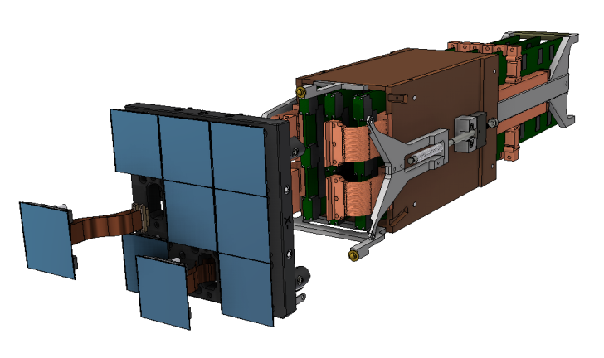
Dark Energy Program - planning
Fabrication phase
Large Synoptic Survey Telescope (LSST)
Stage IV imaging survey
➔FY14 fabrication start for LSST-camera approved!
Partnership with NSF-AST; MOU in place
JOG meets weekly; brief OSTP regularly
CD-3a review in May 2014 (done);
CD-2 review in Nov. 2014
Planning
Dark Energy Spectroscopic Instrument (DESI)
Stage IV spectroscopic survey to use BAO and Redshift Space Distortion (RSD) methods
planning in coordination with NSF-AST
Sept. 2012 CD-0 approved
Jan. 2013 Statement of agency principles signed
Sept. 2014 CD-1 review scheduled
FY14 R&D support continuing
extended BOSS (eBOSS) operations being considered.
LSST - Science Raft Tower,
Part of the DOE deliverables
Science effort, but no “project” plans:
WFIRST NASA Science Definition Team
Euclid (ESA/NASA) space mission

Slide 73
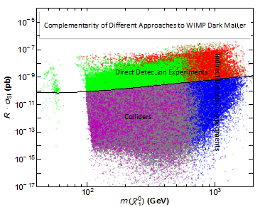
Complementary Methods for Dark Matter Detection
Direct Detection: Deep underground experiments directly measure interactions with DM WIMPs. These provide the most information on the nature of DM if detected.
Indirect Detection: Measure cosmic-ray byproducts of WIMP annihilation in the Galaxy.
Particle Accelerators: Production of new particle species in collisions; cannot determine if they are the DM, however.
These three methods cover all the possible ways of detecting WIMP dark matter.

Slide 75
Cosmic Frontier: Program Model & Guidance
Program Model
Science Mission-driven – We develop and support a specific portfolio of projects to make spectacular leaps in science
the emphasis is on doing experiments and getting results
make significant, coherent contributions to facilities/experiments selected for the program
support a science collaboration in all stages, leading to the best possible science results
form partnerships or use other agency’s facilities when needed (e.g. we don’t build telescopes)
Program Guidance
FACA panels – official advice to the government:
High Energy Physics Advisory Panel (HEPAP) – primary advice
Astronomy and Astrophysics Advisory Committee (AAAC)
– reports to NASA, NSF and DOE on areas of overlap
FACA subpanels:
P5 (2008) – recommended follow-on Particle Astrophysics Scientific Assessment Group (PASAG)
PASAG (2009)
Recommended an optimized program over the next 10 years in 4 funding scenarios
Provided Prioritization criteria → use to consider experiments in portfolio as well as research activities
Dark matter & dark energy remain the highest priorities; but don’t zero out everything else
Do HAWC in any funding scenario
P5 (2014) – we are aligning the future program with their recommendations
Other Input:
National Academies of Science - Astronomy & Astrophysics Decadal survey (New Worlds New Horizons 2010 - NWNH2010): For DOE, LSST was recommended as the priority because DOE role is critical
Specific studies: “Rocky-III” (2012) HEP-requested task force to proactively develop HEP dark energy program science case
Snowmass (2013) - APS/DPF-led community science study

Slide 76
Cosmic Frontier – Developing the Program
Mission-driven Portfolio of Projects
the emphasis is on developing & doing experiments and getting science results
At the Cosmic Frontier, HEP has a leading role in a competitive, multidisciplinary environment
- Technologies are diverse but HEP physics case is simple and compelling. Only question is how far one needs to go in precision/setting limits.
At the Cosmic Frontier, we:
Design and build instrumentation and bring other resources (e.g. computing)
Support HEP-style science collaborations with expertise needed for all phases to the best science results
Form partnerships or use other agency’s facilities where needed (i.e. we don’t build telescope facilities)
Our model also brings significant new capabilities in terms of instrumentation, and coordinated computing, simulation & analysis efforts that provide impacts & resources to other communities (e.g. Astronomy).
In developing the program, we follow the HEPAP/PASAG criteria: Make contributions to select, high impact experiments:
That directly address HEP science goals
That will make a significant, visible or leadership contribution
For which the HEP community contributions or expertise is needed – instrumentation, collaborations, analysis techniques etc.
76

Slide 77
HEP Response – Next Steps
DOE/HEP Management will respond by developing and aligning the program along the P5 recommendations.
This will take some time, many discussions and presentations with partners and stakeholders
DOE management, HEP community, DOE Laboratories, Congress, OMB, OSTP, other US and international Agencies
Communications of “P5 plan rollout”
HEP has already been meeting with DOE management, Congress, OMB, OSTP
HEP presentation at AAAC Meeting: June 10, 2014
HEP presentation at Fermilab Users Meeting: June 11-12, 2014
HEP-organized University PI Meeting: June 16-17, 2014
DPF is actively organizing several events at Congress and on the Hill.
HEPAP/P5 Chairs (Lankford, Ritz) already giving many presentations.
Planning meetings
Will eventually have meetings as needed with experiment management, community interested or involved in specific topics, laboratory management, etc.

Slide 78
Cosmic Frontier – Research Program Model
The P5 (previously PASAG) project criteria can also be applied to determining priorities for funding research efforts:
Does the proposed effort significantly advance HEP science goals?
Will the effort make significant/visible/leadership impact & contributions
Research program priorities:
Priority is to support efforts on projects/experiments in our program, i.e. where we have responsibilities.
Support science collaboration to carry out the experiment in all phases – HEP model
Support research efforts directly in line with our project priorities and science goals
Balance distribution across thrusts to support the priorities and projects; changing distribution as we go forward to support the changing program.
➔Need to make sure that our experiments are adequately supported before supporting or adding to research efforts for other programs.
Ensure some room in the research program for development of ideas for new projects that are aligned with the science drivers.
Research efforts on projects that are aligned with P5 science drivers, but which don’t have HEP participation, will also be considered, taking into account the above and based on funding availability.
78

Slide 79
Cosmic Frontier – Working in the program
Model for working in the field:
Get involved in experiment/science and take on responsibilities for the collaboration and then submit proposal. We don’t usually fund people on speculation.
Have involvement in the community so that you are part of the HEP community! (e.g. DPF Snowmass planning).
Lot of science topics may be in dark energy plan or related to dark energy but need to think of what is the priority & main efforts needed.
Need to explain long term program not just your studies for next 3 years.
Good to have program working on (e.g.) DES and LSST – not just all LSST simulations. Not all has to be funded by HEP, but should explain how your program progresses
Show track record and have responsibilities before funding starts.
Have responsibilities for the experiment – not just science simulations & analysis.
Transitioning to a new project/field requires a lot of work to get up to speed.
- best for faculty member to take the time to really learn the field and take on responsibility first
79

Slide 80
Cosmic Frontier – Comparative Review Comments
Some Review Comments (paraphrased):
Yes, everything you study helps dark energy (etc), but with limited funds we have to prioritize.
Yes you still may be getting science out of a data set, but with limited funds we have to prioritize to support the experiments going on now or starting up sufficiently and align with HEP strategic plans.
Most proposers are excellent scientists but is it clear that what they’re doing is a priority at this time & how integrated they are in experiments?
Just because you had major contributions in the past, doesn’t mean that you will be funded if you don’t have responsibilities, commitments now.
Yes, adding 5 grad students and 5 postdocs to your group would let you get more done, but we are working on optimizing resources and need to spread out responsibilities and support across the collaboration.
Yes you are working on dark matter, but it’s on a project that’s not part of our program and we have to sufficiently support our experiments as a priority.
Yes you’re working on a project in our program, but aren’t working on HEP priority science (e.g. you want to do planet searches)
80

