Slide 1
AAAC Proposal Pressures
Study Group
Interim Report Summary
Keivan Stassun, Vanderbilt University
October 6, 2015
NASA PSS Meeting

Slide 2
Proposal Success Rates Have Fallen
Success rates for competed research proposals in the Astronomical sciences (Heliophysics, Astronomy & Astrophysics, Planetary Science) have fallen dramatically over the last decade at both NASA and NSF
What is the cause of the change?
What are the impacts of the change?
Are there optimum and catastrophic thresholds for success rate?

Slide 3
AAAC Proposal Pressures Study Group
Established Summer 2014
Gather relevant proposal and demographic data from both the agencies and the community in order to understand how the funding environment over the last 10 years has affected researchers and projects. We will compare funding models across agencies and determine appropriate metrics for evaluating success. This will allow us to provide data-driven projections of the impact of such trends in the future, as well as that of any proposed solutions.
Members
Priscilla Cushman (AAAC Chair ) Minnesota.
Jim Buckley (AAAC) Washington U.
Todd Hoeksema (AAS CAPP) Stanford
Chryssa Kouveliotou (APS) GWU
James Lowenthal (AAS CAPP) Smith College
Angela Olinto (AAAC) Chicago
Brad Peterson (NASA NAC) Ohio State
Keivan Stassun (APS) Vanderbilt University
Agency Contact Persons
NSF/AST: Jim Ulvestad, (Daniel Evans)
NSF/PHY PA: Jim Whitmore, Jean Cottam
NASA/APD: Paul Hertz, Hashima Hasan,
Linda Sparke
DOE/HEP Cosmic Frontier: Kathy Turner
NASA/HPD: Arik Posner
NASA /PSD: Jonathan Rall
AAS: Joel Parriott
NRC (NAC): David Lang, James Lancaster
The Astronomy and Astrophysics Advisory Committee – advises NSF, NASA and DoE

Slide 4
Rising Number of Proposals + Budget not keeping up ➔ Declining selection rates
    Many areas of scientific research are experiencing this trend
AAAC interacts primarily with NSF/AST, NASA/APD, DOE/HEP Cosmic Frontiers, with
increasing overlap with NSF/PHY program in particle astrophysics and
gravitational physics, planetary science, and solar and space physics in both
NSF & NASA, and the NSF polar program.
NSF Division of Astronomical Sciences: Very extensive database, all proposals traced by reviewer and proposer. Demographic data kept. Queries need to be properly formulated.
NSF Division of Physics: Access to NSF database, but not as extensively mined.
NASA Astrophysics Segregated by competition. (e.g. linking ATP-2012 with anything else has to be done by hand). Some has been done for certain years, but trends are more difficult. Demographic data is not available.
NASA Heliophysics Similar
NASA Planetary Science Similar
DOE High Energy Physics: Hard to connect new comparative review process (2012) to old.
Mostly spreadsheet data from the proposal panel organizers.

Slide 5
NSF/AST/AAG
Figure 1. Historical NSF/AST (AAG) proposal success rate through 2014. The anomalous spike in FY09 is due to the one-time stimulus provided by ARRA the American Recovery and Reinvestment Act.
http://www.nsf.gov/attachments/131083/public/Dan-Evans_AST_Individual_Investigator_Programs-AAAC_Meeting.pdf

Slide 6
Proposal Pressure in NSF/AST
GB Observing Facilities Divestment Recommended by Portfolio Review Changes the Balance, But Will Not Solve the Problem
If divestment continues on schedule and the budget continues flat,
proposal success rates will hold at roughly 15%.
2004
10%
Projected NSF/AST (AAG) proposal success rate 10% in the absence of facility divestment.

Slide 7
Proposal Pressure in NASA/Astrophysics
30%
18%

Slide 8
Proposal Pressure in NASA Planetary Science
Total Division Budget (inflation-adjusted):
$1,731M (2004) ➔ $1,380M (2015)
~ 40%
~ 20%

Slide 9
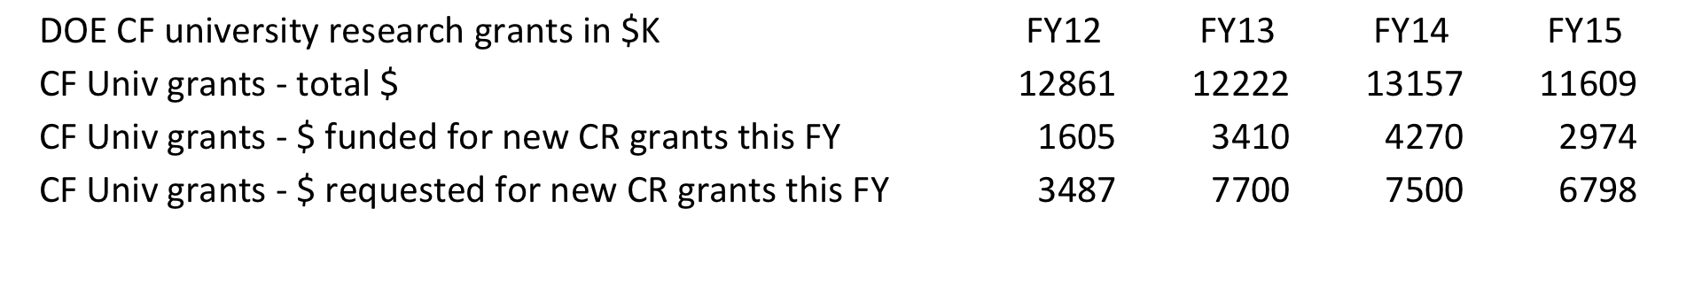
DOE: High Energy Physics at the Cosmic Frontier
Success rates much higher. Proposal Acceptance going up
but may decline to ~ 50% in FY15
Different Mode: Mostly block grants with multiple PIs.
Stable number of Universities, applying every 3 yrs, staggered by years
$$ awarded depends on who is up for renewal
Comparative review process began in 2012
Energy, Intensity, Cosmic separately reviewed

Slide 10
Summary of Proposal Pressure
The proposal selection rate for NSF Astronomical Sciences and NASA Astrophysics has been halved, from approximately 30% to 15% in the last decade.
Similar trends observed in NASA Heliophysics and Planetary Science Divisions
Trends can be seen overall, but details in individual programs are complicated
Programmatic changes or cancellations/suspensions
Fewer statistics
Changes in the size of awards
NSF Particle Astrophysics and Heliophysics programs are highly variable
Again, program size makes statistics difficult
Trend is downward
DOE High Energy Physics Program has a different funding model
Success rate has stayed stable above 50% in Cosmic Frontier
Only 3 years of comparative review panel data available
Next, drill down to understand demographics

Slide 11
What are some of the causes for the change in proposal success rates?
Changes in PI submission rate?
Changes in number of PIs?
Changes in PI demographics (age, institutions)?
Changes in Quality of proposals?
Proposal recycling?
Changes in the size of proposed budgets?
Changes (or lack thereof) in Agency budgets?

Slide 12
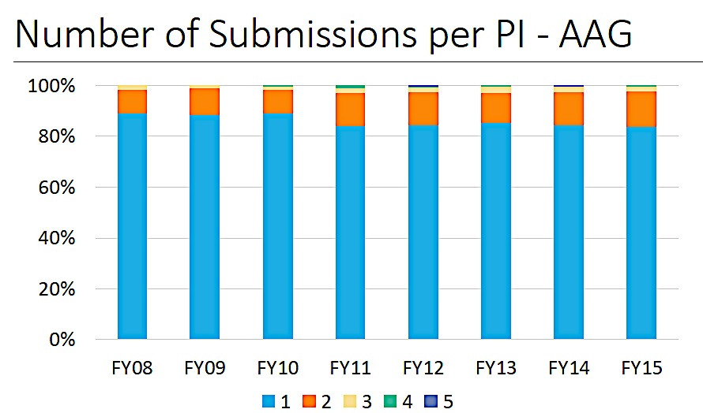
Most NSF/AST and NASA/APD Proposals are Single Proposals
Proposal Increase ➔ The Actual Number of Unique PIs is rising
NSF Astronomy Only ~ 15% Multiple Proposals

Slide 13
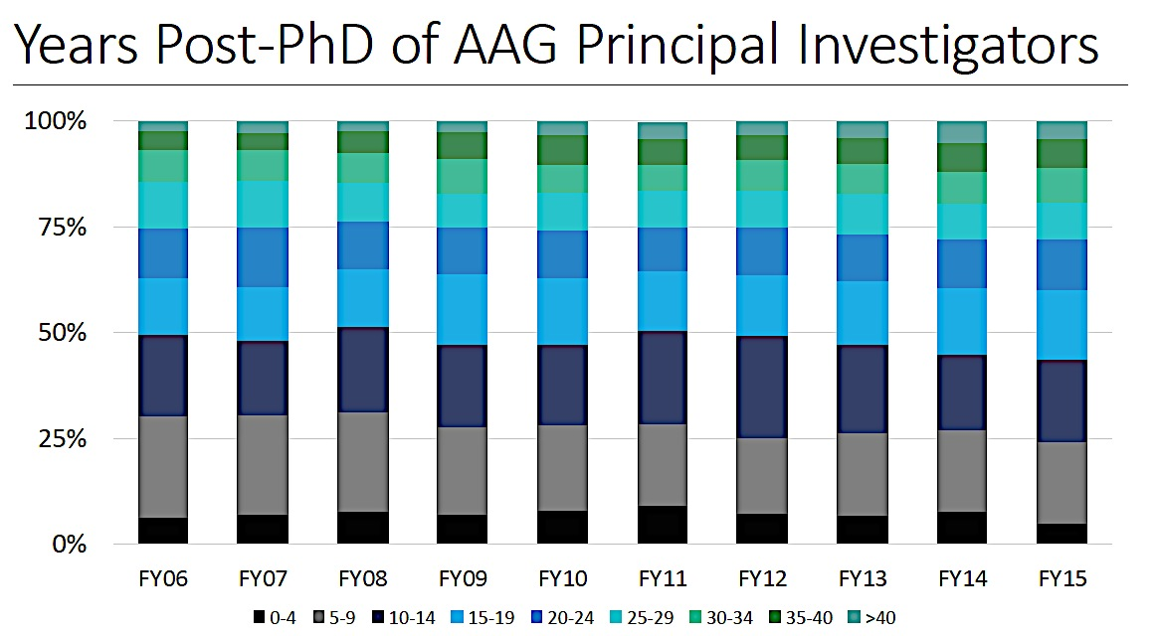
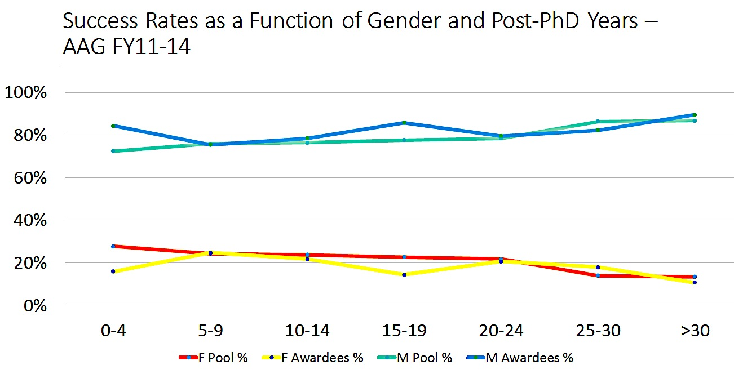
Fraction of Proposals by age of PI (NSF/AST)
No “Postdoc Problem”
The suggestion that recent generous postdoc fellowship programs and targeted encouragement have boosted one segment of the population that is now moving through the system as an increased PI pool
… is NOT true.
M
Result doesn’t depend on gender. Slight increase in women in the younger pool is encouraging.
F

Slide 14
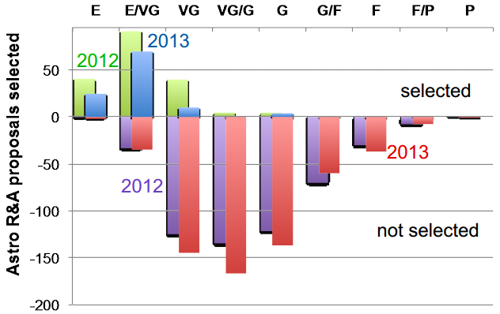
Is the number of Excellent Proposals funded going down?
Quantifying this takes a figure of merit
Reviewer rating is not a good merit indicator for NSF or DOE/HEP Cosmic Frontier
NASA reviewer ratings are more reliable,
but anecdotal evidence for NSF and DOE is in line with data from NASA
2012 ➔ 2013
Fraction of proposals rated ≥ VG
46.7% ➔ 41.9% (-10%)
Decrease in success rate ≥ VG
51% ➔ 39% (-24%)
All SMD ROSES: Number of funded proposals in the VG category was 45% in 2007-2008
Funded from Plot : 25% VG (2012) ➔ 7% (2013)
The Loss is in the VG category, while VG/E and E remain stable at >75% and >90% respectively
http://science.nasa.gov/media/medialibrary/2014/04/09/2014.03.27_ApS_RA_final-2.pdf

Slide 15
Is Selection Rate being driven by Repeat Proposals?
Number of unique PI per year > 1/3 of unique PI over 3 yr
1150
1000
Unsuccessful proposals are being resubmitted.
Modeling the data:
Suppose the number of non-repeat proposals remains steady.
Successful ones removed from pool, unsuccessful ones reapply next year
Apply the actual success rates each year to the mix of new and repeat proposals.
A best fit ➔ 70% of the unsuccessful proposals reapply in the following year.
If repeats at 50% in 2008, by 2014 repeats will be at 60%
Proposal spiral: Ever more unique PIs reapply in consecutive years, accelerating the rise in proposal numbers and falling selection rate (this may have plateaued).

Slide 16
Summary of Demographics
Only collected for NSF and NASA
The number of proposers is going up, not just the number of proposals.
Multiple proposals from the same PI is mostly not a driver
The rise in the number of proposers is not coming disproportionately
from new assistant professors or research scientists
or from non-traditional institutions
They do not represent a shift in gender or race
The merit category that is being depleted has a rating of VG
Very Good proposals are not being funded
Initially unsuccessful proposals are being resubmitted at a higher rate
Proposal budgets are not growing as fast as inflation
Agency budgets generally have been flat, though not in APD.

Slide 17
What are some of the impacts of more proposals and declining success rates?

Slide 18
Impact on Agencies (NSF/AST)
Managing review panels.
NSF/AST staff FTEs have remained relatively flat
But they are running more panels
Each panel has a higher number of proposals.
Organization and execution of each panel takes 130+ hours (NSF Program Officer)
“NSF has developed new tools to optimize internal review processes, but another 30%
increase in proposal volume over the next five years would not be sustainable.”
Recruitment of reviewers and Conflict of Interest
An individual listed as PI or co-PI on an NSF/AST AAG proposal cannot serve as a reviewer.
1,100 qualified individuals are prohibited from joining a panel.
Hard to find un-conflicted senior members of the community to join the panels.
Declining reviewer acceptance rates; 20-25% of reviewers agree to serve
Drives up the time program staff spend on appointing panelists.

Slide 19
Impact on Agencies (NASA/APD)
(statistics courtesy of H. Hasan)
COST (2014)
832 proposals handled in core R&A programs.
Estimated cost: ~ $ 3M
NASA staff time, direct expenses for reviewer travel, meeting space,
plan, execute, and document the evaluation and selection process
Basis of estimate clearly delineated in spreadsheet.
this cost does not include the cost of the GO program TAC reviews that handle three times as many proposals
FINDING REVIEWERS
Statistics currently: 50% of prospective reviewers accept when asked 4-6 mo. 20% when asked 3-4 weeks ahead
Will this change in the future?
CONFLICTS OF INTEREST
Currently not a problem.
COI issues can often be mitigated by putting the reviewer on a different panel from the problematic proposal

Slide 20
Is there a proposal success-rate floor?
A healthy level of competition identifies the best science and boosts productivity.
Unhealthy success rates discourage innovation and cause inefficiencies.
Probability of success / failure
Cost to scientific productivity
Cost of review process
Impact on health of discipline
Impact on U.S. competiveness

Slide 21
Cumulative Probability of Proposer Failure vs. Success Rate
The Matthew Effect - New/unfunded researchers suffer decreased success rates. An average 20% success rate overall actually means ~50% and ~10% for recently funded and recently unfunded proposers, respectively.
Von Hippel and Von Hippel, 2015: http://journals.plos.org/plosone/article?id=10.1371/journal.pone.0118494

Slide 22
The Opportunity Cost of Writing Proposals
Writing a proposal takes time. Von Hippel & Von Hippel survey results suggest that it takes a PI 116 hours and CoIs 55 hours to write a proposal. That translates into a number something like 0.4 papers.
With success rates at 20%, that means the time cost of writing a successful proposal is greater than the time it takes to write 2 papers.
The typical astronomy grant results in about 8 publications. As success rates fall even further, new researchers with success rates at 6% will spend more time writing proposals than would be spent writing the papers that result from a successful proposal.

Slide 23
Summary & Remarks
Increase in the number of PIs and in many programs long no-growth budget profiles have led to decreasing proposal success rates.
The cause does not lie in changing demographics, proposal quality, grant size.
The tendency to recycle proposals exacerbates the problem.
Lower success rates stress the agencies, reviewers, the community, and the nation.
Success rates greater than 30% are healthy.
Success rates of 15% are not sustainable – anecdotally people are leaving, panels are more risk averse, and new researchers are not entering the field.
The solutions are not clear.
Options include:
  More funding
  Rebalancing the program
  Fiddling with the process – grant size, grant opportunities
  Decreasing the size of the U.S. astronomical science community – strategically or not

Slide 24
FUTURE PLANS
Possibly administering a survey to AAS, APS members
Continuing to refine data from Agencies
Publishing a Final Report by the end of 2015 or early 2016
Our hope is to have data-driven answers
Not on what the agencies SHOULD do,
but what are the likely results of Actions like
Do nothing
RFP every other year
Limit number of proposals per PI
Limit funding available per proposal
Initiate pre-proposals or sifting method
Other… ?

Slide 25
Back up Slides

Slide 26
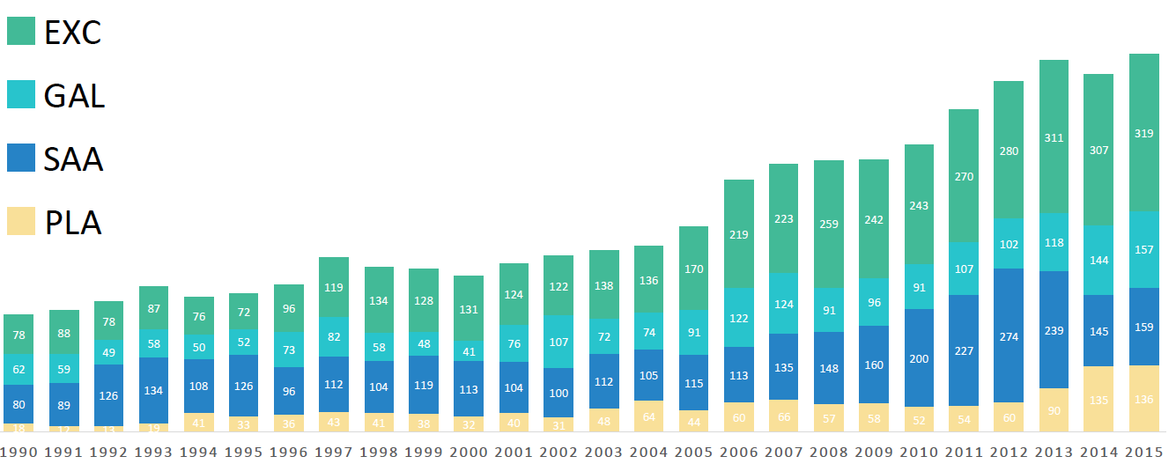
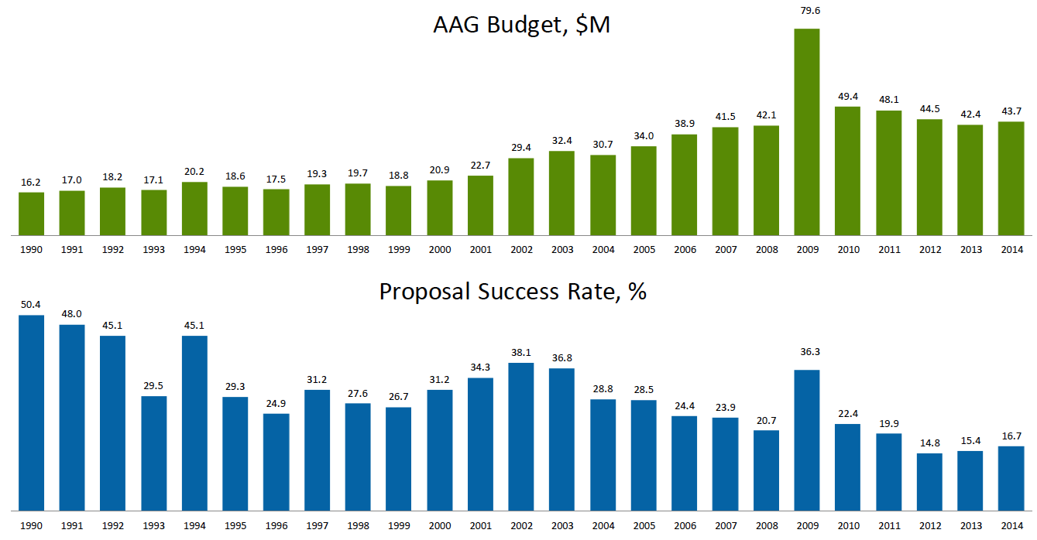
Proposal Pressure in NSF/AST
In the Astronomy & Astrophysics Grant Program
771
2004
379
238
Number of AAG Proposals by program and year
$44M
$31M
$16M
AAG Budget $M
50%
ARRA
30%
AAG Proposal Success Rate
16%

Slide 27
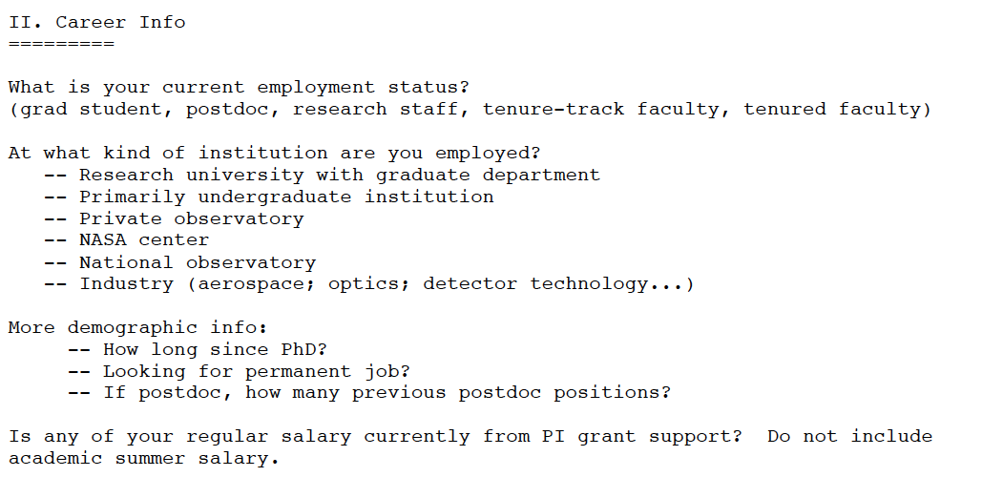
Impact on Researchers
Requires a Survey
Draft a set of questions in conjunction with AAS (Todd Hoeksema, James Lowenthal)
Put in a Proposal to AAS for preparing a Survey
If accepted, AAS provides funding to AIP to
professionally develop and manage and administer survey
Etc…

Slide 28
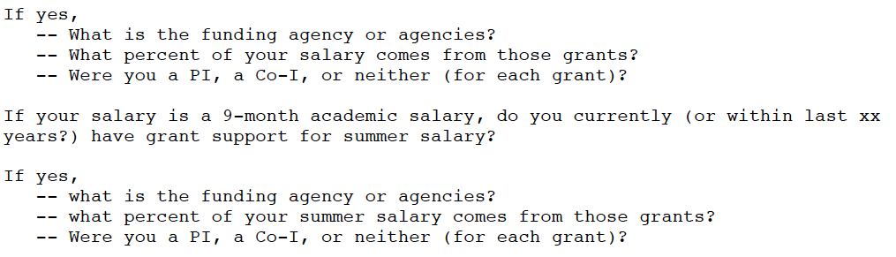
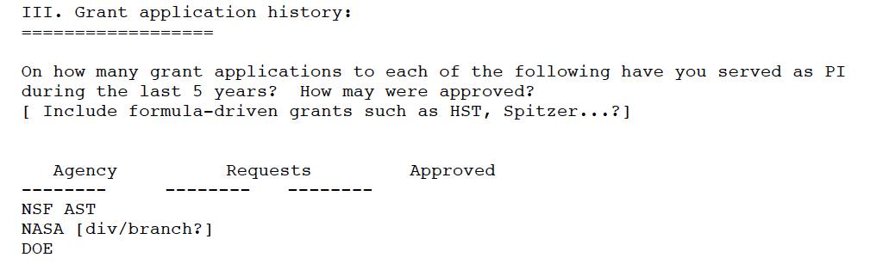
Impact on Researchers
Requires a Survey
Etc…

Slide 29
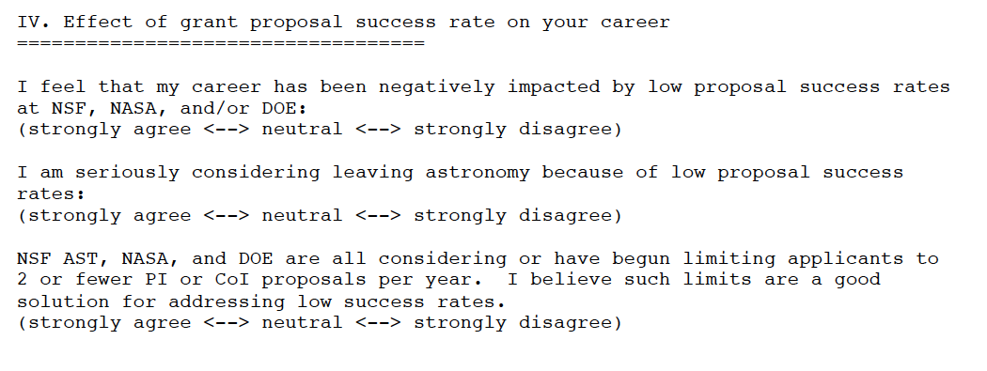
Impact on Researchers
Requires a Survey
A series of multiple choice statements with 5 choices.
Etc…

