Slide 1
Neutron Benchmarking WG Status Update
Ray Bunker
September 26, 2013

Slide 2
Working Group Activities
Broad-interest discussions among all WG members
Ongoing analysis for first NMM measurement
Coordinated DAQ for NMM & veto shield

Slide 3
Broad-interest WG discussions
Started by mixing non-NMM topics into NMM Fri meetings
Nov 2, 2012 → Chao updates USD liquid scintillator detector data analysis
Jan 4, 2013 → Anthony leads discussion of Watchman Project (LLNL)
Feb 8,2013 → Julien & Adam introduce their He-3 NCDs at MIT work
Found new members at LRT 2013
Tom Langford → NIST Gaithersberg; the FaNS detector
Lea Reichhart → UCL; using ZEPLIN III to measure neutrons
Began ~monthly “Summary” meetings
Specifically dedicated to broad-interest discussions (high-level presentations):
May 10th → FaNS & USD Liquid Scintillator
May 31st → ZEPLIN III & MIT NCDs
Next meeting → MIT NCD simulations, NMM status
Extended summer hiatus …

Slide 4
Ongoing NMM Analysis
First NMM fast-neutron measurement
Use ~2 years of already acquired data
Measure flux of high-energy neutrons (>50 MeV)
Publish first NMM paper by summer 2014!
Primarily a Syracuse activity
Coordinated by Richard & Ray
Geant4 simulation work by Yu Chen (grad)
Builds on previous work by Melinda Sweany (Sandia)
Data analysis by Chris Nedlik (undergrad)
Builds on previous work by UCSB students (Ray, Joel, and others)

Slide 5
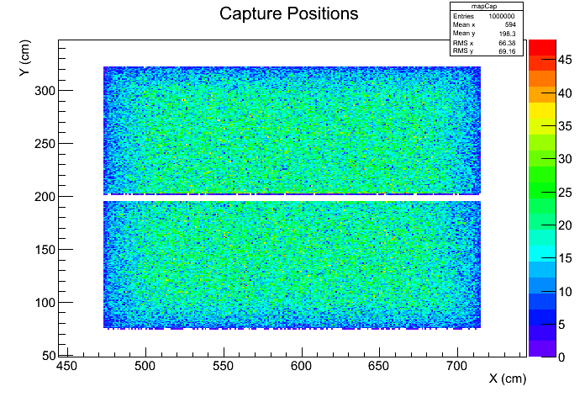
NMM Analysis—Highlights!
Geant4 MC simulation
of neutron capture positions
for neutrons generated
across surface of Pb target
Courtesy Y. Chen
North Tank
Number Captured per cm²
South Tank

Slide 6
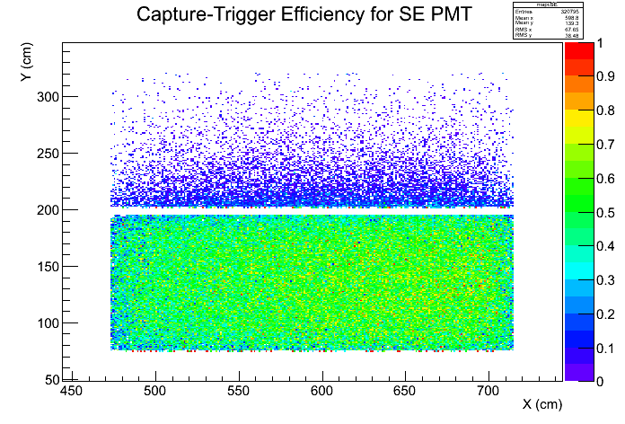
NMM Analysis—Highlights!
First estimate of absolute
neutron capture efficiency
Courtesy Y. Chen
North Tank
Fraction Detected per cm²
South Tank

Slide 7
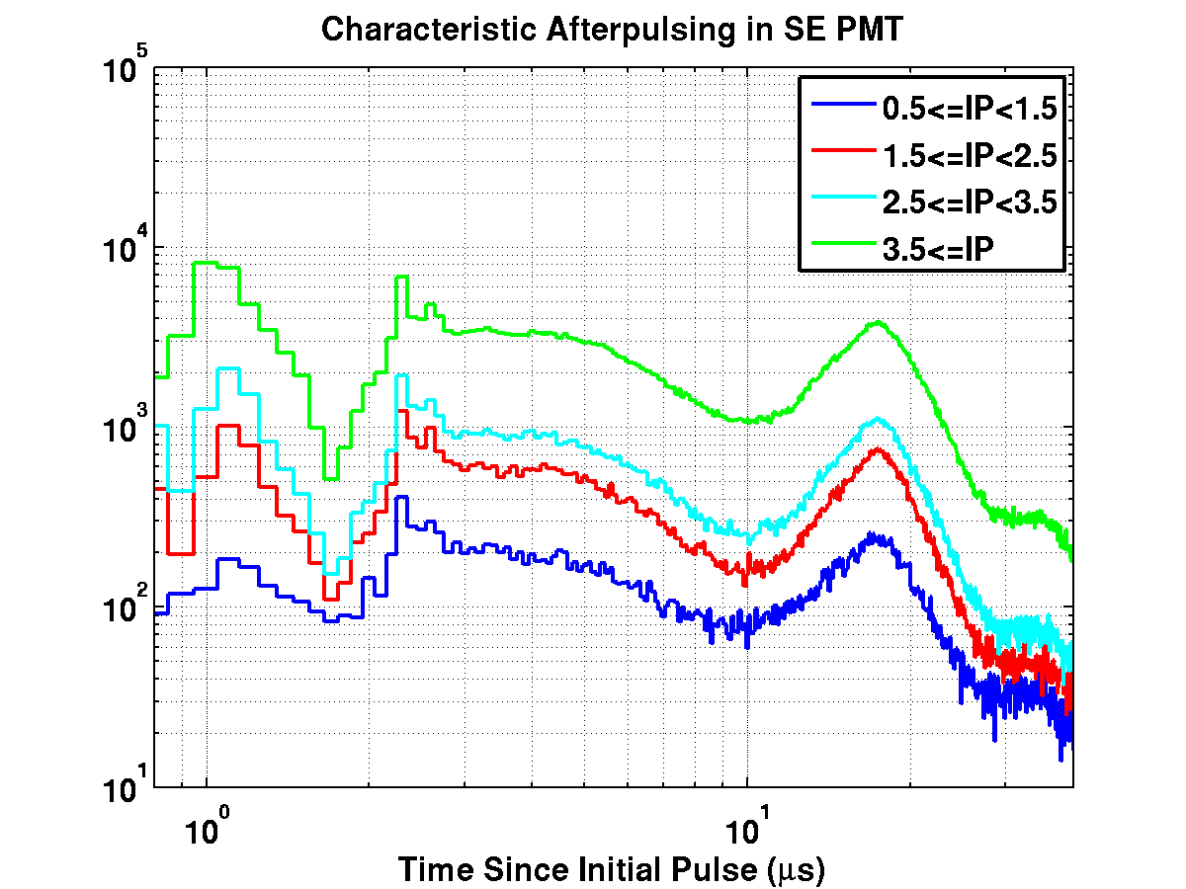
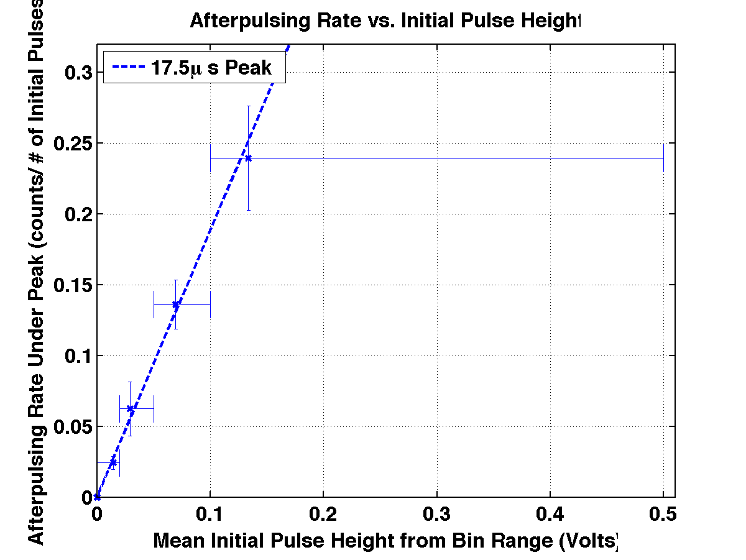
NMM Analysis—Highlights!
Detailed data-driven understanding of 20” PMT afterpulsing
Afterpulsing rate
vs.
Initial-pulse amplitude
Courtesy C. Nedlik
~17.5 μs afterpulsing peak

Slide 8
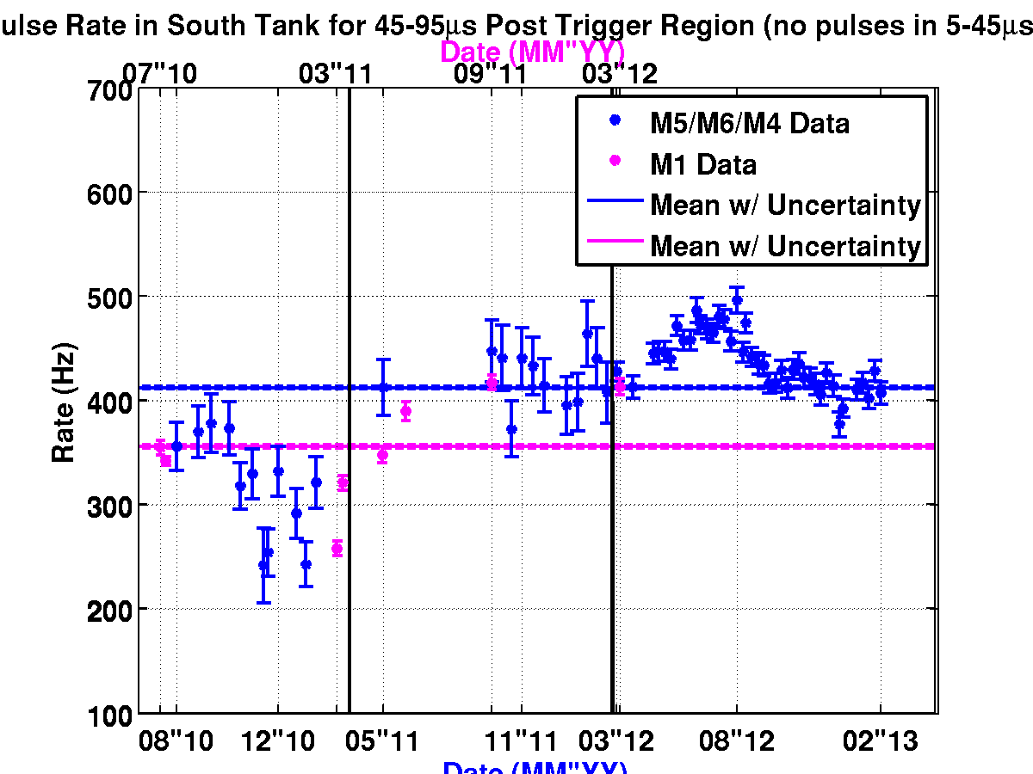
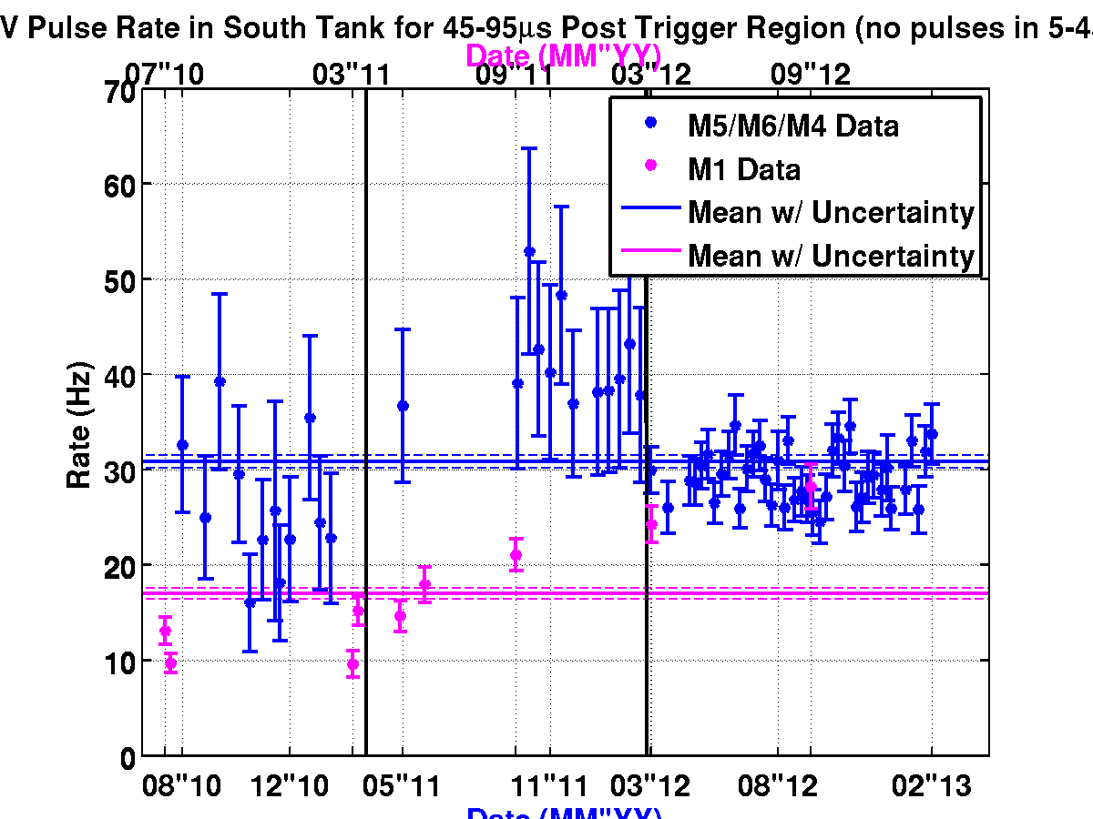
NMM Analysis—Highlights!
Using background gamma rate to understand detector stability
South Tank—All Gamma-like Pulses
South Tank—Large Gamma-like Pulses
Courtesy C. Nedlik

Slide 9
Coordinated NMM & Veto-shield DAQ
Reinstrument NMM & veto shield
To correlate fast neutrons in NMM to veto-shield showers
Added hardware to NMM to allow GPS time stamps
Modified NMM software to incorporate time stamps (Anthony)
Recommissioned/upgraded entire LBCF veto shield
UMN and Soudan crews
Upgraded veto-shield DAQ to better manage data flow (UMN)
Worked out & tested correlated time stamps between systems
UMN crew led by Anthony
Recorded several weeks of “muon-mode” NMM data:
For further tests & to help develop analysis tools
Began NMM fast-neutron search w/ fully instrumented veto shield!
To be continued through the next ~1 year

Slide 10
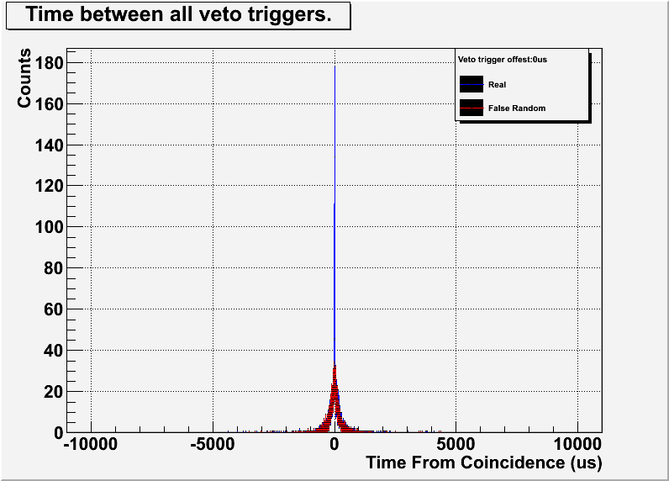
NMM/Veto-shield DAQ—Highlights!
Demonstration of time-stamp correlation timing resolution
Courtesy A. Villano

Slide 11
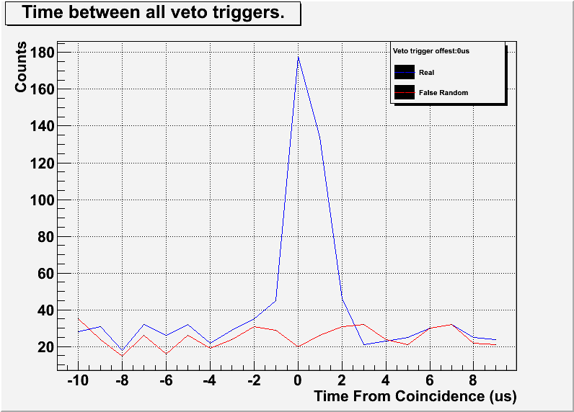
NMM/Veto-shield DAQ—Highlights!
Demonstration of time-stamp correlation timing resolution
Courtesy A. Villano

