Slide 1
Comparing Geant4 and FLUKA
A.N. Villano
University of Minnesota

Slide 2
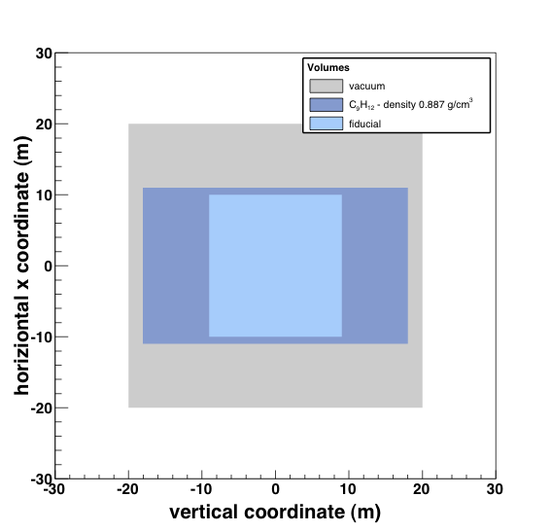
Geometry
Using various energies
(10 – 1000 GeV)
Light and heavy materials (water, salt, iron, lead, etc.)
Some specialized materials (liquid scint.)
Incident μ±

Slide 3
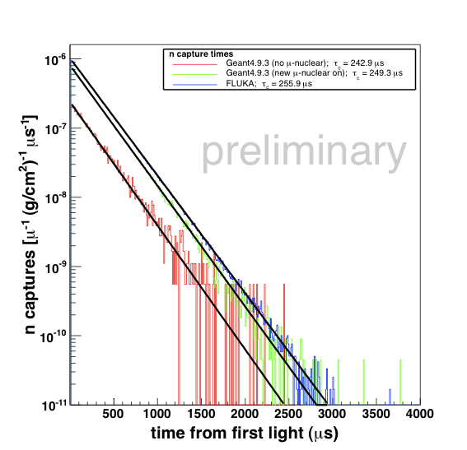
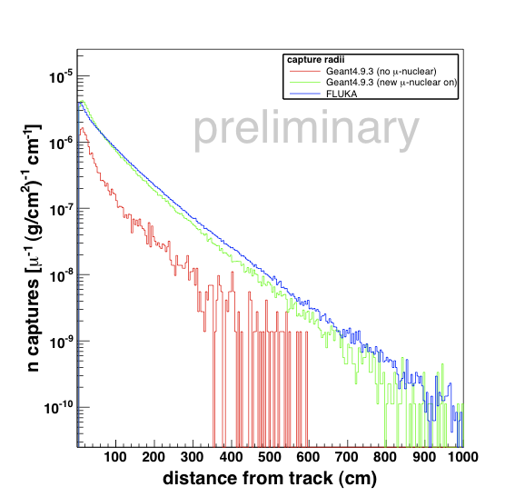
Scintillator Results
Timing distributions look correct in size and gets capture time within ~10%
Distance from track distribution has small discrepancies at small radii

Slide 4
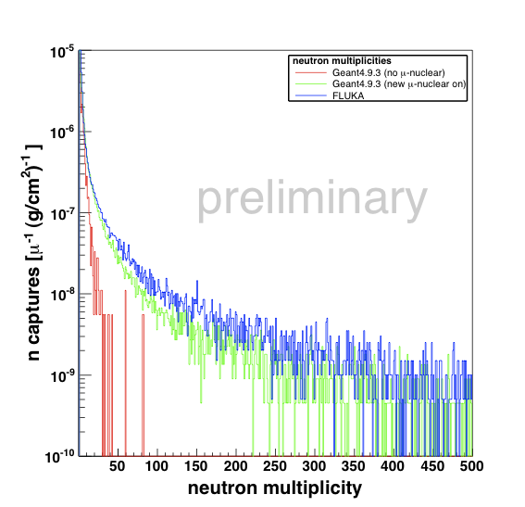
Scintillator Results
When μ-nuclear included, fair matching
High multiplicity events good probe of μ direct interactions
Geant4 seems to give smaller rates for very high multiplicity events

Slide 5
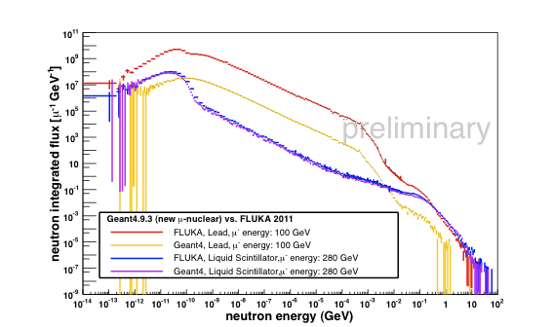
Flux Results (Scintillator & Lead)

Slide 6
Available Data and Versions
FLUKA v2011 & Geant v4.9.3 (patched for μ-nuclear)
Data available with ~ 1M events for water, scintillator, iron, lead → analysis of all will complete by end summer
Simulations will also be run in Geant v4.9.5 for the near term results

Slide 7
GEANT 4 Model (As I Understand)
First calculate the cross section for emission (and absorption) of virtual photon with given probability (given total cross section)
Classify event into energy range
Most interesting fragmentation happens using Regge model followed by hadronization cascade (Bertini-style cascade 0-10 GeV; FTF QCD string above 10 GeV )

Slide 8
FLUKA Model
One of the things I’d actually like to learn about at this workshop
As I understand one thing that is very useful about FLUKA is that the models aren’t as user changeable, and so more stable than Geant4

Slide 9
Program For Benchmarking
The first pass simulation comparisons will produce a large amount of data which should be made publically available
Persistent problem is versioning and tracking all data
Idea is to centralize and have every release of various codes (Geant4 or FLUKA) to trigger updated simulations with raw data available to everyone

Slide 10
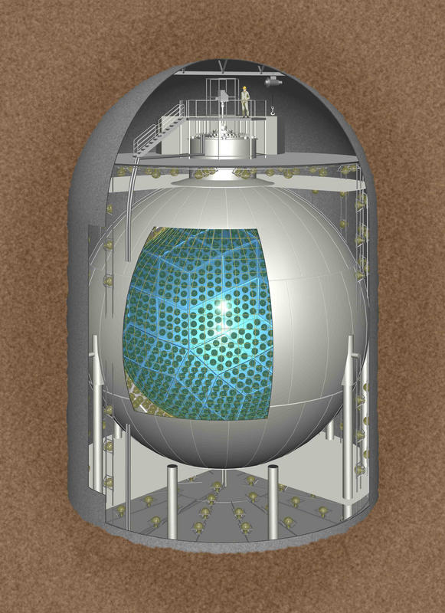
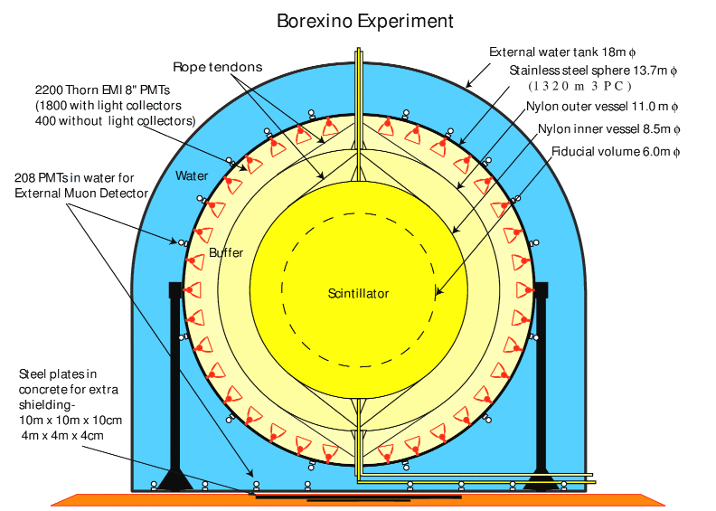
Matching to Data
Kamland
Borexino

Slide 11
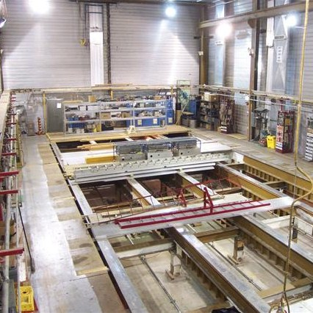
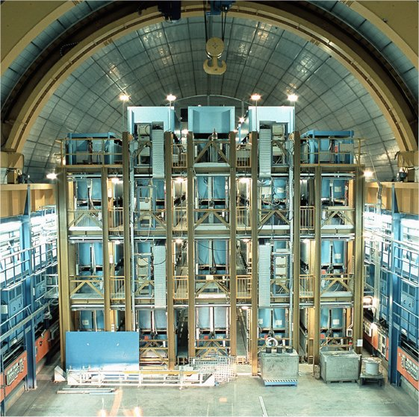
Matching to Data
Soudan
LVD

Slide 12
Timeline and Goals
Finish analysis on existing Geant v4.9.3 plus new μ-nuclear interactions and make raw (and analyzed) data available (summer 2012)
If normalization issues exist examine models in detail (LRT timescale)
“Automate” the simulation for switching versions readily (some shell scripting, LRT timescale)
If automation successful, find permanent host and design useful interface for public data access

