Slide 1
Muon Shield at Soudan
A.N. Villano
University of Minnesota

Slide 2
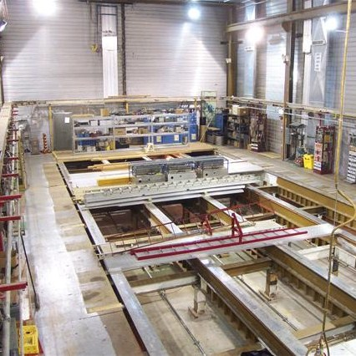
Muon Veto Shield Overview
32m X 17 m X 10 m cavern (old Soudan-II experiment shield)
about 1000 tubes
two channels each
very segmented
C10 gas proportional tubes
about 2400 V on single coaxial sense wires

Slide 3
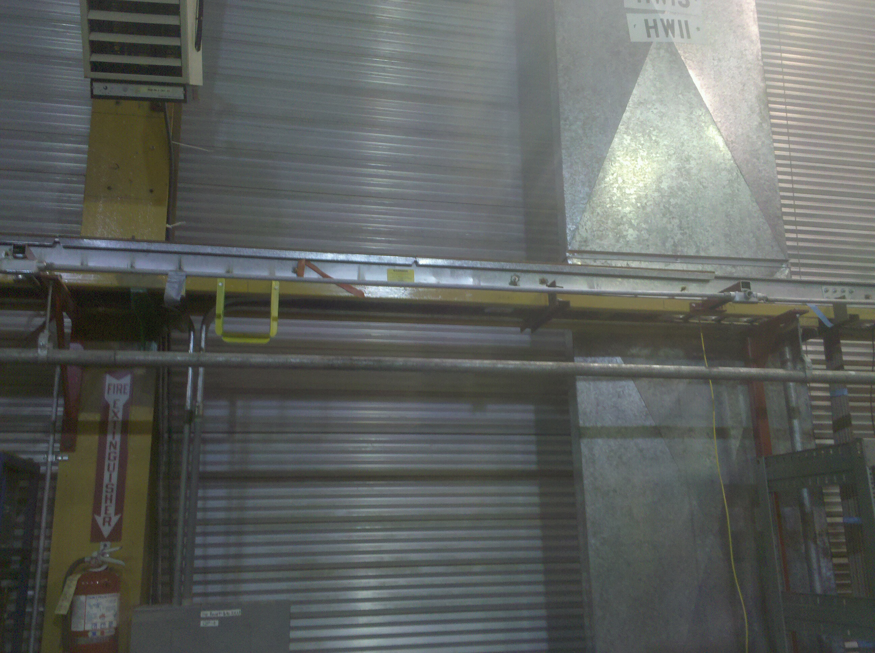
Panels

Slide 4
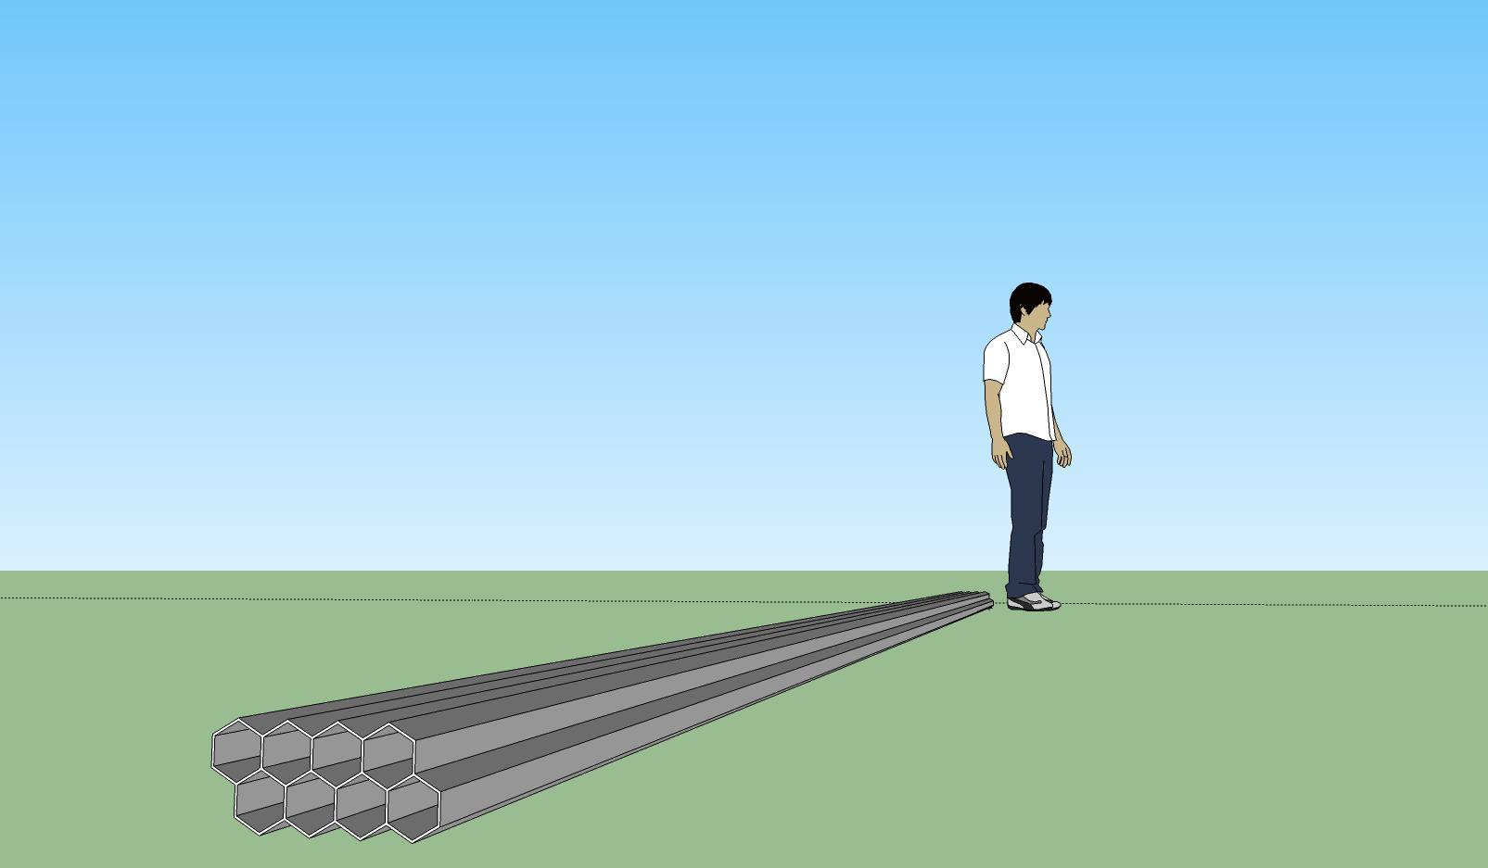
Tubes

Slide 5
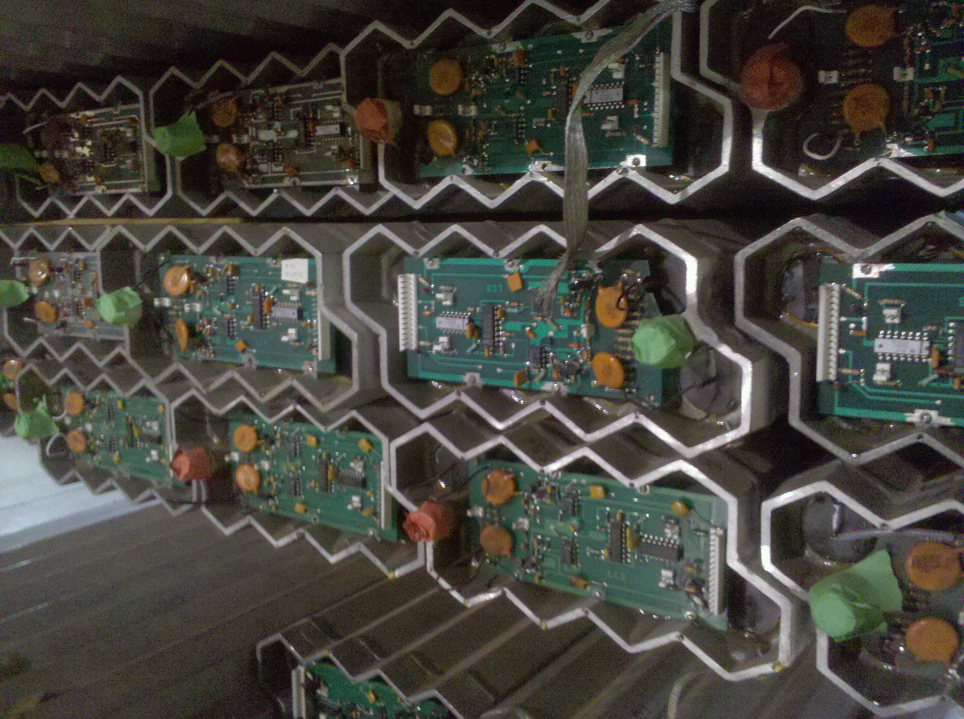
Channels
Channel 1
Channel 2
Preamps

Slide 6
DAQ Layout
Top view of the cavern
Cross-hatched squares are DAQ “stations”
Red indicated items which needed repair, all but one panel fixed now

Slide 7
Electronics and DAQ
Logic pulses are 1 μs wide and stretched to 4 μs to remove after-pulsing
Single channel rates are high but require channel 1 & 2 coincidence (previous slide)
4 DAQ stations with many panels plugged in
NorthEast, NorthWest, SouthEast, SouthWest
Use separate simple LabView-based systems and read in logic pulses output by preamps

Slide 8
GPS Timing
Real events of interest will typically be inter-station coincidences
DAQs on stations are totally independent so accurate absolute timestamps are used (accurate to 1 μs; Symmetricom PCI card)
Neutron Multiplicity Meter is planned to test the same time stamping for obtaining coincidences with the shield
Plan to make timing hardware generic so any setup placed in the cavern can have coincidence power

Slide 9
Data Availability
After data read out use a series of databases to store different data:
Individual station databases:
Store raw trigger data, little or no cuts
Written from raw files which are flushed periodically
Server coincidence database:
Periodically (weekly?; daily?) search for coincidences and store in condensed form
This data useful for coincidences with other detectors although if special cases warrant it we can go back to individual databases
Personally, I’d like to make all these databases available to “the public” through simple interfaces…but don’t want to tie up our data chain with queries so some care needed

Slide 10
Timeline and Goals
Currently taking data will all stations
About 95% of shield working and about 85% have noise levels near target
Database chain is being constructed now, finished this summer
GPS correlation with other detectors NMM USD needs some hardware and design but is feasible and funding requested (if funding could design clean and generic GPS timing system this fall)
Have already taken coincidence data with the NMM for μ± events, which looks promising

