Slide 1
Cosmogenic Activities Update and Simulation Breakout
A.N. Villano
University of Minnesota

Slide 2
Geant4/FLUKA Comparison
Goal: Using a simple geometry, compare Geant4 and FLUKA observables related to neutron production. Further find the most efficient subset of observables which constrain microscopic physics while allowing comparison to experiments.

Slide 3
Geant4/FLUKA Comparison
Fiducialized slab geometry 1600 g/cm²
Mostly muon primaries so far
Use a central plane to calculate neutron fluxes
  Comparison over many decades of neutron energy
Get statistics on captures
Find cosmo. produced isotopes
Total neutron yield
Related to data for scintillator: Borexino, Kamland, LVD

Slide 4
G4/FLUKA Scintillator Distributions
Distributions related to data from Borexino, Kamland
Qualitative agreement between Geant4/FLUKA but important differences
Timing spectrum for neutron captures suggests slight difference in transport
Multiplicity dist. suggest difference in single neut. processes

Slide 5
G4/FLUKA Energy Flux / LRT Paper
A.N. Villano et al. AIP Conference Proceedings 1549 pp 227-230 (2013)

Slide 6
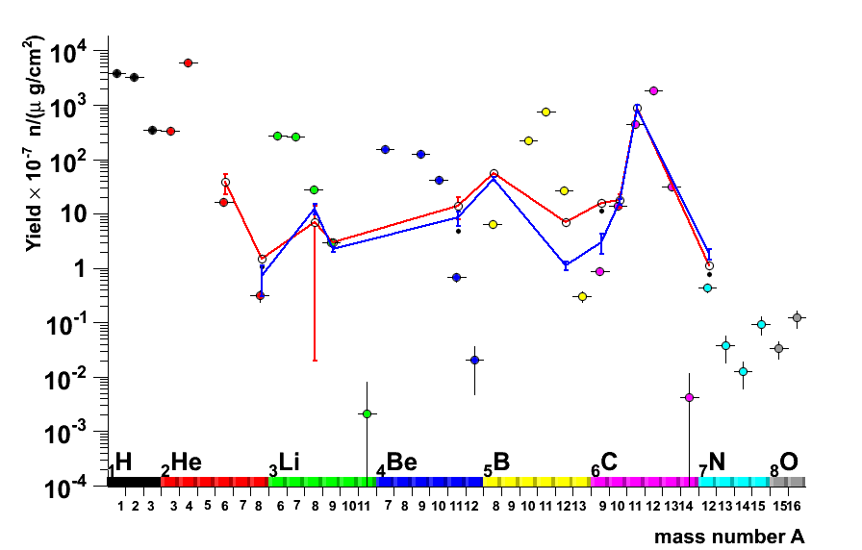
G4/FLUKA Next Steps (Isotopes)
See Also: Sarah Lindsay’s talk Friday

Slide 7
G4/FLUKA Next Steps (Yields)
See Also: Allison Kennedy’s talk Friday
Geant4 produces more neutrons in scintillator for monoenergetic muon primaries in scintillator
The yield is one of the more possible experimental measurements
Experimentally, however the yield is plotted vs. mean energy at a site, so currently including simulations with non-monoenergetic primaries

Slide 8
Streamlined Benchmarking
Current comparisons use Geant4.9.5/FLUKA 2011.2.17
Want to converge on a small set of telling observables which track code ‘quality’
Can set up benchmark simulations with standard geometry inputs, for users to check local simulation versions/options for correctness for underground physics

Slide 9
“Simulation” Breakout Sessions
Specialized Detector Physics Simulation (Thu 3:30 – 5:00 pm)
Specialized detector physics
Specific benchmarking with specialized geometry
Microscopic data for vetting specialized detector physics

Slide 10
“Simulation” Breakout Sessions
Cross-Collab. with Neutron Benchmarking (Thu 5:00 – 6:00 pm)
Useful experimental datasets
  Gran Sasso (LVD, Borexino)
  Soudan (LBCF, MINOS, Soudan 2)
  CERN (HE muon spallation)
Simulation physics constraint schemes
  Directly measure spallation cross sections?
  Cavern measurements (delayed n’s w/o energy) … etc

Slide 11
“Simulation” Breakout Sessions
Simulation Codes (Fri 4:00 – 5:00 pm)
Simulation packages for low-bknd physics (Geant4,FLUKA,MCNP)
Processes in each simulation package
  Model for adding to each package
  Relevant processes which exist in each package
  Specific models used by all the processes – and for different versions of the packages

Slide 12
“Simulation” Breakout Sessions
Cross-Collab. with Radiogenics (Fri 5:00 – 6:00 pm)
Cross sections data for microscopic (e.g. (alpha,n)) events
  Need help fleshing this out, for me I have more questions than answers here
  Where do the (alpha,n) cross section data come from?
  Are the databases “complete?”
Specific small scale cross section data (e.g. (alpha,n))
  Can we constrain cross sections from low-bknd counting measurements?
  How can we implement a simulation of these events most effectively – throw alphas or throw resulting n’s?

