Slide 1
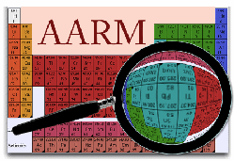
Muon Topology and Coincident Neutrons with the Soudan Veto-Shield
A.N. Villano
University of Minnesota

Slide 2
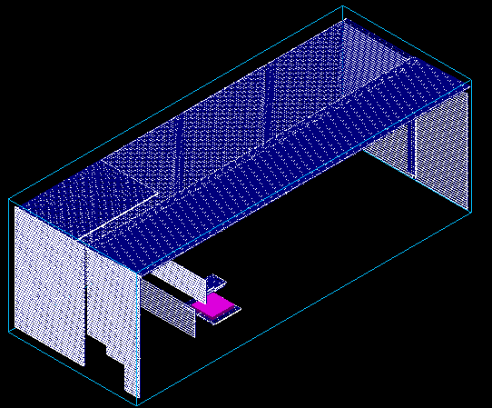
Systems In Place (Veto-shield)
32 m x 14.5 m x 11 m cavern
Covered top and sides with proportional tubes
Neutron Multiplicity Meter (NMM) placed toward the north-west (lead stack visible at left)

Slide 3
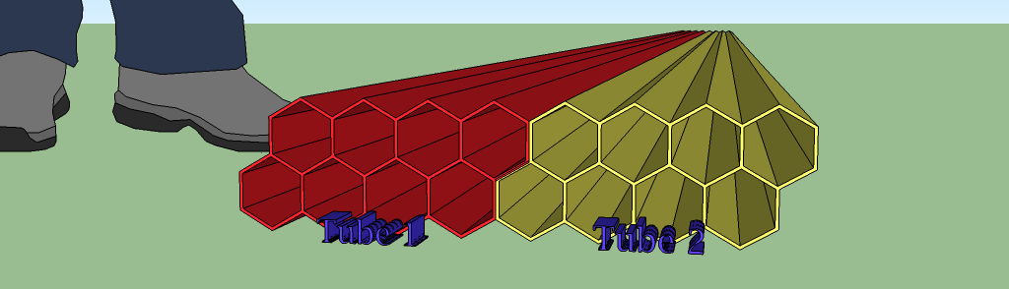
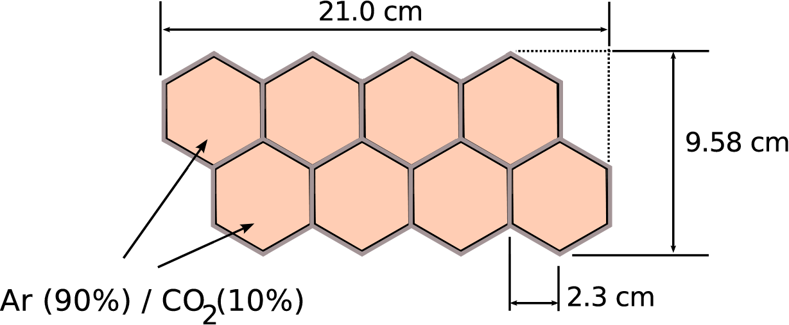
Veto-Shield Proportional Tubes
Center fed wires at 2350 V

Slide 4
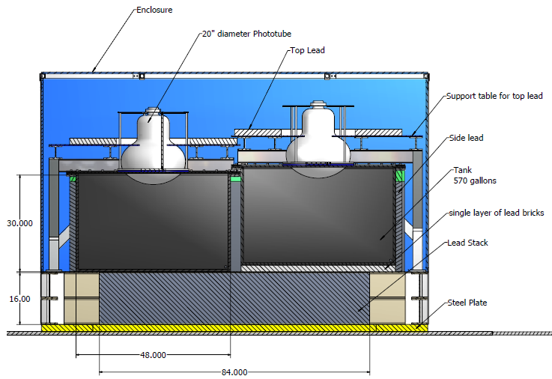
Systems In Place (NMM)

Slide 5
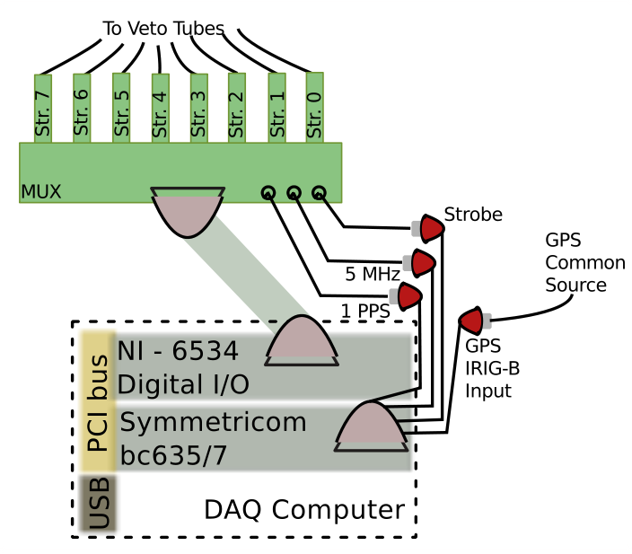
1 μs Correlated Timing
Symmetricom card synced to GPS
Front end electronics count a disciplined 5 MHz signal
DAQ computer records the absolute time of every event – best accuracy about ~ 1 μs

Slide 6
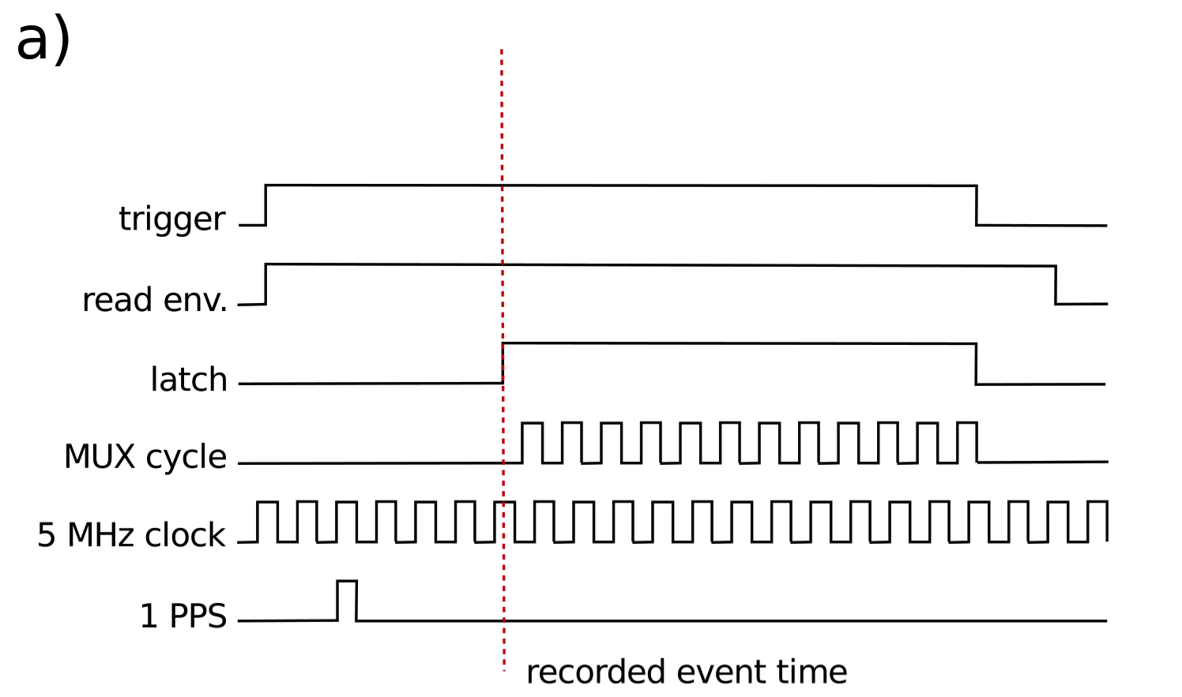
1 μs Correlated Timing

Slide 7
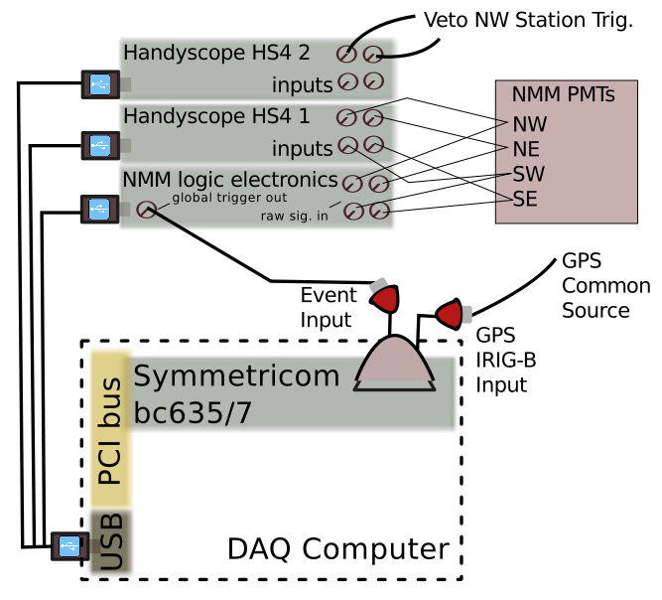
1 μs Correlated Timing
Symmetricom card synced to GPS
Time latched in response to hardware trigger from NMM
DAQ computer records the absolute time of every event – best accuracy about ~ 1 μs

Slide 8
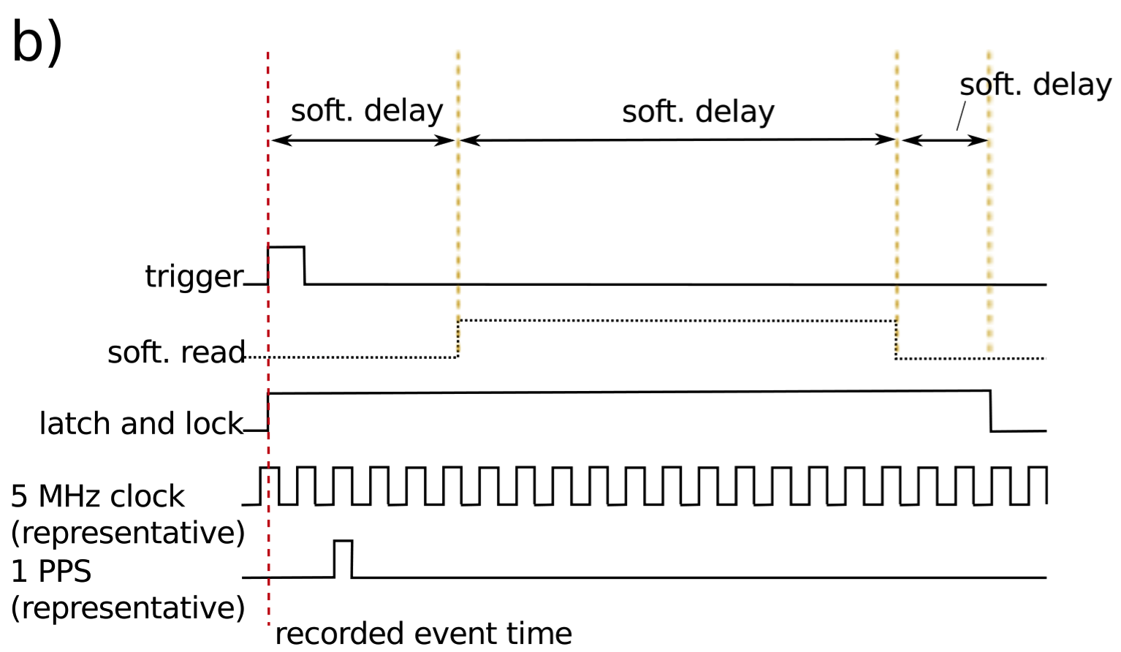
1 μs Correlated Timing

Slide 9
Making a Facility
Each quadrant (approx.) of the shield read out by an independent DAQ
Other detectors inside the shield can be synced (like the NMM) to record coincident events

Slide 10
The Physics Case
Generally the facility has the ability to examine the topology of events of cosmogenic origin deep underground
Specific analyses can constrain simulations (2 ex.)
  In conjunction with NMM can discover how HE neutrons correlate to remote cavern muons
  Tagging vertical-going single muons will be used to study multiple-muon (muon bundle) events
Use with existing experiments as active ‘veto’ or as tagger for background-type events

Slide 11
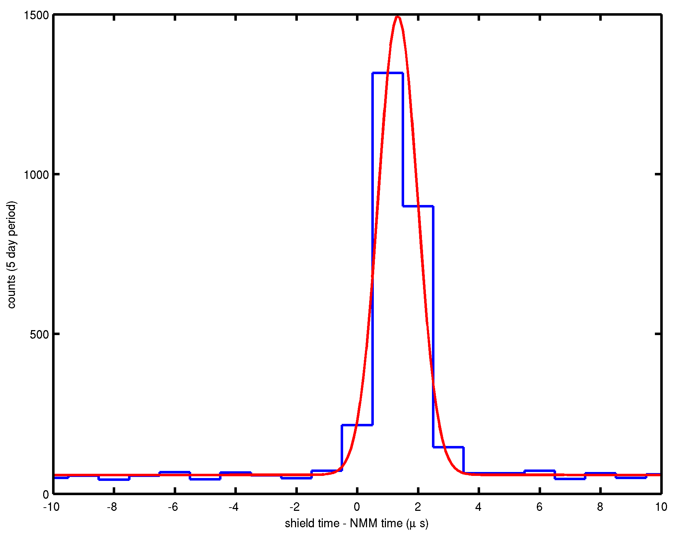
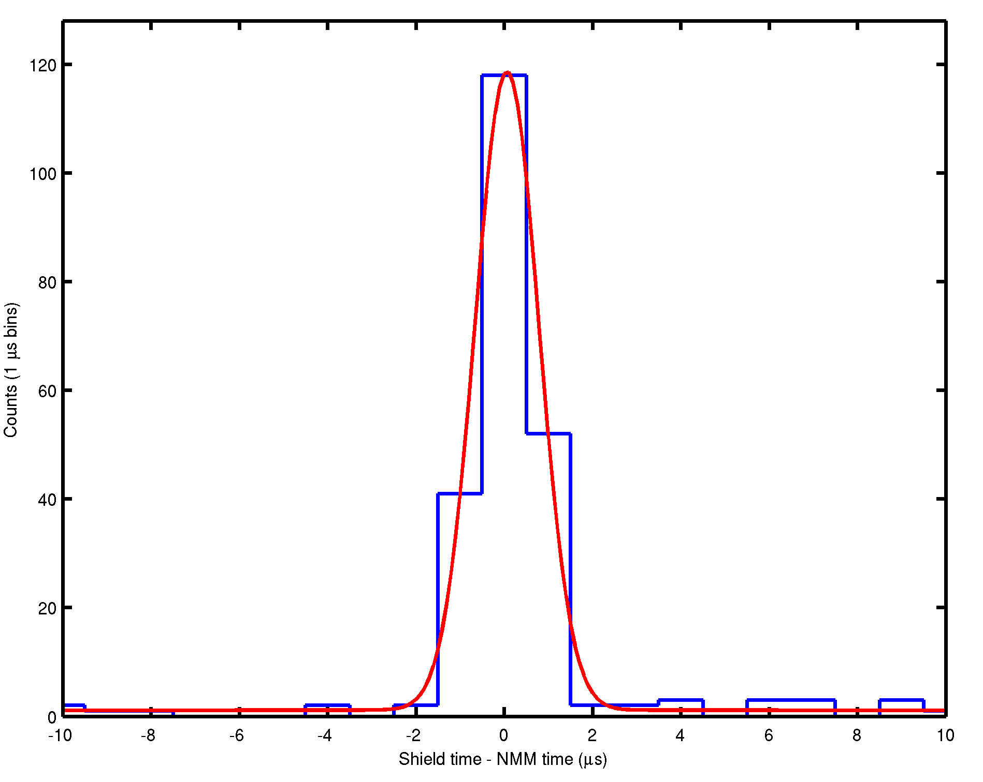
Coincident Events
Muons with NMM (special NMM run)
Ceiling
Below NMM
Track these muons across the shield
Use the muon NMM data to help with muon-bundle analysis
Have about ~ 1 month of good correlated muon data

Slide 12
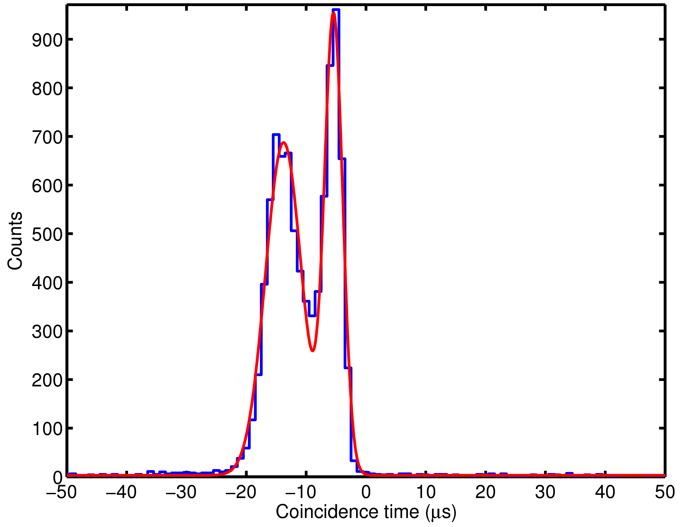
Coincident Events
Neutrons with NMM
Delayed structure from mult. trigger
Structure in the timing spectrum provides info about corr. activity
This effort will extend and improve the NMM’s primary goal, by answering questions about the parent muons related to the HE neutrons
Have about ~ 6 months of good correlated muon data

Slide 13
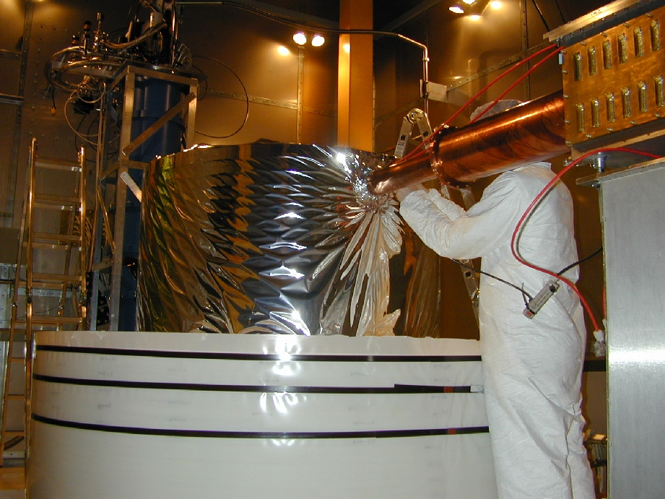
The CDMS Experiment
CDMS detector located outside the shield, searching for rare WIMP scatter events
Does have instrumentation with a GPS signal and Symmetricom readout
Also equipped with an outer scintillator veto

Slide 14
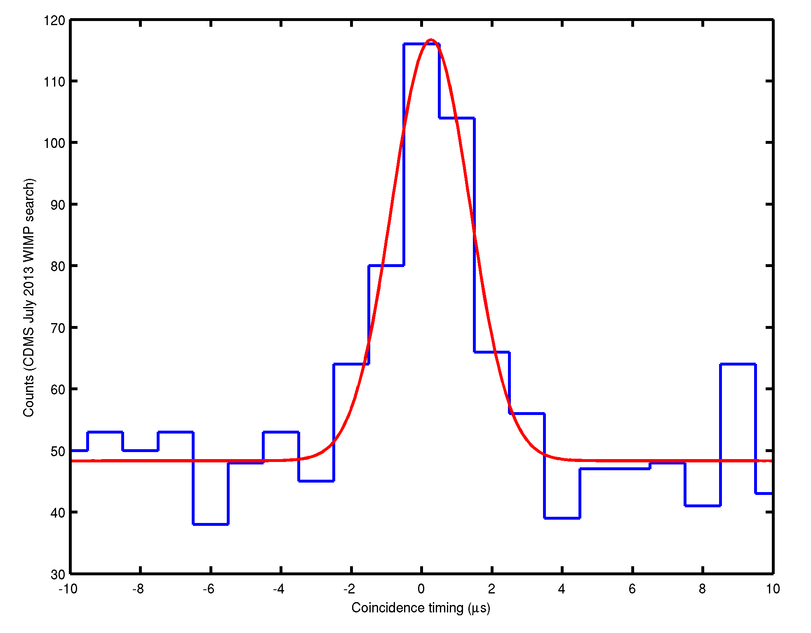
CDMS Coincidences and Data Period
Left is a sample correlating with only CDMS events with CDMS-veto activity
The Veto-shield activity period spans from about June 2012 to present, overlapping with the SuperCDMS-Soudan runs

Slide 15
CoGeNT and C4
CoGeNT and C4 are prime examples of detectors probing very interesting physics from inside the shield
Can provide active vetoing info event-by-event
Or ancillary info on background modulation
DAQ hardware needs Symmetricom time implemented

Slide 16
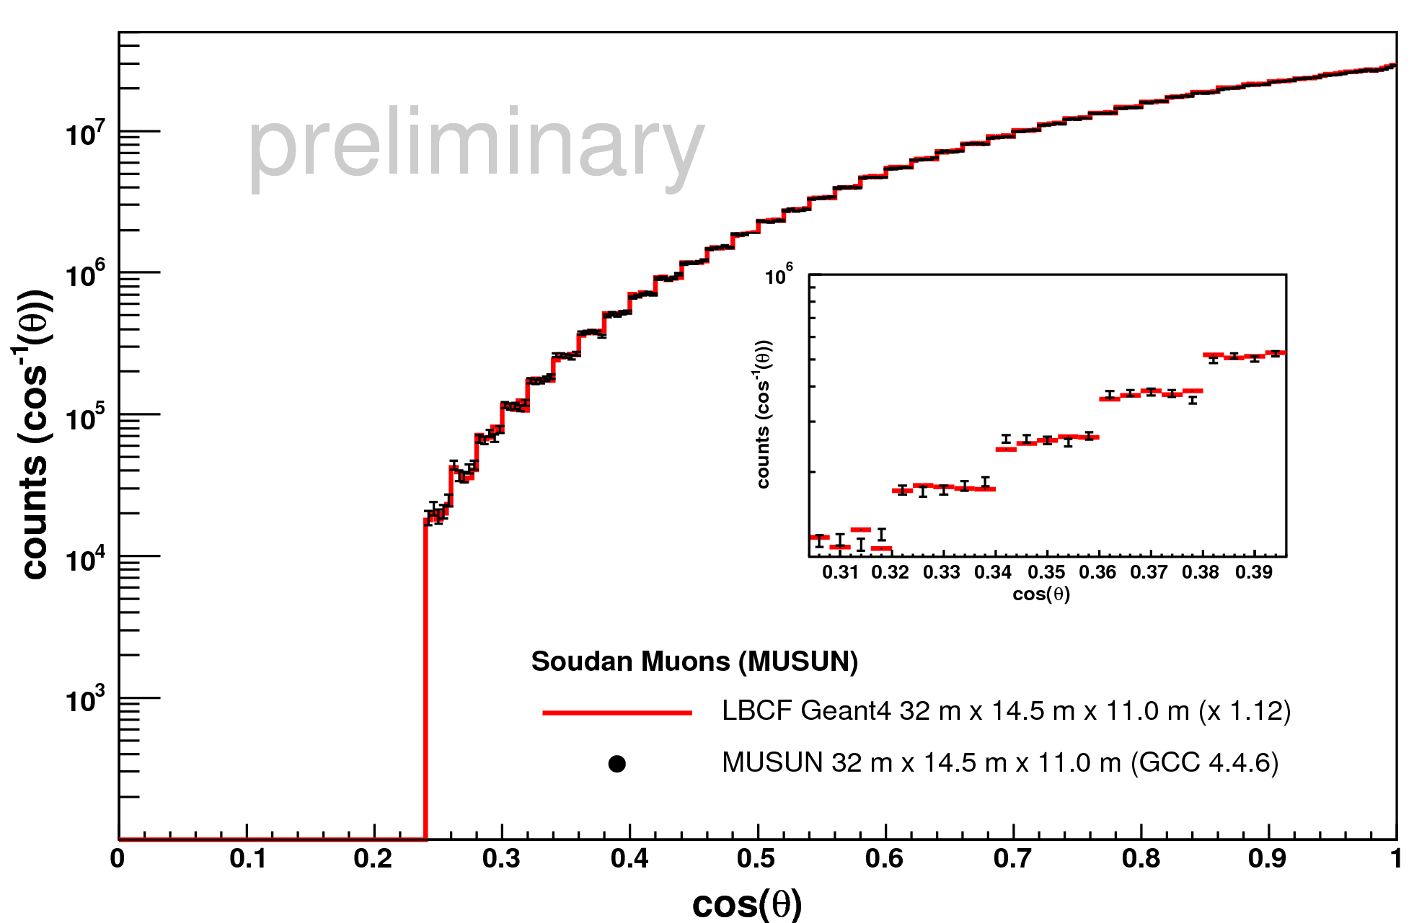
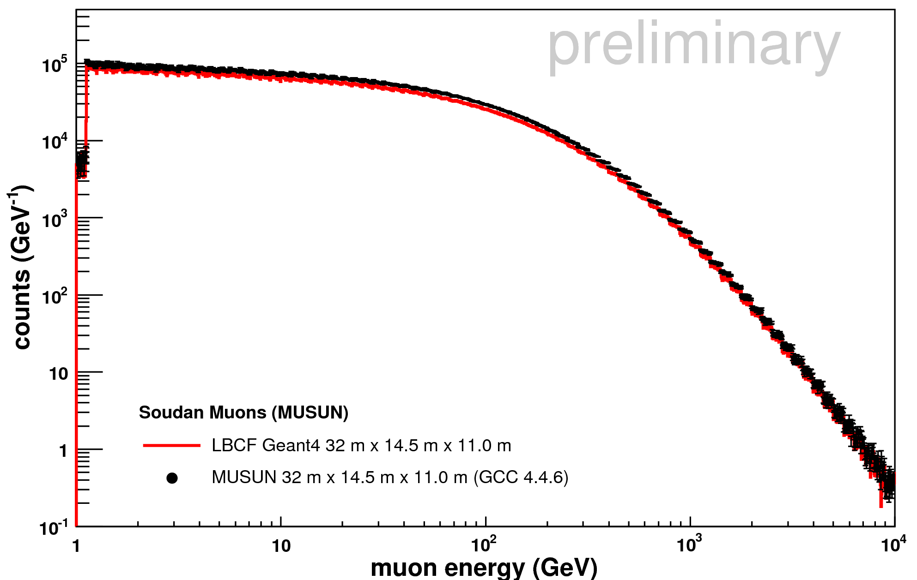
The Soudan Simulation
Aside from experimental vetoing or monitoring, independent physics requires efficiencies
We have a Geant4 simulation of the whole cavern and are updating this with all detector structures in the mine to get full information
Since the muon distributions at Soudan are known, can throw many properly distributed primaries

Slide 17
Summary
The Veto-shield allows correlated timing at the ~ 1 μs level
Many detectors can be used in conjunction with muon tracking
Can be used as direct veto for Soudan low background experiments
Rich possibilities for other physics results supporting neutron benchmarking efforts
To-do list includes Veto-shield coincident analysis and simulation on timescale of Spring/Summer
Always Interested in correlating new and interesting detectors underground – especially neutron detectors

