Slide 1
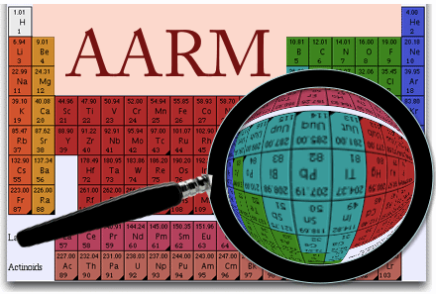
Neutron Benchmarking Working Group

Slide 2
Introduction to Working Group
International collaboration of rare-event physicists interested in:
Improved understanding of neutron backgrounds (in general)
How best to measure, simulate, shield, and veto neutrons
Organization of data & use for physical constraints
Other muon-induced backgrounds (e.g., bundles)
Working-group Chair → Ray Bunker
Working-group Co-chair → Anthony Villano
Working-group Wiki:
https://zzz.physics.umn.edu/lowrad/nmm
Meetings:
General-interest “summary” meetings → Fridays at 11 am eastern
Detailed data-analysis meetings → Tuesdays at 11 am eastern
Esnet 886388 (no pin) … anyone interested is welcome to attend/present/discuss!

Slide 3
Introduction to Working Group
Who …
Directly funded by AARM:
Syracuse University → Ray Bunker, Yu Chen, Chris Nedlik, Richard Schnee
U. of Arkansas at Little Rock → Anton Empl, Sarah Lindsay
U. of Minnesota → Prisca Cushman, Matt Fritts, Sean Geldert, John Greavu, Joseph Jeffers, Anthony Villano
U. of South Dakota → Dongming Mei, Chao Zhang, (Joel Sander)
Other active groups:
Berkeley → Raul Hennings-Yeomans
MIT → Adam Anderson, Julien Billard, Tali Feliciano, Alex Leder
U. College London → Lea Reichhart
Yale → Thomas Langford
Loosely affiliated groups:
Case Western → Dan Akerib, Emily Dragowski, Chang Lee
Regis University → Fred Gray
Sandia/Livermore National Lab → Adam Bernstein, Caleb Roecker, Melinda Sweany
U. Bologna → Marco Selvi
UC Davis → Marc Bergevin, Mani Tripathi
UC Santa Barbara → Harry Nelson

Slide 4
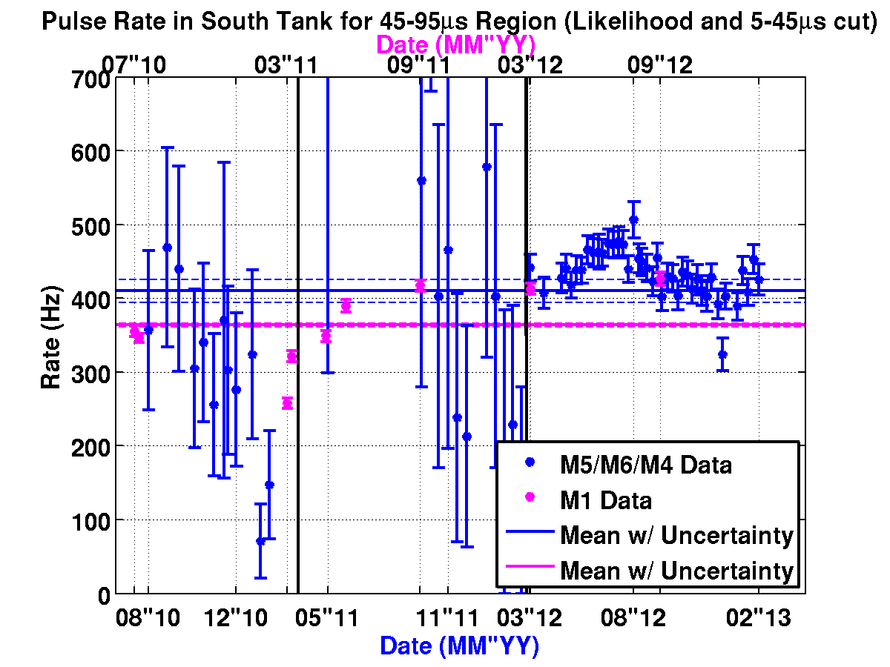
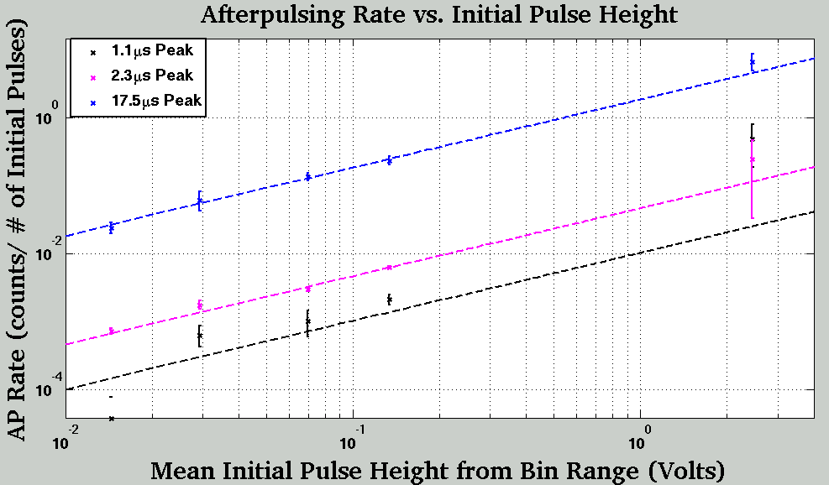
Working Group Activities
Neutron Detectors in the Soudan Mine:
Neutron Multiplicity Meter (NMM) → high-energy neutrons at 2090 mwe
Primary effort → finalize measurement using 1st two years of data (ongoing)
Improved understanding of detector response:
via Geant4 simulation starting with muons in rock
Detector stability via data-driven characterization
Effect of afterpulsing in large 20” PMTs
→ see Anthony Villano’s talk tomorrow
undergraduate
analysis projects
Rate due to Background Gammas
Afterpulsing Rate vs. Initiating Pulse Height

Slide 5
Working Group Activities
Neutron Detectors in the Soudan Mine:
Neutron Multiplicity Meter (NMM) → high-energy neutrons at 2090 mwe
Primary effort → finalize measurement using 1st two years of data (ongoing)
Improved understanding of detector response:
via Geant4 simulation starting with muons in rock
Detector stability via data-driven characterization
Effect of afterpulsing in large 20” PMTs
Also, continued operations to improve stats & in concert with veto shield ↓
The Soudan full-cavern Veto Shield → showers, bundles & μ-neutron correlations
Fully operational… working on stability and data management
Established correlated GPS time stamps with NMM
Developing general framework to permit correlations with other detectors
Again → see Anthony Villano’s talk tomorrow

Slide 6
Working Group Activities
Neutron Detectors in the Soudan Mine:
Neutron Multiplicity Meter (NMM) → high-energy neutrons at 2090 mwe
Primary effort → finalize measurement using 1st two years of data (ongoing)
Improved understanding of detector response:
via Geant4 simulation starting with muons in rock
Detector stability via data-driven characterization
Effect of afterpulsing in large 20” PMTs
Also, continued operations to improve stats & in concert with veto shield ↓
The Soudan full-cavern Veto Shield → showers, bundles & μ-neutron correlations
Fully operational… working on stability and data management
Established correlated GPS time stamps with NMM
Developing general framework to permit correlations with other detectors
U. South Dakota Liquid-scintillator Neutron Detector → medium- to high-energy neutrons
Continued operation to improve statistics
Continued development of data analysis & simulated response
→ See Chao Zhang’s talk tomorrow

Slide 7
Working Group Activities
Friday Summary Meetings to explore wide range of topics:
³He neutron-capture detector for monitoring reactor neutrons (MIT group)
FaNS neutron spectroscopy for high-energy neutron benchmarking
→ see Thomas Langford’s talk tomorrow
WATCHMAN anti-neutrino monitoring (& high-energy neutrons)
→ see Mark Gerling’s talk tomorrow
Neutron yield in Pb using the ZEPLIN-III muon veto (L. Reichhart @ UCL)
Medium- to high-energy flux of neutrons in the Davis cavern (USD group)
Simulations to inform next-generation neutron-detector & -veto designs
Further international collaboration (e.g., with LVD and Edelweiss)
see Marco Selvi’s talk tomorrow (LVD)
Develop FLUKA model of the NMM for comparison to Geant4 (Arkansas group)

Slide 8
Thursday 3:30-6 pm Breakout Session
Identify topics and tasks
Neutron Benchmarking Topics
Measurements → Thu 3:30-4:30 pm
Where are we now?
Which neutron/μ-related backgrounds are well measured?
Muon-induced neutrons
Others?
Organization of measurements and constraints?
What remains to be done?
Which backgrounds are still poorly constrained?
High-energy neutron flux & energy spectrum vs. depth
→ which production processes are least well constrained?
→ topology with respect to parent muon/shower
Background from muon bundles
Long-lived isotopes from muon spallation & stopping muons
Radiogenic bencmarking
Others?
Data – Part I → Thu 4:30-5 pm
Existing data sets — can new measurements be made with existing data?
LVD, Borexino, and other large-volume detectors
Cross-collaboration with Simulation Working Group → Thu 5-6 pm
Summary papers:
Mei & Hime, PRD 73 (2006) 053004
Araujo et al., NIM A 545 (2005) 398
Kudryavtsev et al., NIM A 505 (2004) 688
Kudryavtsev et al., Eur. Phys. J. A 36 (2008) 171
Wang et al., PRD 64 (2001) 013012
Detector-specific papers:
KamLAND—Abe et al., PRC 81 (2010) 025807
Galbiati & Beacom, PRC 72 (2005) 025807
Modaine—Kozlov et al., Astropart. Phys. 34 (2010) 97
Zeplin III—Reichhart et al., Astropart Phys. 47 (2013) 67
Borexino—Bellini et al., JCAP 1308 (2013) 049
LVD—Persiani et al., AIP Conf. Proc. 1549 (2013) 235
Spallation-source papers:
Chazal et al., Nucl. Phys. A 663 (2000) 885
Marion et al., NIM A 582 (2007) 611

Slide 9
Friday 4-6 pm Breakout Session
Prioritize topics and plan future work
Neutron Benchmarking Topics
Data – Part II → Fri 4-4:30 pm
Near-term expected data — what can/will we do with data from current experiments?
NMM, FaNS, WATCHMAN, USD detector, and others
Detector Technology → Fri 4:30-6 pm
Pros & cons of different neutron-detection technologies
liquid scintillator vs. water
Gd vs. Li vs. B doping
modular vs. monolithic
etc.
Design/proposal of next-generation neutron detector/facility for underground measurements
Also, neutron-veto design & prototyping
Funding for underground benchmarking in general
Saturday 10:30 am – 12 pm
Integration into proposals, Consortium planning, and new integrative initiatives

