Slide 1
Neutron Benchmarking Working Group: Coincident Timing
¹A.N. Villano, ²Ray Bunker
¹University of Minnesota
²Syracuse University

Slide 2
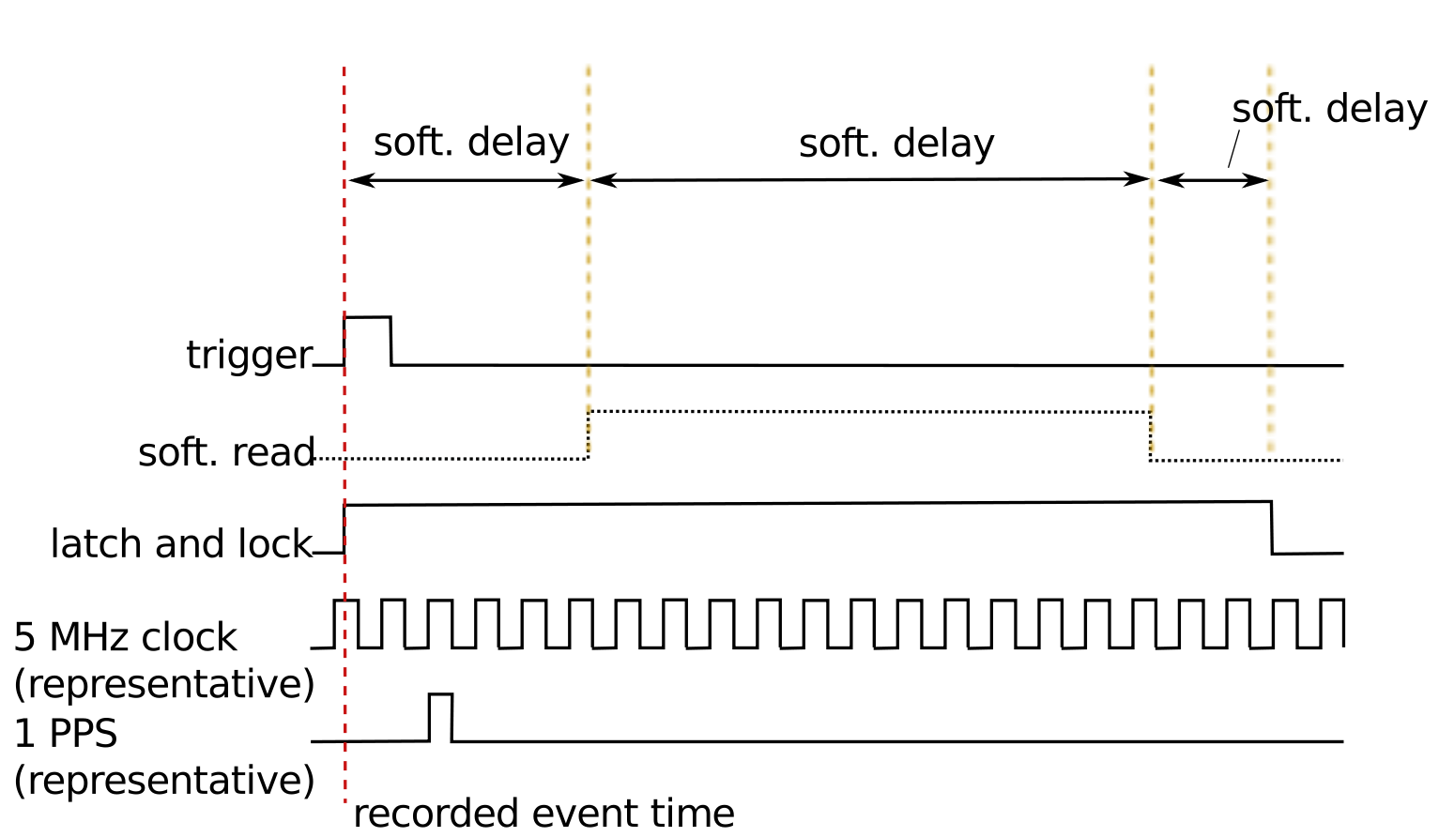
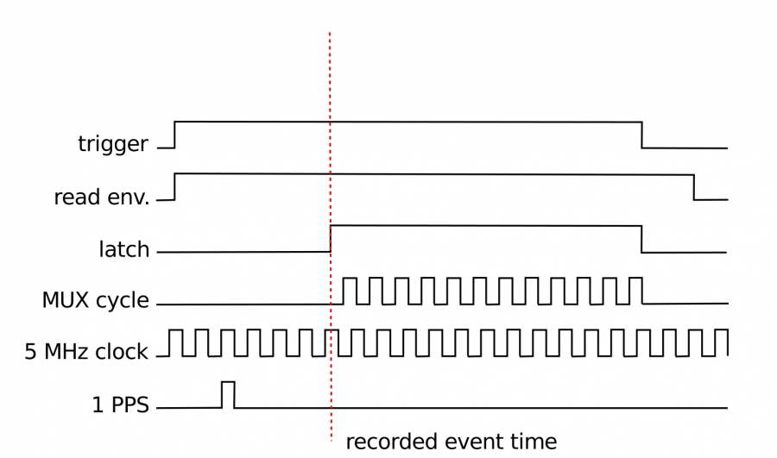
Timing Logistics
NMM
Software/hardware upgrades completed spring
NMM full timing readout into its data stream
DAQ code maintained in GIT repository
Soudan Veto

Slide 3
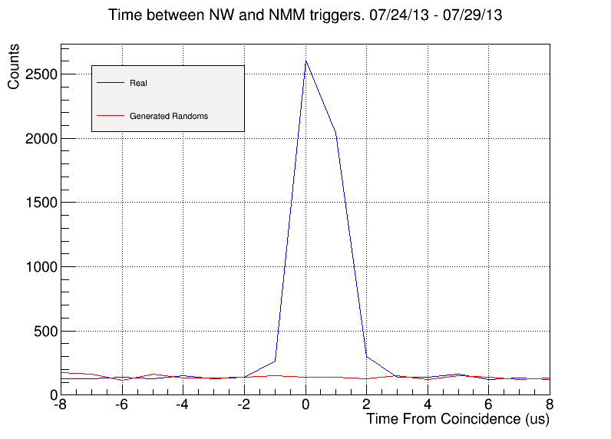
Coincident Muon Runs
See clear veto-nmm coincident peak during muon running
+/- 2 μs resolution
About the right number of coincident triggers ~ 300 triggers per 6 hour run

Slide 4
Further Work
See details of setup in the LRT 2013 proceedings: https://zzz.physics.umn.edu/lowrad/nmm/lrtproceedings
Currently running 1-month-long fast-neutron coincident search
Oct 5. have a workshop for analyzers of coincident data
More analyzers welcome, contact Anthony, Ray, Prisca if you have an interested student, there is a lot of data to go through that all has interesting/useful aspects

